Slide 1
Pictorials

Slide 2
Pictorial
Pictorial sketches are sketches that show height, width, and depth all in one view. There are three common types:
  Isometric
  Oblique
  Perspective

Slide 3
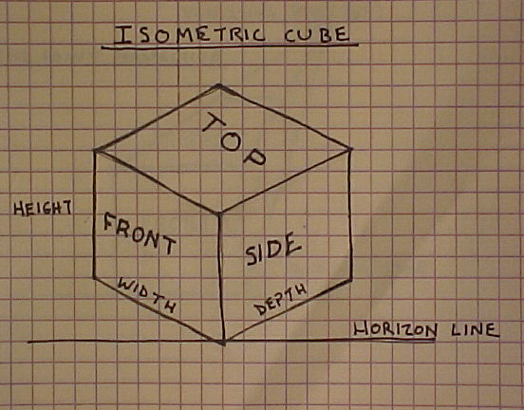
Isometric
Note one view shows
height width and depth.
Width and depth lines
are drawn at 30 degrees from
the horizon line.

Slide 4
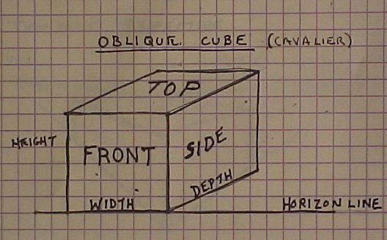
Oblique
Front view is true
size and shape.
Width lines are
parallel with the
horizon.
In Cavalier Oblique depth
is full size. This cube
has the same height, width
and depth dimensions
Depth in an oblique
pictorial is
distorted.
Easiest of the pictorials
to draw.
Depth lines are drawn
at an angle with the
horizon.

Slide 5
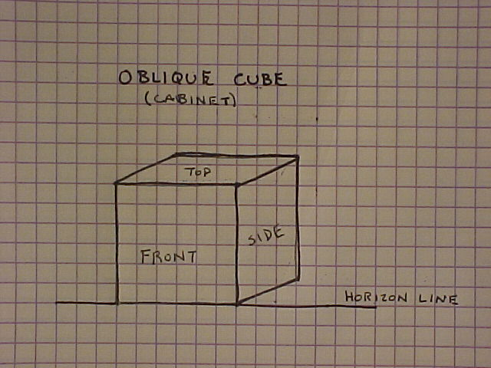
Oblique
Width lines are
parallel with the
horizon.
In Cabinet Oblique depth
is half size. This allows the view
to look more realistic.
Front view is true
size and shape.

Slide 6
Perspective
Perspective is a way to draw that shows a view of the object in the most realistic way. Vanishing points are used to guide the lines in the object to the horizon line or the horizontal line you see at your line of sight. We will discuss one and two point perspective.

Slide 7
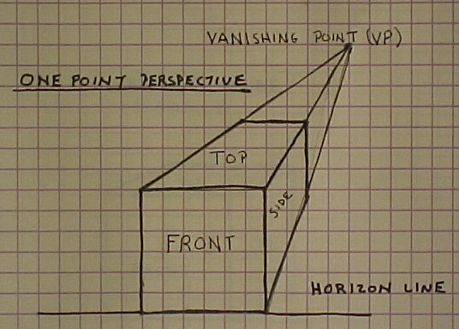
One Point Perspective
All lines in the depth project
to one point (vanishing
point). The location of the
vanishing point is based
on your line of sight.
Note: The vanishing
point in this sample
is chosen for
demonstration.

Slide 8
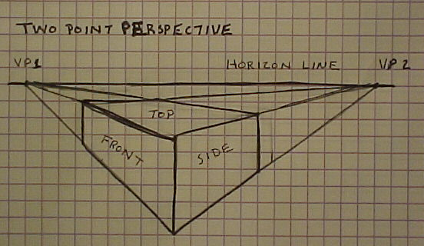
Two Point Perspective
In two point perspective
the depth lines converge on one
vanishing point (VP2) and the
width lines converge on the
other vanishing point (VP1).

Slide 9
Orthographic
(Multiview Drawings)
Pictorial sketches are great for engineers to explain ideas and communicate what the final part will look like to the customer. Unfortunately, pictorial drawings have some disadvantages. Foreshortened views and distorted features do not allow for accurate prototyping. Many times, for parts to be accurately depicted, you need straight on views of each surface.

Slide 10
Orthographic
(Multiview Drawings)
In order to obtain these straight line views we have a type of drawing called Orthographic Projection also known as Multiview drawings. Orthographic projection is a way to project a view based on a line of sight that is perpendicular to that view. There are six of these views to any object as shown in the next slide.

Slide 11
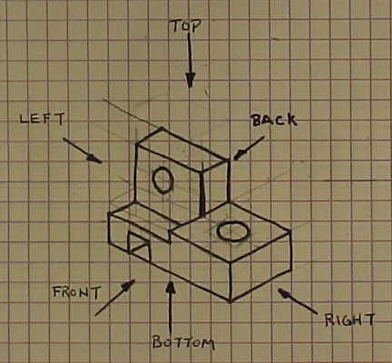
Orthographic
(Multiview Drawings)
The arrows represent the
line of sight associated
with each view.
Use the button
below to jump
between this
view and the ortho
view on the next
page.
ORTHO

Slide 12
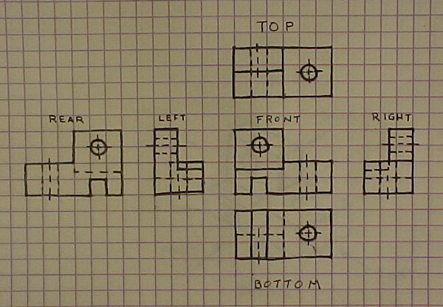
Orthographic
Principal Views
Note how the views
are oriented. Each view is
adjacent to the other as
if they were unfolded
from a 3D shape.
Front,
Top and Right views
are used most often. You can
see how other views resemble
these three except they are not
as clear due to hidden lines.
Click to go back
to ISO view.
ISO

Slide 13
Orthographic
Angle of Projection
The example you have just seen is shown in the third angle of projection. This is the standard in the United States and Canada. The rest of the world draws in the first angle of projection. The following slides will show how the views are derived and what they look like.

Slide 14
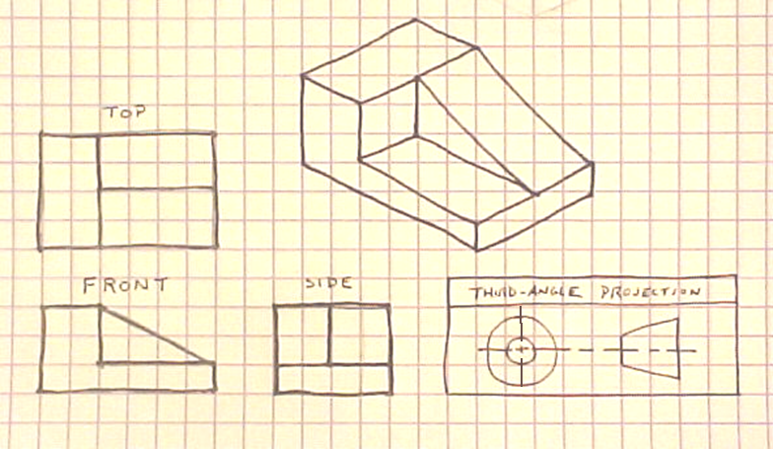
Orthographic
3rd Angle Projection (USA)

Slide 15
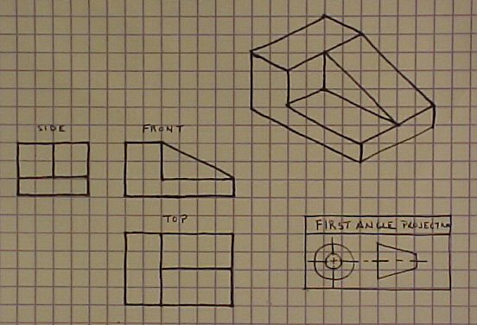
Orthographic
1st Angle Projection (EUROPE)

Slide 16
Orthographic
View Selection
Finding the best view of a part can be difficult. Two or more sides may look like the best solution for a front view. On the next slide is a list of characteristics that you should use in choosing your views.

Slide 17
Orthographic
View Selection
Steps in selecting the front.
  Most natural position or use.
  Shows best shape and characteristic contours.
  Longest dimensions.
  Fewest hidden lines.
  Most stable and natural position.
  Relationship of other views
    Most contours.
    Longest side.
    Least hidden lines.
    Best natural position.

Slide 18
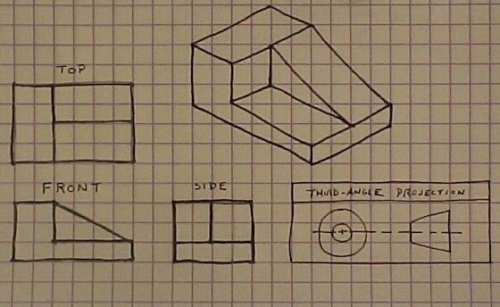
Orthographic
View Selection
Most natural position.
Longest Dimension
Best shape description.
No hidden lines.

Slide 19
Orthographic
View Selection Numbers
Another decision on view selection you need to make is how many views. You usually do not need more than three but you may only need one or two. The following slides will show when to make a decision between one, and two view drawings.

Slide 20
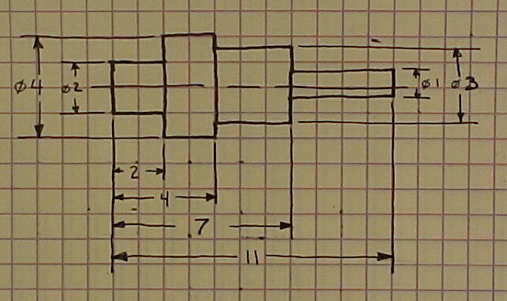
One View Selection
Two views
will be identical
Uniform shape.
All dimensions easily
shown on one view.

Slide 21
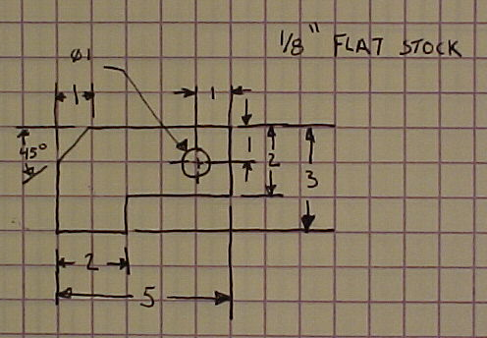
One View Selection
It is also possible to
have one view drawings
of objects that are flat
and have even thickness.
Gauges and gaskets are
two such objects. We
have a gauge here on the
left.

Slide 22
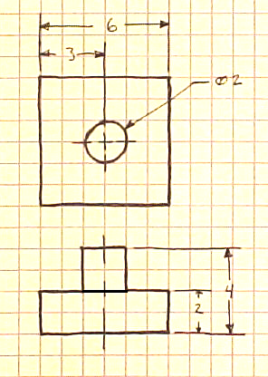
Two View Selection
Symmetrical parts. A third view
would be identical to the other
views
Second view is necessary for
depth.

Slide 23
Precedence of Lines
In multiple view drawings, many times different line types will take up the same space, therefore, we have line precedence. The following is an explanation of which lines exist over others.
  Object lines over hidden and center.
  Hidden over center.
  Cutting plane lines over center lines.
The following slide will show an example.

Slide 24
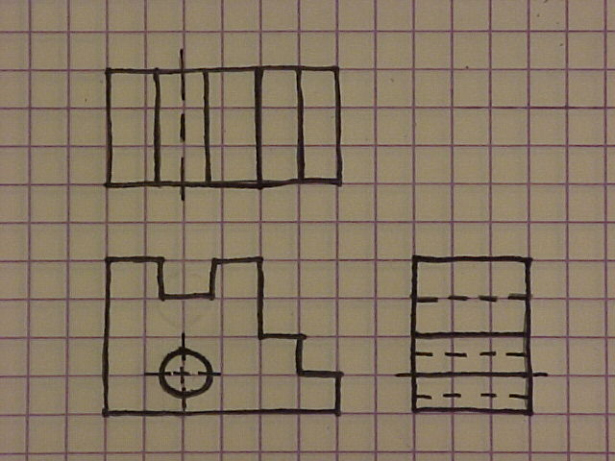
Precedence of Lines
An object line here takes precedence
over the center line. However we
draw short thin lines beyond the
object to show there is a center line
underneath the object line.
Object lines took precedence over
the hidden lines you would see
from the hole. The center line in
the top view would show the depth
of the hole as well as the right
side view.

