Slide 1
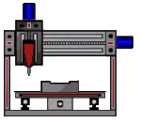
Fabrication
A quick overview

Slide 2
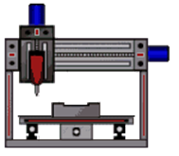
Fabrication
  As a Designer you need to know how things can be made.
  The selected fabrication process affects how you design your parts.
  Important choices you make:
    What material(s) are your parts to be made from; ferrous or non-ferrous metal, plastic, wood, composite, sheet material etc.?
    How many are you making?
    What are the design constraints:
      Precision, tolerances, fits.
      Allowable features such as undercuts, section thicknesses.
      Will you need tapers, fillets, ribs.
      You must understand and take into account the limitations of the fabrication techniques and machinery that are available!

Slide 3
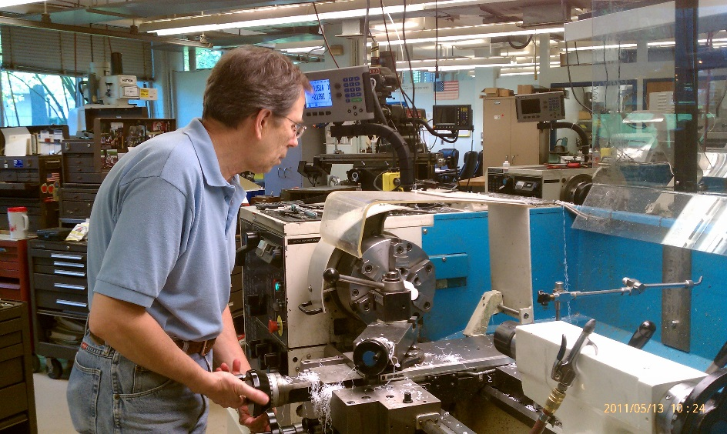
Manual machining
  Requires a highly skilled operator.
  Constant attention to operation.
  Labor intensive, SLOW!
  Difficult to achieve accuracy.
  Limits to kinds of operations.
  Error prone.
  Lower cost machines/tools.

Slide 4
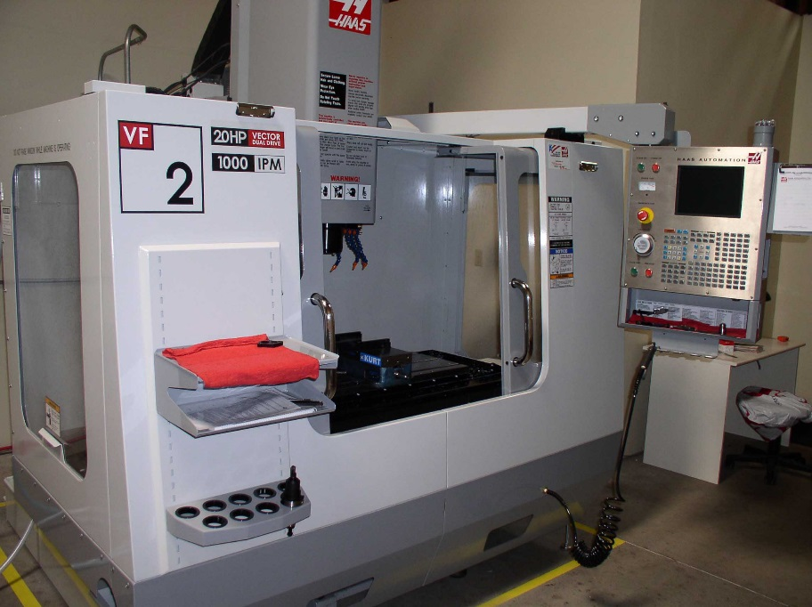
Automated Fabrication: CNC and CAM
CNC = Computer Numerical Control, CAM = Computer Aided Manufacture
  Minimal operator training.
  Requires programming.
  Operations are mostly automated.
  Minimal labor.
  Can be highly accurate, fast.
  Can perform multiple operations in one setup.
  Errors are rare.
  Machines are expensive.

Slide 5
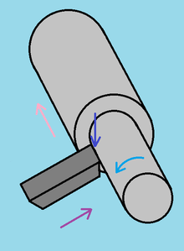
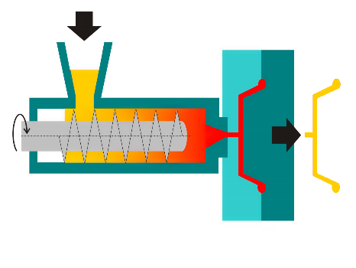
Subtractive vs Additive
-
  Subtractive Fabrication:
  Create a part by selectively taking material away from source material (billet, sheet, block, strip).
  Often involves cutting and/or reshaping.
  Examples: Milling, Drilling, Turning, Sawing, Chiseling, Stamping.
  Additive Fabrication:
  Create a part by adding material to form a whole.
  The material is often in pellet, filament, powder or liquid form.
  Often involves heat or solvent to shape/meld/adhere.
  Examples: Molding, Casting, Extruding, 3D Printing, Sculpting.
+

Slide 6
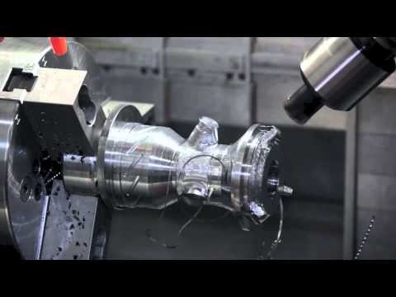
Subtractive: Multi-axis machining

Slide 7
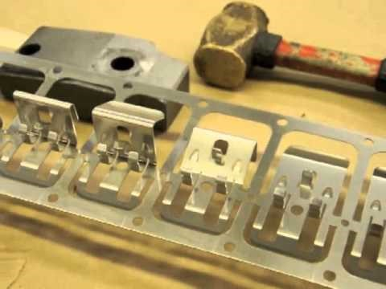
Subtractive: Progressive Die Stamping

Slide 8
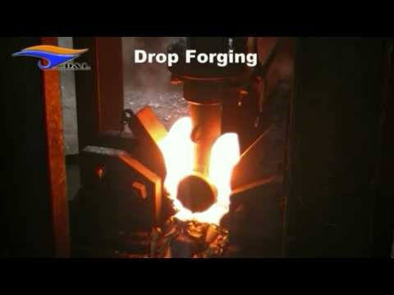
Subtractive: Forging

Slide 9
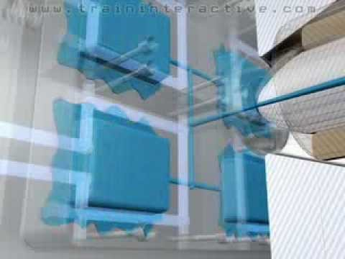
Additive: Injection Molding

Slide 10
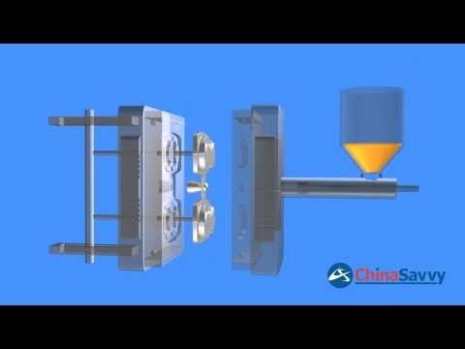
Additive: Die Casting

Slide 11
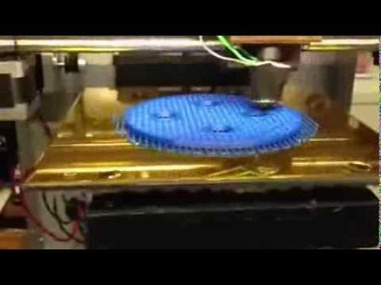
Additive: 3D Printing

Slide 12
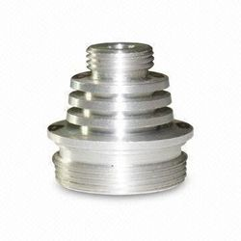
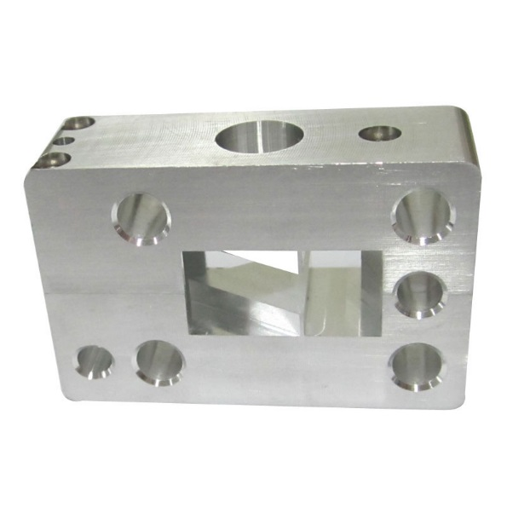
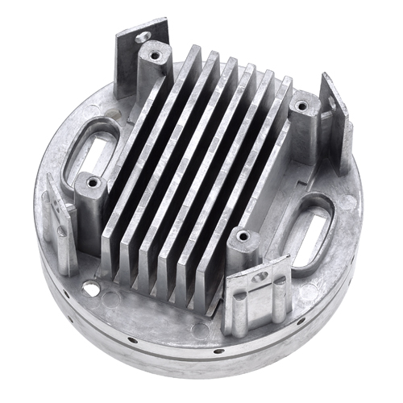
What machine/process would YOU choose?
A
B
C
Material: Steel
Quantity:1
Material: Aluminum
Quantity:5
Material: Zinc
Quantity:30,000

Slide 13
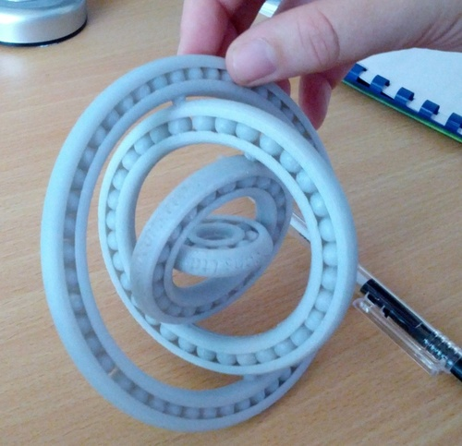
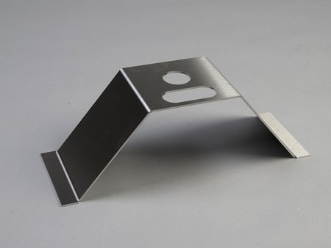
What machine/process would YOU choose?
D
E
F
Material: ABS
Quantity:10
Material: Stainless
Quantity:5,000,000
Material: Stainless
Quantity:5

Slide 14
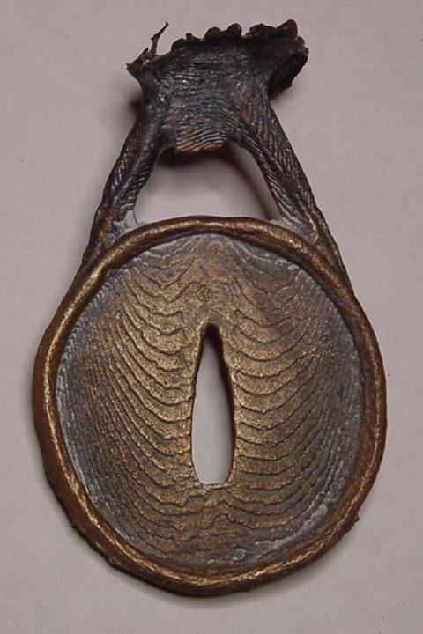
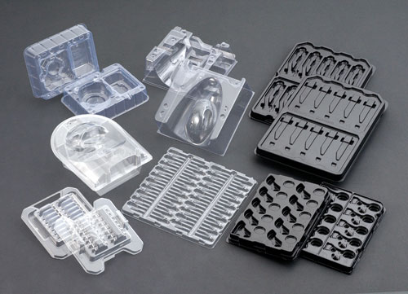
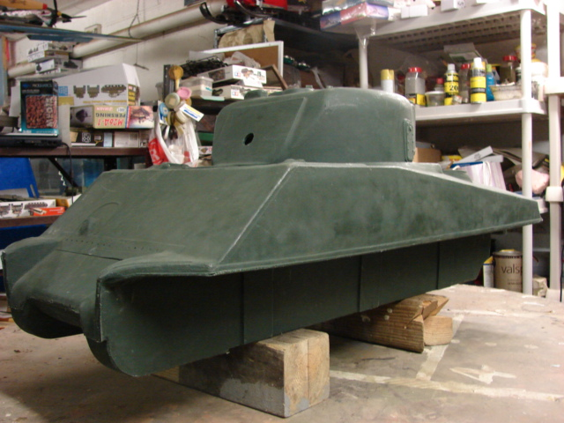
What machine/process would YOU choose?
G
H
I
Material: Styrene
Quantity:10,000
Material: HDPVC
Quantity:500
Material: Bronze
Quantity:50

