Slide 1
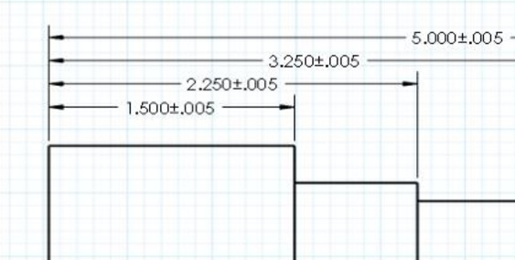
Dimensions and Tolerances
Making things fit

Slide 2
General rules of dimensioning (1)
      Dimensions should NOT be duplicated, or the same information be given in two different ways.
      No unnecessary dimensions should be used - only those needed to produce or inspect the part.
      Dimensions should be placed at finished surfaces or important center lines.
      Dimensions should be placed so that it is not necessary for the observer to calculate, scale, or assume any measurement.
      Dimensions should be attached to the view that best shows the shape of the feature to be dimensioned.
      Avoid dimensioning to hidden lines wherever possible.
      Dimensions should not be placed on the object unless that is the only clear option.

Slide 3
General rules of dimensioning (2)
      Overall dimensions should be placed the greatest distance away from the object so that intermediate dimension can nest closer to the object to avoid crossing extension lines.
      A dimension should be attached to only one view (i.e., extension lines should not connect two views)
      When possible, avoid crossing dimension lines.
      When possible, avoid crossing extension lines.
      A center line may be extended and used as an extension line.
      Leaders should slope at a 30, 45 or 60 degree angle.
      Dimension numbers should be centered between arrowheads, except when using stacked dimensions then the numbers should be staggered.

Slide 4
General rules of dimensioning (3)
      In general, a circle is dimensioned by its diameter, an arc by its radius.
      Holes should be located by their center lines.
      Holes should be dimensioned in the view that shows the feature as a circle.
      Extension lines start approximately 1/16" from the object and extend 1/8" past the last dimension.
      The first dimension is approximately ½" from the object and spaced uniformly approximately 3/8" apart.

Slide 5
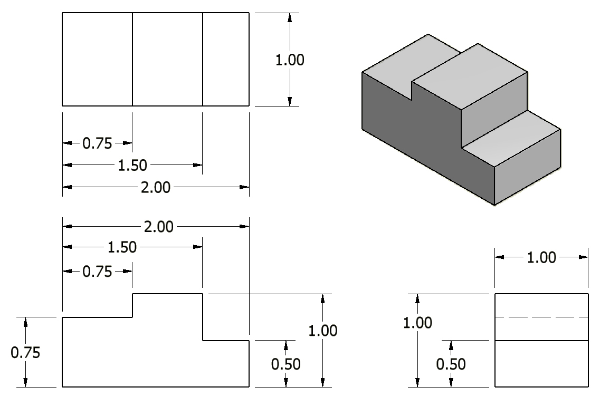
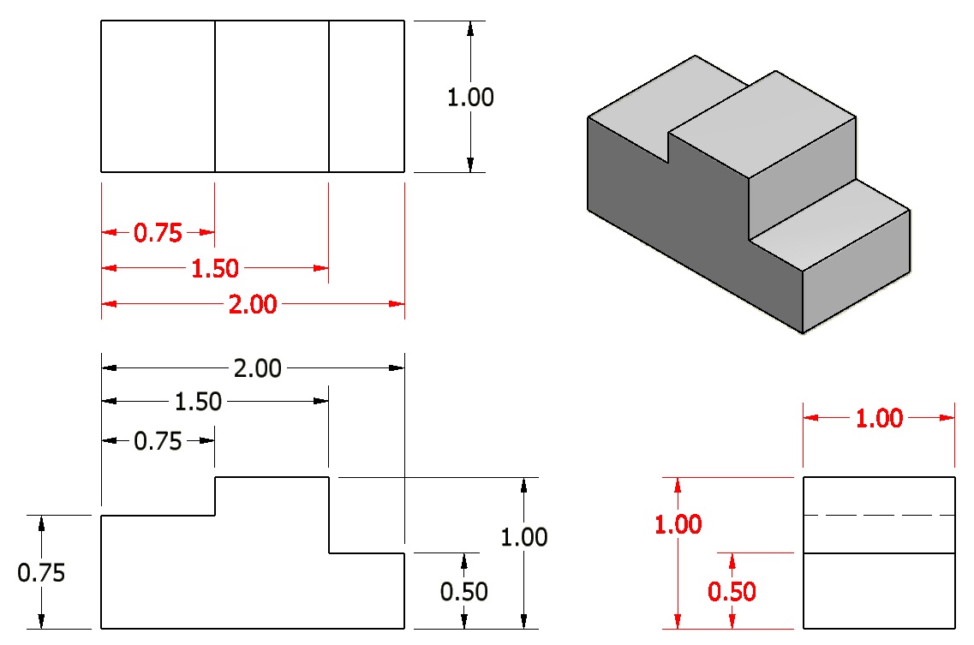
1. Dimensions should NOT be duplicated, or the same information given in two different ways.
Incorrect

Slide 6
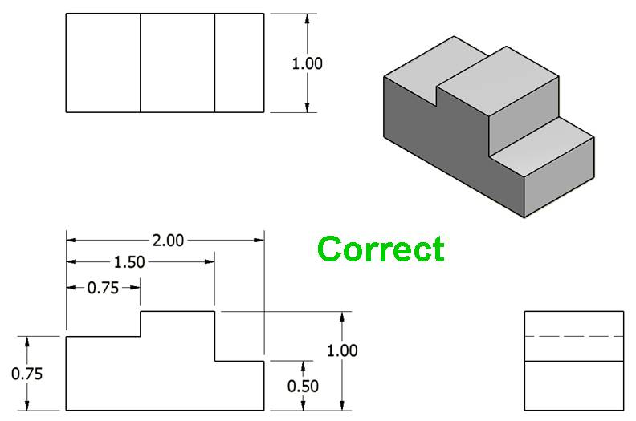
1. Dimensions should NOT be duplicated, or the same information given in two different ways.
Notes:
References:
Pg 337 Engineering Drawing and Design 3rd Edition by David Madsen et. al.
Pg 109 Fundamentals of Modern Drafting by Paul Wallach
Pg 425 Technical Drawing 9th Edition by Frederick Giesecke et. al.
Pg 701 Technical Graphics Communication 3rd Edition by Gary Bertoline & Eric Wiebe

Slide 7
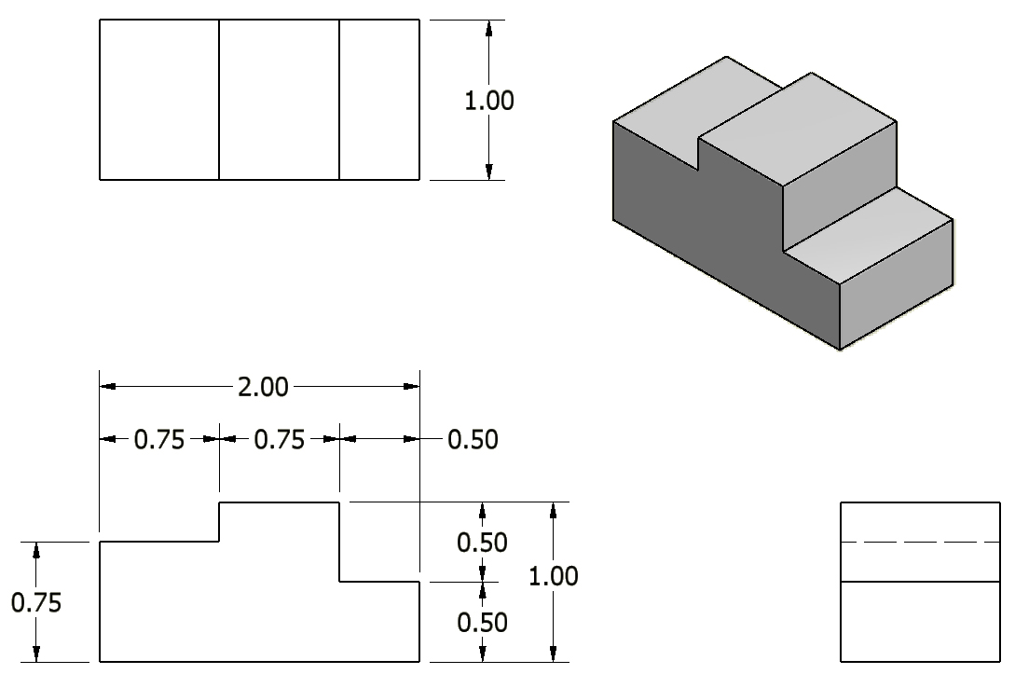
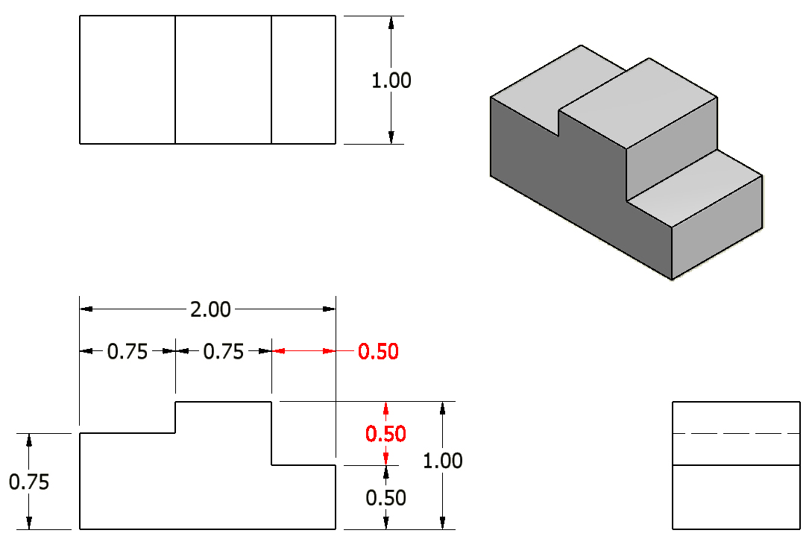
2. No unnecessary dimensions should be used – only those needed to produce or inspect the part.
Incorrect
Notes:
References:
Pg 109 Fundamentals of Modern Drafting by Paul Wallach
Pg 392 Technical Drawing 9th Edition by Frederick Giesecke et. al.
Note: In a chain of dimensions, as seen with the width and height dimensions in the front view, one of the dimensions is unnecessary and must be removed. Overall dimensions for width, height, and depth must be present.

Slide 8
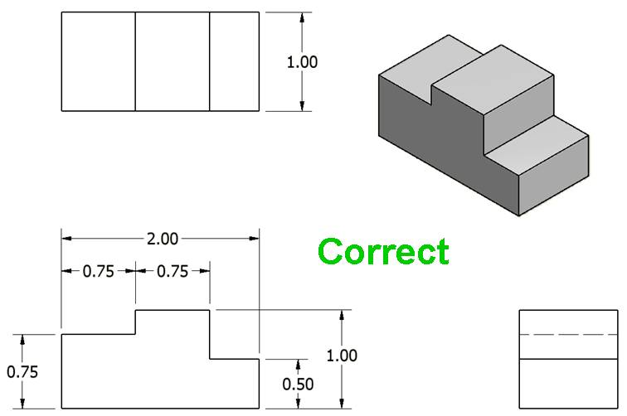
2. No unnecessary dimensions should be used – only those needed to produce or inspect the part.
Notes:
References:
Pg 109 Fundamentals of Modern Drafting by Paul Wallach
Pg 392 Technical Drawing 9th Edition by Frederick Giesecke et. al.
Note: In a chain of dimensions, as seen with the width and height dimensions in the front view, one of the dimensions is unnecessary and must be removed. Overall dimensions for width, height, and depth must be present.

Slide 9
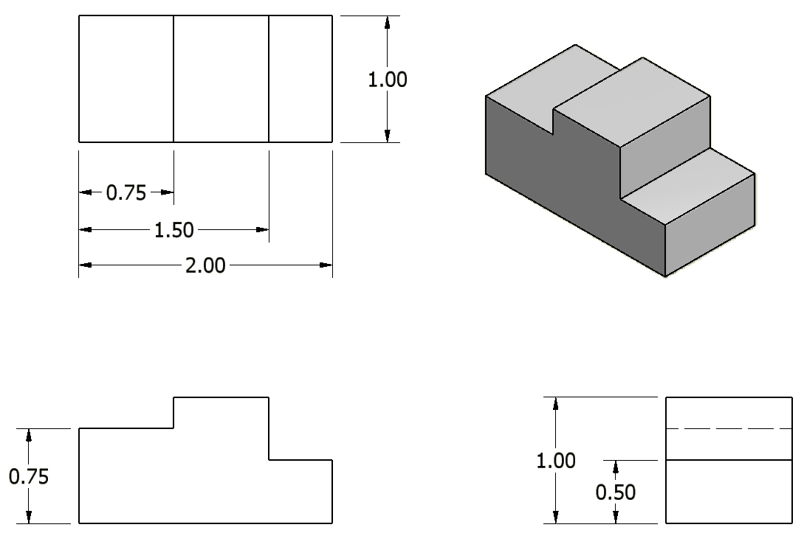
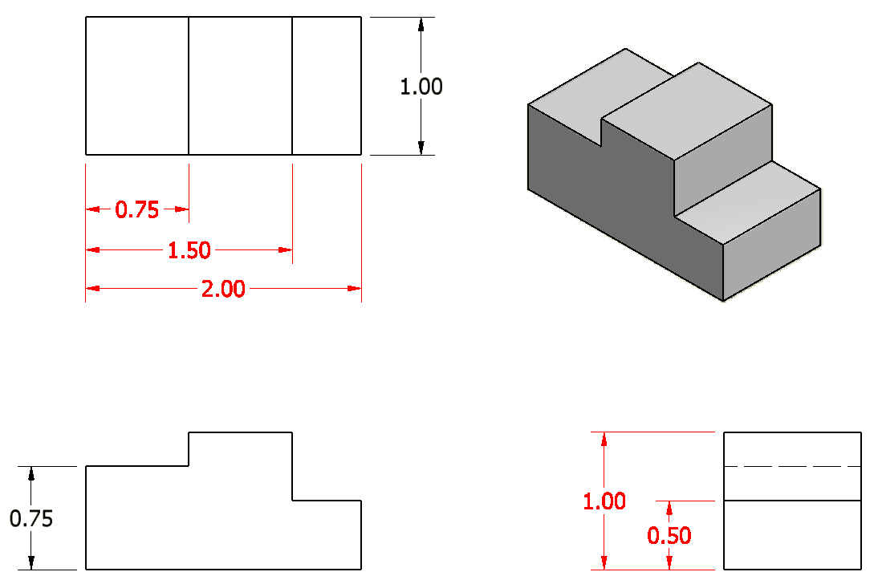
3. Dimensions should be attached to the view that best shows the contour of the feature to be dimensioned.
Incorrect
Notes:
References:
Pg 342 Engineering Drawing and Design 3rd Edition by David Madsen et. al.
Pg 405 & 425 Technical Drawing 9th Edition by Frederick Giesecke et. al.
Pg 698, 700, 701-703 Technical Graphics Communication 3rd Edition by Gary Bertoline & Eric Wiebe
It should be noted that the 2.00 inch dimension would be appropriately located if placed on the top view, but the front view is preferred because it is supposed to provide the most information about an object’s geometry.

Slide 10
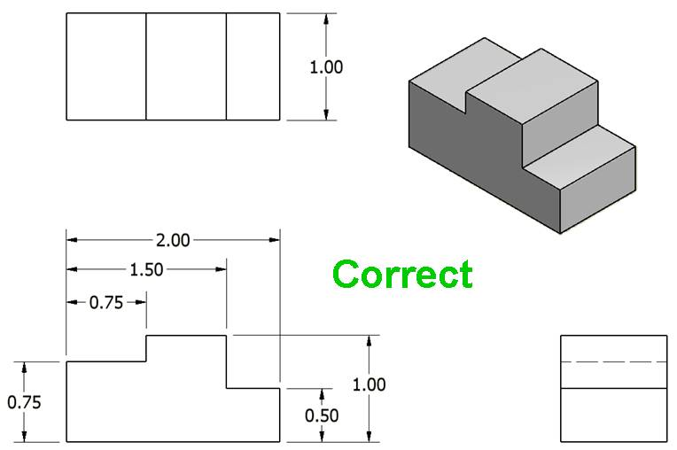
3. Dimensions should be attached to the view that best shows the contour of the feature to be dimensioned.
Notes:
References:
Pg 342 Engineering Drawing and Design 3rd Edition by David Madsen et. al.
Pg 405 & 425 Technical Drawing 9th Edition by Frederick Giesecke et. al.
Pg 698, 700, 701-703 Technical Graphics Communication 3rd Edition by Gary Bertoline & Eric Wiebe
It should be noted that the 2.00 inch dimension would be appropriately located if placed on the top view, but the front view is preferred because it is supposed to provide the most information about an object’s geometry.

Slide 11
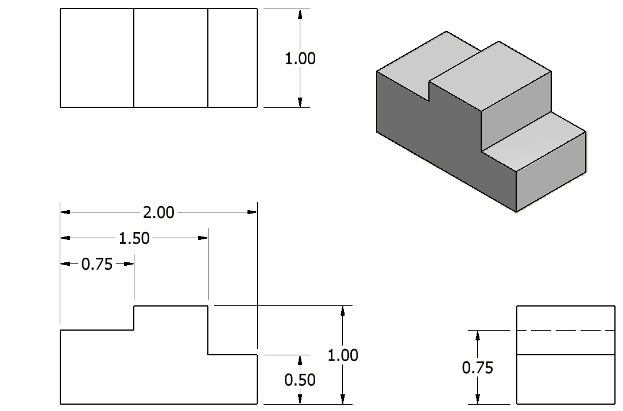
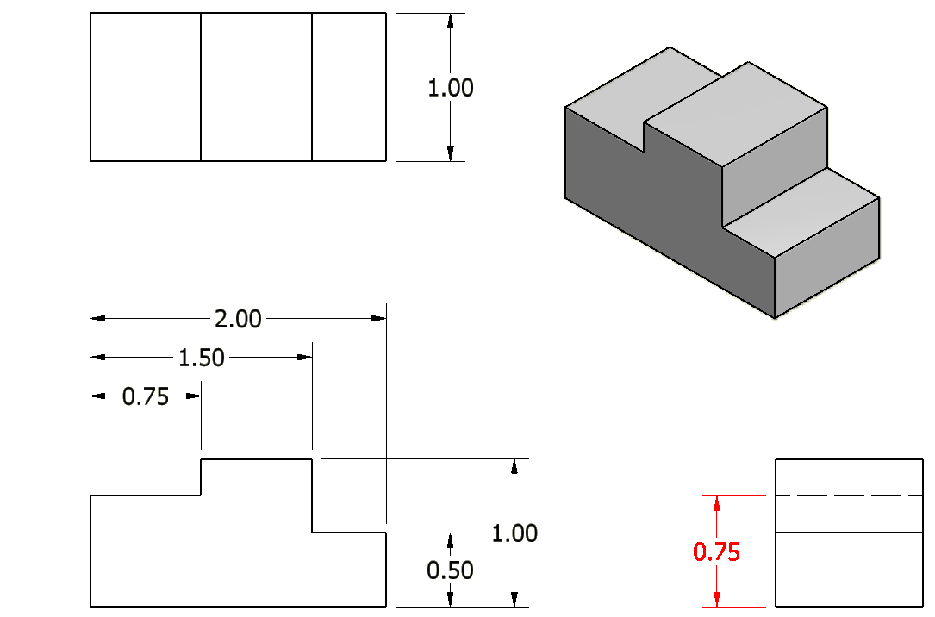
4. Whenever possible, avoid dimensioning to hidden lines and features.
Incorrect
Notes:
References:
Pg 342 Engineering Drawing and Design 3rd Edition by David Madsen et. al.
Pg 134 Fundamentals of Modern Drafting by Paul Wallach
Pg 426 Technical Drawing 9th Edition by Frederick Giesecke et. al.
Pg 703 Technical Graphics Communication 3rd Edition by Gary Bertoline & Eric Wiebe

Slide 12
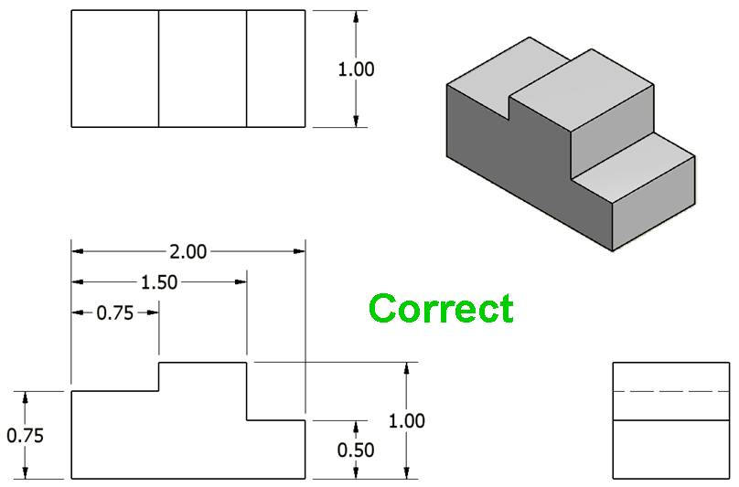
4. Whenever possible, avoid dimensioning to hidden lines and features.
Notes:
References:
Pg 342 Engineering Drawing and Design 3rd Edition by David Madsen et. al.
Pg 134 Fundamentals of Modern Drafting by Paul Wallach
Pg 426 Technical Drawing 9th Edition by Frederick Giesecke et. al.
Pg 703 Technical Graphics Communication 3rd Edition by Gary Bertoline & Eric Wiebe

Slide 13

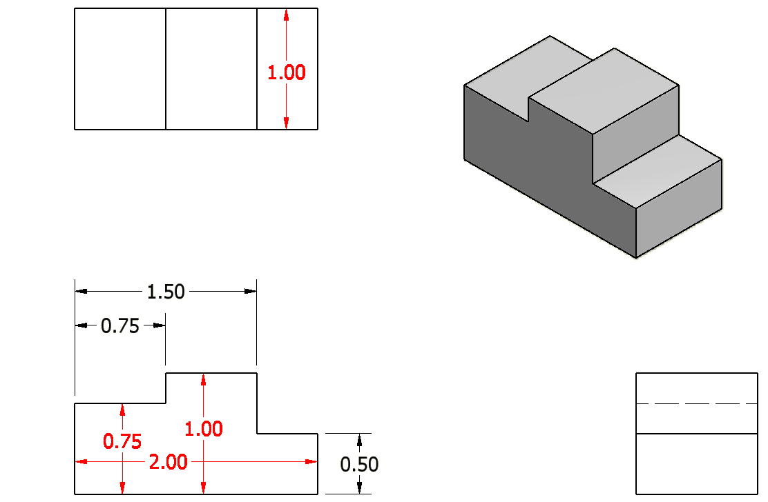
5. Avoid dimensioning over or through the object.
Incorrect
Notes:
References:
Pg 342 Engineering Drawing and Design 3rd Edition by David Madsen et. al.
Pg 394, 404, 426 Technical Drawing 9th Edition by Frederick Giesecke et. al.
Pg 692 Technical Graphics Communication 3rd Edition by Gary Bertoline & Eric Wiebe

Slide 14
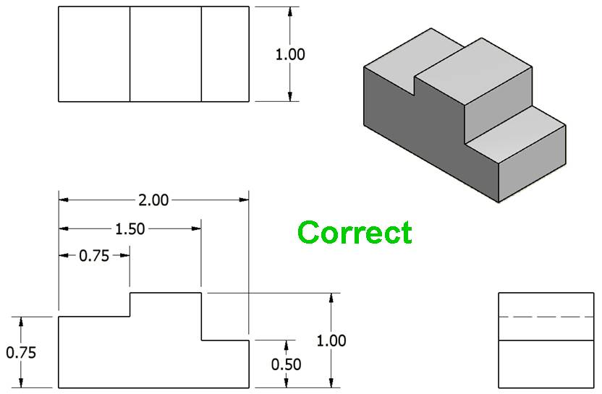
5. Avoid dimensioning over or through the object.
Notes:
References:
Pg 342 Engineering Drawing and Design 3rd Edition by David Madsen et. al.
Pg 394, 404, 426 Technical Drawing 9th Edition by Frederick Giesecke et. al.
Pg 692 Technical Graphics Communication 3rd Edition by Gary Bertoline & Eric Wiebe

Slide 15
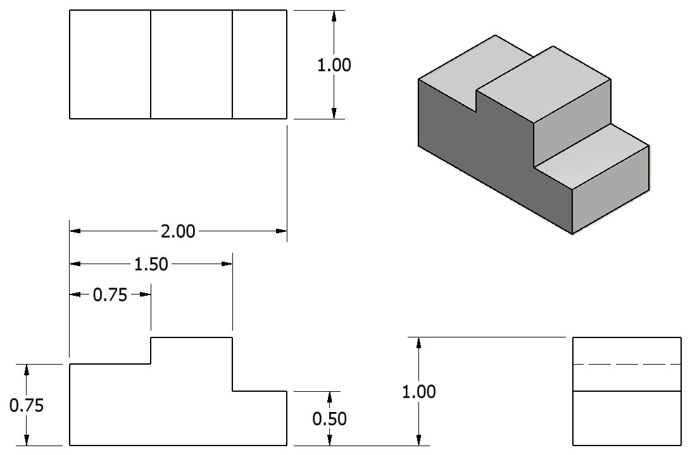
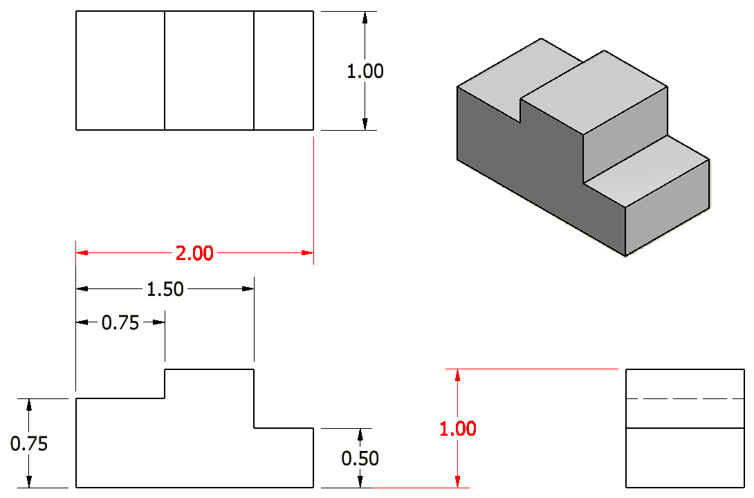
6. A dimension should be attached to only one view; for example, extension lines should not connect two views.
Incorrect
Notes:
Reference:
Pg 426 Technical Drawing 9th Edition by Frederick Giesecke et. al.

Slide 16

6. A dimension should be attached to only one view; for example, extension lines should not connect two views.
Notes:
Reference:
Pg 426 Technical Drawing 9th Edition by Frederick Giesecke et. al.

Slide 17
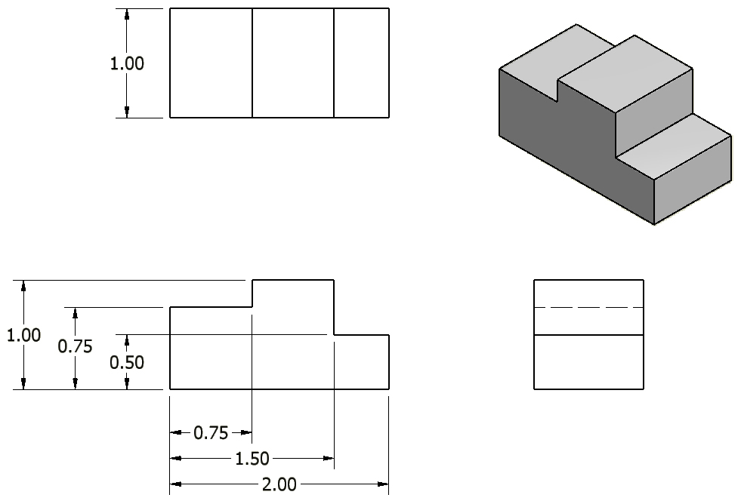
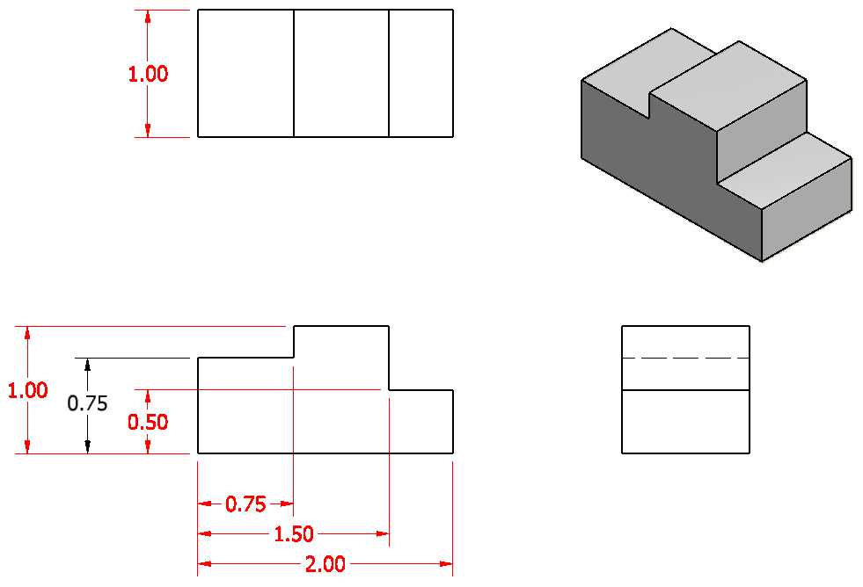
7. Whenever possible, locate dimensions between adjacent views.
Incorrect
Notes:
References:
Pg 342 Engineering Drawing and Design 3rd Edition by David Madsen et. al.
Pg 108 Fundamentals of Modern Drafting by Paul Wallach
Pg 426 Technical Drawing 9th Edition by Frederick Giesecke et. al.

Slide 18
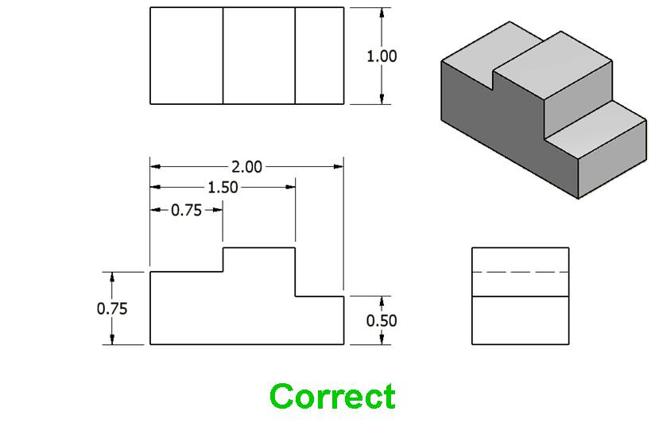
7. Whenever possible, locate dimensions between adjacent views.
Question: is there a dimension missing?
Notes:
References:
Pg 342 Engineering Drawing and Design 3rd Edition by David Madsen et. al.
Pg 108 Fundamentals of Modern Drafting by Paul Wallach
Pg 426 Technical Drawing 9th Edition by Frederick Giesecke et. al.

Slide 19
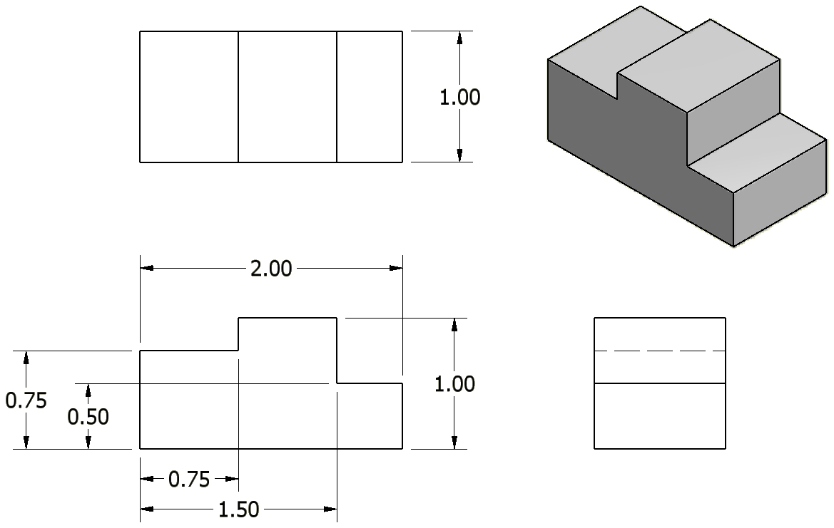
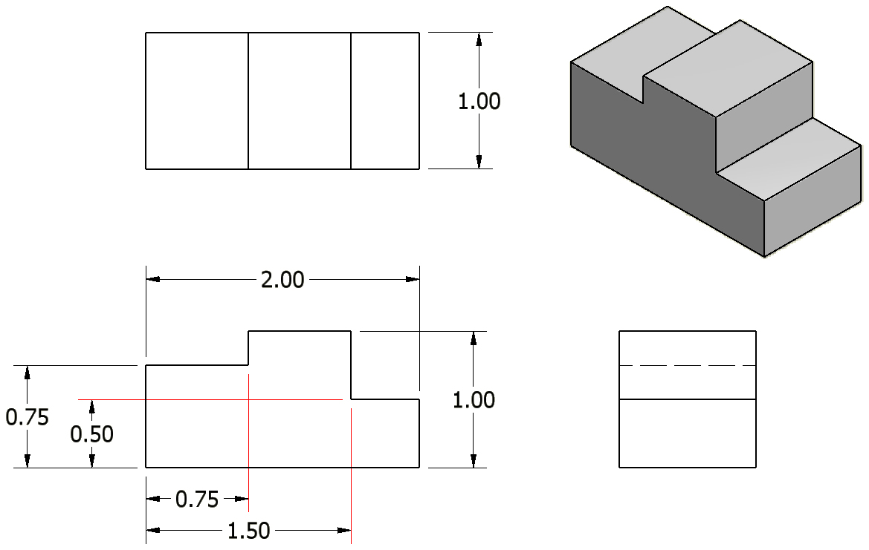
8. Whenever possible, avoid sending extension lines through object views.
Incorrect
Notes:
Reference:
Pg 342-343 Engineering Drawing and Design 3rd Edition by David Madsen et. al.

Slide 20
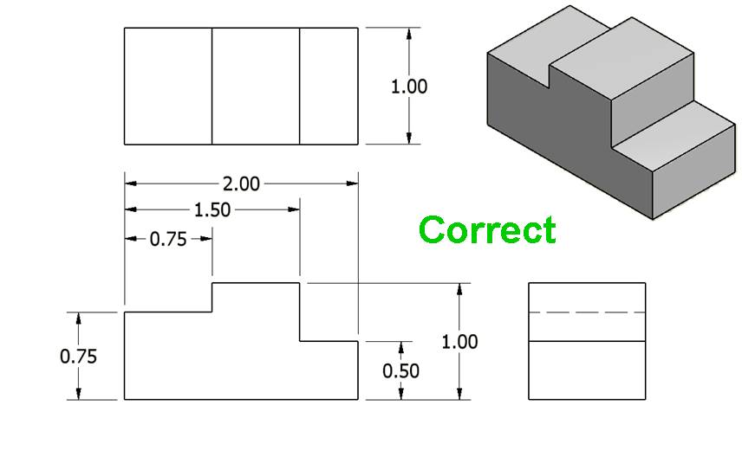
8. Whenever possible, avoid sending extension lines through object views.
Notes:
Reference:
Pg 342-343 Engineering Drawing and Design 3rd Edition by David Madsen et. al.

Slide 21
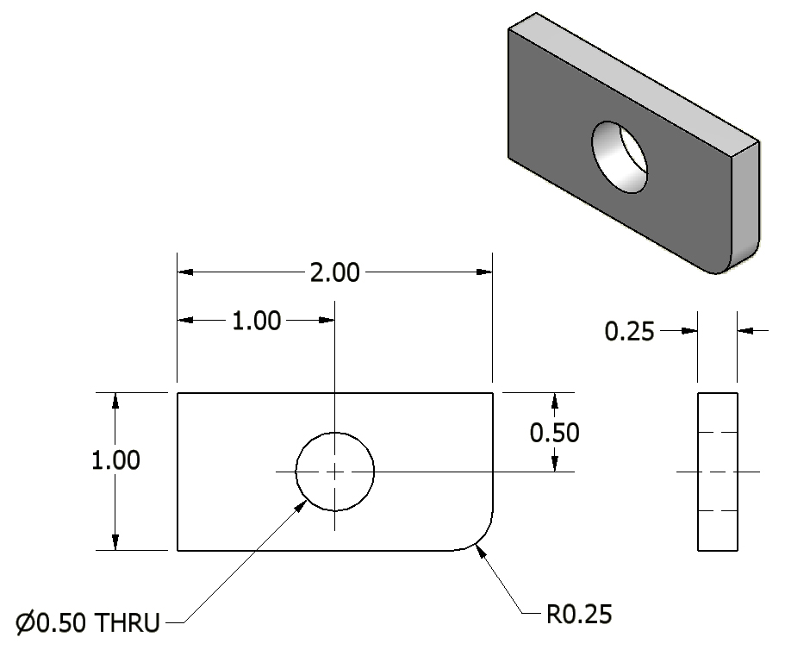
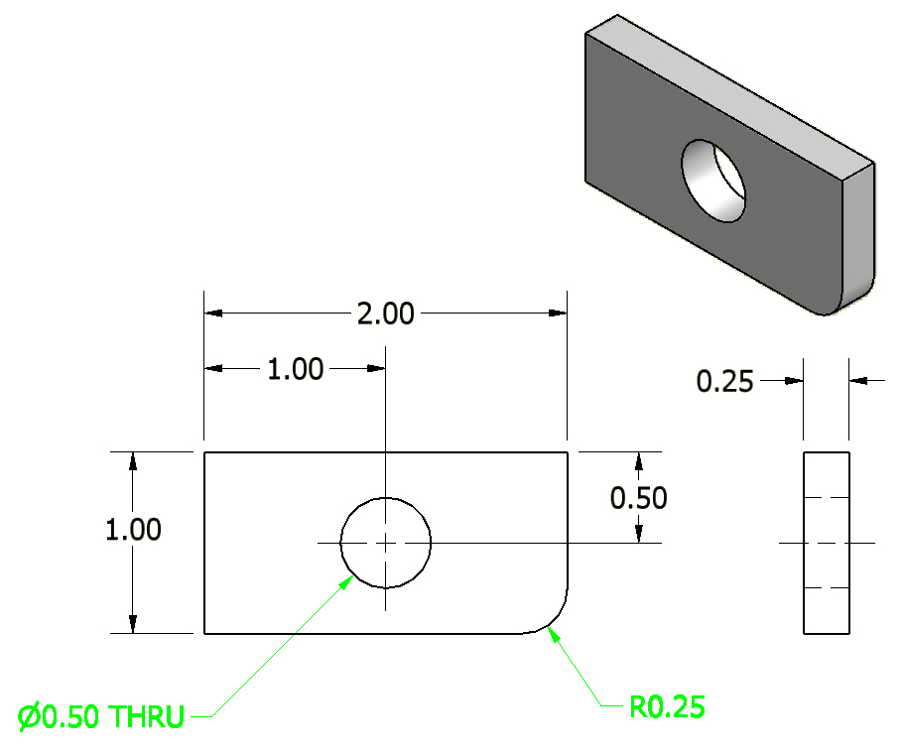
9. In general, a circle is dimensioned by its diameter and an arc by its radius.
Notes:
References:
Pg 344-345, 347-349 Engineering Drawing and Design 3rd Edition by David Madsen et. al.
Pg 131, 138-139 Fundamentals of Modern Drafting by Paul Wallach
Pg 402-403, 410-411, 427 Technical Drawing 9th Edition by Frederick Giesecke et. al.
Pg 687-688, 695-696 Technical Graphics Communication 3rd Edition by Gary Bertoline & Eric Wiebe

Slide 22
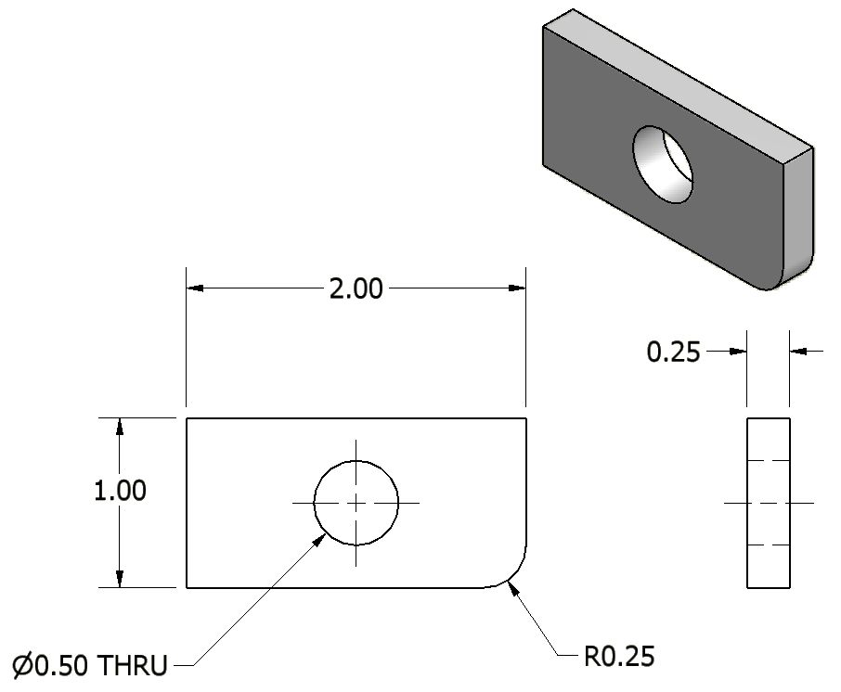
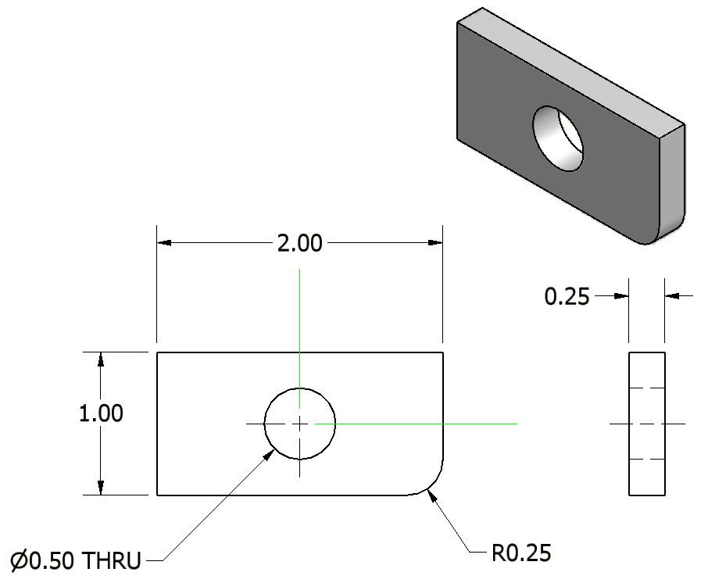

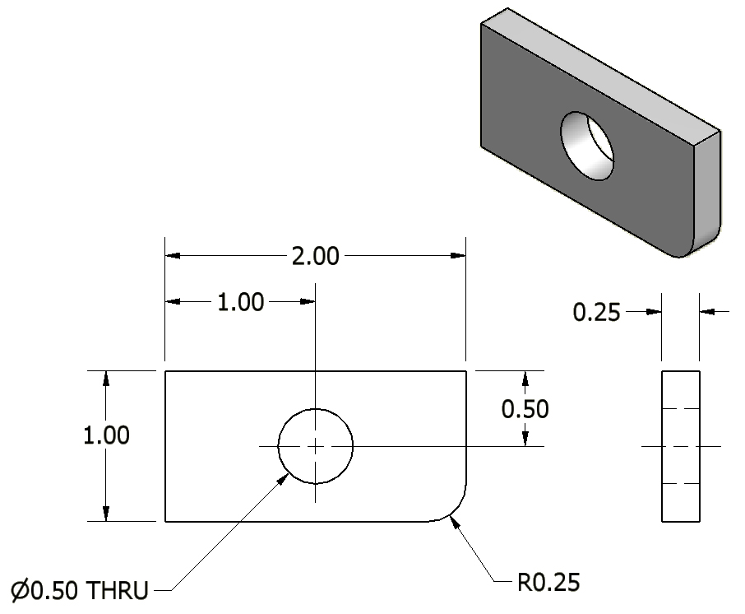
10. Holes are located by their centerlines, which may be extended and used as extension lines.
Notes:
References:
Pg 44, 340 Engineering Drawing and Design 3rd Edition by David Madsen et. al.
Pg 393-394, 426 Technical Drawing 9th Edition by Frederick Giesecke et. al.
Pg 690-691 Technical Graphics Communication 3rd Edition by Gary Bertoline & Eric Wiebe

Slide 23
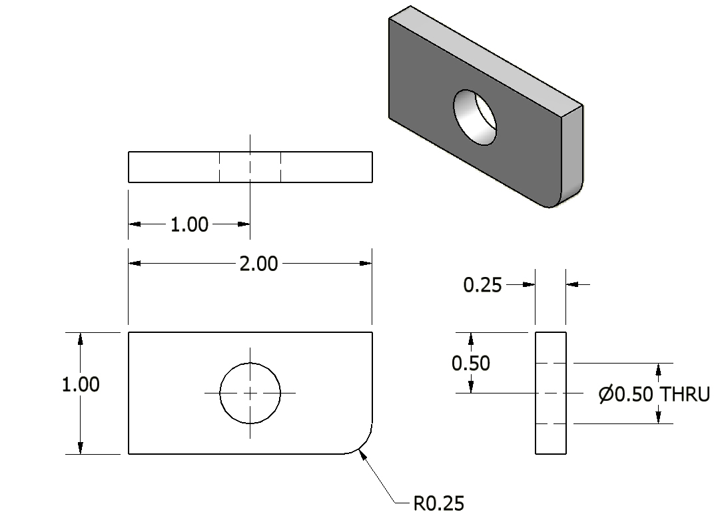
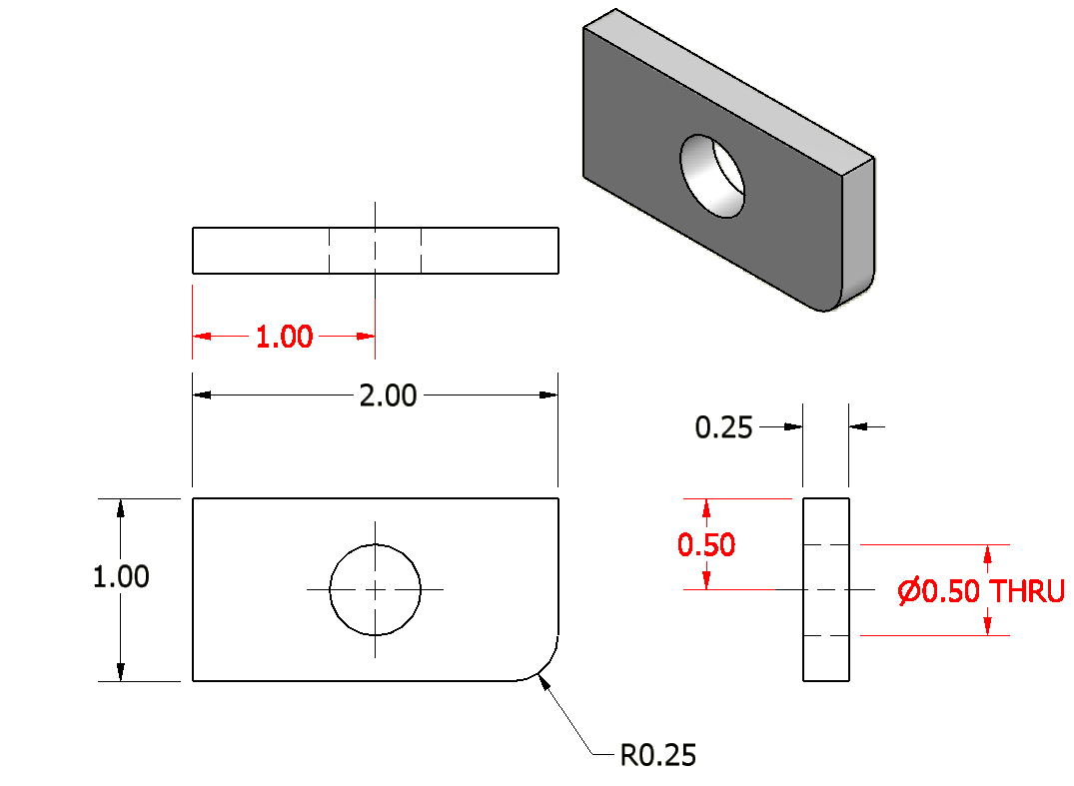
11. Holes should be located and sized in the view that shows the feature as a circle.
Incorrect
Notes:
References:
Pg 351 Engineering Drawing and Design 3rd Edition by David Madsen et. al.
Pg 109 Fundamentals of Modern Drafting by Paul Wallach
Pg 411, 427 Technical Drawing 9th Edition by Frederick Giesecke et. al.
Pg 693 Technical Graphics Communication 3rd Edition by Gary Bertoline & Eric Wiebe

Slide 24
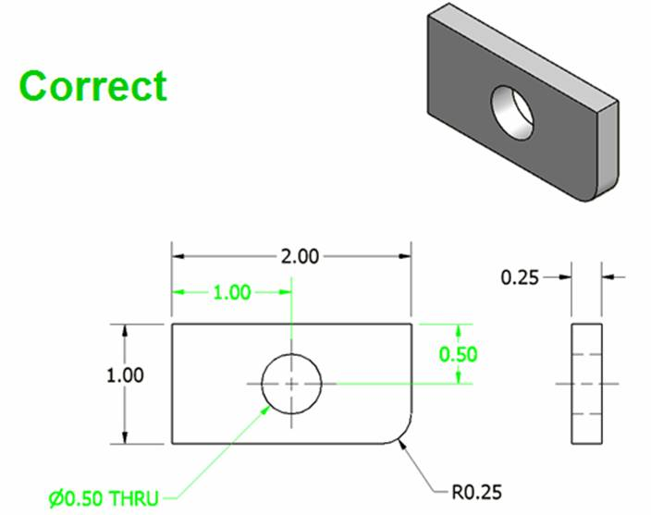
11. Holes should be located and sized in the view that shows the feature as a circle.
Notes:
References:
Pg 351 Engineering Drawing and Design 3rd Edition by David Madsen et. al.
Pg 109 Fundamentals of Modern Drafting by Paul Wallach
Pg 411, 427 Technical Drawing 9th Edition by Frederick Giesecke et. al.
Pg 693 Technical Graphics Communication 3rd Edition by Gary Bertoline & Eric Wiebe
Note: The top view was removed, because it is not needed to completely communicate the object’s geometry.

Slide 25
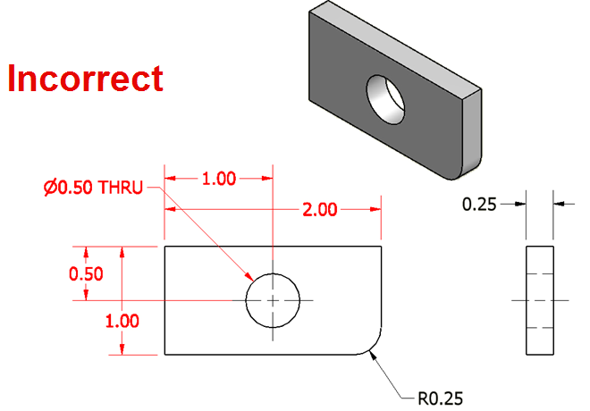
12. Do not cross a dimension line with an extension line, and avoid crossing dimensions with leader lines.
Notes:
References:
Pg 342 Engineering Drawing and Design 3rd Edition by David Madsen et. al.
Pg 394, 426 Technical Drawing 9th Edition by Frederick Giesecke et. al.

Slide 26
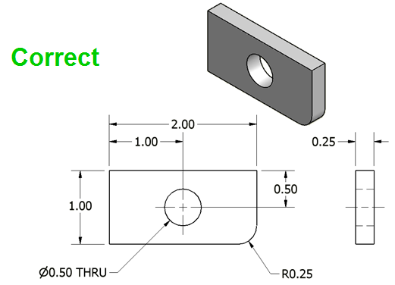
12. Do not cross a dimension line with an extension line, and avoid crossing dimensions with leader lines.
Notes:
References:
Pg 342 Engineering Drawing and Design 3rd Edition by David Madsen et. al.
Pg 394, 426 Technical Drawing 9th Edition by Frederick Giesecke et. al.

Slide 27
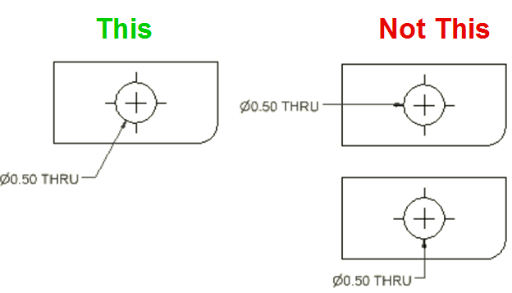
13. Leader lines point toward the center of the feature, and should not occur horizontally or vertically.
Notes:
References:
Pg 45, 344 Engineering Drawing and Design 3rd Edition by David Madsen et. al.
Pg 395-396, 402-403, 426 Technical Drawing 9th Edition by Frederick Giesecke et. al.
Pg 686-687, 703 Technical Graphics Communication 3rd Edition by Gary Bertoline & Eric Wiebe
Note: Slopes greater than 75° and less than 15° from horizontal should be avoided. A leader has a .25 in shoulder at one end that begins at the center of the vertical height of the lettering and an arrowhead at the other end point.

Slide 28
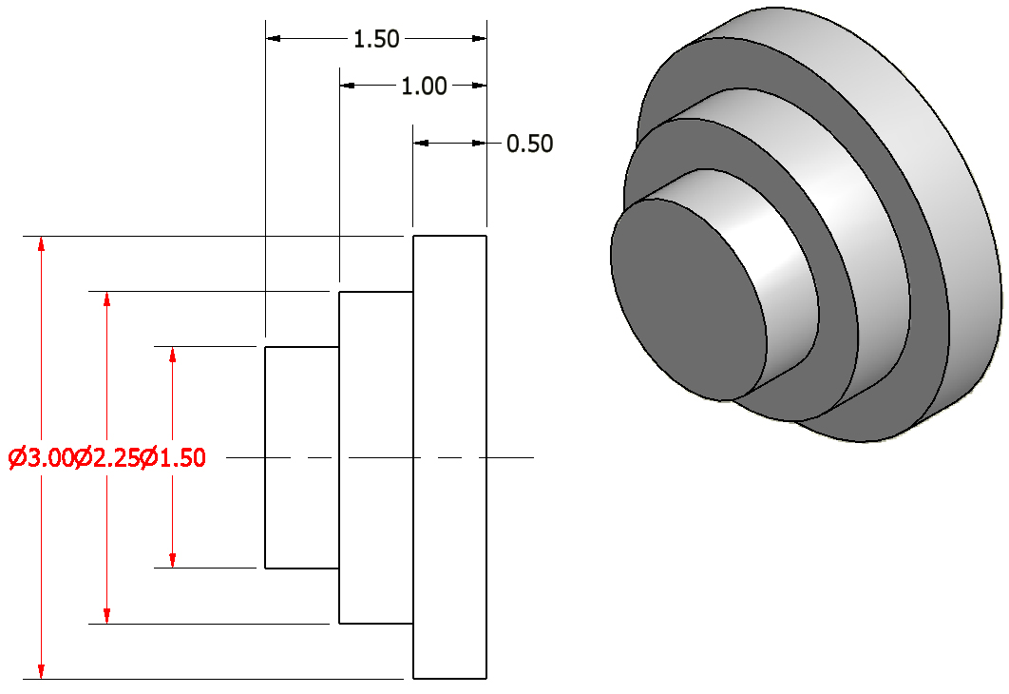
14. Dimension numbers should be centered between arrowheads, except when using stacked dimensions, and then the numbers should be staggered.
Incorrect
Notes:
References:
Pg 341-342 Engineering Drawing and Design 3rd Edition by David Madsen et. al.
Pg 137 Fundamentals of Modern Drafting by Paul Wallach
Pg 400, 426 Technical Drawing 9th Edition by Frederick Giesecke et. al.
Pg 690-691 Technical Graphics Communication 3rd Edition by Gary Bertoline & Eric Wiebe
Note: The 0.50 dimension cannot fit in between its extension lines, and is placed to the outside of the common extension line to avoid confusion.

Slide 29
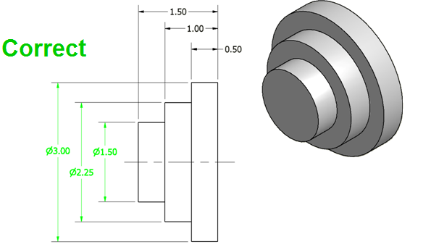
14. Dimension numbers should be centered between arrowheads, except when using stacked dimensions, and then the numbers should be staggered.
Notes:
References:
Pg 341-342 Engineering Drawing and Design 3rd Edition by David Madsen et. al.
Pg 137 Fundamentals of Modern Drafting by Paul Wallach
Pg 400, 426 Technical Drawing 9th Edition by Frederick Giesecke et. al.
Pg 690-691 Technical Graphics Communication 3rd Edition by Gary Bertoline & Eric Wiebe

Slide 30

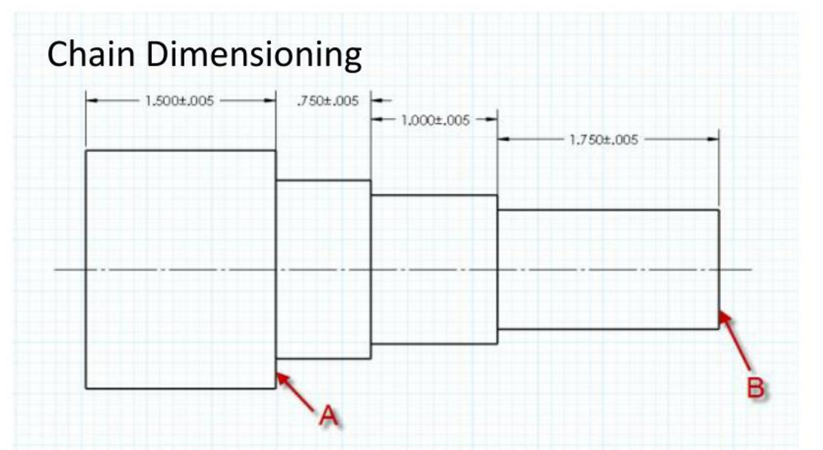
Chain Dimensioning allows the most variation in the distance from A to B, giving a total tolerance accumulation of .015” and a maximum distance AB of 3.515”.
Chain dimensioning can be used when the tolerance accumulation won’t affect the function of the part.

Slide 31

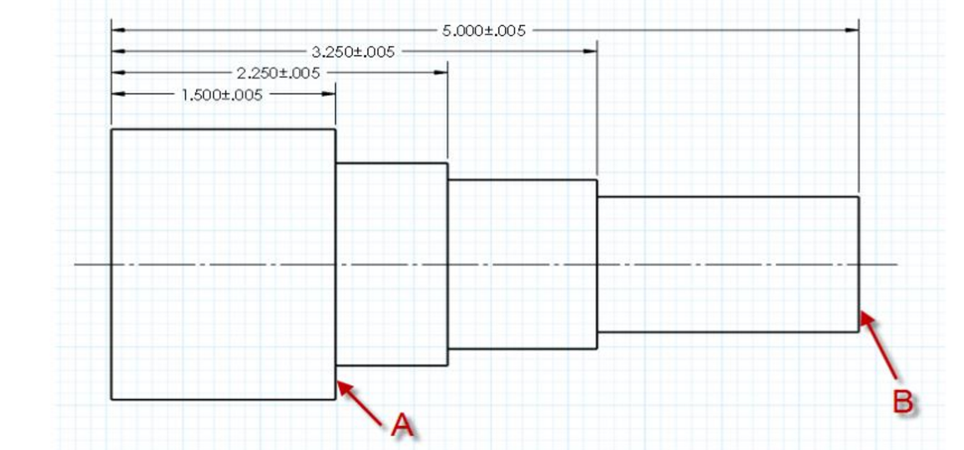
Sometimes called “ordinate” or “datum” dimensioning
Datum
Baseline Dimensioning provides a tolerance of 2x the base tolerance between any two features, or .010”. The maximum distance AB is 3.510”.
Baseline or “Ordinate” dimensioning is the easiest to follow when machining and measuring a part.

Slide 32

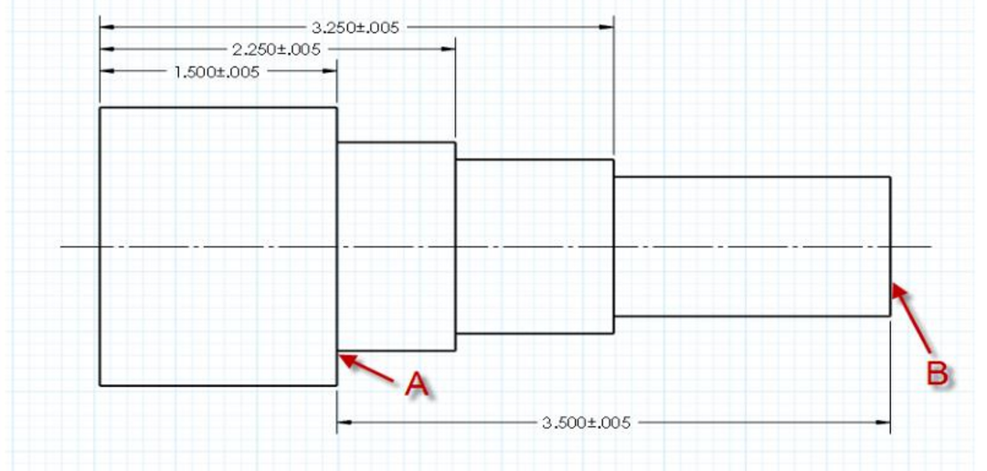
What to do if a feature must be controlled.
Direct dimensioning provides the lowest tolerance from A to B, in this case +/-.005”. The maximum distance AB of 3.505”
Direct dimensioning should be used to control the distance between two critical features like A and B.

Slide 33

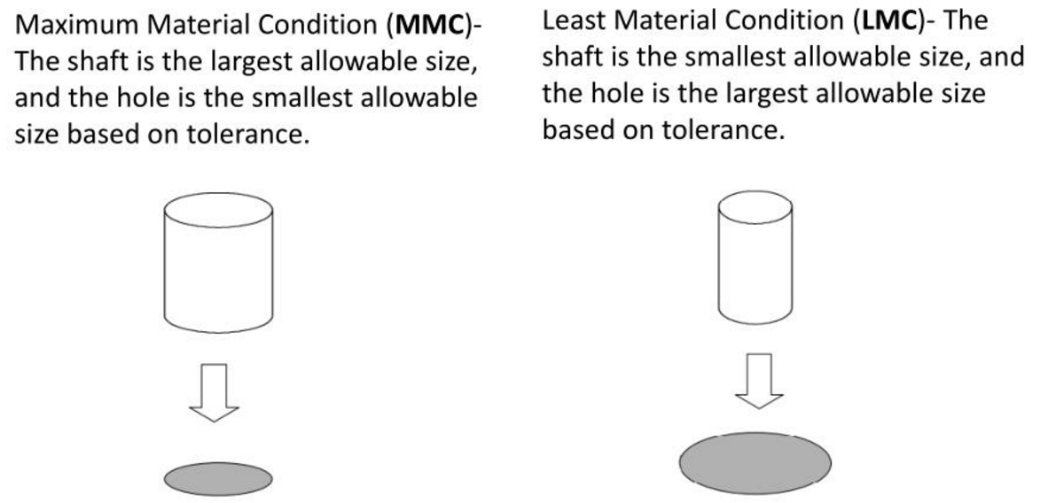
Appropriately adding/subtracting the tolerances from the nominal dimensions will predict how the parts will fit.

Slide 34
Example of Fit
3.500 +/- .005
3.505 +/- .005
?
1.345
+/- .005
1.355
+/- .005
Will it always fit?
No! 3.500 + .005 > 3.505 - .005

Slide 35
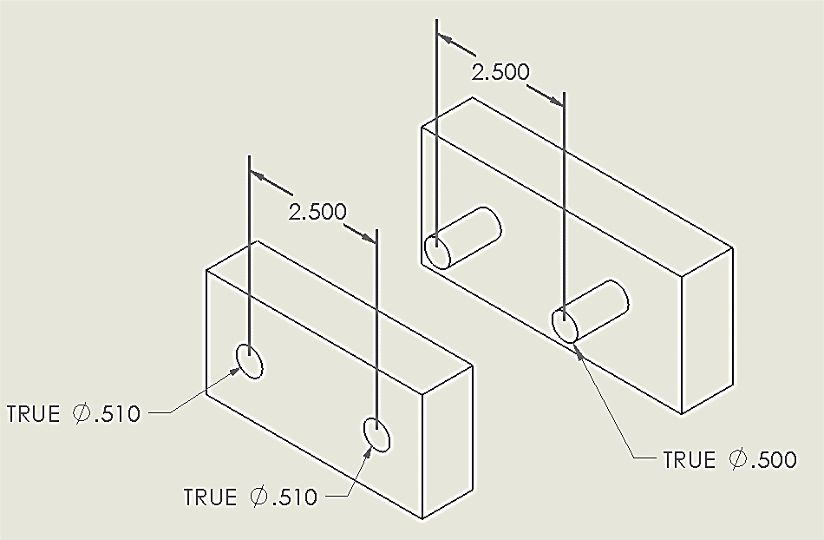
Example of Fit
Tolerance:
+/- .005
Will it always fit?
It’s not as simple!

Slide 36
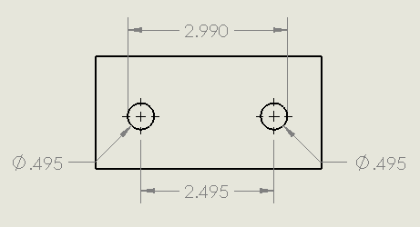
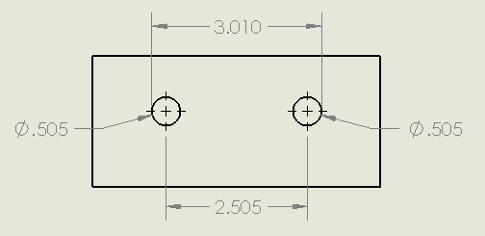
Tolerance:
+/- .005
Example of Fit
Part B
Part A
Part A
Part B
LMC
Will it always fit?
NO!
MMC

Slide 37
Fit Classifications
Loose
RC – Running or Sliding Fits
LC – Clearance Locational Fits
LT – Transition Locational Fits
LN – Interference Locational Fits
FN – Force or Shrink Fits
Tight

Slide 38

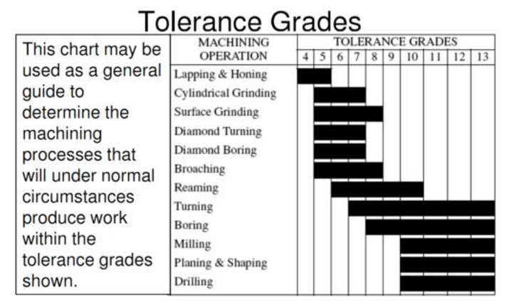
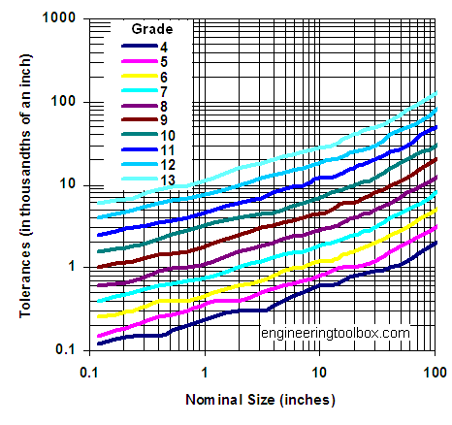

Slide 39

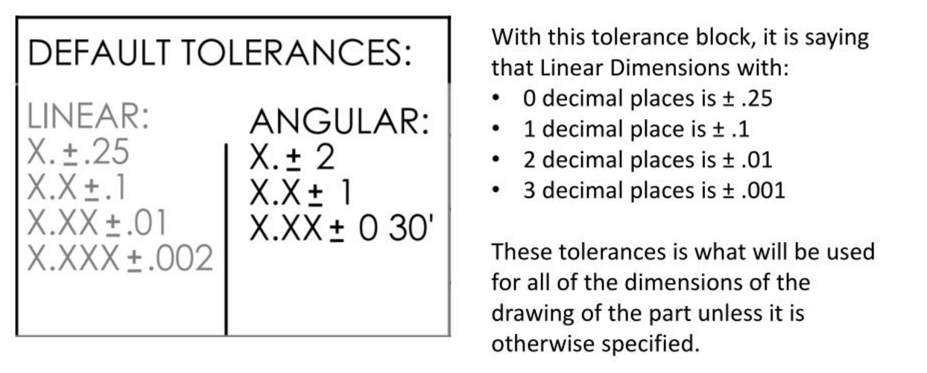

Slide 40
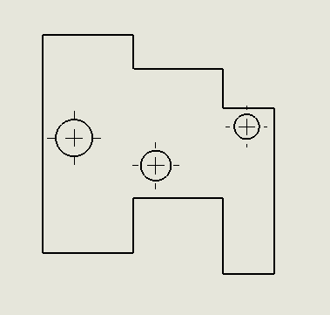
Working with Ordinate Dimensions in Solidworks
You want to dimension this part...

Slide 41
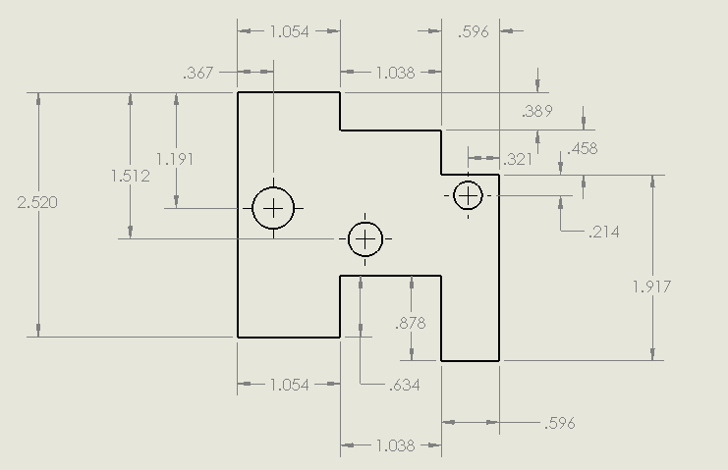
Ordinate Dimensions
You could do chain dimensioning (what’s wrong with this picture?)

Slide 42
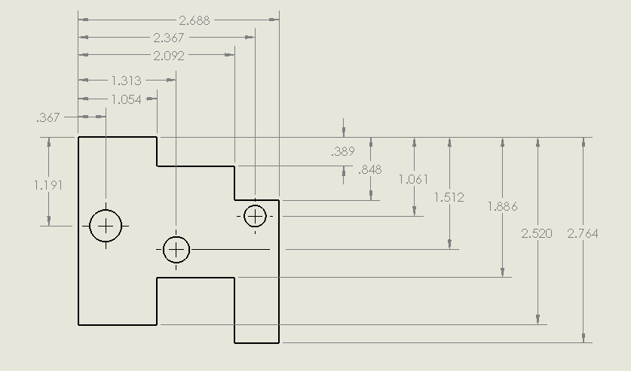
Ordinate Dimensions
Notice
the datums
You could do baseline dimensioning (a bit better)

Slide 43
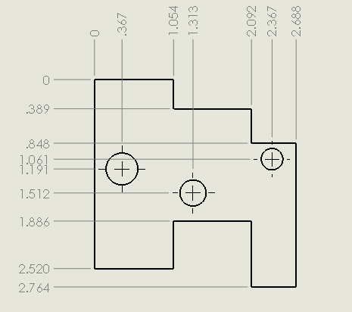

Ordinate Dimensions
Or you can use ordinate dimensions (now let’s clean it up)

Slide 44

Cleaning up the Ordinates
Let’s “jog” any dimensions that are too close...

Slide 45

Cleaning up the Ordinates
Looks better, now let’s move a few to the other side...

Slide 46


Cleaning up the Ordinates
We need to “Break Alignment” to allow moving one dimension.

Slide 47




Cleaning up the Ordinates
You can remove an ordinate with the delete key.
You can add an ordinate by right clicking on one of the series and selecting “Add to Ordinate”

Slide 48

Cleaning up the Ordinates
Now it’s starting to look better!

