Slide 1
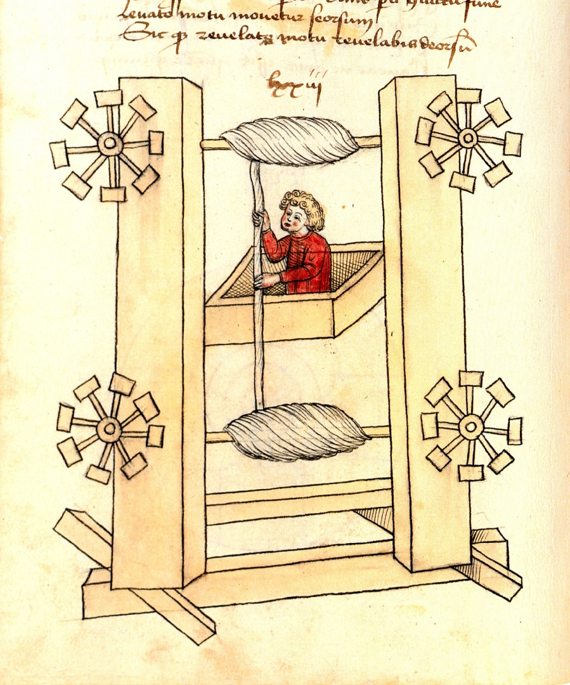
Design Development
Image credit: http://en.wikipedia.org/wiki/Elevator

Slide 2
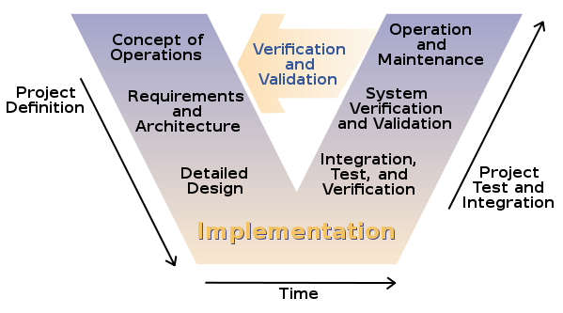
Software Design Process
Image credit: http://en.wikibooks.org/wiki/Introduction_to_Software_Engineering/Print_version

Slide 3
Tools
On-line reference
Tools
  Gantt chart
  Decision matric
  Brainstorming
  Design Reviews
Concepts
  Functional redundancy
  Data logging

Slide 4
Overview of the Design Process
Establish a need ⬅ Done
Develop project plan ⬅ Today’s objective
Determine engineering specifications ⬅ 11/05
  Research possible solutions
Develop concepts ⬅ 11/19
  Define primary concept and alternatives
  Analyze tradeoffs
Develop product design ⬅ Final exam meeting
  System integration

Slide 5
Develop Project Plan
Identify tasks & objectives ⬅
Develop a task sequence
Estimate personnel, time, and other resources needed for each task
Form design teams

Slide 6
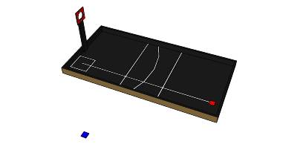
Competition Rules
Summary from the semester start

Slide 7
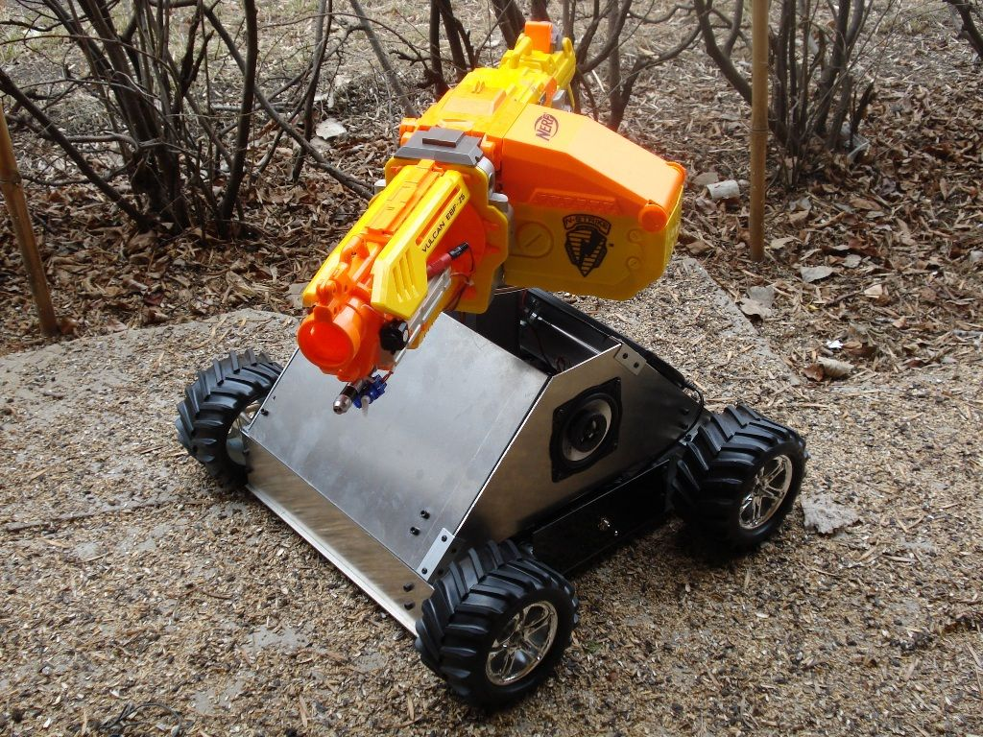
Identify Tasks
Major Components:
  Controller
  Drive train
  Launcher
  Color sensors
  Power supply
  …
Image credit: http://www.instructables.com/id/RC-Nerf-Tank/

Slide 8
In-Class Activity 1
Identify tasks & objectives ⬅
Develop a task sequence
Estimate personnel, time, and other resources needed for each task
Form design teams

Slide 9
In-Class Activity 2
Identify tasks & objectives
Develop a task sequence ⬅
Estimate personnel, time, and other resources needed for each task
Form design teams

Slide 10
In-Class Activity 3
Identify tasks & objectives
Develop a task sequence
Estimate personnel, time, and other resources needed for each task ⬅
Form design teams

Slide 11
In-Class Activity 4
Identify tasks & objectives
Develop a task sequence
Estimate personnel, time, and other resources needed for each task
Form design teams ⬅

Slide 12
Requirements for Design Brief (11/05)
What is a design brief?
Requirements for 11/05
  Detailed functional specifications
  Detailed interface specifications
    Hardware, software, power…
  Fabrication/creation & maintenance constraints
  Reliability requirements
  Ease of use/learning requirements
  Ideas for Solutions
Each team should submit a short electronic presentation to Moodle for presentation in class on 11/05

