Slide 1
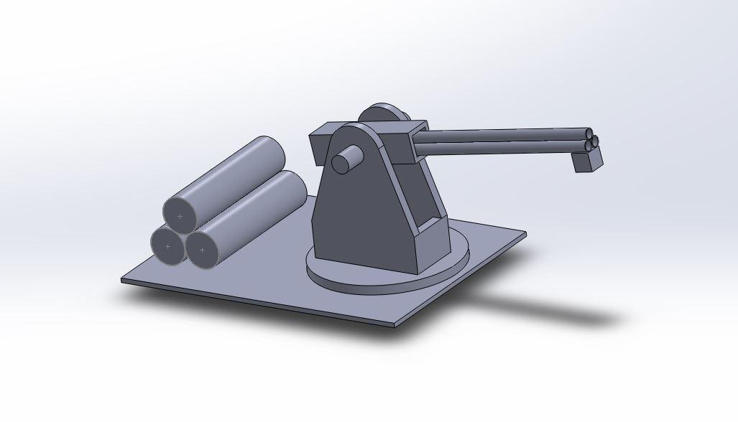
Firing Mechanism
Francis Caraher
Branden Essick
Caleb Kiser
Andrew Proctor
Riaan Coetsee
Joshua Gutowski
Francis Caraher
Christopher Sigmon
Davd Conway

Slide 2
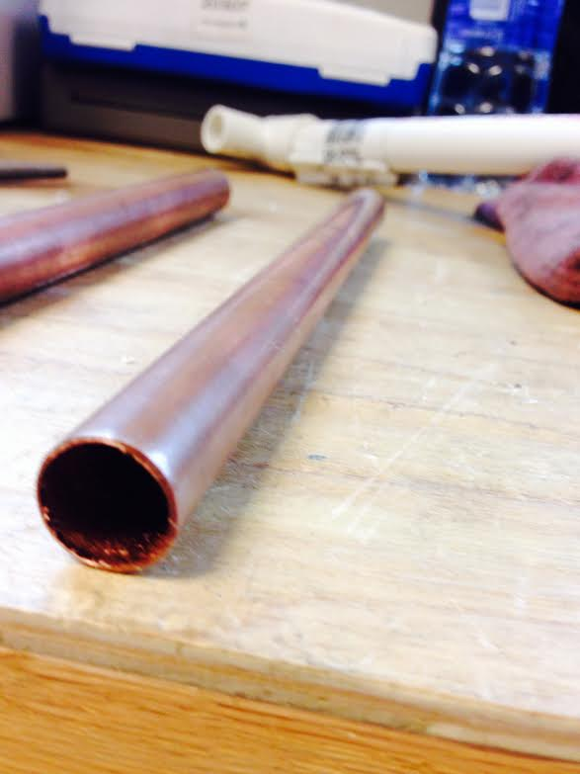
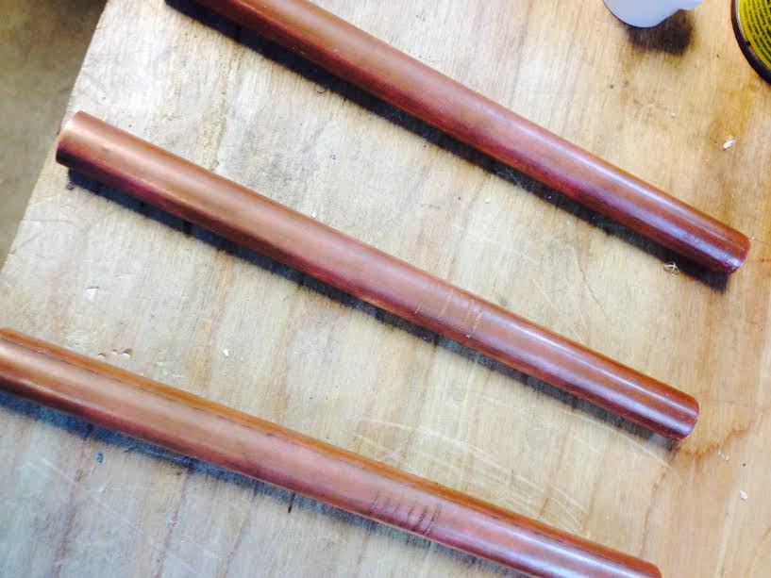
Barrels
Made of Copper for convenient fitting.
Diameter approx. 12.5 mm
Length approx. 16 cm

Slide 3
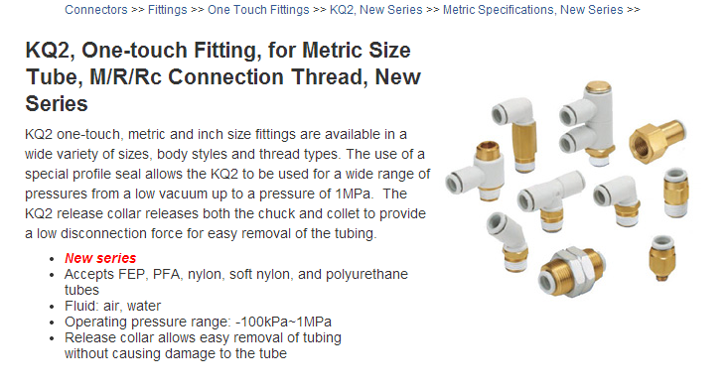
Pneumatic Fittings

Slide 4
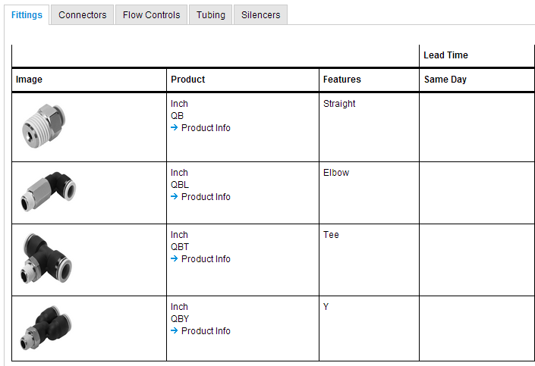
Pneumatic Fittings continued

Slide 5
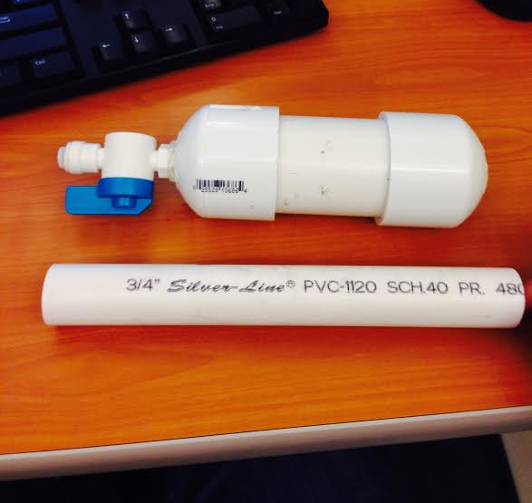
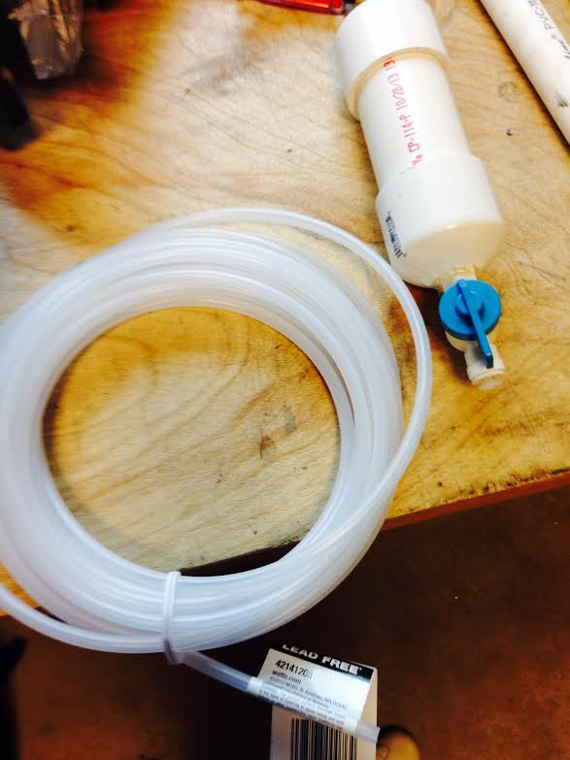
Compressed Air Tank
We decided to switch to a smaller ¾ in. PVC pipe to hold the air instead of the 1½ in. tank.
¾in. tank can hold 60 psi.
This will decrease the excess bulk.

Slide 6
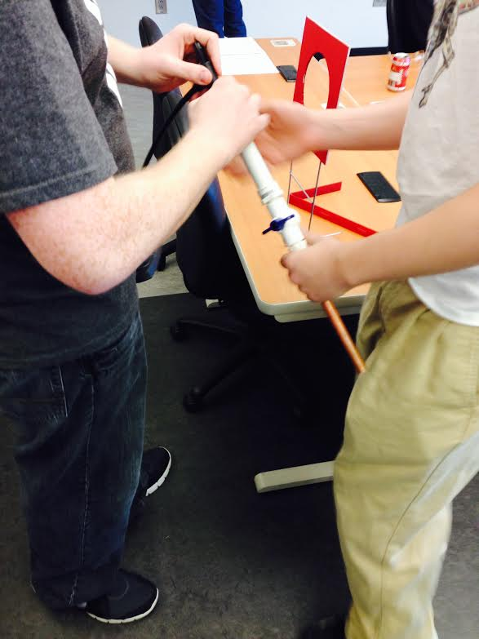
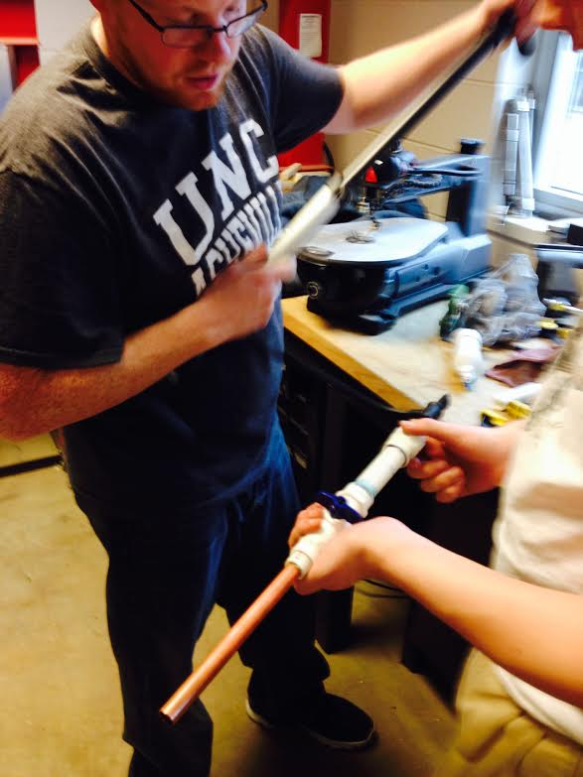
Measurements
Tire pump used to pressurize the tank. This will be used to fill the tank before the competition begins.
4 pumps - 60 psi (easily launched across a room)
3 pumps - 30 psi

Slide 7
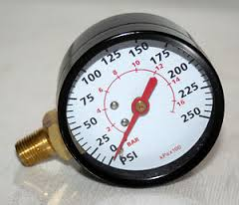
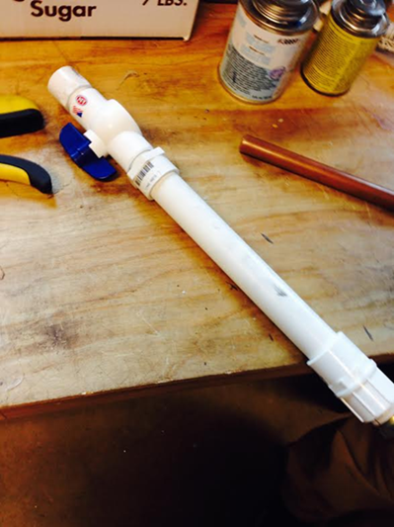
Issues
Still in need of an attached pressure gauge (due to specs)
Pressure leak causing significant decrease in range.
Tank losing most of the air after about a minute.

Slide 8
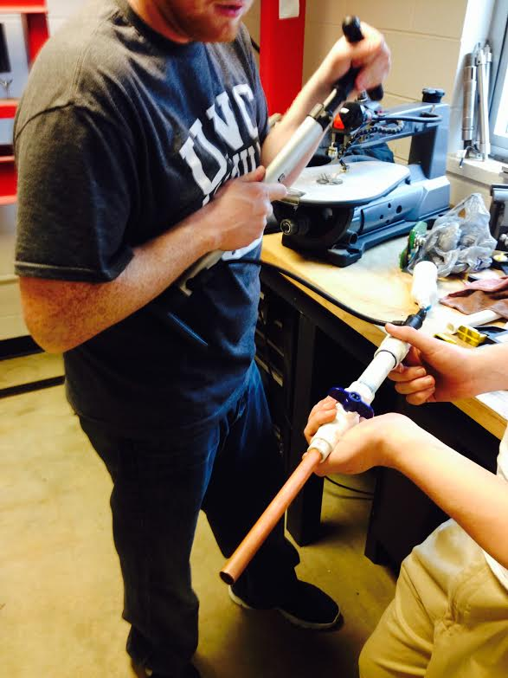
Demonstration
Please allow us to demonstrate the firing mechanism.

Slide 9
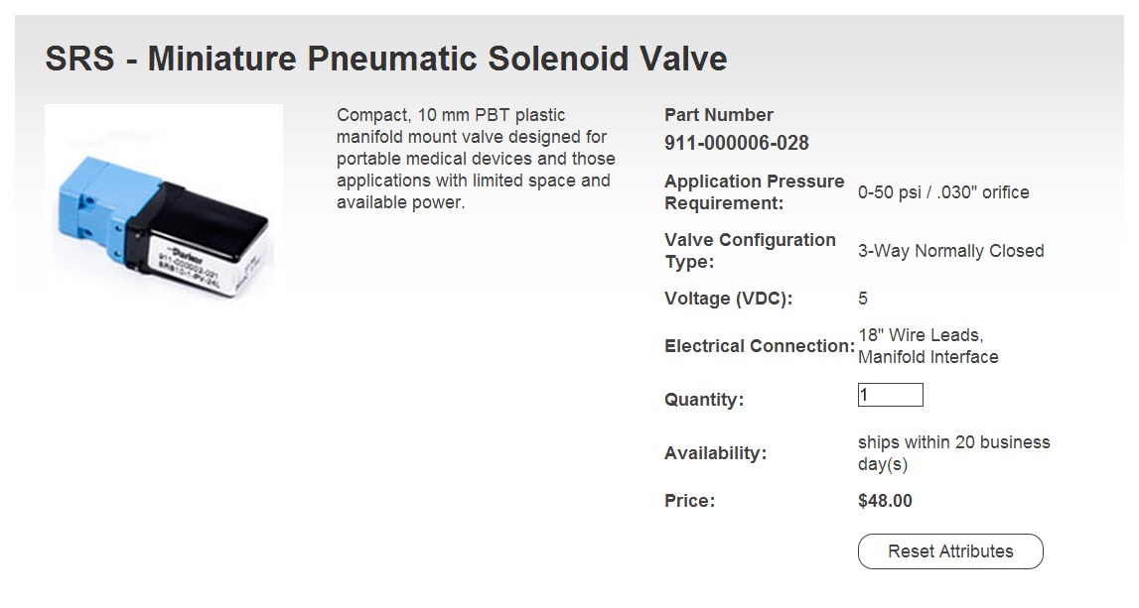
Firing the Darts using a Solenoid

Slide 10
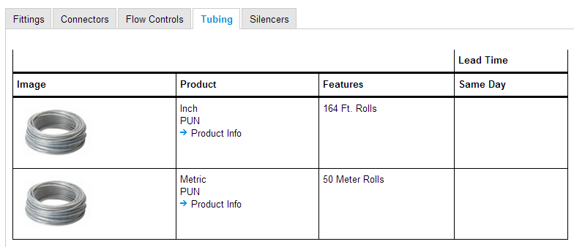
Pneumatic Tubing

Slide 11
Turret design
8-in long copper barrels
solenoids
sonar sensor
Air tanks
gears and motors

Slide 12
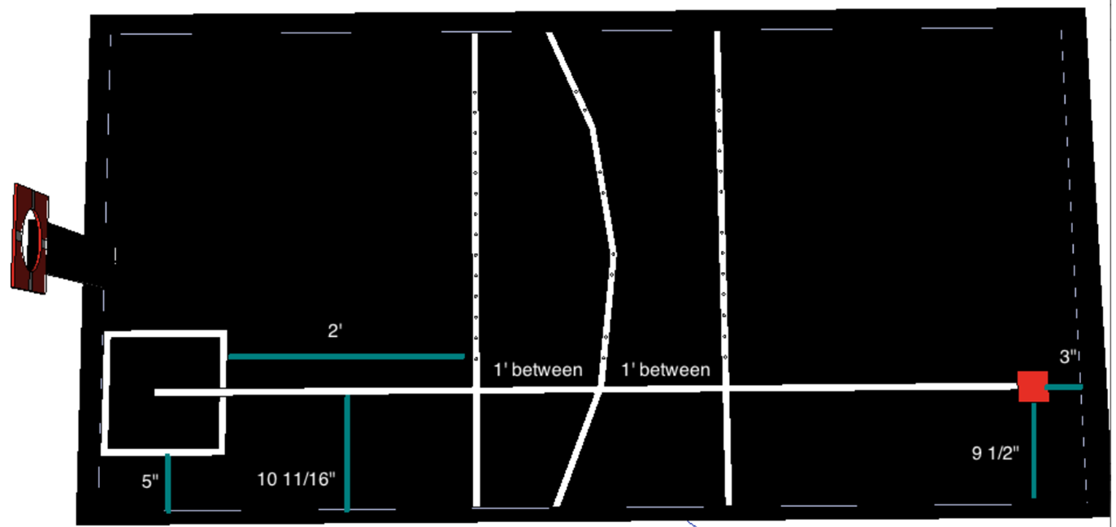
Turret Movement
Robot
tan⁻¹(60/18)=73.3008°
tan⁻¹(60/16)=75.0686°
tan⁻¹(60/20)=71.5651°
75.0686°-73.3008°
=1.7678°
73.3008°-71.5651°
=1.7357°
Error must be less than:
±1.7°
18”
60”

Slide 13
Cost Estimate
Part | Qty | Cost Estimate | Weight Estimate( lbs)
Air Tank | 3 | $8.00 | 0.5
Gage | 3 | $2.00 | 0.5
Solenoid | 3 | $48.00 | 0.2
Nozzle | 3 | $2.00 | 0.2
Air Fittings | 6 | $4.00 | 0.1
Tubing | 5 (4" strips) | $2.00 | 0.01
Encoder | 2 | $40.00 | 3
Total Cost $294

Slide 14

END

