Slide 1
Navigation
Team Navigators - 12/03/13

Slide 2
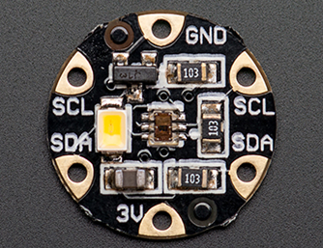
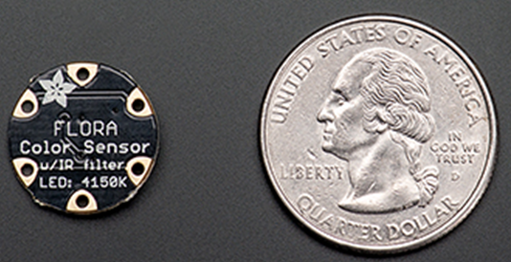
Sensors - Color Sensor
Adafruit Flora Color Sensor
Power Requirements: 3.3V or 5V
Dimensions: 0.6” diameter
Cost: $12.50
Height Above Field
Additional LED
Notes:
Height Above Field: In the video it recommends being as close to the object as possible and more than an inch can throw off readings.
Additional LED: has an LED attached to ensure proper color reading
Video: https://www.youtube.com/watch?feature=player_detailpage&v=xZ8z1IgKhNE#t=1341

Slide 3

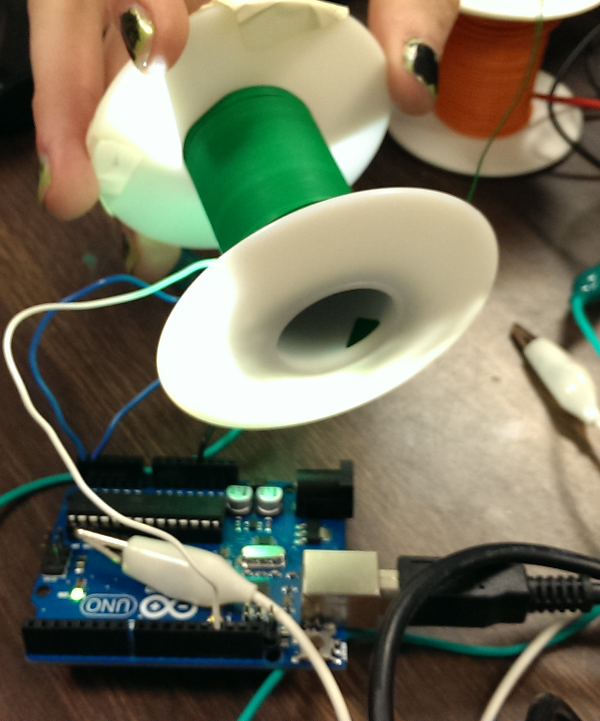
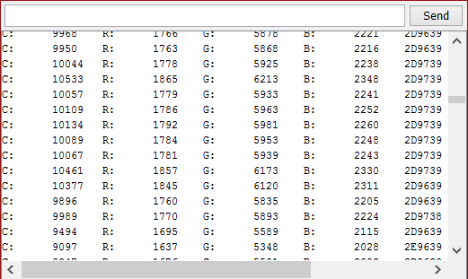
Color Sensor
2D9739
Notes:
Height Above Field: In the video it recommends being as close to the object as possible and more than an inch can throw off readings.
Additional LED: has an LED attached to ensure proper color reading
Video: https://www.youtube.com/watch?feature=player_detailpage&v=xZ8z1IgKhNE#t=1341

Slide 4
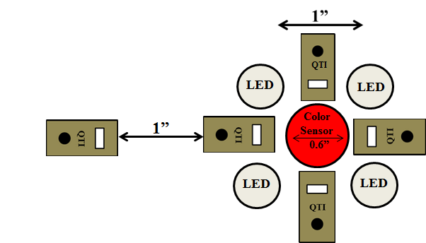
Sensor Array
Line = ¾”
QTI = ⅜”
Notes:
LED

Slide 5
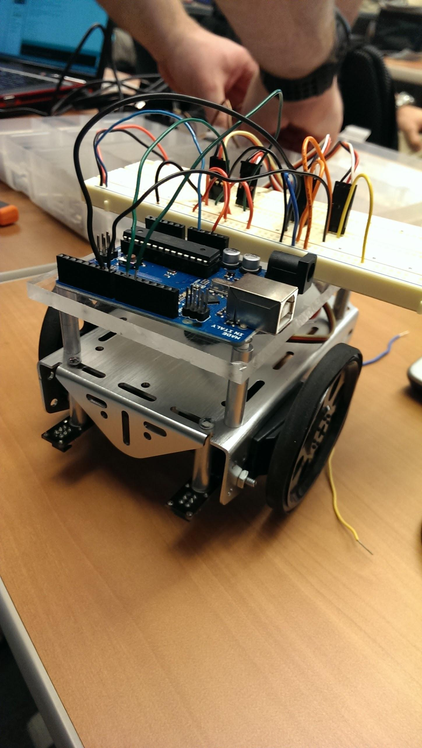
Ol’ Yeller 2.0
R.I.P Ol’ Yeller 1.0

Slide 6
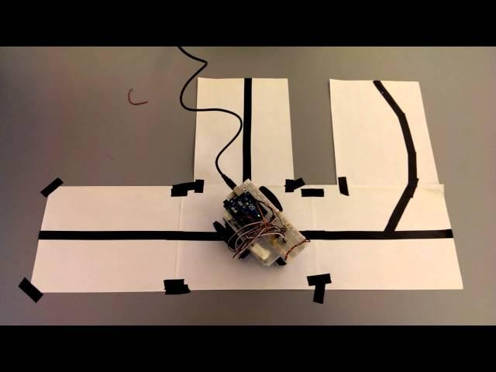
Ol’ Yeller 2.0 - This isn’t even my final form

Slide 7
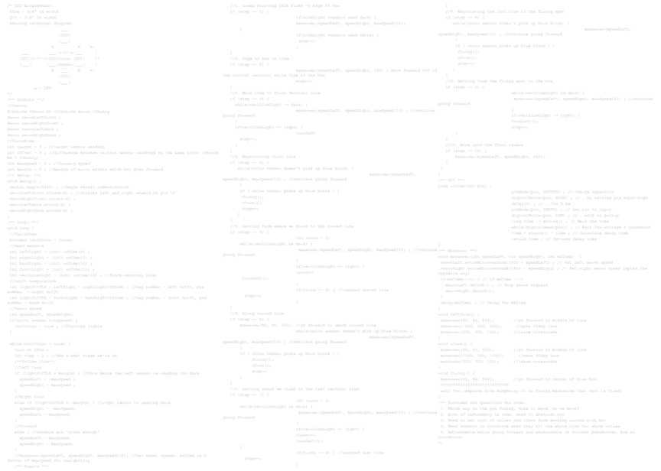
Pseudocode
Divided into events:
1) Green starting LEDs fired move to edge of box
2) Move from edge of box to line
3) Transition from main line to first vertical line
4) Negotiate the first line, wait for firing
- Color sensor detects blue block
5) Getting from firing location to curved line

Slide 8
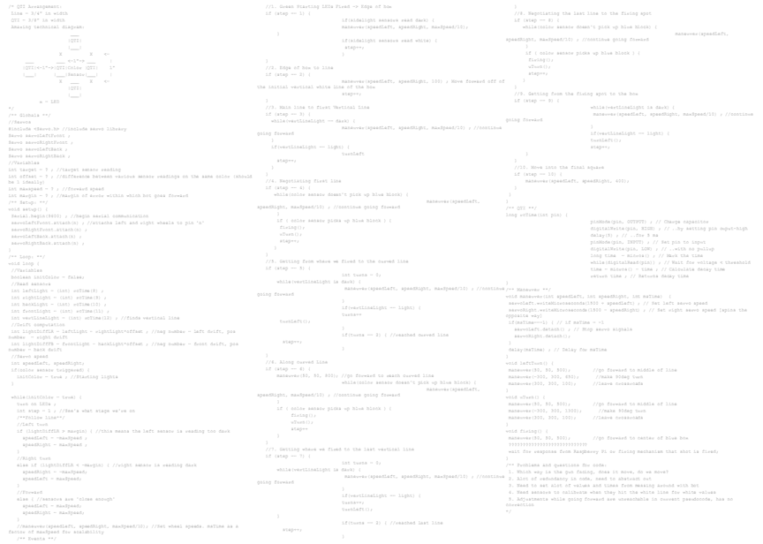
Pseudocode
6) Following the curved line, waiting for firing
- Color sensor detects blue block
7) Returning to main line and finding last line
8) Negotiating last line to firing spot
- Color sensor detects blue block
9) Getting from firing spot to final box
10) Move into final box

Slide 9
To Infinity and Beyond
Functional Pseudocode for line following
Color sensor selected acquired; tested
Notes:
Develop a working prototype
Fine-tune code - Remove redundancies, set values,

