Slide 1
Targeting
Boris Sarkisov
Richard Bilhorn
Christopher King
Nathan Lewis
Casey Miller
Jake Rubin

Slide 2
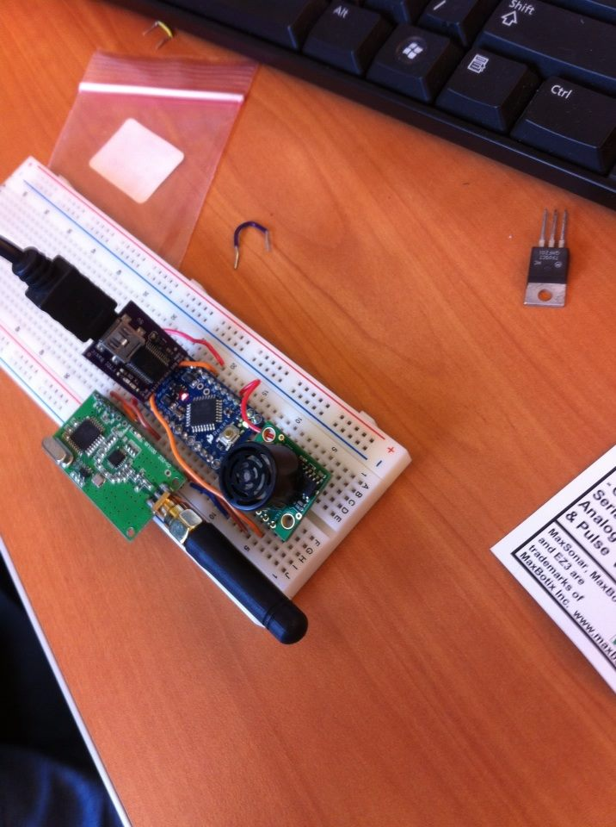
Methodology
Test the accuracy of the chosen sonar.
Attach sonar to a circuit on a stationary breadboard.
Get an item resembling the target with a large hole in the middle, and see how well the sonar can detect it at multiple distances.

Slide 3
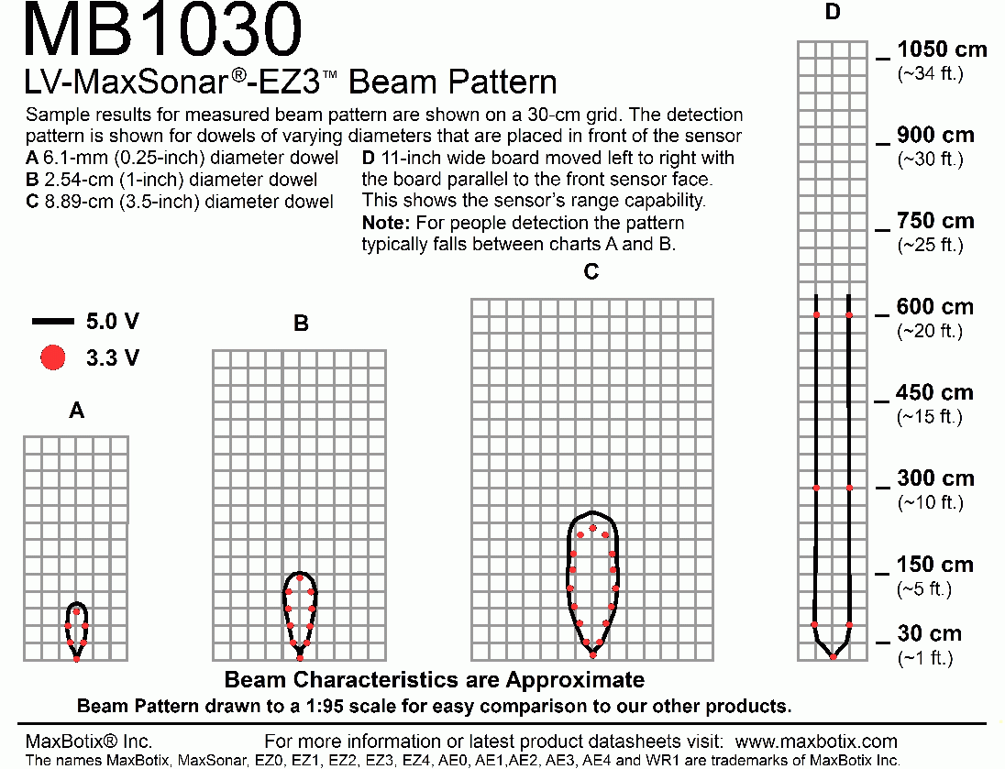
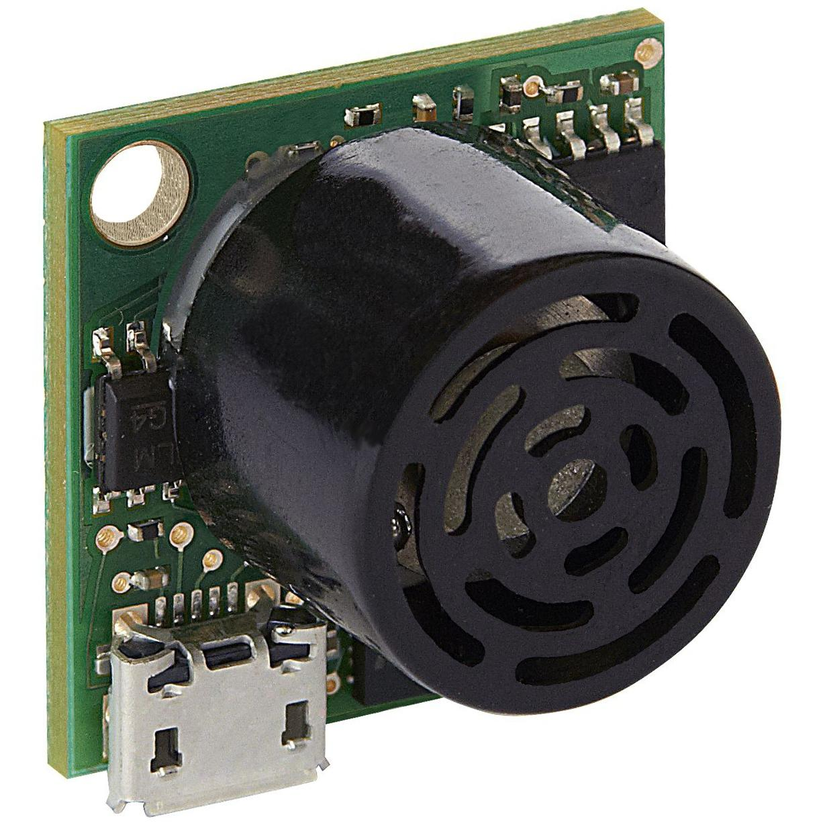
Device Type
MB1030 LV-MaxSonar-EZ3

Slide 4
Testing Method
Sonar was hooked up to arduino and showing results on computer. We slid a mock target at 3ft in front of the sonar to determine when the sonar was picking up the target and when it was not. The mock targets were first a flat surface, then the actual recreated target with the 5in diameter hole.

Slide 5
Testing Stage
Distance 3ft | Test 1 - No modifications to sonar Very inconsistant results (88cm - 350cm) depending on exact angle of target | Test 2 - Adding focusing pipe Much more accurate results. Detected target when it was 4 cm - 5 cm from center lines (eliminated angle issues) | Test 3 - Aiming at the actual target With focusing pipe attached it found both the edge and the center of the target

Slide 6
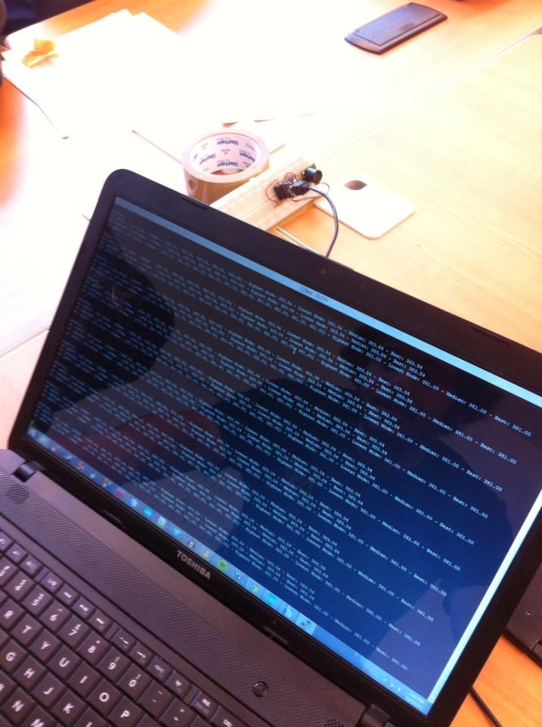
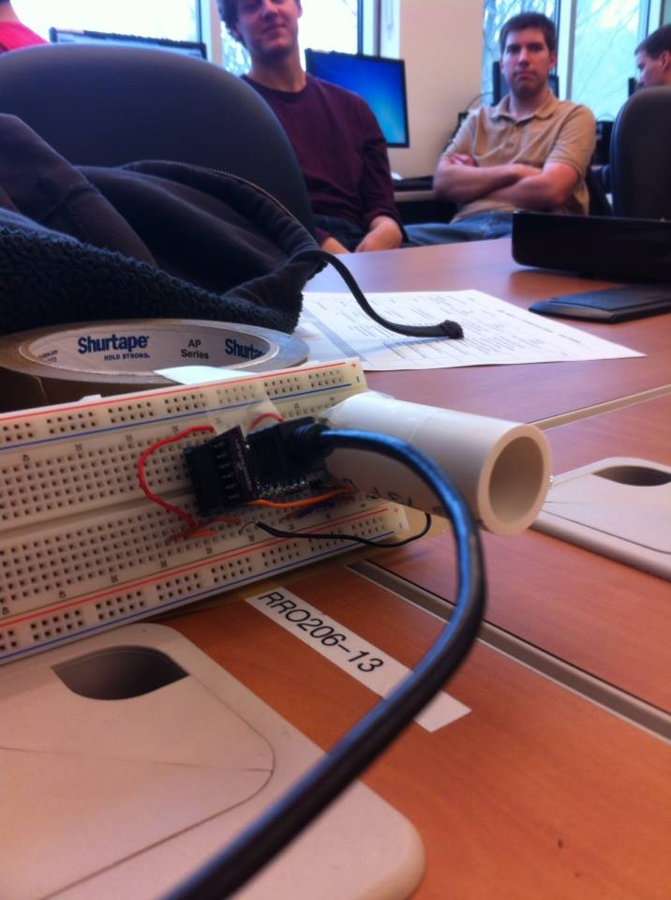
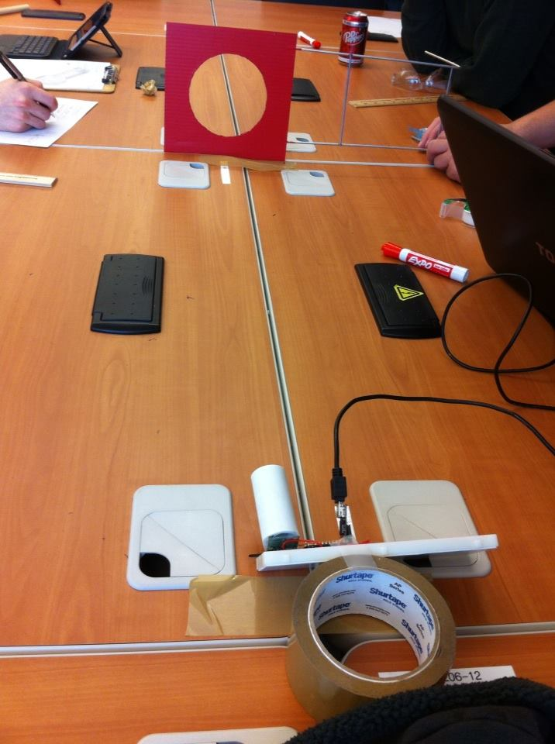
Testing Stage (cont.)
Test 1 Test 2 Test 3

Slide 7
Results
-The sonar by itself was pretty inconsistent
-The angle of the target greatly varied the results
-However, using a pipe to focus the beam produced much more accurate results
-Possible improvements:
A. Better material used for focusing pipe
B. Adjust the length of the pipe

Slide 8
Final Conclusion
-The sonar is a plausible way to find the target and aim accurately. We believe that with further testing of the pipe we can produce more accurate results. It does find the edge and hole of the target.
-If we cannot get it to work in further trials we will look into infrared

