Slide 1
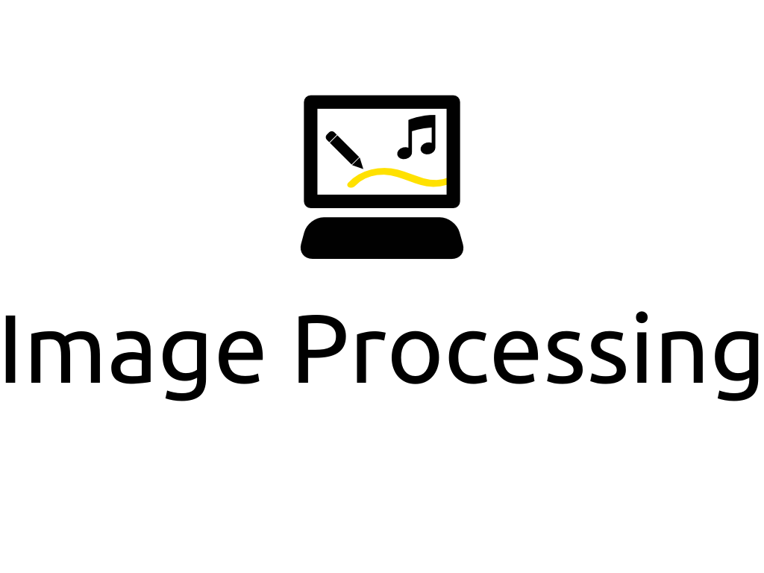

Slide 2
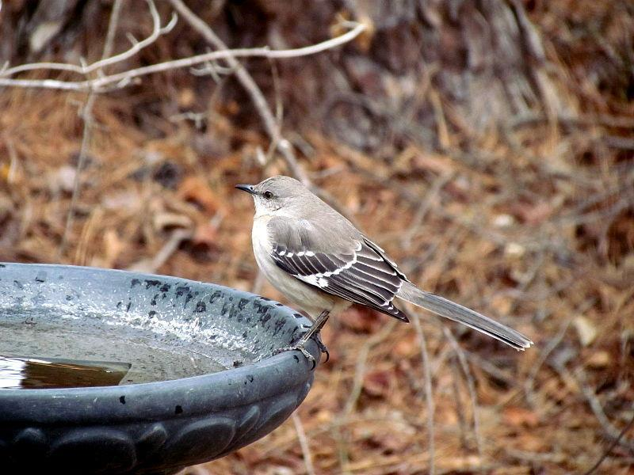
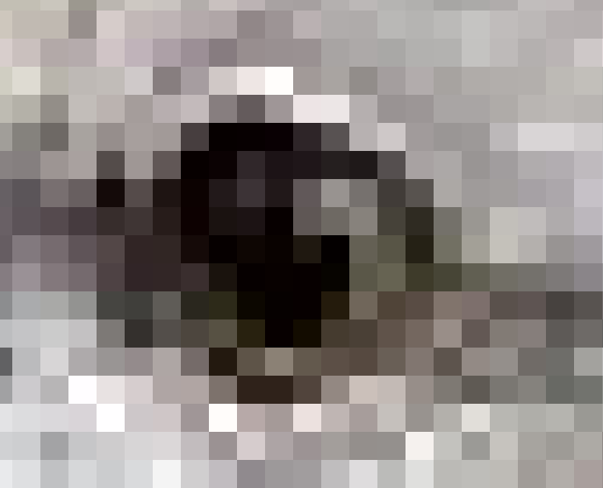
Resolution
244
244
244
243
242
242
243
242
0
0
0
230
Resolution: 6 x 4
230
242
0
255
0
230
230
230
0
0
0
242

Slide 3
Scaling an Image
244
244
244
243
242
242
243
242
0
0
0
230
...reduces image quality
why?
230
242
0
255
0
230
230
230
0
0
0
242
244
244
244
244
easy if we use exact multiples
complicated if we don't

Slide 4
Selections and Masks
A mask is another name for a selection
A mask is a subset of an image’s pixels
This allows us to restrict our processing to a subset of pixels
How do we select regions in GIMP?

Slide 5
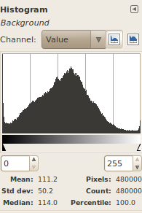
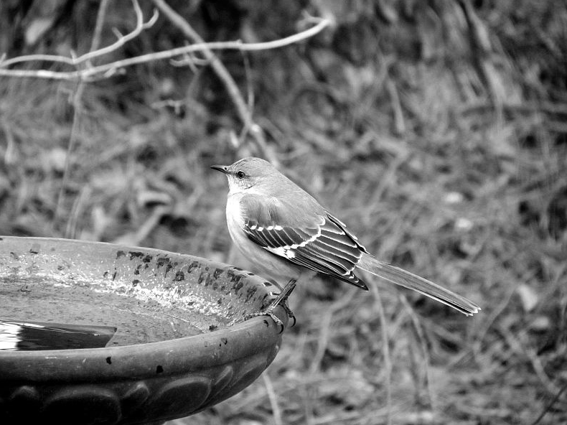
Histograms
A graph of pixel color frequencies

Slide 6
Pixel Point Processing
244
244
244
243
242
242
243
243
243
242
241
241
243
242
0
0
0
230
242
241
0
0
0
229
230
242
0
255
0
230
229
241
0
254
0
229
230
230
0
0
0
242
229
229
0
0
0
241
We change each pixel individually
Can be used for lightening, darkening, contrast adjustments

Slide 7
Pixel Group Processing
244
244
244
243
242
242
1/9*243 + 1/9*242 + 1/9*0 +
1/9*230 + 1/9*242 + 1/9*0 +
1/9*230 + 1/9*230 + 1/9*0 =
243
242
0
0
0
230
230
242
0
255
0
230
158
230
230
0
0
0
242
1/9
1/9
1/9
1/9
1/9
1/9
convolution mask
1/9
1/9
1/9
We change each pixel based on its neighbors
Can be used for blurring, sharpening, complex filters

