Slide 1
Encoding Sound

Slide 2
What is sound?

Slide 3
What is sound?
Sound is a mechanical wave that is an oscillation of pressure transmitted through a solid, liquid, or gas, composed of frequencies within the range of hearing and of a level sufficiently strong to be heard, or the sensation stimulated in organs of hearing by such vibrations.

Slide 4

What is sound?

Slide 5
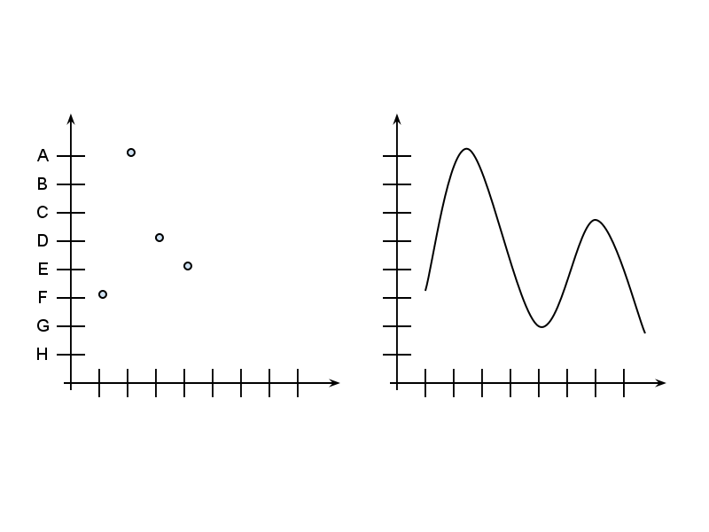
digital
analog
analog signals and messages can be thought of as changes in values over time

Slide 6
Differences
- Analog signals are continuous along both the time and value axes
- A computer cannot store continuous values
5
4
3
2
1
what does it mean for a set of possible values to be continuous?

Slide 7
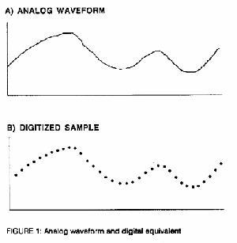
Storing Analog Signals
the process of converting an analog signal to a digital signal for storage on a computer is called digitization

Slide 8
Digitization
Digitization has two main components:
1. Sampling -- solves the problem of time continuity
2. Quantization -- solves the problem of value continuity

Slide 9
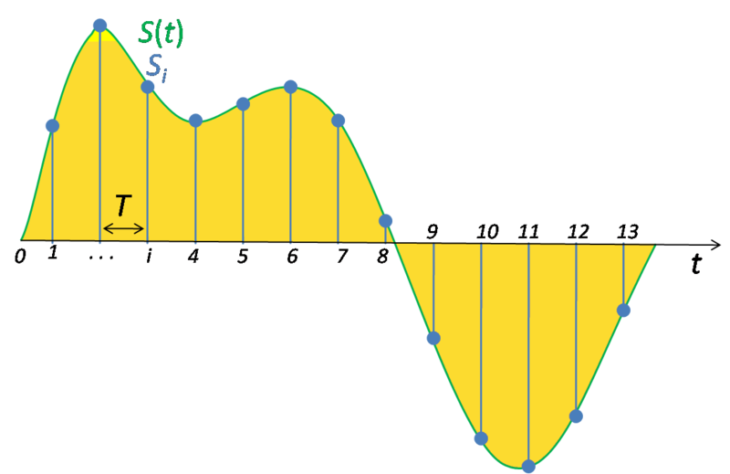
Sampling
Sampling takes measurements of the analog signal at specified time intervals

Slide 10
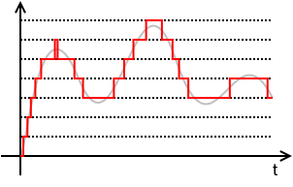
Quantization
Quantization rounds the real-number measurement to the closest code

Slide 11
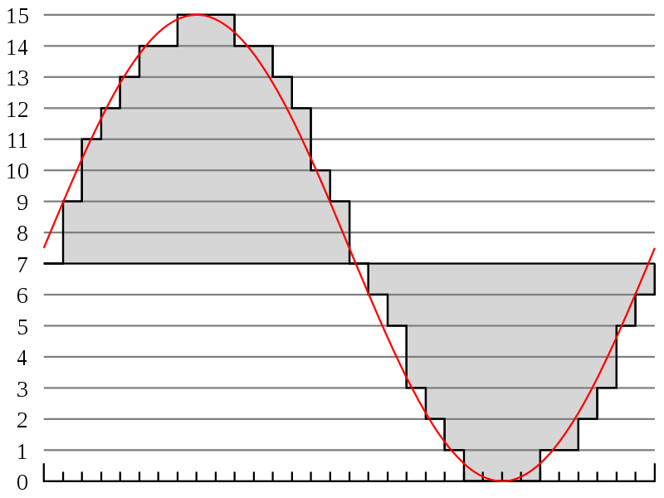
Quality
A digitized signal is an approximation of an analog signal.

Slide 12
Quality
Depends on:
Sampling Rate: how often you measure the signal
Bit-Depth: how many quantization levels you have
Tradeoff:
higher quality (higher sampling rate, higher bit-depth) means a bigger file

Slide 13
Exercises
1. Suppose we sample a 2 minute music file at 36000Hz (samples per second). How many samples would we take?
2. Suppose we digitize the above samples with 8-bit quantization levels. How many bits would our encoded music file be?
3. There are 8 bits in a byte, and 1024 bytes in a kilobyte. How many kilobytes would our encoded music file be?

Slide 14
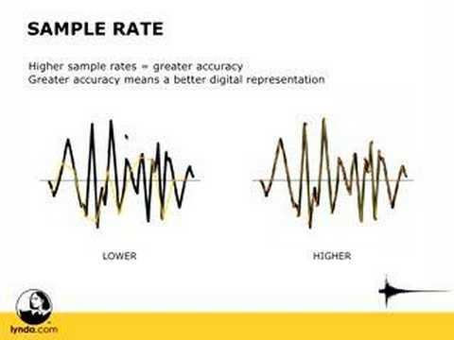
Sampling Rate

Slide 15
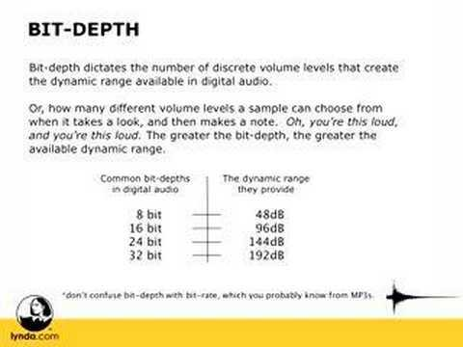
Bit Depth

Slide 16
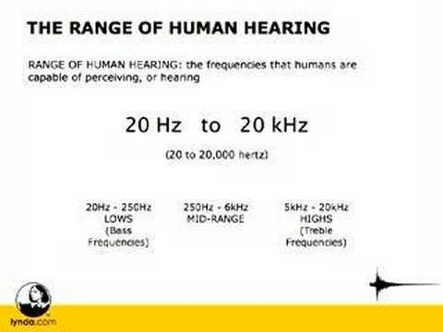
Hertz and Frequency Response

