Slide 1
Digital Encodings

Slide 2



Digital Encodings

Slide 3


Why do we care?
computers can't store or process non-digital

Slide 4

Why do we care?
computers can store and process digital!

Slide 5
How do we do it?
hello
1. break it up into individual objects
2. encode individual objects
3. string the codes together
[h]
[e]
[l]
[l]
[o]
010
111
101
101
011
010111101101011
individual parts of messages are called characters

Slide 6

It works with images too!
individual parts are called pixels

Slide 7
Building an encoding scheme...
A: 0
B: 00
C: 101
...
Z: 1000101010111
A: 0000
B: 0001
C: 0100
...
Z: 1111
variable-length
vs.
fixed-length
decode: 000000010100

Slide 8
Building an encoding scheme...
A: 0
B: 00
C: 101
...
Z: 1000101010111
A: 0000
B: 0001
C: 0100
...
Z: 1111
variable-length
vs.
fixed-length
variable-length can lead to ambiguity (why?)
fixed-length is easier to decode (why?)
but fixed-length requires planning (why?)

Slide 9
Counting...
A bit is a 0 or a 1
A bitstring is a sequence of bits
How many objects can be encoded with a fixed-length code of length 2?
a, b, c, d, e
How many bitstrings of length 2 are there?
00, 01, 10, 11
a : 00
b : 01
c : 10
d : 11
e : ??

Slide 10
Counting...
A bit is a 0 or a 1
A bitstring is a sequence of bits
How many objects can be encoded with a fixed-length code of length 2?
a, b, c, d, e
How many bitstrings of length 2 are there?
00, 01, 10, 11
a : 00
b : 01
c : 10
d : 11
e : ??
4
4

Slide 11
Listing bitstrings...
length 1
0
1
length 2
00
01
10
11
length 3
000
001
010
011
100
101
110
111
length 4
0000
0001
0010
0011
0100
0101
0110
0111
1000
1001
1010
1011
1100
1101
1110
1111
is
there
a
pattern?

Slide 12
Counting bitstrings...
If we have 1 bit, we have 2 bitstrings...
... 2 bits, 4 bitstrings ...
... 3 bits, 8 bitstrings ...

Slide 13
Counting bitstrings...
If we have 1 bit, we have 2 bitstrings...
... 2 bits, 4 bitstrings ...
... 3 bits, 8 bitstrings ...
each time we add a bit, we double the number of bitstrings!

Slide 14
Counting bitstrings...
If we have 1 bit, we have 2 bitstrings...
... 2 bits, 4 bitstrings ...
... 3 bits, 8 bitstrings ...
each time we add a bit, we double the number of bitstrings!
So, if we have 3 bits, we have 2*2*2 = 8 bitstrings.
if we have n bits, we have 2^{n} bitstrings!

Slide 15
Counting bitstrings
How many bitstrings do we need to encode n objects?
10, 20, 30, 40, 50, 60, 70...

Slide 16
Counting bitstrings
How many bitstrings do we need to encode n objects?
We need x bits where
2^{x-1} < n <= 2^{x}

Slide 17
Counting bitstrings
How many bitstrings do we need to encode n objects?
We need x bits where
2^{x-1} < n <= 2^{x}
Through the magic of algebra, we can find that
x = log₂n (rounded up)

Slide 18
Properties of an encoding scheme
universal
reversible
simple
efficient
unambiguous

Slide 19
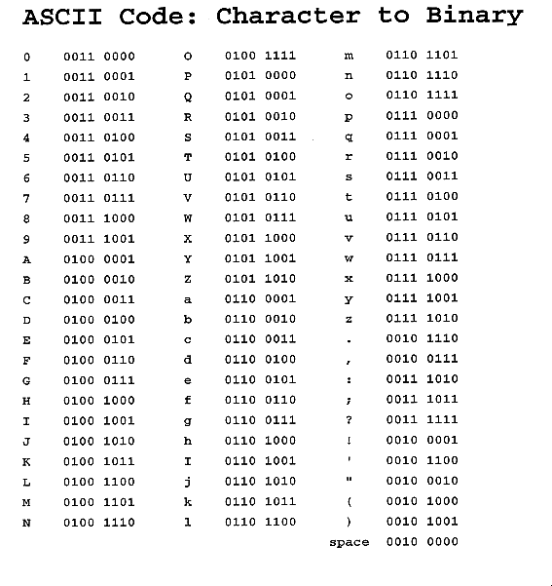
Example: ASCII

Slide 20

Example: ASCII
American Standard Code for Information Interchange
developed between 1960 and 1963
7 or 8 bits (1 byte) per character
includes control characters

Slide 21
Example: Unicode
Uses 16 bits per character
Encodes many symbols from other languages
How many more objects can be encoded?

Slide 22
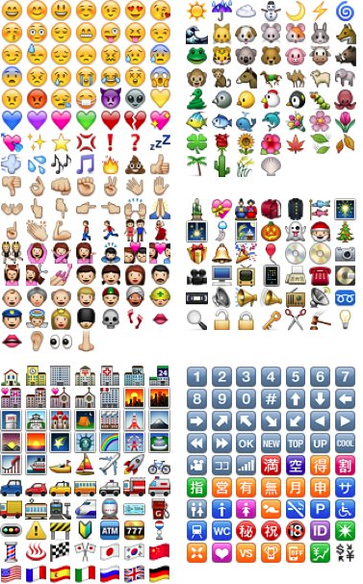
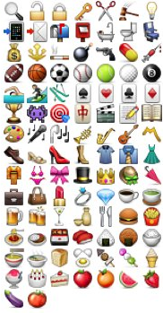
Example: Emoji!
subset of unicode
722 characters

Slide 23
Examples and Exercises...
1. List all the bitstrings of length 1, 2, 3, and 4.
2. How many bitstrings are there of length 5, 6, 7 and 8?
3. How long do the bitstrings have to be to encode 10, 20, 30, 40, 50, 60, 70, and 80 objects?
4. Suppose you have a file that has 26, 600, 1024, 50, and 64 characters in it. If you use a 4,5,6,7,8 bit fixed-length encoding scheme, then how many bits does it take to store the file?
5. Describe the processes that you use to answer exercise 1, 2, 3, and 4.

