Slide 1


Slide 2
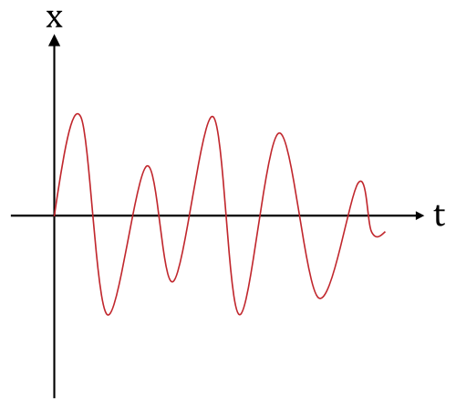
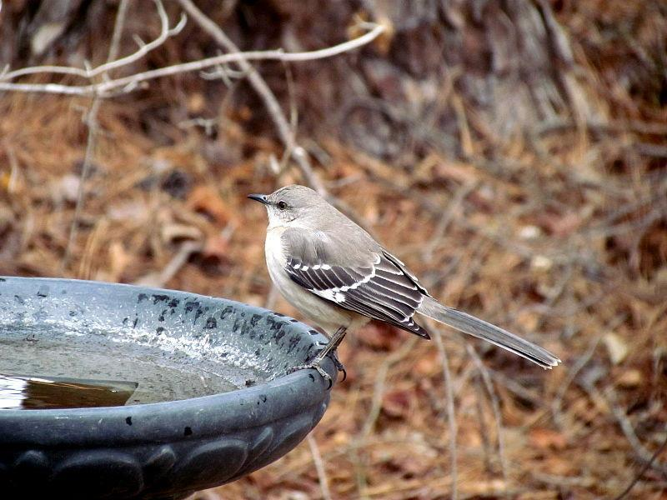

Visuals are analog signals...

Slide 3
Digitization
Like sound, images are encoded through digitization. This involves two steps:
Sampling
Quantization
Based on your knowledge of these two processes, explain how images are digitized.

Slide 4
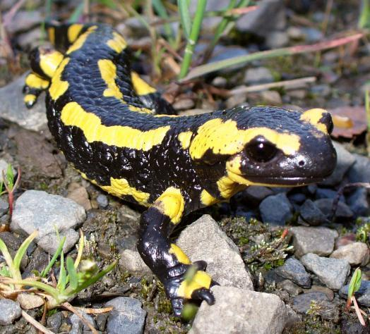
let's digitize this visual

Slide 5
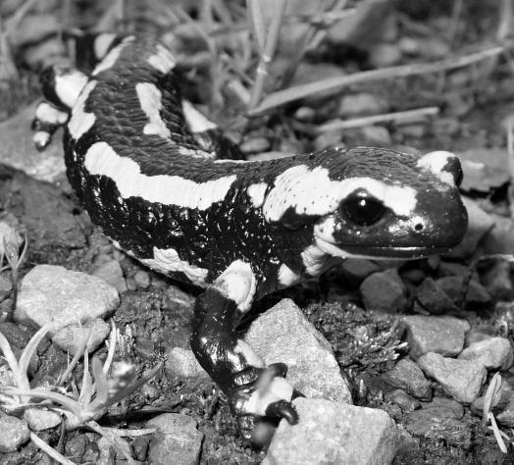
we'll use a grayscale digitizer

Slide 6
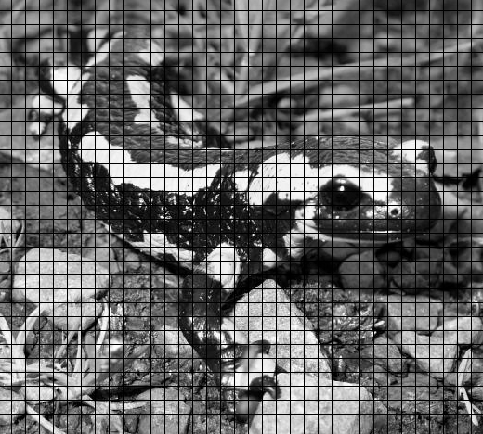
we sample the visual

Slide 7
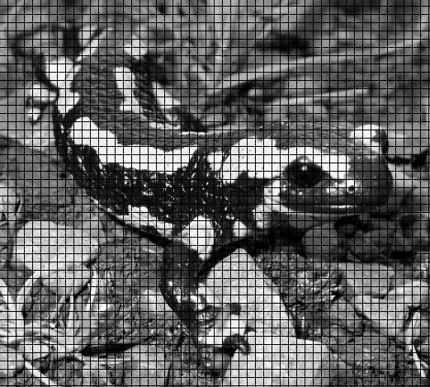
we can take more samples

Slide 8
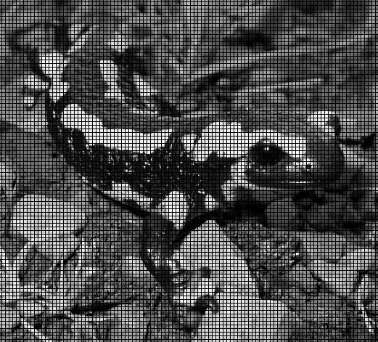
or even more

Slide 9
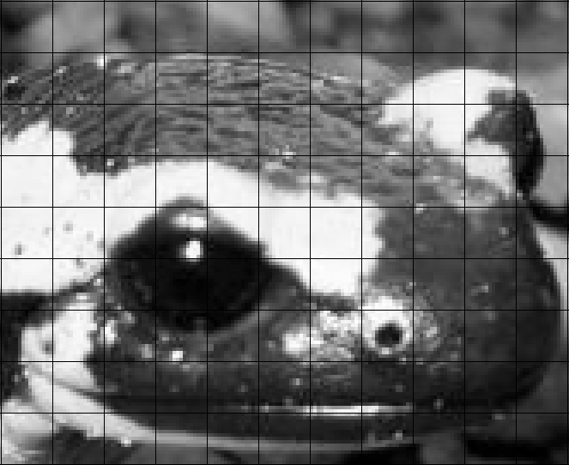
then we quantize the image

Slide 10
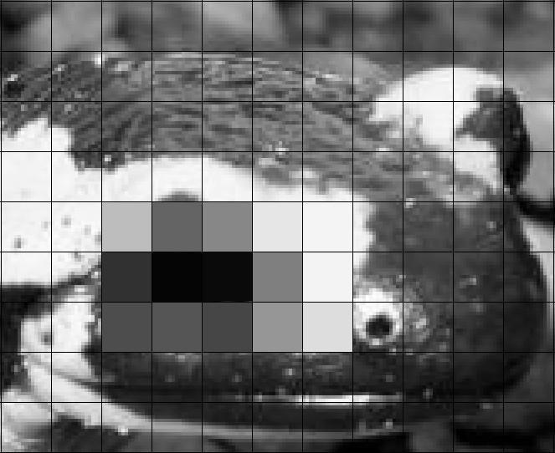
then we quantize the image

Slide 11
189 | 100 | 135 | 230 | 244
49 | 5 | 10 | 127 | 243
77 | 85 | 70 | 150 | 221
which makes it easy to digitize

Slide 12
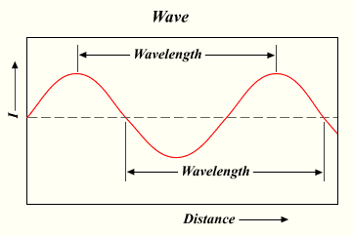
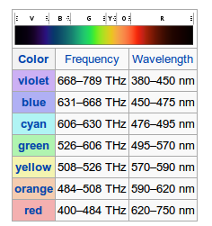
Light
Light has wave-like properties
Colors correspond to different wavelengths of light

Slide 13
The eye
Eyes are very complex, but respond to light waves
Rods cannot distinguish color, but allow you to see at night
Cones respond to different wavelengths of light

Slide 14

Different cones respond to...
Red Light
Green Light
Blue Light

Slide 15
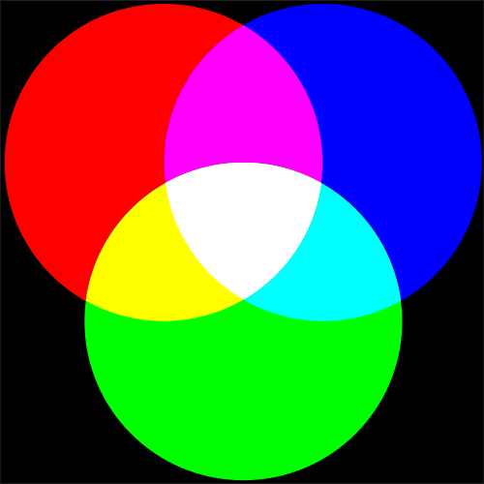
RGB
The RGB color model is commonly used to represent colors digitally
Mixing different quantities of Red, Green and Blue light allows you to produce any visible colors

Slide 16
Digitization
Resolution (number of samples) -- number of rows of pixels by the number of columns of pixels
Color Depth (number of bits per quantization level) -- number of bits stored per pixel (8 bit, 16 bit, 32 bit)

Slide 17

Resolution
244
244
244
243
242
242
243
242
0
0
0
230
Resolution: 6 x 4
230
242
0
255
0
230
230
230
0
0
0
242

Slide 18
Color-Depth
RGB colors are stored as a bit-strings
Each bit-string has 1 byte each for red, green and blue
So, usually, the color-depth on a computer is 24 bits.
There are 256 possible bit-strings associated with a byte, so R,G, and B each have 256 different possible values
0
0
1
1
0
0
1
0
0
0
0
0
0
0
1
0
0
1
0
0
1
1
0
1

Slide 19
Bitmap Graphics
Bitmap graphics (or raster graphics), are data structures representing a generally rectangular grid of pixels, or points of color, viewable via a monitor, paper, or other display medium. Bitmap images are stored in image files with varying formats.
source: Wikipedia

Slide 20
Exercises
1. How many pixels are stored in a bitmap image with a resolution of 200x300, 500x500, 1024x768, 800x600, 5000x10000?
2. For each of the images above, calculate the file size for each of the following color-depths: 8, 16, 24, 32, 64.
3. A bitmapped image has a file size of 2.25 MB. If it has a resolution of 1024x768, what is the color depth?

