Slide 1
Chapter 8
Digital Design and Computer Architecture, 2nd Edition
David Money Harris and Sarah L. Harris
Edited by J Dean Brock
For CSCI 320

Slide 2
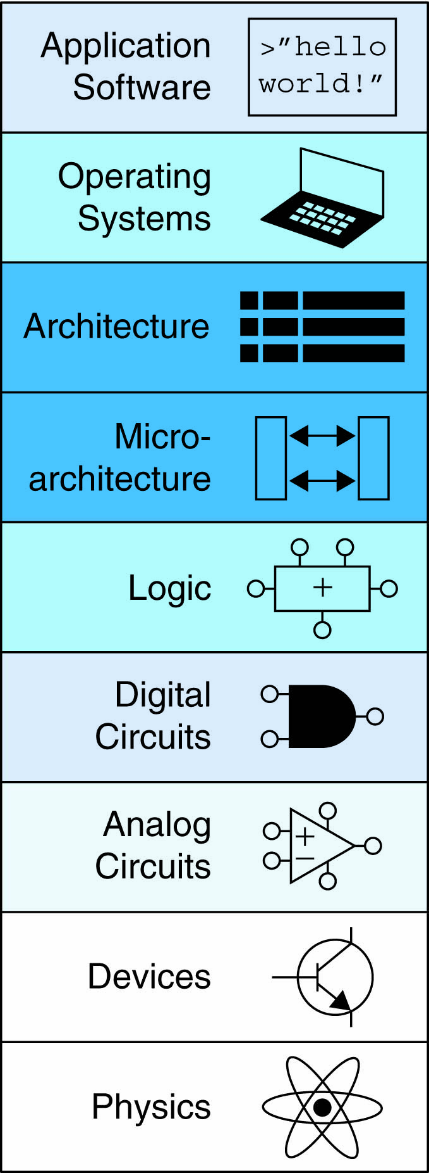
Chapter 8 :: Topics
Introduction
Memory System Performance Analysis
Caches
Virtual Memory
Memory-Mapped I/O
Summary

Slide 3
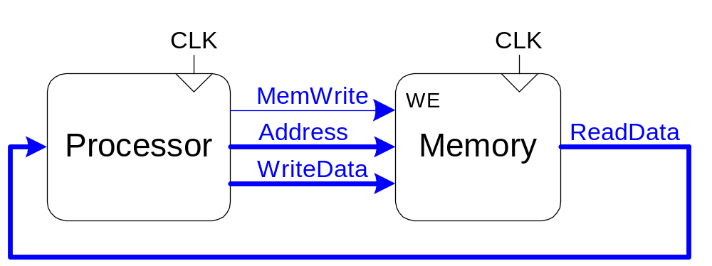
Introduction
Computer performance depends on:
  Processor performance
  Memory system performance
Memory Interface

Slide 4
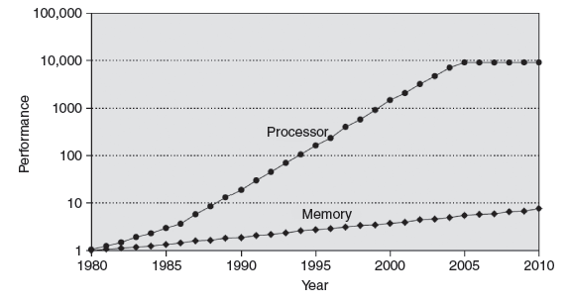
Processor-Memory Gap
In prior chapters, assumed access memory in 1 clock cycle – but hasn’t been true since the 1980’s

Slide 5
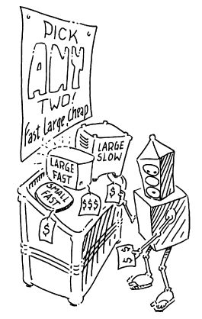
Memory System Challenge
Make memory system appear as fast as processor
Use hierarchy of memories
Ideal memory:
  Fast
  Cheap (inexpensive)
  Large (capacity)
But can only choose two!

Slide 6
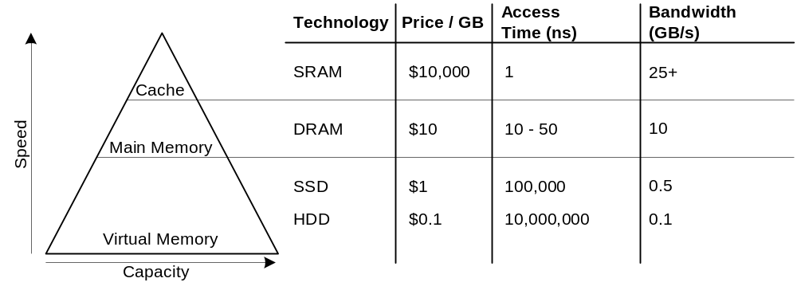
Memory Hierarchy

Slide 7
Locality
Exploit locality to make memory accesses fast
Temporal Locality:
  Locality in time
  If data used recently, likely to use it again soon
  How to exploit: keep recently accessed data in higher levels of memory hierarchy
Spatial Locality:
  Locality in space
  If data used recently, likely to use nearby data soon
  How to exploit: when access data, bring nearby data into higher levels of memory hierarchy too

Slide 8
Memory Performance
Hit: data found in that level of memory hierarchy
Miss: data not found (must go to next level)
Hit Rate = # hits / # memory accesses
= 1 – Miss Rate
Miss Rate = # misses / # memory accesses
= 1 – Hit Rate
Average memory access time (AMAT): average time for processor to access data
AMAT = t_{cache} + MR_{cache}[t_{MM} + MR_{MM}(t_{VM})]

Slide 9
Memory Performance Example 1
A program has 2,000 loads and stores
1,250 of these data values in cache
Rest supplied by other levels of memory hierarchy
What are the hit and miss rates for the cache?

Slide 10
Memory Performance Example 1
A program has 2,000 loads and stores
1,250 of these data values in cache
Rest supplied by other levels of memory hierarchy
What are the hit and miss rates for the cache?
Hit Rate = 1250/2000 = 0.625
Miss Rate = 750/2000 = 0.375 = 1 – Hit Rate

Slide 11
Memory Performance Example 2
Suppose processor has 2 levels of hierarchy: cache and main memory
t_{cache} = 1 cycle, t_{MM} = 100 cycles
What is the AMAT of the program from Example 1?

Slide 12
Memory Performance Example 2
Suppose processor has 2 levels of hierarchy: cache and main memory
t_{cache} = 1 cycle, t_{MM} = 100 cycles
What is the AMAT of the program from Example 1?
AMAT = t_{cache} + MR_{cache}(t_{MM})
= [1 + 0.375(100)] cycles
= 38.5 cycles

Slide 13
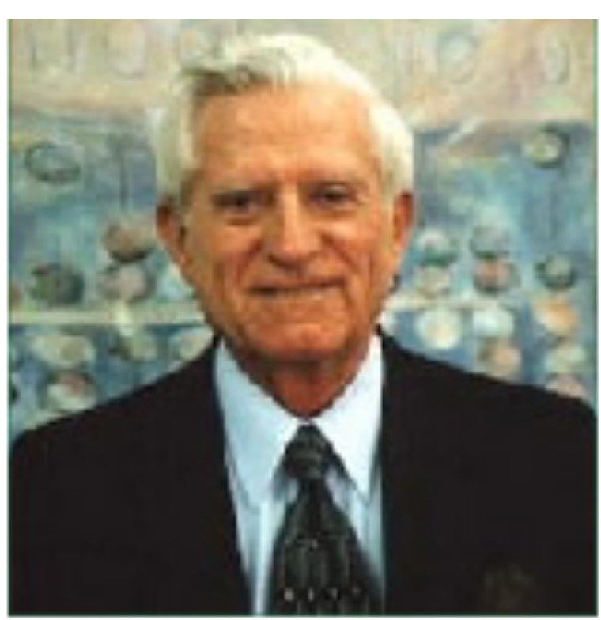
Gene Amdahl, 1922-
Amdahl’s Law: the effort spent increasing the performance of a subsystem is wasted unless the subsystem affects a large percentage of overall performance
Co-founded 3 companies, including one called Amdahl Corporation in 1970

Slide 14
Cache
Highest level in memory hierarchy
Fast (typically ~ 1 cycle access time)
Ideally supplies most data to processor
Usually holds most recently accessed data

Slide 15
Cache Design Questions
What data is held in the cache?
How is data found?
What data is replaced?
Focus on data loads, but stores follow same principles

Slide 16
What data is held in the cache?
Ideally, cache anticipates needed data and puts it in cache
But impossible to predict future
Use past to predict future – temporal and spatial locality:
  Temporal locality: copy newly accessed data into cache
  Spatial locality: copy neighboring data into cache too

Slide 17
Cache Terminology
Capacity (C):
  number of data bytes in cache
Block size (b):
  bytes of data brought into cache at once
Number of blocks (B = C/b):
  number of blocks in cache: B = C/b
Degree of associativity (N):
  number of blocks in a set
Number of sets (S = B/N):
  each memory address maps to exactly one cache set

Slide 18
How is data found?
Cache organized into S sets
Each memory address maps to exactly one set
Caches categorized by # of blocks in a set:
  Direct mapped: 1 block per set
  N-way set associative: N blocks per set
  Fully associative: all cache blocks in 1 set
Examine each organization for a cache with:
  Capacity (C = 8 words)
  Block size (b = 1 word)
  So, number of blocks (B = 8)

Slide 19
Example Cache Parameters
C = 8 words (capacity)
b = 1 word (block size)
So, B = 8 (# of blocks)
Ridiculously small, but will illustrate organizations

Slide 20
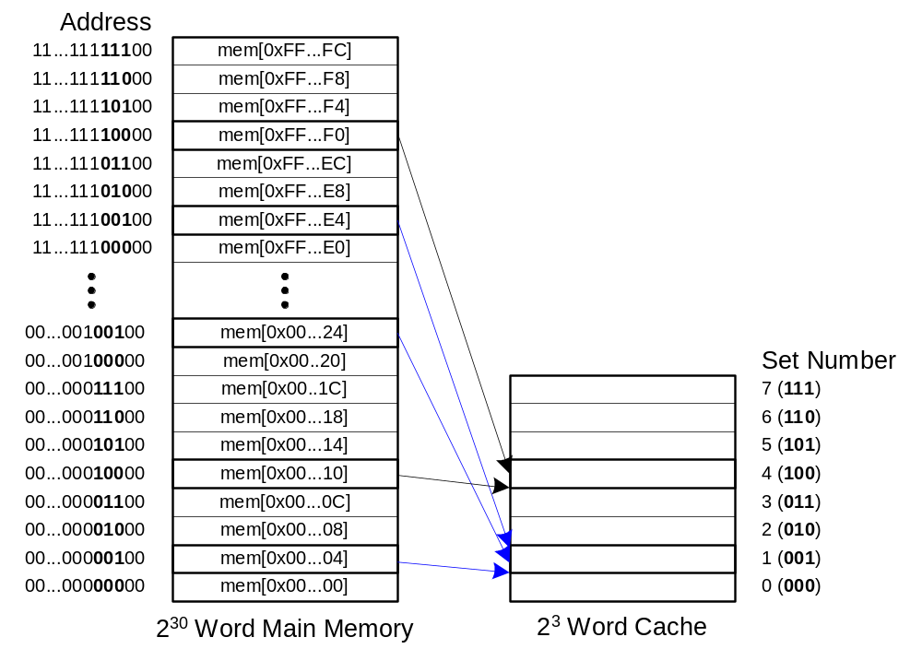
Direct Mapped Cache

Slide 21
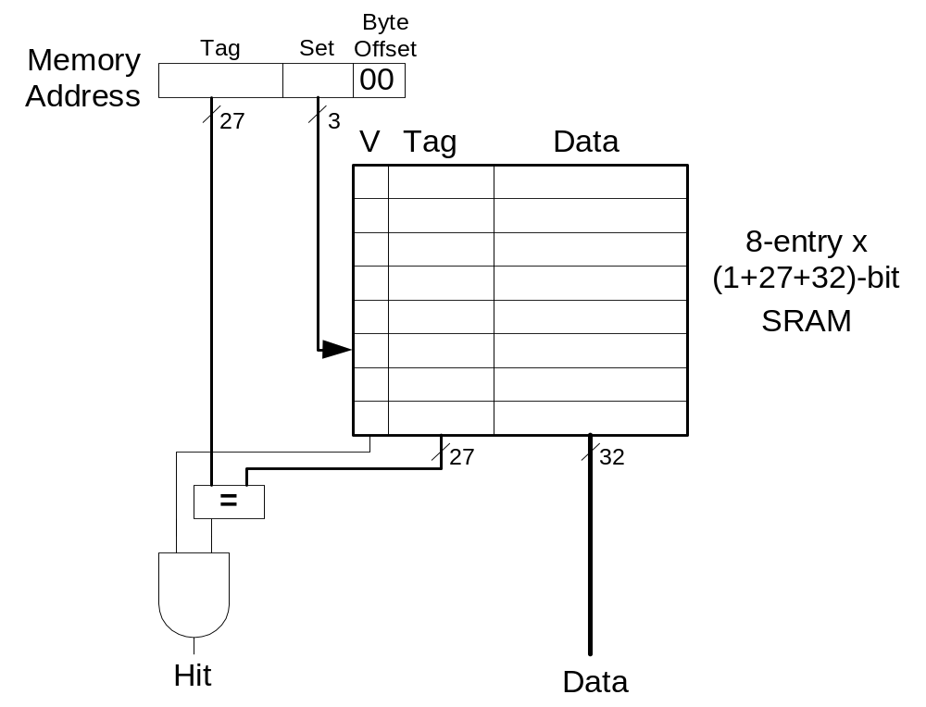
Direct Mapped Cache Hardware

Slide 22
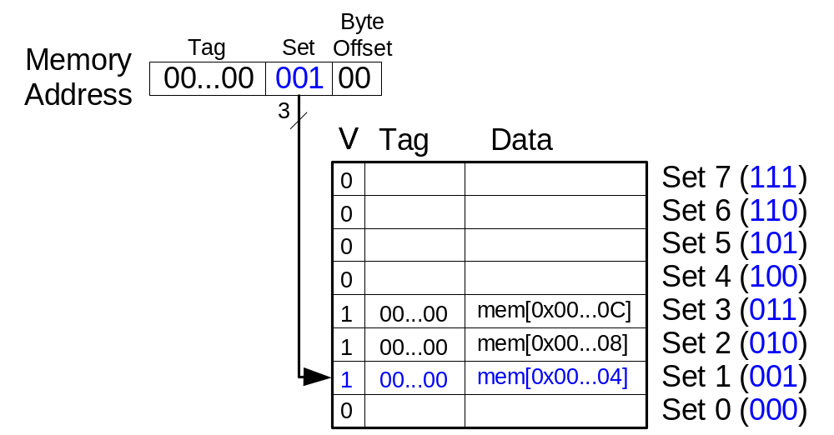
Direct Mapped Cache Performance
# MIPS assembly code
addi $t0, $0, 5
loop: beq $t0, $0, done
lw $t1, 0x4($0)
lw $t2, 0xC($0)
lw $t3, 0x8($0)
addi $t0, $t0, -1
j loop
done:
Miss Rate = ?

Slide 23
Direct Mapped Cache Performance
# MIPS assembly code
addi $t0, $0, 5
loop: beq $t0, $0, done
lw $t1, 0x4($0)
lw $t2, 0xC($0)
lw $t3, 0x8($0)
addi $t0, $t0, -1
j loop
done:
Miss Rate = 3/15
= 20%
Temporal Locality
Compulsory Misses

Slide 24
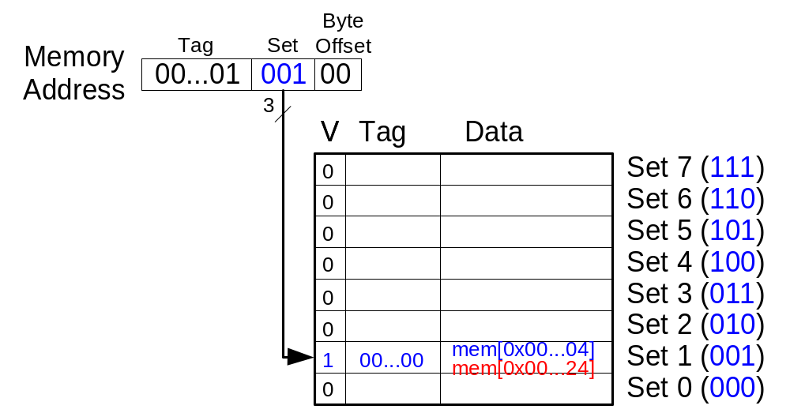
Direct Mapped Cache: Conflict
# MIPS assembly code
addi $t0, $0, 5
loop: beq $t0, $0, done
lw $t1, 0x4($0)
lw $t2, 0x24($0)
addi $t0, $t0, -1
j loop
done:
Miss Rate = ?

Slide 25
Direct Mapped Cache: Conflict
# MIPS assembly code
addi $t0, $0, 5
loop: beq $t0, $0, done
lw $t1, 0x4($0)
lw $t2, 0x24($0)
addi $t0, $t0, -1
j loop
done:
Miss Rate = 10/10
= 100%
Conflict Misses

Slide 26
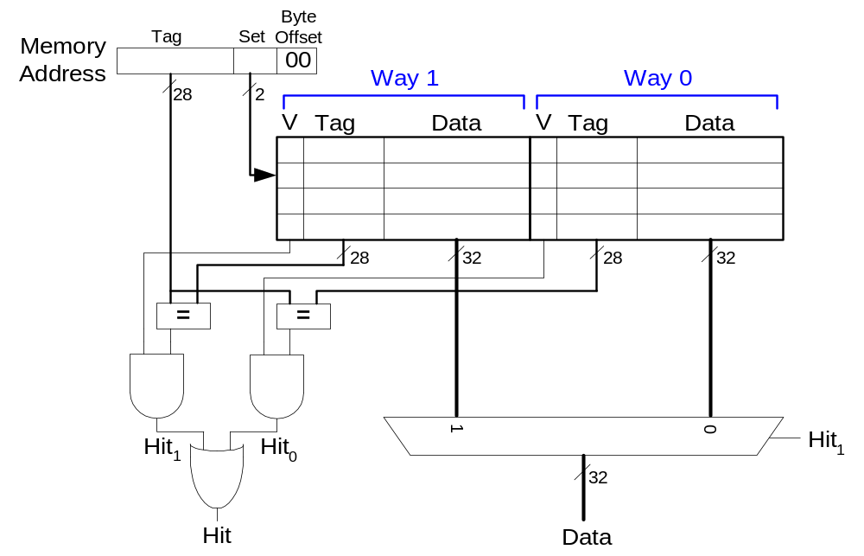
N-Way Set Associative Cache

Slide 27
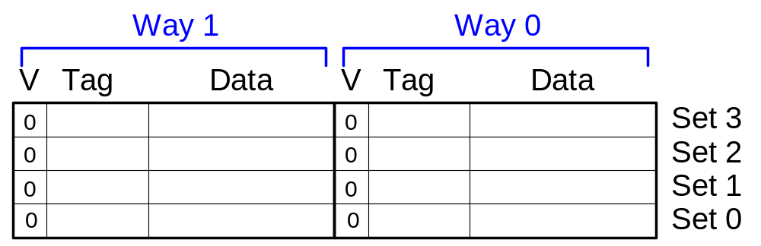
N-Way Set Associative Performance
# MIPS assembly code
addi $t0, $0, 5
loop: beq $t0, $0, done
lw $t1, 0x4($0)
lw $t2, 0x24($0)
addi $t0, $t0, -1
j loop
done:
Miss Rate = ?

Slide 28
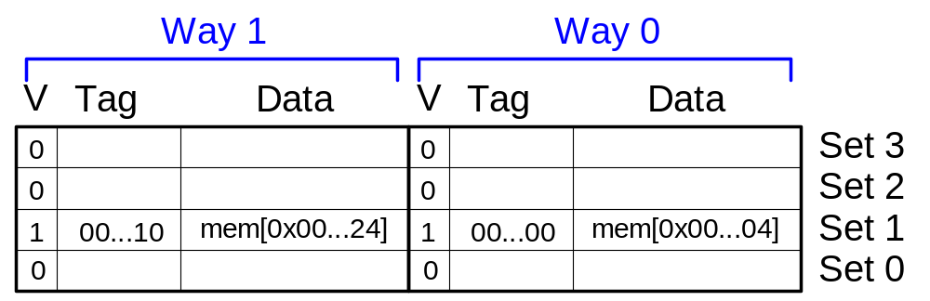
N-Way Set Associative Performance
# MIPS assembly code
addi $t0, $0, 5
loop: beq $t0, $0, done
lw $t1, 0x4($0)
lw $t2, 0x24($0)
addi $t0, $t0, -1
j loop
done:
Miss Rate = 2/10
= 20%
Associativity reduces
conflict misses

Slide 29
Fully Associative Cache
Reduces conflict misses
Expensive to build

Slide 30
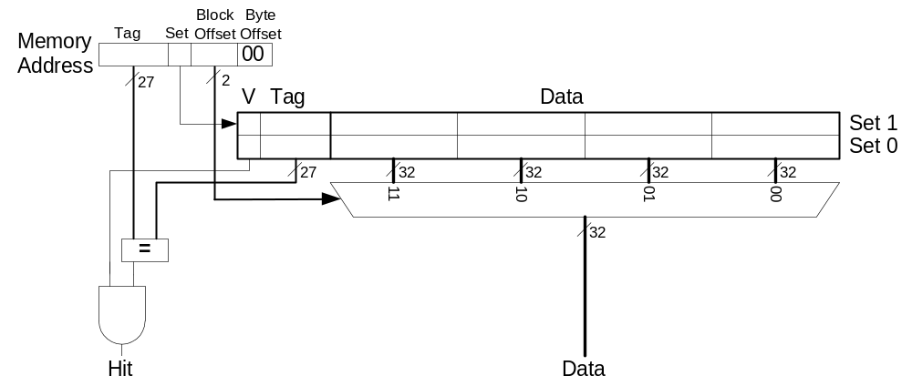
Spatial Locality?
Increase block size:
  Block size, b = 4 words
  C = 8 words
  Direct mapped (1 block per set)
  Number of blocks, B = 2 (C/b = 8/4 = 2)

Slide 31
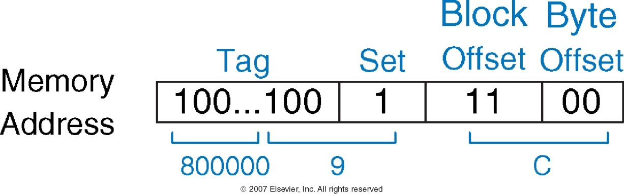
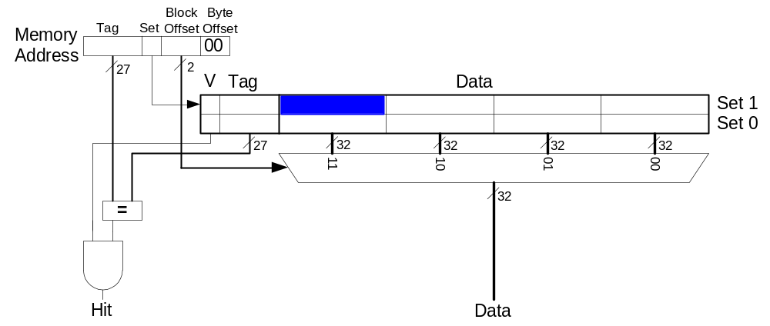
Cache with Larger Block Size

Slide 32
Direct Mapped Cache Performance
addi $t0, $0, 5
loop: beq $t0, $0, done
lw $t1, 0x4($0)
lw $t2, 0xC($0)
lw $t3, 0x8($0)
addi $t0, $t0, -1
j loop
done:
Miss Rate = ?

Slide 33
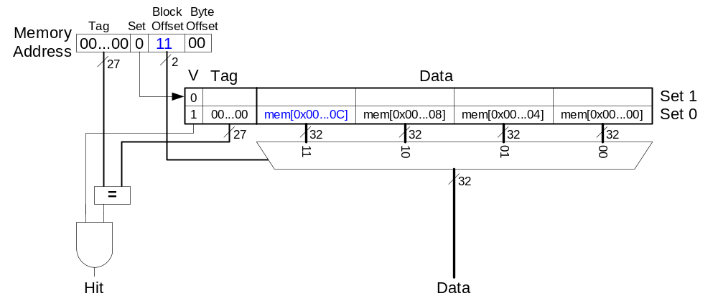
Direct Mapped Cache Performance
addi $t0, $0, 5
loop: beq $t0, $0, done
lw $t1, 0x4($0)
lw $t2, 0xC($0)
lw $t3, 0x8($0)
addi $t0, $t0, -1
j loop
done:
Miss Rate = 1/15
= 6.67%
Larger blocks
reduce compulsory misses
through spatial locality

Slide 34
Cache Organization Recap
Capacity: C
Block size: b
Number of blocks in cache: B = C/b
Number of blocks in a set: N
Number of sets: S = B/N
Organization | Number of Ways (N) | Number of Sets (S = B/N)
Direct Mapped | 1 | B
N-Way Set Associative | 1 < N < B | B / N
Fully Associative | B | 1

Slide 35
Capacity Misses
Cache is too small to hold all data of interest at once
If cache full: program accesses data X & evicts data Y
Capacity miss when access Y again
How to choose Y to minimize chance of needing it again?
Least recently used (LRU) replacement: the least recently used block in a set evicted

Slide 36
Types of Misses
Compulsory: first time data accessed
Capacity: cache too small to hold all data of interest
Conflict: data of interest maps to same location in cache
Miss penalty: time it takes to retrieve a block from lower level of hierarchy

Slide 37
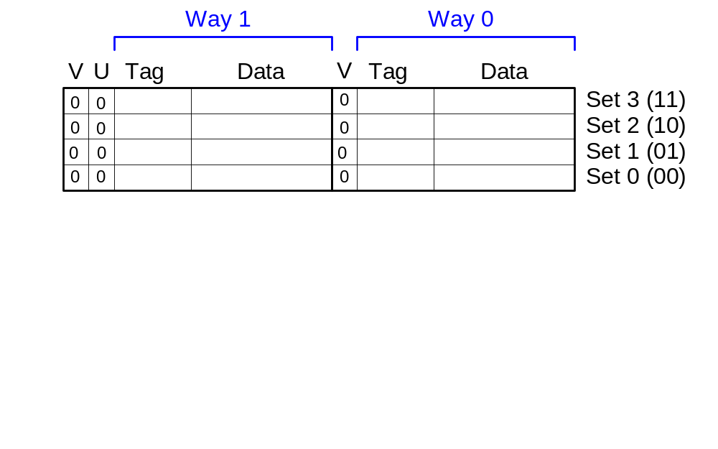
LRU Replacement
# MIPS assembly
lw $t0, 0x04($0)
lw $t1, 0x24($0)
lw $t2, 0x54($0)

Slide 38
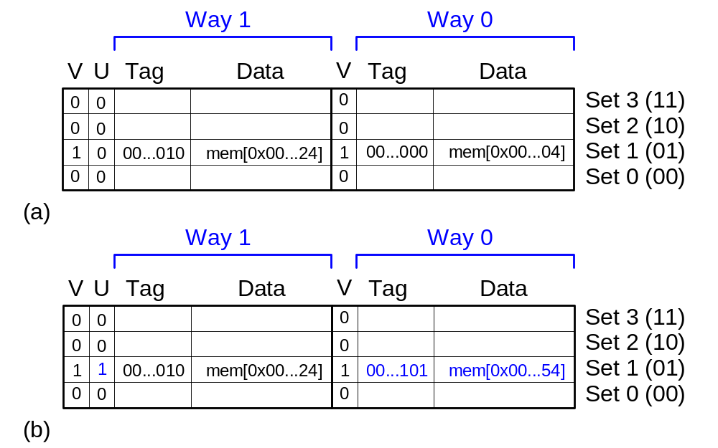
LRU Replacement
# MIPS assembly
lw $t0, 0x04($0)
lw $t1, 0x24($0)
lw $t2, 0x54($0)

Slide 39
Cache Summary
What data is held in the cache?
  Recently used data (temporal locality)
  Nearby data (spatial locality)
How is data found?
  Set is determined by address of data
  Word within block also determined by address
  In associative caches, data could be in one of several ways
What data is replaced?
  Least-recently used way in the set

Slide 40
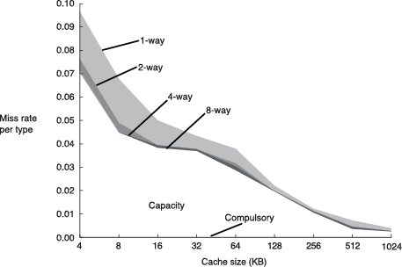
Miss Rate Trends
Bigger caches reduce capacity misses
Greater associativity reduces conflict misses
Adapted from Patterson & Hennessy, Computer Architecture: A Quantitative Approach, 2011

Slide 41
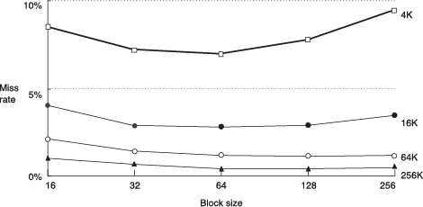
Miss Rate Trends
Bigger blocks reduce compulsory misses
Bigger blocks increase conflict misses

Slide 42
Multilevel Caches
Larger caches have lower miss rates, longer access times
Expand memory hierarchy to multiple levels of caches
Level 1: small and fast (e.g. 16 KB, 1 cycle)
Level 2: larger and slower (e.g. 256 KB, 2-6 cycles)
Most modern PCs have L1, L2, and L3 cache

Slide 43
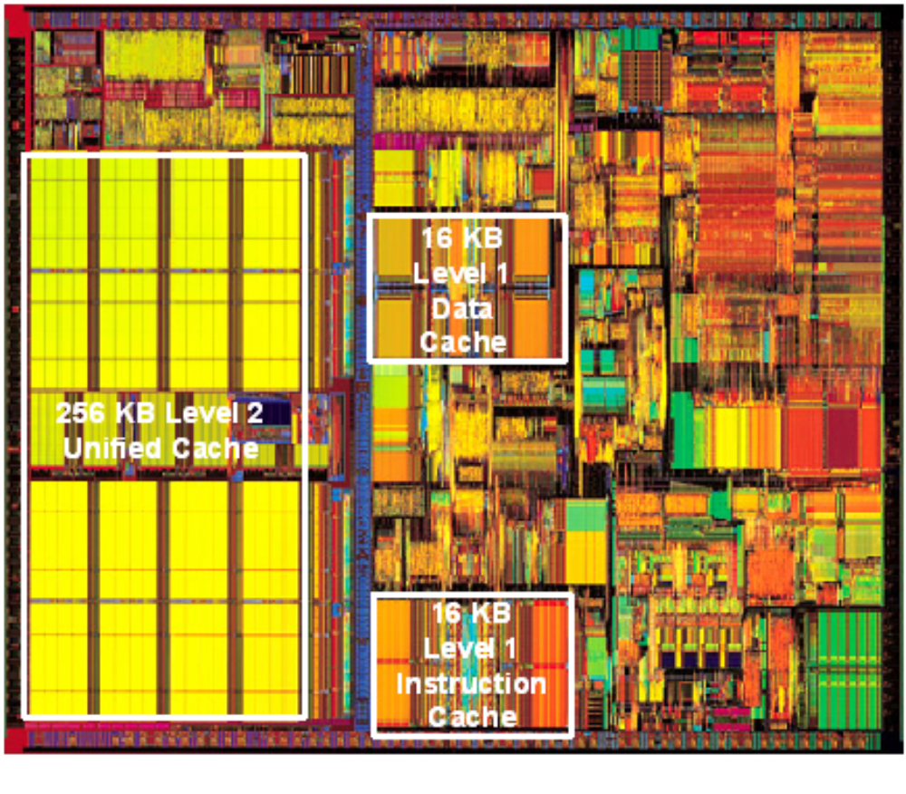
Intel Pentium III Die

Slide 44
Wikipedia summary of I7 cache structure
Intel product brief
Nehalem cache organization
Snoopy caches or bus sniffing

Slide 45
Virtual Memory
Gives the illusion of bigger memory
Main memory (DRAM) acts as cache for hard disk

Slide 46
Memory Hierarchy
Physical Memory: DRAM (Main Memory)
Virtual Memory: Hard drive
  Slow, Large, Cheap

Slide 47
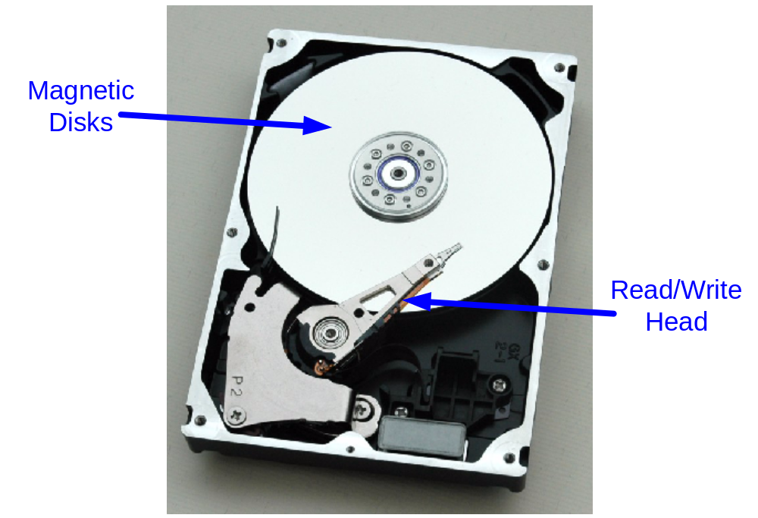
Hard Disk
Takes milliseconds to seek correct location on disk

Slide 48
Virtual Memory
Virtual addresses
  Programs use virtual addresses
  Entire virtual address space stored on a hard drive
  Subset of virtual address data in DRAM
  CPU translates virtual addresses into physical addresses (DRAM addresses)
  Data not in DRAM fetched from hard drive
Memory Protection
  Each program has own virtual to physical mapping
  Two programs can use same virtual address for different data
  Programs don’t need to be aware others are running
  One program (or virus) can’t corrupt memory used by another

Slide 49
Cache/Virtual Memory Analogues
Cache | Virtual Memory
Block | Page
Block Size | Page Size
Block Offset | Page Offset
Miss | Page Fault
Tag | Virtual Page Number
Physical memory acts as cache for virtual memory

Slide 50
Virtual Memory Definitions
Page size: amount of memory transferred from hard disk to DRAM at once
Address translation: determining physical address from virtual address
Page table: lookup table used to translate virtual addresses to physical addresses

Slide 51
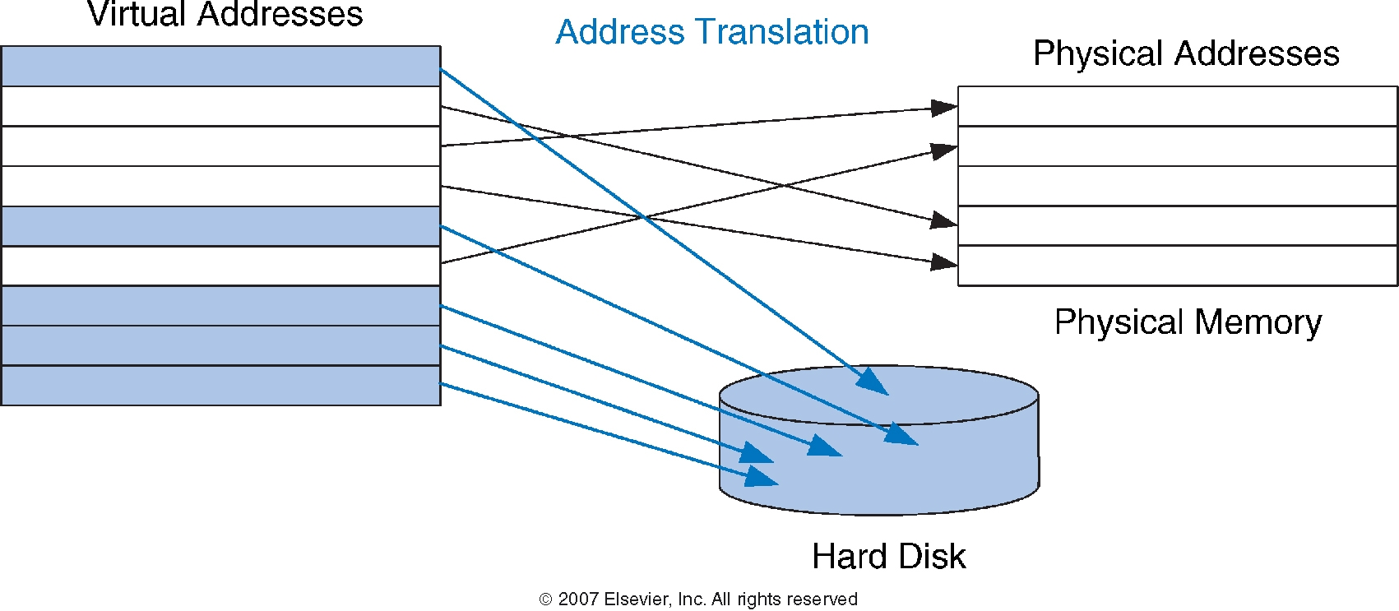
Virtual & Physical Addresses
Most accesses hit in physical memory
But programs have the large capacity of virtual memory

Slide 52
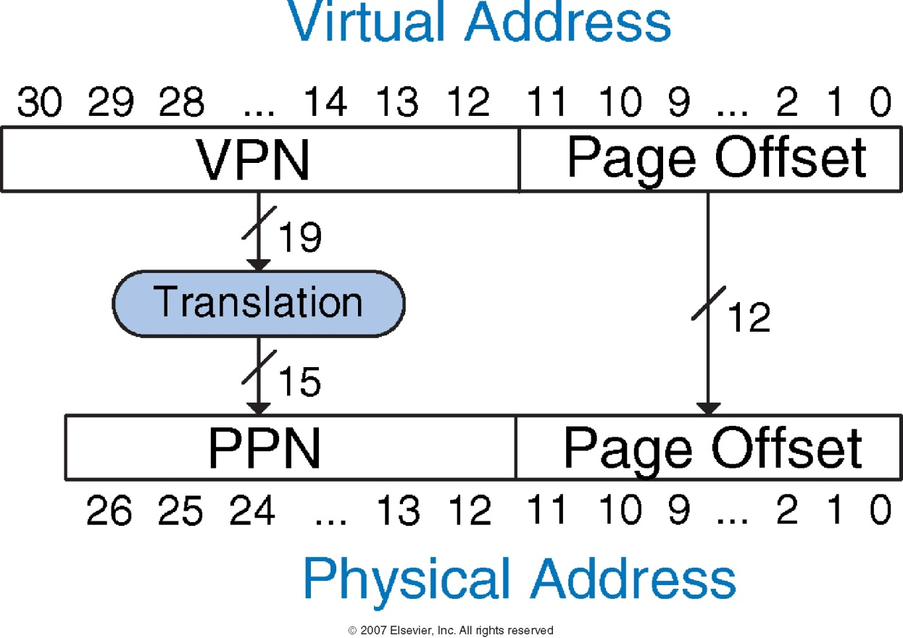
Address Translation

Slide 53
top - 13:22:57 up 29 days, 21:02, 2 users, load average: 0.19, 0.12, 0.09
Tasks: 208 total, 1 running, 203 sleeping, 4 stopped, 0 zombie
Cpu(s): 0.0%us, 0.0%sy, 0.0%ni,100.0%id, 0.0%wa, 0.0%hi, 0.0%si, 0.0%st
Mem: 7893048k total, 7703588k used, 189460k free, 5445560k buffers
Swap: 16779884k total, 0k used, 16779884k free, 464928k cached
Processes: 74 total, 3 running, 71 sleeping, 506 threads 11:44:31
Load Avg: 0.26, 0.56, 0.62 CPU usage: 11.98% user, 12.39% sys, 75.61% idle
SharedLibs: 54M resident, 3764K data, 4100K linkedit.
MemRegions: 20374 total, 852M resident, 24M private, 476M shared.
PhysMem: 261M wired, 1252M active, 424M inactive, 1937M used, 110M free.
VM: 62G vsize, 460M framework vsize, 13690274(0) pageins, 1497102(0) pageouts.
Networks: packets: 5471393/1693M in, 3796797/660M out.
Disks: 5041407/95G read, 4110202/190G written.
PID COMMAND %CPU TIME #TH #WQ #POR #MREG RPRVT RSHRD RSIZE
96782 Google Chrom 0.0 00:15.72 10 1 106 325 2592K 62M 27M
96772 bash 0.0 00:00.02 1 0 17 27 256K 244K 868K
96771 login 0.0 00:00.43 1 0 20 55 176K 244K 672K
96769 Terminal 2.7 01:14.52 5 1 117 137+ 10M+ 23M+ 19M+
96768 Google Chrom 2.4 63:37.23 25 1 173 2642 16M 54M 47M
96765 Google Chrom 0.0 09:19.45 10 1 108 361 15M 63M 41M
95703 Microsoft Po 0.6 22:24.58 16/1 2 304 1739 123M 74M 184M
93014 mdworker 0.0 28:44.44 3 1 55 158 3940K 4896K 15M
92862 Google Chrom 0.0 05:14.82 5 1 104 311 21M 90M 38M
92859 Google Chrom 4.9 76:16.16 50 1 393 635 62M 116M 112M
90259 PrinterProxy 0.0 00:06.98 2 1 99 126 4236K 12M 8648K
90252 TextEdit 0.0 00:06.22 2 1 99 102 1248K 11M 8012K
87961 soffice 0.0 12:58.55 5 1 156 885 32M 20M 93M
75572 DirectorySer 0.0 02:20.44 5 3 74- 84- 1648K- 244K 329

Slide 54
Virtual Memory Example
System:
  Virtual memory size: 2 GB = 2³¹ bytes
  Physical memory size: 128 MB = 2²⁷ bytes
  Page size: 4 KB = 2¹² bytes

Slide 55
Virtual Memory Example
System:
  Virtual memory size: 2 GB = 2³¹ bytes
  Physical memory size: 128 MB = 2²⁷ bytes
  Page size: 4 KB = 2¹² bytes
Organization:
  Virtual address: 31 bits
  Physical address: 27 bits
  Page offset: 12 bits
  # Virtual pages = 2³¹/2¹² = 2¹⁹ (VPN = 19 bits)
  # Physical pages = 2²⁷/2¹² = 2¹⁵ (PPN = 15 bits)
Sometimes the physical addresses are longer

Slide 56
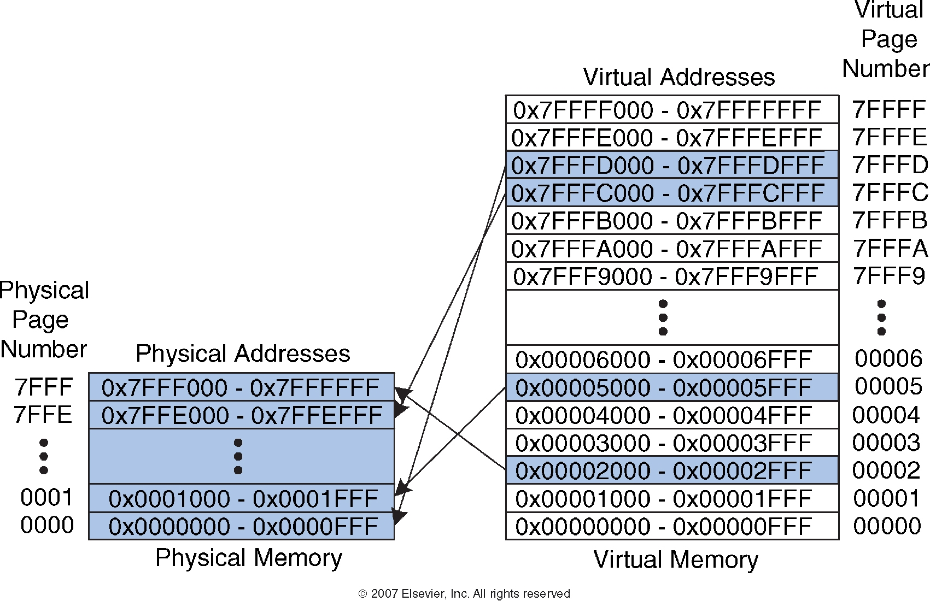
Virtual Memory Example
19-bit virtual page numbers
15-bit physical page numbers

Slide 57
Virtual Memory Example
What is the physical address of virtual address 0x247C?

Slide 58
Virtual Memory Example
What is the physical address of virtual address 0x247C?
  VPN = 0x2
  VPN 0x2 maps to PPN 0x7FFF
  12-bit page offset: 0x47C
  Physical address = 0x7FFF47C

Slide 59
How to perform translation?
Page table
  Entry for each virtual page
  Entry fields:
    Valid bit: 1 if page in physical memory
    Physical page number: where the page is located

Slide 60
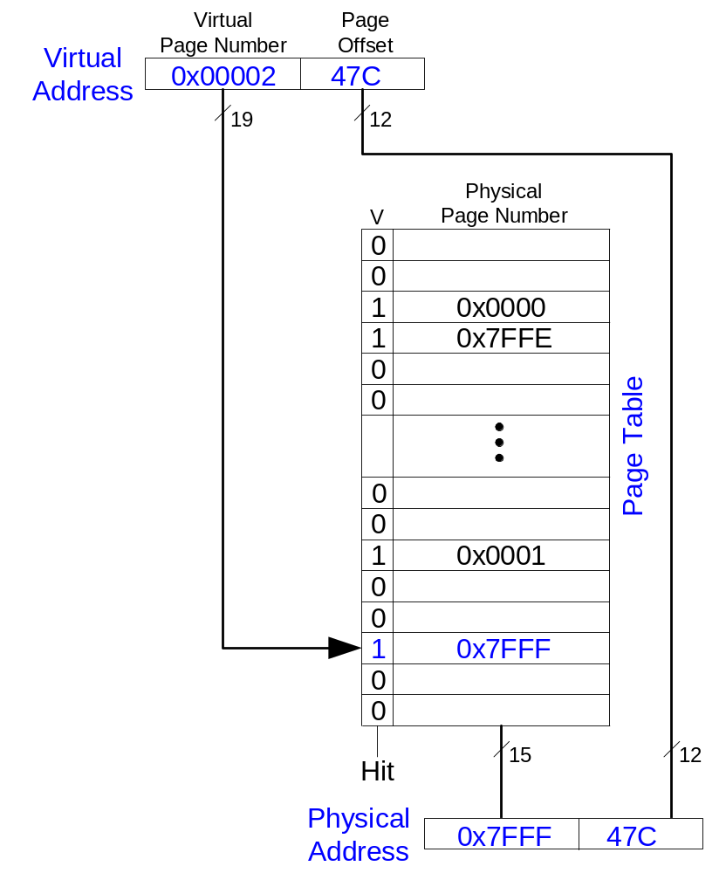
Page Table Example
VPN is index into page table

Slide 61
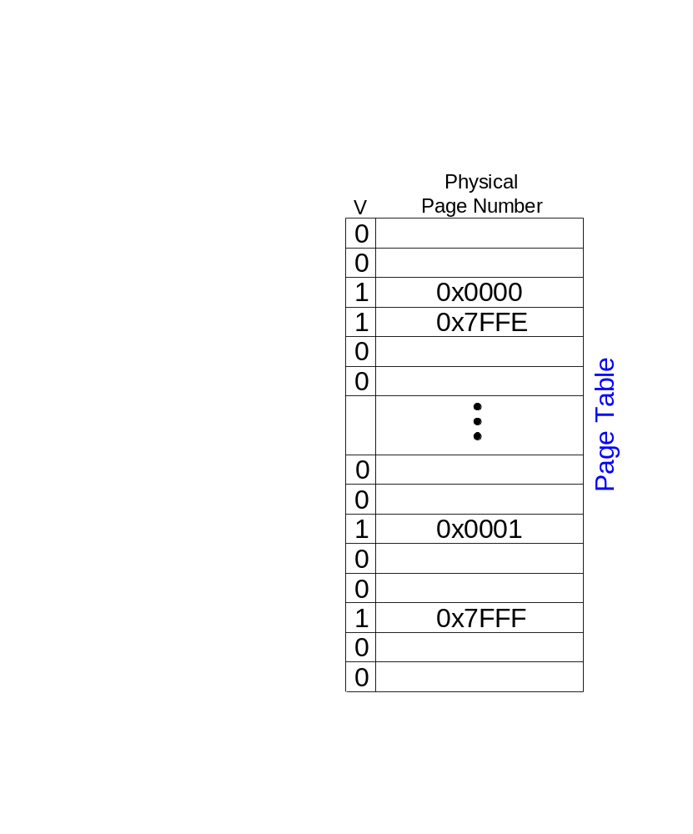
Page Table Example 1
What is the physical address of virtual address 0x5F20?

Slide 62
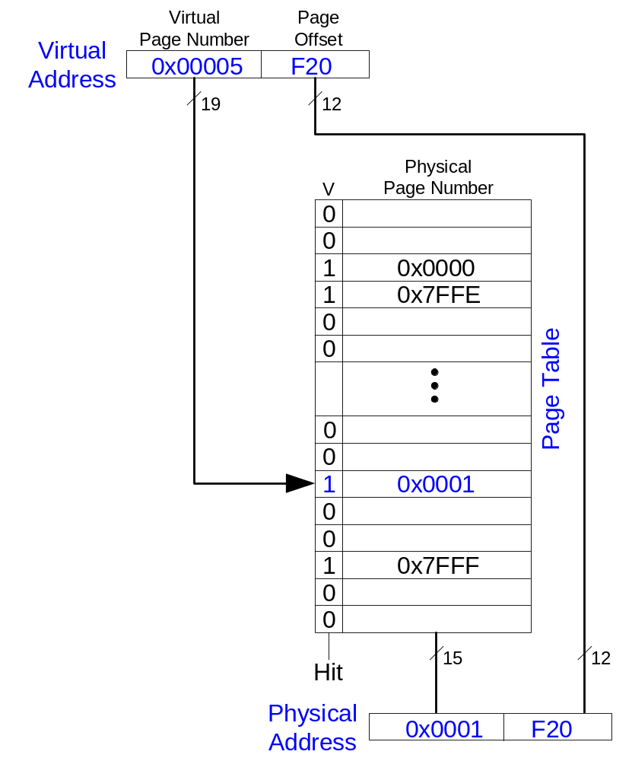
Page Table Example 1
What is the physical address of virtual address 0x5F20?
  VPN = 5
  Entry 5 in page table VPN 5 => physical page 1
  Physical address: 0x1F20

Slide 63
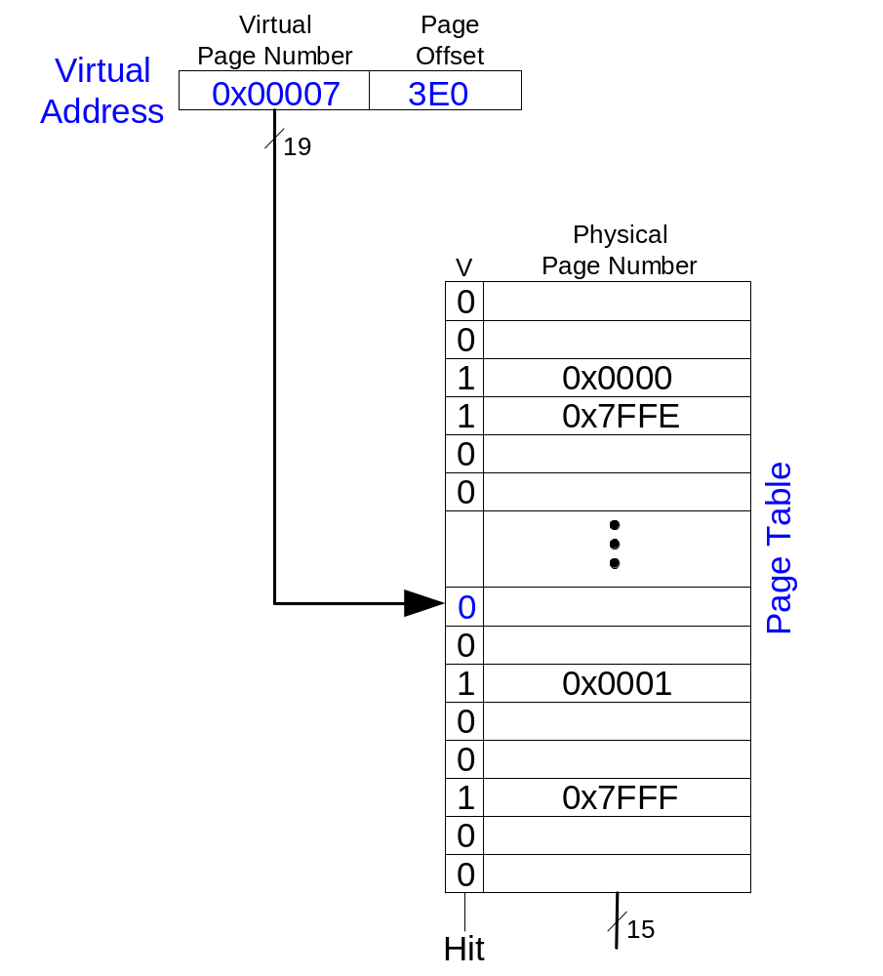
Page Table Example 2
What is the physical address of virtual address 0x73E0?

Slide 64
Page Table Example 2
What is the physical address of virtual address 0x73E0?
  VPN = 7
  Entry 7 is invalid
  Virtual page must be paged into physical memory from disk

Slide 65
Page Table Challenges
Page table is large
  usually located in physical memory
Load/store requires 2 main memory accesses:
  one for translation (page table read)
  one to access data (after translation)
Cuts memory performance in half
  Unless we get clever…

Slide 66
Translation Lookaside Buffer (TLB)
Small cache of most recent translations
Reduces # of memory accesses for most loads/stores from 2 to 1

Slide 67
TLB
Page table accesses: high temporal locality
  Large page size, so consecutive loads/stores likely to access same page
TLB
  Small: accessed in < 1 cycle
  Typically 16 - 512 entries
  Fully associative
  > 99 % hit rates typical
  Reduces # of memory accesses for most loads/stores from 2 to 1

Slide 68
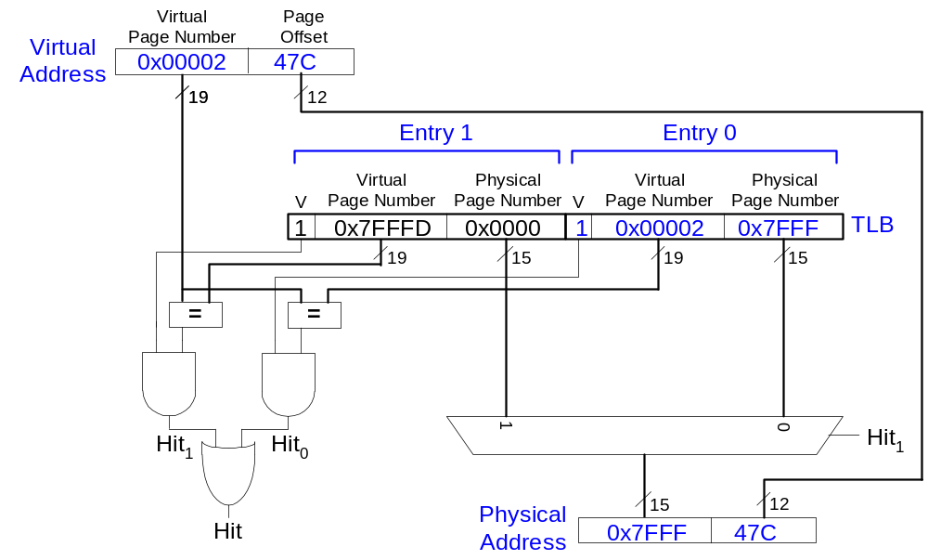
Example 2-Entry TLB

Slide 69
Memory Protection
Multiple processes (programs) run at once
Each process has its own page table
Each process can use entire virtual address space
A process can only access physical pages mapped in its own page table

Slide 70
Virtual Memory Summary
Virtual memory increases capacity
A subset of virtual pages in physical memory
Page table maps virtual pages to physical pages – address translation
A TLB speeds up address translation
Different page tables for different programs provides memory protection

Slide 71
Memory-Mapped I/O
Processor accesses I/O devices just like memory (like keyboards, monitors, printers)
Each I/O device assigned one or more address
When that address is detected, data read/written to I/O device instead of memory
A portion of the address space dedicated to I/O devices

Slide 72
Memory-Mapped I/O Hardware
Address Decoder:
  Looks at address to determine which device/memory communicates with the processor
I/O Registers:
  Hold values written to the I/O devices
ReadData Multiplexer:
  Selects between memory and I/O devices as source of data sent to the processor

Slide 73
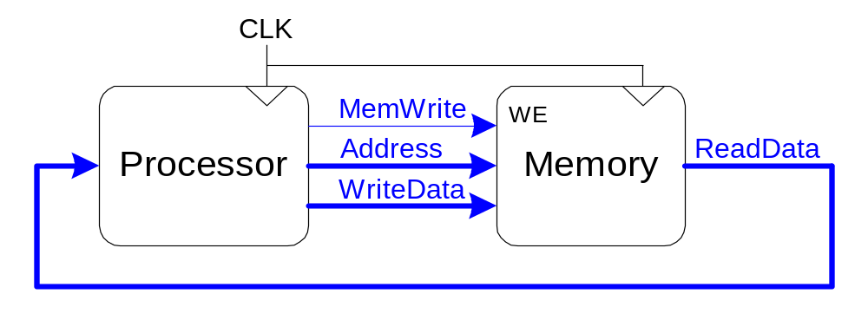
The Memory Interface

Slide 74
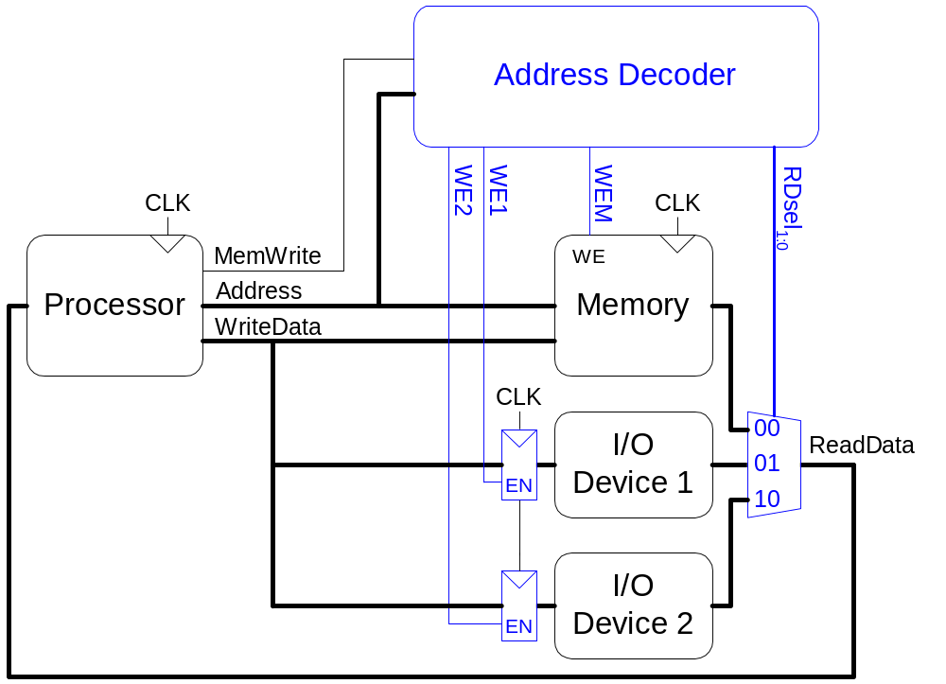
Memory-Mapped I/O Hardware

Slide 75
Memory-Mapped I/O Code
Suppose I/O Device 1 is assigned the address 0xFFFFFFF4
  Write the value 42 to I/O Device 1
  Read value from I/O Device 1 and place in $t3

Slide 76
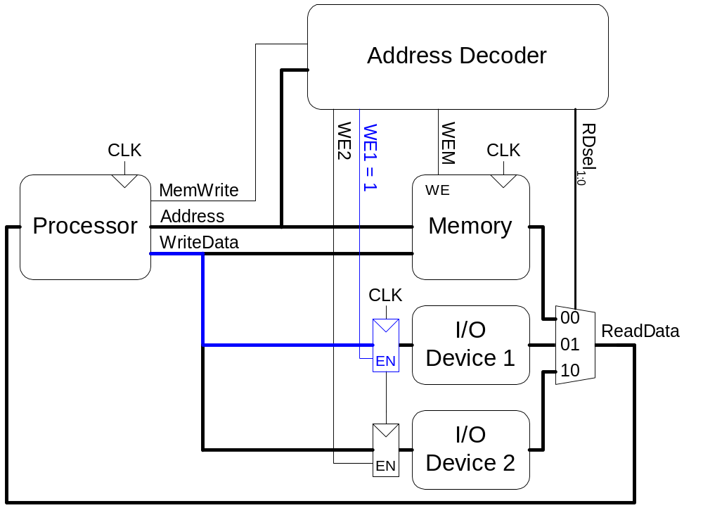
Memory-Mapped I/O Code
Write the value 42 to I/O Device 1 (0xFFFFFFF4)
  addi $t0, $0, 42
  sw $t0, 0xFFF4($0)

Slide 77
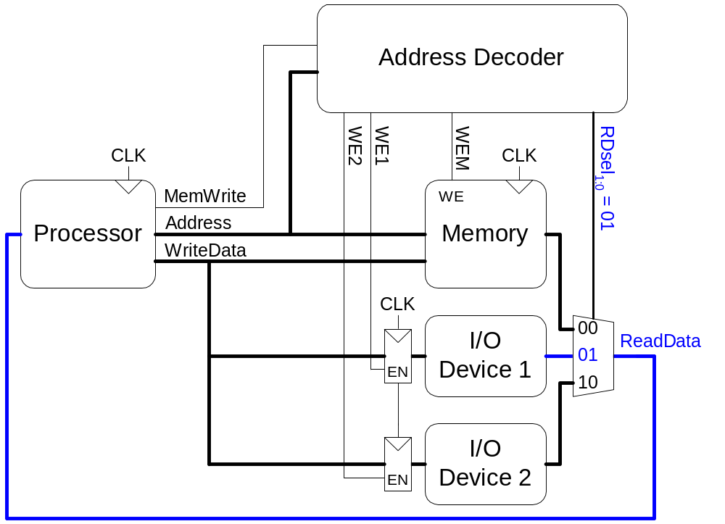
Memory-Mapped I/O Code
Read the value from I/O Device 1 and place in $t3
  lw $t3, 0xFFF4($0)

Slide 78
Input/Output (I/O) Systems
Embedded I/O Systems
  Toasters, LEDs, etc.
PC I/O Systems

Slide 79
Embedded I/O Systems
Example microcontroller: PIC32
  microcontroller
  32-bit MIPS processor
  low-level peripherals include:
    serial ports
    timers
    A/D converters

Slide 80
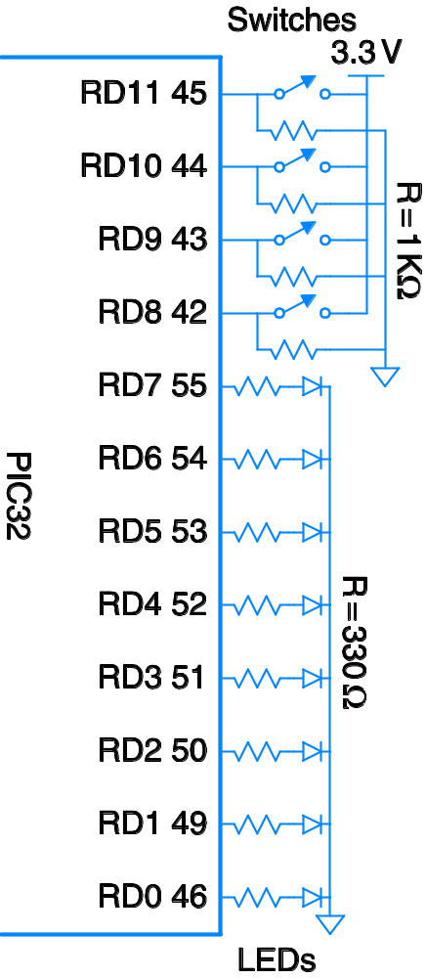
Digital I/O
// C Code
#include <p3xxxx.h>
int main(void) {
int switches;
TRISD = 0xFF00; // RD[7:0] outputs
// RD[11:8] inputs
while (1) {
// read & mask switches, RD[11:8]
switches = (PORTD >> 8) & 0xF;
PORTD = switches; // display on LEDs
}
}
This should look familiar

Slide 81
Serial I/O
Example serial protocols
  SPI: Serial Peripheral Interface
  UART: Universal Asynchronous Receiver/Transmitter
  Also: I²C, USB, Ethernet, etc.

Slide 82
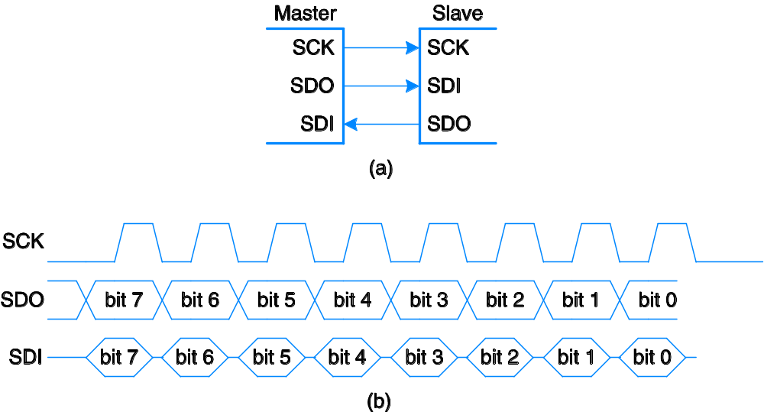
SPI: Serial Peripheral Interface
Master initiates communication to slave by sending pulses on SCK
Master sends SDO (Serial Data Out) to slave, msb first
Slave may send data (SDI) to master, msb first
Compare to I²C

Slide 83
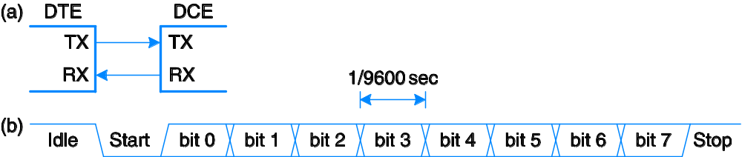
UART: Universal Asynchronous Rx/Tx
Configuration:
  start bit (0), 7-8 data bits, parity bit (optional), 1+ stop bits (1)
  data rate: 300, 1200, 2400, 9600, …115200 baud
Line idles HIGH (1)
Common configuration:
  8 data bits, no parity, 1 stop bit, 9600 baud

Slide 84
Timers
// Create specified ms/us of delay using built-in timer
#include <P32xxxx.h>
void delaymicros(int micros) {
if (micros > 1000) { // avoid timer overflow
delaymicros(1000);
delaymicros(micros-1000);
}
else if (micros > 6){
TMR1 = 0; // reset timer to 0
T1CONbits.ON = 1; // turn timer on
PR1 = (micros-6)*20; // 20 clocks per microsecond
// Function has overhead of ~6 us
IFS0bits.T1IF = 0; // clear overflow flag
while (!IFS0bits.T1IF); // wait until overflow flag set
}
}
void delaymillis(int millis) {
while (millis--) delaymicros(1000); // repeatedly delay 1 ms
} // until done

Slide 85
Analog I/O
  Needed to interface with outside world
Analog input: Analog-to-digital (A/D) conversion
  Often included in microcontroller
  N-bit: converts analog input from V_{ref-}-V_{ref+} to 0-2^{N-1}
Analog output:
  Digital-to-analog (D/A) conversion
    Typically need external chip (e.g., AD558 or LTC1257)
    N-bit: converts digital signal from 0-2^{N-1} to V_{ref-}-V_{ref+}
  Pulse-width modulation

Slide 86
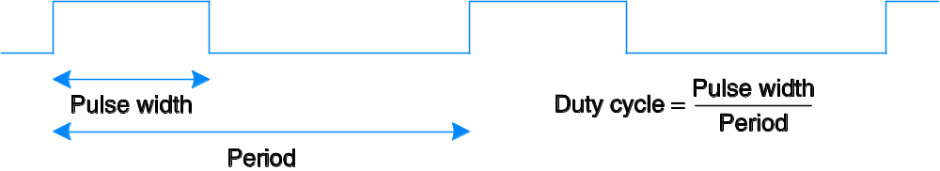
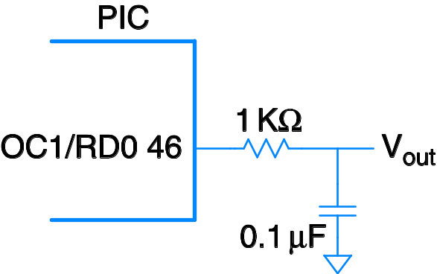
Pulse-Width Modulation (PWM)
Average value proportional to duty cycle
Add high-pass filter on output to deliver average value
A way to make bad music

Slide 87
Other Microcontroller Peripherals
Examples
  Character LCD
  VGA monitor
  Bluetooth wireless
  Motors

Slide 88
Personal Computer (PC) I/O Systems
USB: Universal Serial Bus
  USB 1.0 released in 1996
  standardized cables/software for peripherals
PCI/PCIe: Peripheral Component Interconnect/PCI Express
  developed by Intel, widespread around 1994
  32-bit parallel bus
  used for expansion cards (i.e., sound cards, video cards, etc.)
DDR: double-data rate memory

Slide 89
Personal Computer (PC) I/O Systems
TCP/IP: Transmission Control Protocol and Internet Protocol
  physical connection: Ethernet cable or Wi-Fi
SATA: hard drive interface
Input/Output (sensors, actuators, microcontrollers, etc.)
  Data Acquisition Systems (DAQs)
  USB Links

