Slide 1
Chapter 5
Digital Design and Computer Architecture, 2nd Edition
David Money Harris and Sarah L. Harris
Edited by J Dean Brock
For CSCI 320

Slide 2
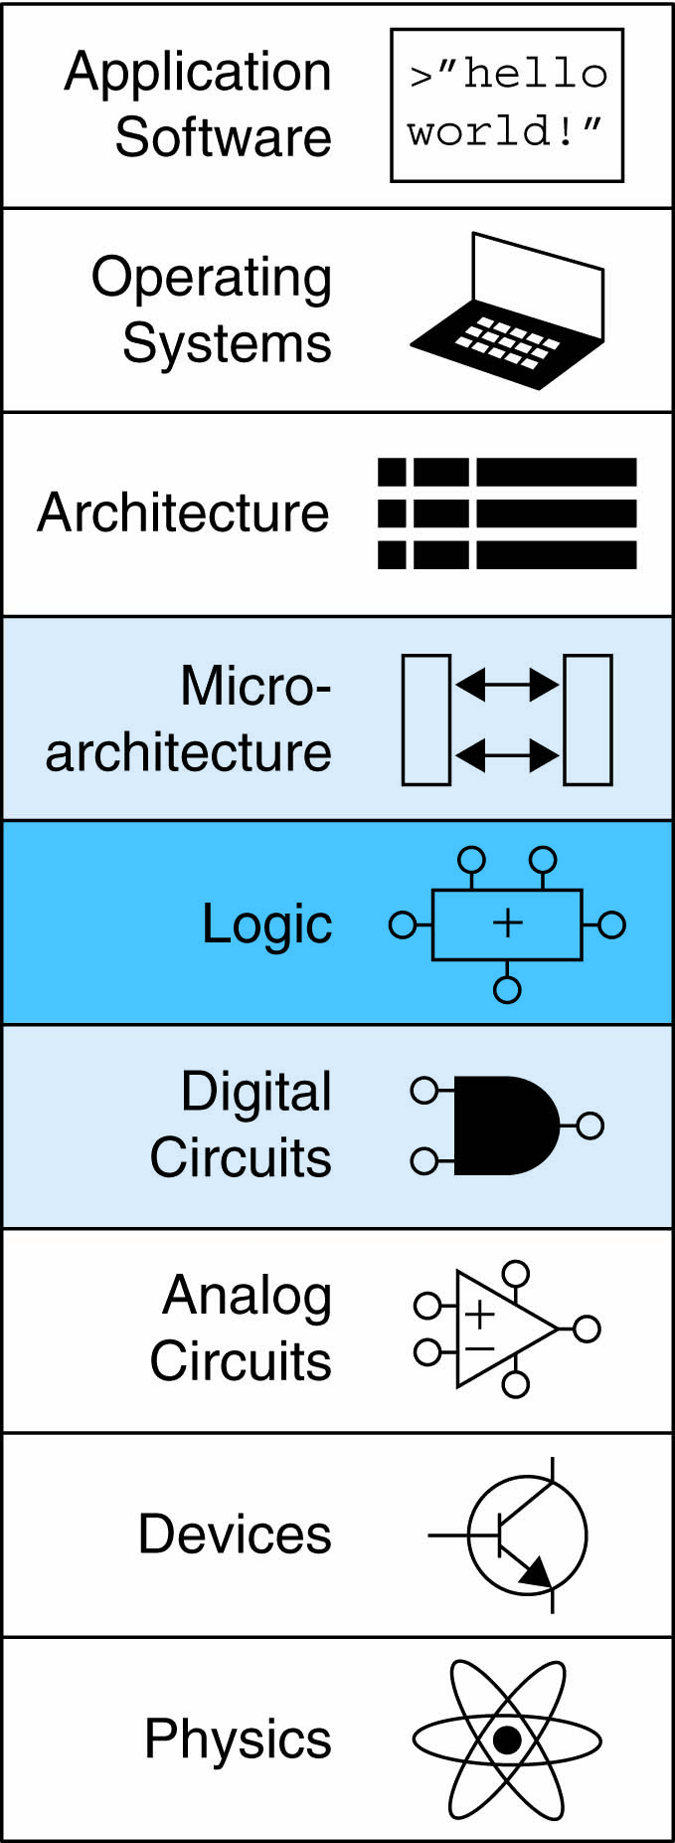
Chapter 5 :: Topics
Introduction
Arithmetic Circuits
Number Systems
Sequential Building Blocks
Memory Arrays
Logic Arrays

Slide 3
Introduction
Digital building blocks:
  Gates, multiplexers, decoders, registers, arithmetic circuits, counters, memory arrays, logic arrays
Building blocks demonstrate hierarchy, modularity, and regularity:
  Hierarchy of simpler components
  Well-defined interfaces and functions
  Regular structure easily extends to different sizes
Will use these building blocks in Chapter 7 to build microprocessor

Slide 4
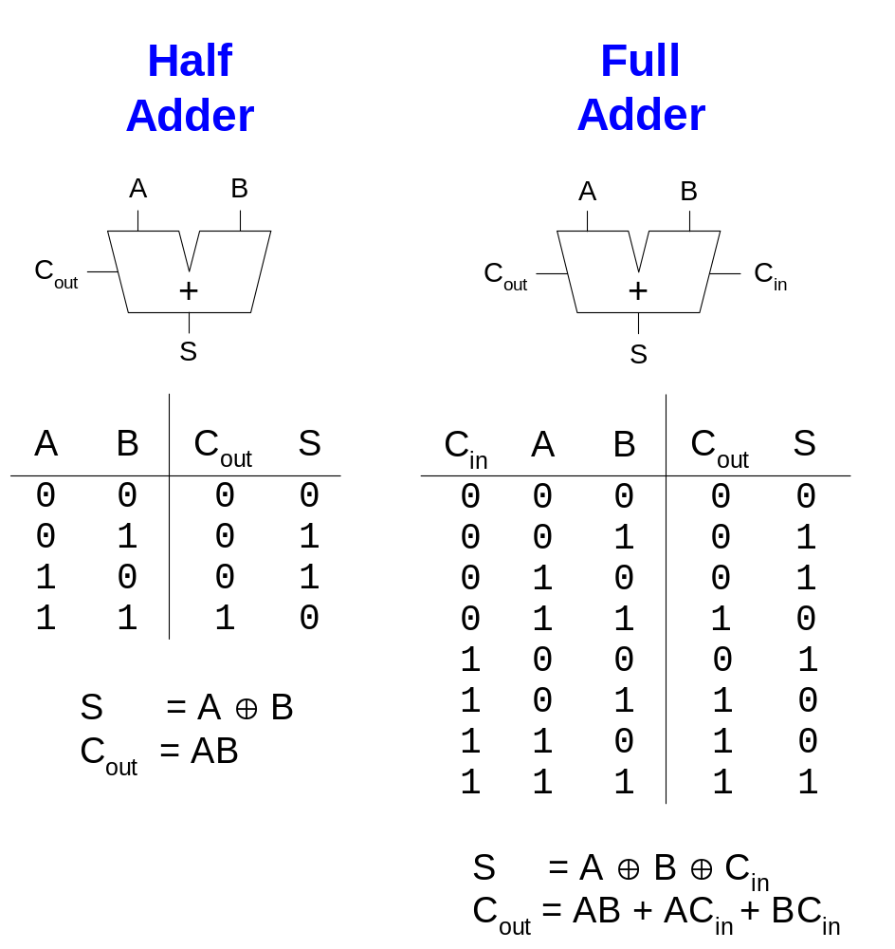
1-Bit Adders
I think we did this in the lab

Slide 5
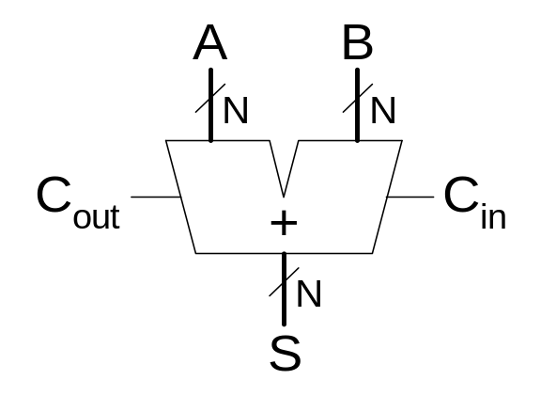
Multibit Adders (CPAs)
Types of carry propagate adders (CPAs):
  Ripple-carry (slow)
  Carry-lookahead (fast)
  Prefix (faster)
Carry-lookahead and prefix adders faster for large adders but require more hardware
  Symbol

Slide 6
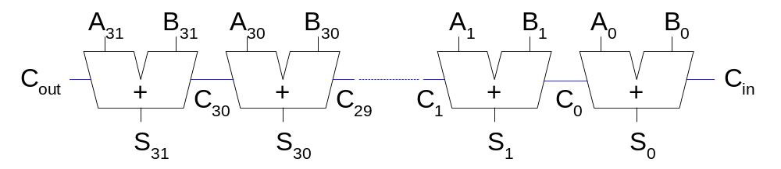
Ripple-Carry Adder
Chain 1-bit adders together
Carry ripples through entire chain
Disadvantage: slow

Slide 7
Carry-Lookahead Adder
Compute carry out (C_{out}) for k-bit blocks using generate and propagate signals
Some definitions:
  Column i produces a carry out by either generating a carry out or propagating a carry in to the carry out
  Generate (G_{i}) and propagate (P_{i}) signals for each column:
    Column i will generate a carry out if A_{i} AND B_{i} are both 1.
  G_{i} = A_{i} B_{i}
    Column i will propagate a carry in to the carry out if A_{i} OR B_{i} is 1.
  P_{i} = A_{i} + B_{i}
    The carry out of column i (C_{i}) is:
  C_{i} = A_{i} B_{i} + (A_{i} + B_{i} )C_{i-1} = G_{i} + P_{i} C_{i-1}

Slide 8
Carry-Lookahead Addition
Step 1: Compute G_{i} and P_{i} for all columns
Step 2: Compute G and P for k-bit blocks
Step 3: C_{in} propagates through each k-bit propagate/generate block

Slide 9
Prefix Adder
Computes carry in (C_{i-1}) for each column, then computes sum:
S_{i} = (A_{i} ⊕ B_{i}) ⊕ C_{i}
Computes G and P for 1-, 2-, 4-, 8-bit blocks, etc. until all G_{i} (carry in) known
log₂N stages

Slide 10
Prefix Adder
Carry in either generated in a column or propagated from a previous column.
Column -1 holds C_{in}, so
  G₋₁ = C_{in}, P₋₁ = 0
Carry in to column i = carry out of column i-1:
  C_{i-1} = G_{i-1:-1}
G_{i-1:-1}: generate signal spanning columns i-1 to -1
Sum equation:
  S_{i} = (A_{i} ⊕ B_{i}) ⊕ G_{i-1:-1}
Goal: Quickly compute G_{0:-1}, G_{1:-1}, G_{2:-1}, G_{3:-1}, G_{4:-1}, G_{5:-1}, … (called prefixes)

Slide 11
Prefix Adder
Generate and propagate signals for a block spanning bits i:j:
  G_{i:j} = G_{i:k} + P_{i:k} G_{k-1:j}
  P_{i:j} = P_{i:k}P_{k-1:j}
In words:
  Generate: block i:j will generate a carry if:
    upper part (i:k) generates a carry or
    upper part propagates a carry generated in lower part (k-1:j)
  Propagate: block i:j will propagate a carry if both the upper and lower parts propagate the carry

Slide 12
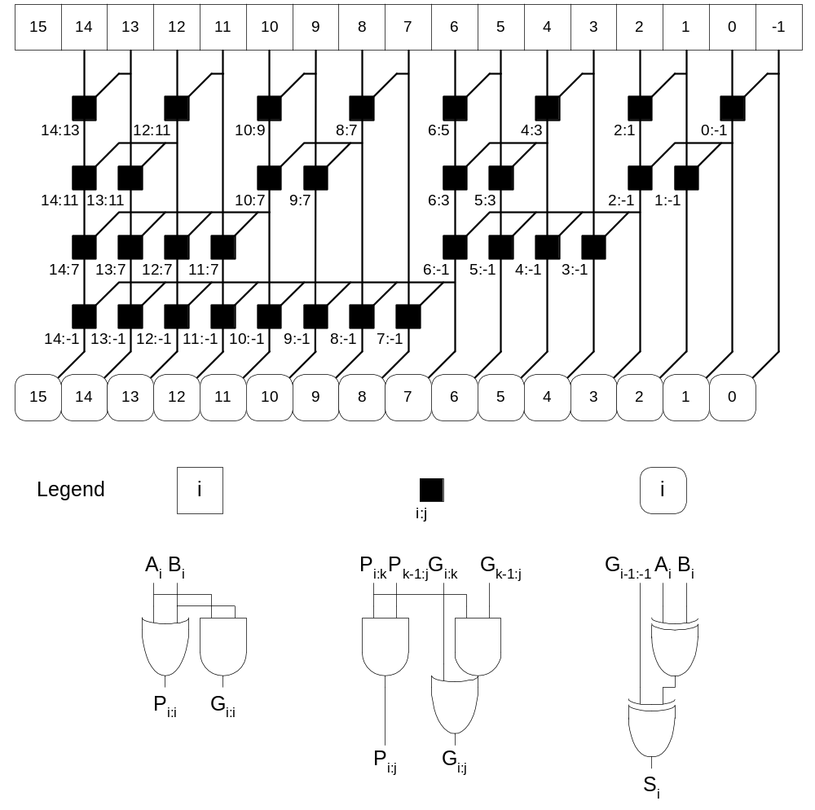
Prefix Adder Schematic
Sklansky adder

Slide 13
Prefix Adder Delay
t_{PA} = t_{pg} + log₂N(t_{pg_prefix} ) + t_{XOR}
  t_{pg}: delay to produce P_{i} G_{i} (AND or OR gate)
  t_{pg_prefix}: delay of black prefix cell (AND-OR gate)

Slide 14
Adder Delay Comparisons
Compare delay of: 32-bit ripple-carry, carry-lookahead, and prefix adders
CLA has 4-bit blocks
2-input gate delay = 100 ps; full adder delay = 300 ps
t_{ripple} = Nt_{FA} = 32(300 ps)
= 9.6 ns
t_{CLA} = t_{pg} + t_{pg_block} + (N/k – 1)t_{AND_OR} + kt_{FA}
= [100 + 600 + (7)200 + 4(300)] ps
= 3.3 ns
t_{PA} = t_{pg} + log₂N(t_{pg_prefix} ) + t_{XOR}
= [100 + log₂32(200) + 100] ps
= 1.2 ns

Slide 15
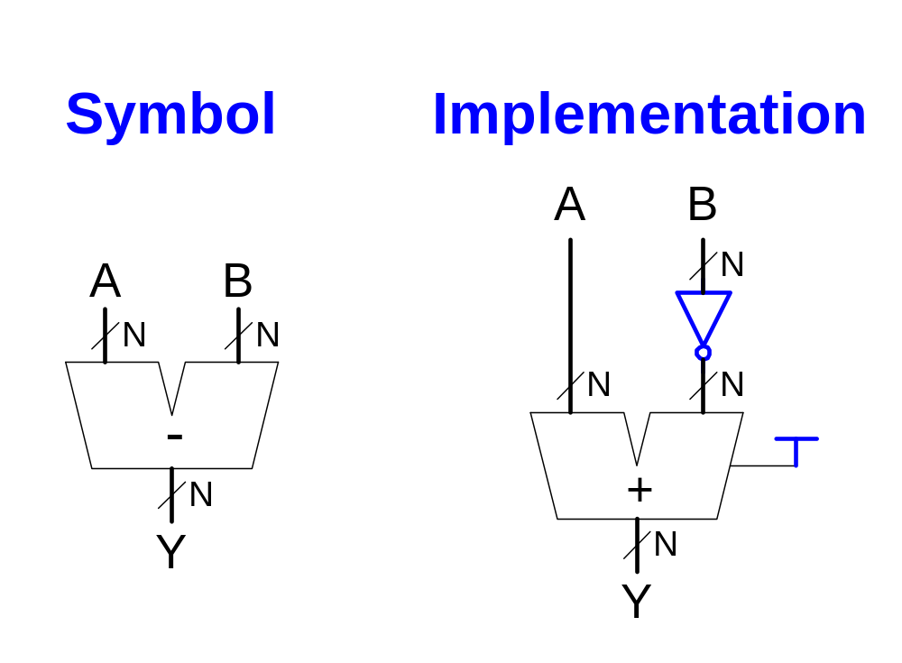
Subtracter

Slide 16
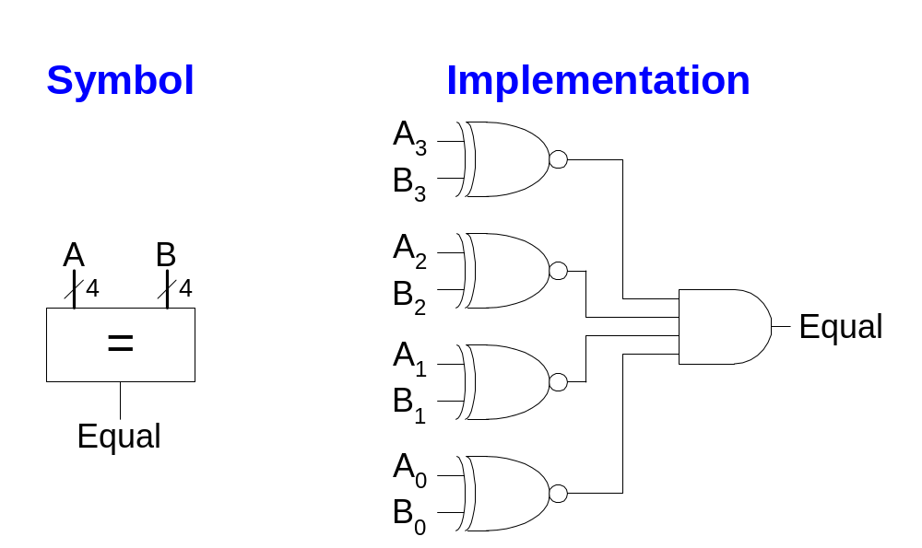
Comparator: Equality

Slide 17
Shifters
Logical shifter: shifts value to left or right and fills empty spaces with 0’s
  Ex: 11001 >> 2 =
  Ex: 11001 << 2 =
Arithmetic shifter: same as logical shifter, but on right shift, fills empty spaces with the old most significant bit (msb).
  Ex: 11001 >>> 2 =
  Ex: 11001 <<< 2 =
Rotator: rotates bits in a circle, such that bits shifted off one end are shifted into the other end
  Ex: 11001 ROR 2 =
  Ex: 11001 ROL 2 =
<<< is not an Java operator
And >>> works differently in Java

Slide 18
Shifters
Logical shifter:
  Ex: 11001 >> 2 = 00110
  Ex: 11001 << 2 = 00100
Arithmetic shifter:
  Ex: 11001 >>> 2 = 11110
  Ex: 11001 <<< 2 = 00100
Rotator:
  Ex: 11001 ROR 2 = 01110
  Ex: 11001 ROL 2 = 00111

Slide 19
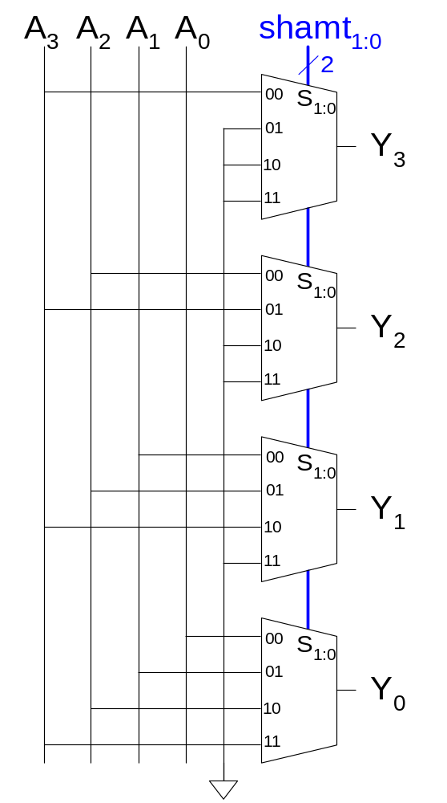
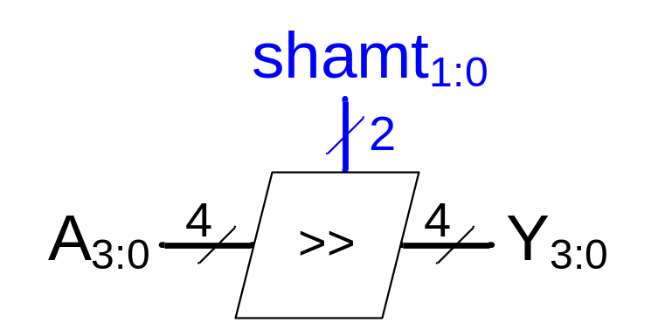
Shifter Design
shamt determines the amount of the shift

Slide 20
Shifters as Multipliers, Dividers
A << N = A × 2^{N}
  Example: 00001 << 2 = 00100 (1 × 2² = 4)
  Example: 11101 << 2 = 10100 (-3 × 2² = -12)
A >>> N = A ÷ 2^{N}
  Example: 01000 >>> 2 = 00010 (8 ÷ 2² = 2)
  Example: 10000 >>> 2 = 11100 (-16 ÷ 2² = -4)

Slide 21
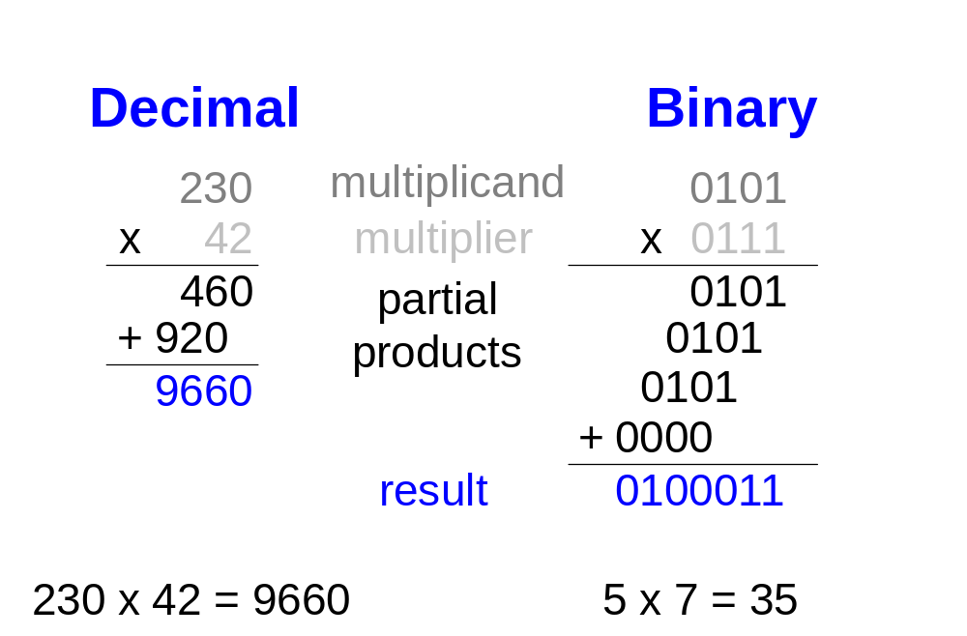
Multipliers
Partial products formed by multiplying a single digit of the multiplier with multiplicand
Shifted partial products summed to form result

Slide 22
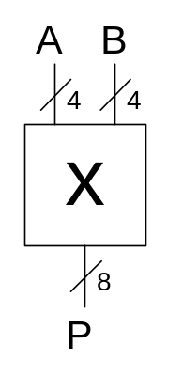
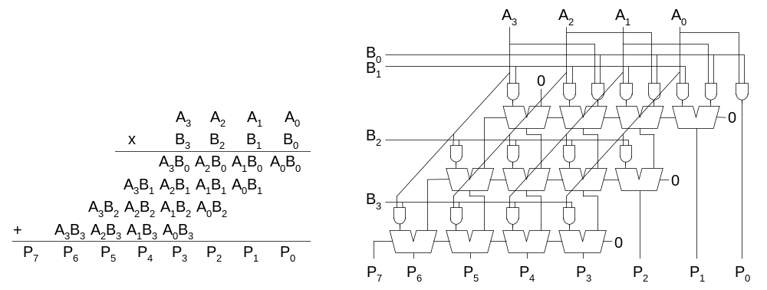
4 x 4 Multiplier
This may be called
“grid multiplication” in elementary schools

Slide 23
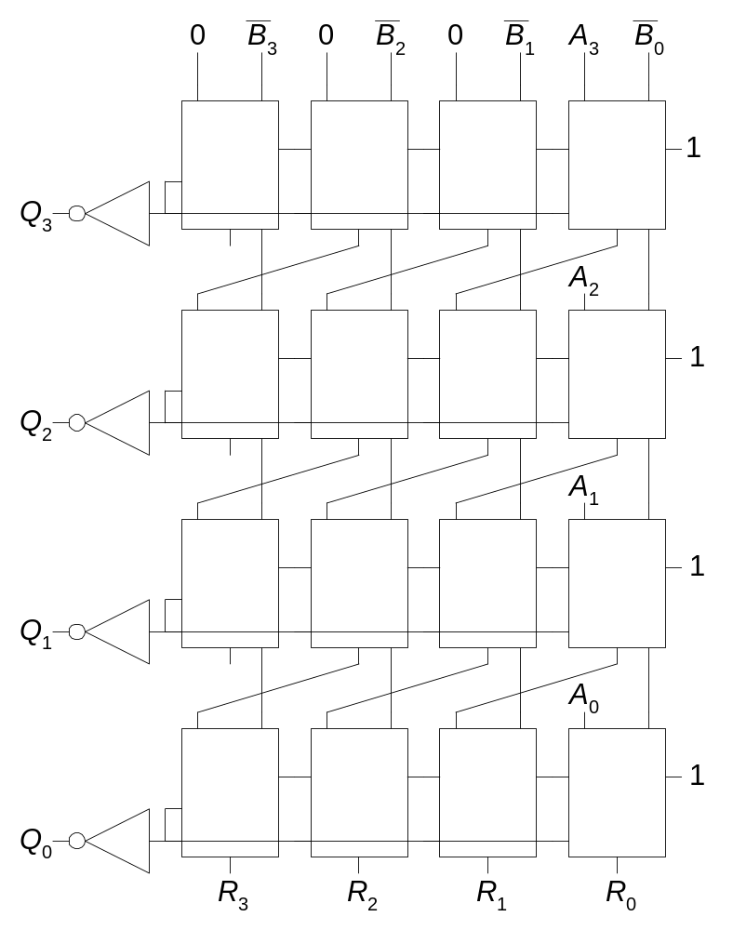
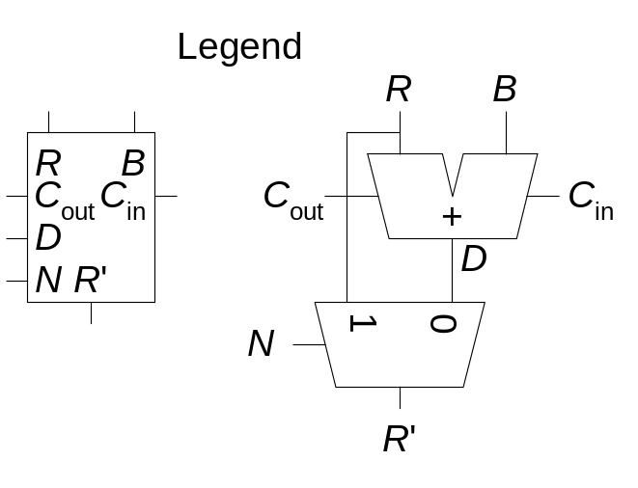
4 x 4 Divider
A/B = Q + R/B
Algorithm:
R’ = 0
for i = N-1 to 0
R = {R’ << 1. A_{i}}
D = R - B
if D < 0, Q_{i}=0, R’=R
else Q_{i}=1, R’=D
R’=R

Slide 24
Number Systems
Numbers we can represent using binary representations
  Positive numbers
    Unsigned binary
  Negative numbers
    Two’s complement
    Sign/magnitude numbers
What about fractions?

Slide 25
Numbers with Fractions
Two common notations:
  Fixed-point: binary point fixed
  Floating-point: binary point floats to the right of the most significant 1

Slide 26
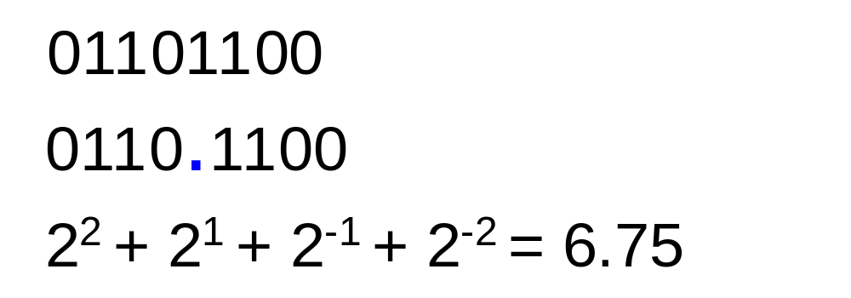
Fixed-Point Numbers
6.75 using 4 integer bits and 4 fraction bits:
  Binary point is implied
  The number of integer and fraction bits must be agreed upon beforehand

Slide 27
Signed Fixed-Point Numbers
Representations:
  Sign/magnitude
  Two’s complement
Example: Represent -7.5₁₀ using 4 integer and 4 fraction bits
  Sign/magnitude:
  11111000
  Two’s complement:
  1. +7.5: 01111000
  2. Invert bits: 10000111
  3. Add 1 to lsb: + 1
  10001000
Sensors often use fixed point numbers

Slide 28
Floating-Point Numbers
Binary point floats to the right of the most significant 1
Similar to decimal scientific notation
For example, write 273₁₀ in scientific notation:
  273 = 2.73 × 10²
In general, a number is written in scientific notation as:
± M × B^{E}
  M = mantissa
  B = base
  E = exponent
  In the example, M = 2.73, B = 10, and E = 2

Slide 29
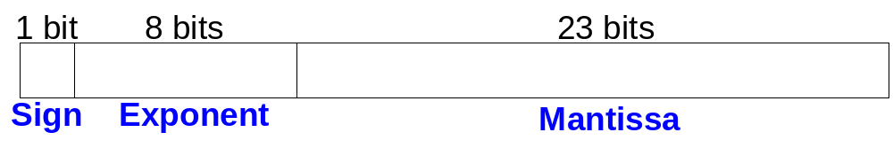
Floating-Point Numbers
Example: represent the value 228₁₀ using a 32-bit floating point representation
We show three versions –final version is called the IEEE 754 floating-point standard

Slide 30
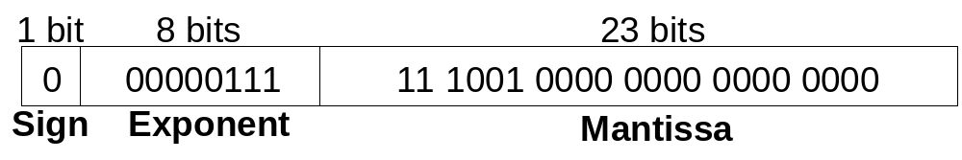
Floating-Point Representation 1
Convert decimal to binary (don’t reverse steps 1 & 2!):
  228₁₀ = 11100100₂
Write the number in “binary scientific notation”:
  11100100₂ = 1.11001₂ × 2⁷
Fill in each field of the 32-bit floating point number:
  The sign bit is positive (0)
  The 8 exponent bits represent the value 7
  The remaining 23 bits are the mantissa

Slide 31
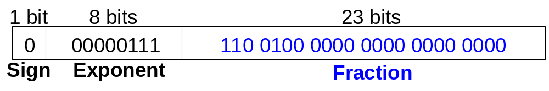
Floating-Point Representation 2
First bit of the mantissa is always 1:
  228₁₀ = 11100100₂ = 1.11001 × 2⁷
So, no need to store it: implicit leading 1
Store just fraction bits in 23-bit field

Slide 32
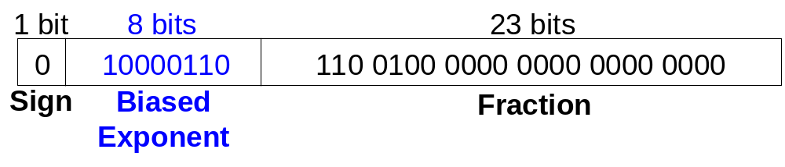
Floating-Point Representation 3
Biased exponent: bias = 127 (01111111₂)
  Biased exponent = bias + exponent
  Exponent of 7 is stored as:
  127 + 7 = 134 = 0x10000110₂
The IEEE 754 32-bit floating-point representation of 228₁₀
in hexadecimal: 0x43640000

Slide 33
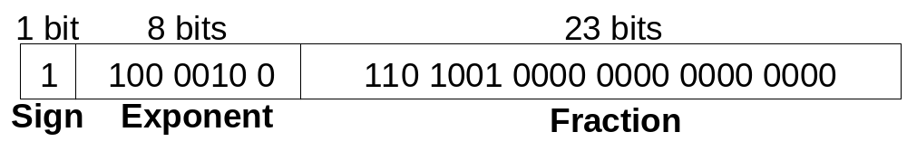
Floating-Point Example
Write -58.25₁₀ in floating point (IEEE 754)
Convert decimal to binary:
  58.25₁₀ = 111010.01₂
Write in binary scientific notation:
1.1101001 × 2⁵
Fill in fields:
  Sign bit: 1 (negative)
  8 exponent bits: (127 + 5) = 132 = 10000100₂
  23 fraction bits: 110 1001 0000 0000 0000 0000
in hexadecimal: 0xC2690000
Now try 7.7

Slide 34
Floating-Point: Special Cases
Number | Sign | Exponent | Fraction
0 | X | 00000000 | 00000000000000000000000
∞ | 0 | 11111111 | 00000000000000000000000
- ∞ | 1 | 11111111 | 00000000000000000000000
NaN | X | 11111111 | non-zero
When the exponent field is 0000000, the floating point number is unnormalized.
Take a look at http://www.cs.unca.edu/brock/classes/Fall2013/csci255/notes/Arithmetic.ods

Slide 35
Floating-Point Precision
Single-Precision:
  32-bit
  1 sign bit, 8 exponent bits, 23 fraction bits
  bias = 127
Double-Precision:
  64-bit
  1 sign bit, 11 exponent bits, 52 fraction bits
  bias = 1023

Slide 36
Floating-Point: Rounding
Overflow: number too large to be represented
Underflow: number too small to be represented
Rounding modes:
  Down
  Up
  Toward zero
  To nearest
Example: round 1.100101 (1.578125) to only 3 fraction bits
  Down: 1.100
  Up: 1.101
  Toward zero: 1.100
  To nearest: 1.101 (1.625 is closer to 1.578125 than 1.5 is)

Slide 37
Floating-Point Addition
Extract exponent and fraction bits
Prepend leading 1 to form mantissa
Compare exponents
Shift smaller mantissa if necessary
Add mantissas
Normalize mantissa and adjust exponent if necessary
Round result
Assemble exponent and fraction back into floating-point format

Slide 38
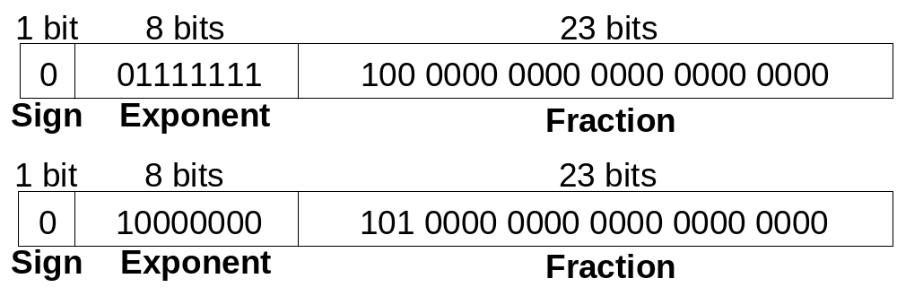
Floating-Point Addition Example
1. Extract exponent and fraction bits
For first number (N1): S = 0, E = 127, F = .1
For second number (N2): S = 0, E = 128, F = .101
2. Prepend leading 1 to form mantissa
N1: 1.1
N2: 1.101

Slide 39
Floating-Point Addition Example
3. Compare exponents
127 – 128 = -1, so shift N1 right by 1 bit
4. Shift smaller mantissa if necessary
shift N1’s mantissa: 1.1 >> 1 = 0.11 (× 2¹)
5. Add mantissas
0.11 × 2¹
+ 1.101 × 2¹
10.011 × 2¹

Slide 40

Floating Point Addition Example
6. Normalize mantissa and adjust exponent if necessary
10.011 × 2¹ = 1.0011 × 2²
7. Round result
No need (fits in 23 bits)
8. Assemble exponent and fraction back into floating-point format
S = 0, E = 2 + 127 = 129 = 10000001₂, F = 001100..
in hexadecimal: 0x40980000

Slide 41
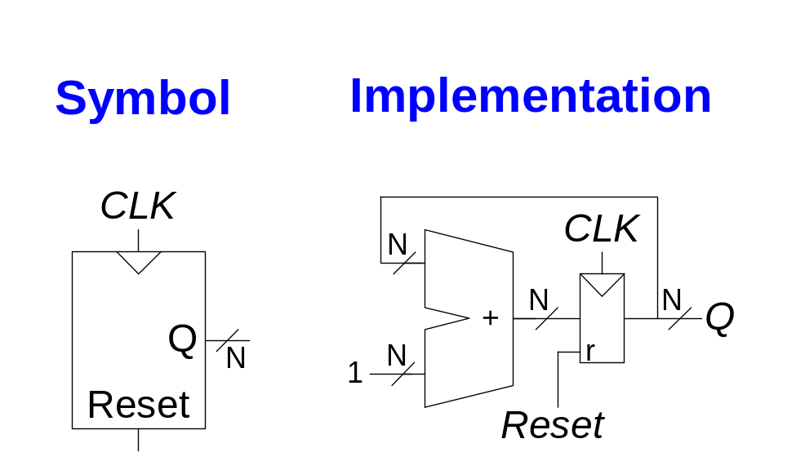
Counters
Increments on each clock edge
Used to cycle through numbers. For example,
  000, 001, 010, 011, 100, 101, 110, 111, 000, 001…
Example uses:
  Digital clock displays
  Program counter: keeps track of current instruction executing

Slide 42
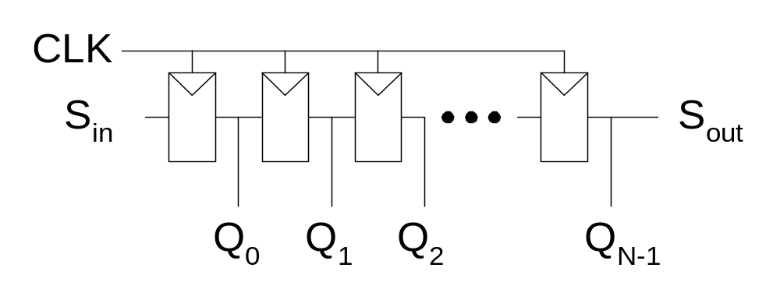
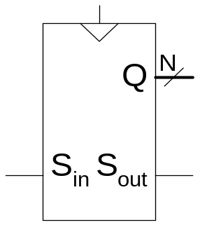
Shift Registers
Shift a new bit in on each clock edge
Shift a bit out on each clock edge
Serial-to-parallel converter: converts serial input (S_{in}) to parallel output (Q_{0:N-1})
Symbol:
Implementation:

Slide 43
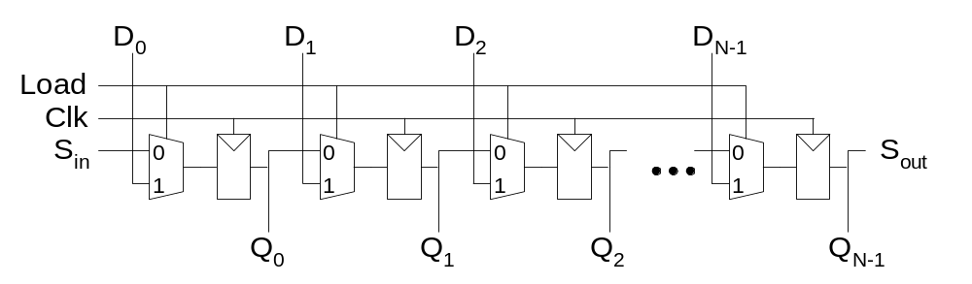
Shift Register with Parallel Load
When Load = 1, acts as a normal N-bit register
When Load = 0, acts as a shift register
Now can act as a serial-to-parallel converter (S_{in} to Q_{0:N-1}) or a parallel-to-serial converter (D_{0:N-1} to S_{out})

Slide 44
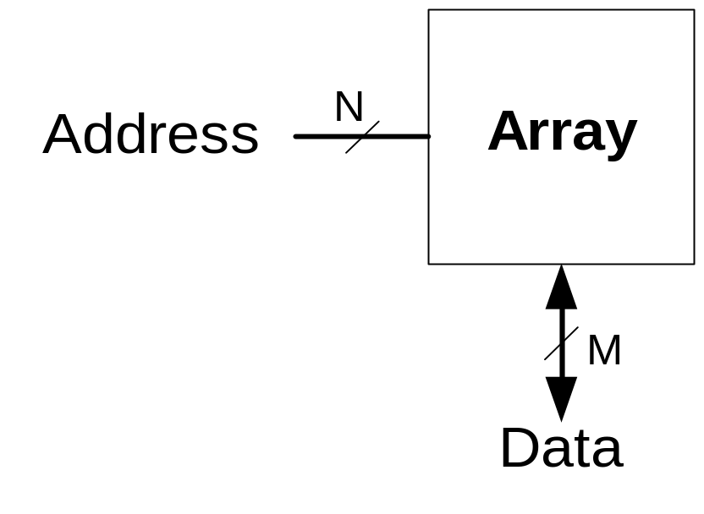
Memory Arrays
Efficiently store large amounts of data
3 common types:
  Dynamic random access memory (DRAM)
  Static random access memory (SRAM)
  Read only memory (ROM)
M-bit data value read/ written at each unique N-bit address

Slide 45
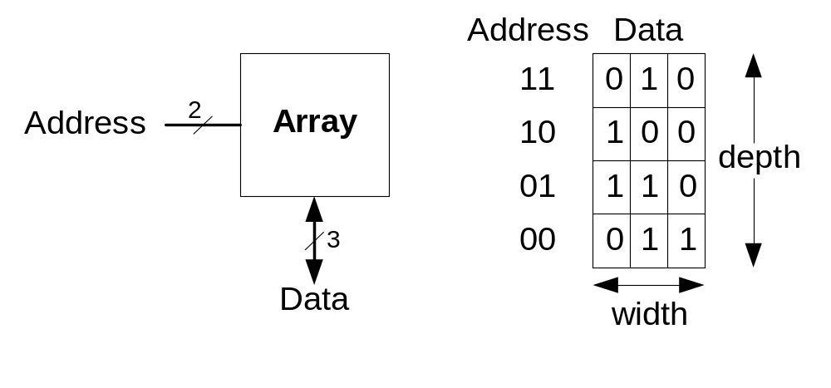
Memory Arrays
2-dimensional array of bit cells
Each bit cell stores one bit
N address bits and M data bits:
  2^{N} rows and M columns
  Depth: number of rows (number of words)
  Width: number of columns (size of word)
  Array size: depth × width = 2^{N} × M

Slide 46
Memory Array Example
2² × 3-bit array
Number of words: 4
Word size: 3-bits
For example, the 3-bit word stored at address 10 is 100

Slide 47
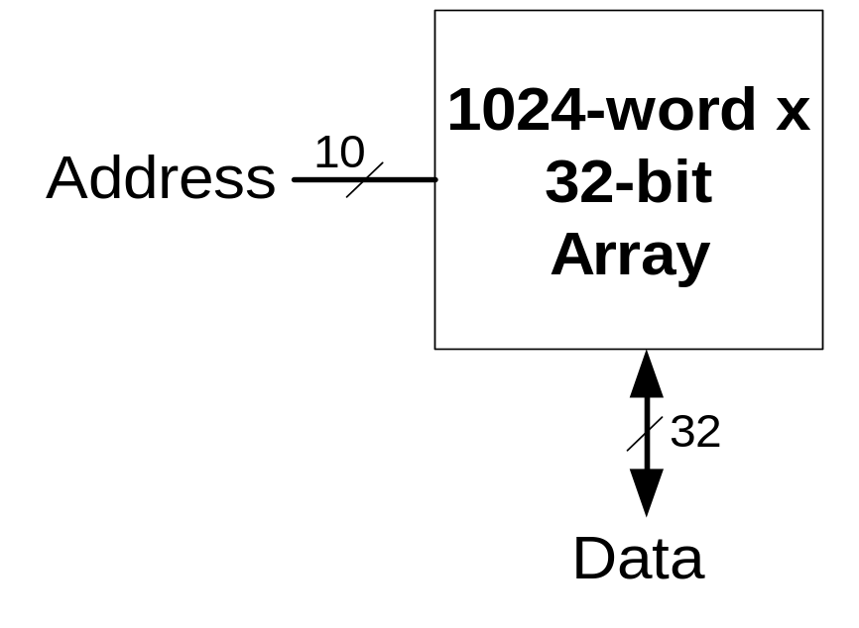
Memory Arrays

Slide 48
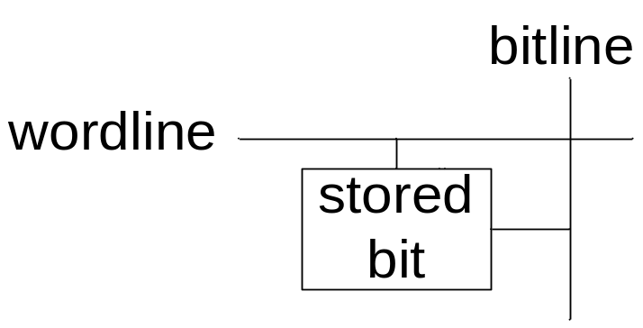
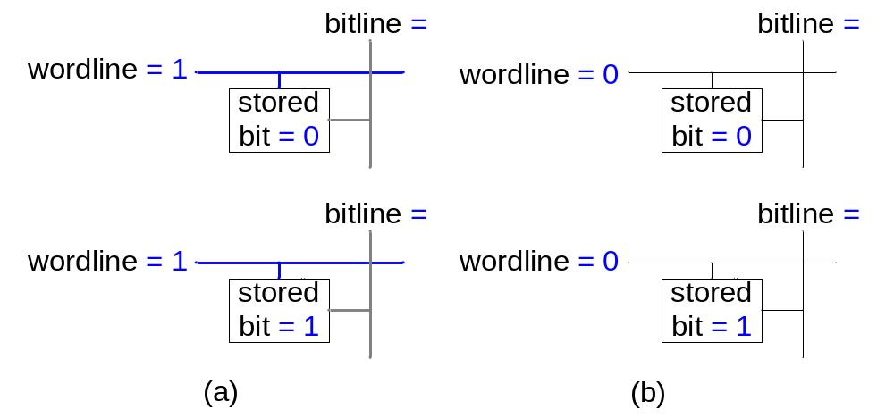
Memory Array Bit Cells
0
Z
1
Z

Slide 49
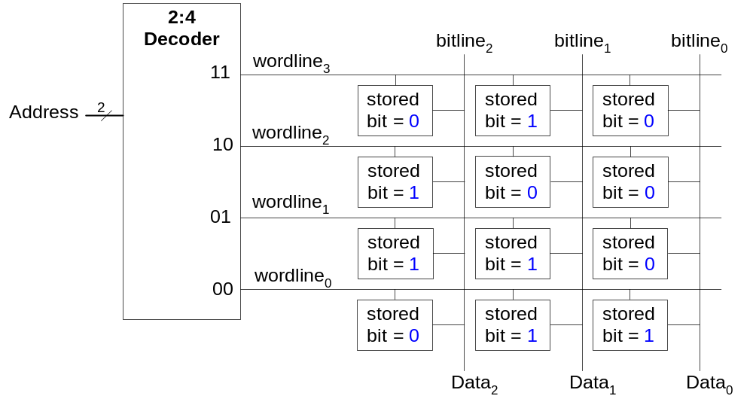
Memory Array
Wordline:
  like an enable
  single row in memory array read/written
  corresponds to unique address
  only one wordline HIGH at once

Slide 50
Types of Memory
Random access memory (RAM): volatile
Read only memory (ROM): nonvolatile

Slide 51
RAM: Random Access Memory
Volatile: loses its data when power off
Read and written quickly
Main memory in your computer is RAM (DRAM)
Historically called random access memory because any data word accessed as easily as any other (in contrast to sequential access memories such as a tape recorder)

Slide 52
ROM: Read Only Memory
Nonvolatile: retains data when power off
Read quickly, but writing is impossible or slow
Flash memory in cameras, thumb drives, and digital cameras are all ROMs
  Historically called read only memory because ROMs were written at manufacturing time or by burning fuses. Once ROM was configured, it could not be written again. This is no longer the case for Flash memory and other types of ROMs.

Slide 53
Types of RAM
DRAM (Dynamic random access memory)
SRAM (Static random access memory)
Differ in how they store data:
  DRAM uses a capacitor
  SRAM uses cross-coupled inverters

Slide 54

Robert Dennard, 1932 -
Invented DRAM in 1966 at IBM
Others were skeptical that the idea would work
By the mid-1970’s DRAM in virtually all computers

Slide 55
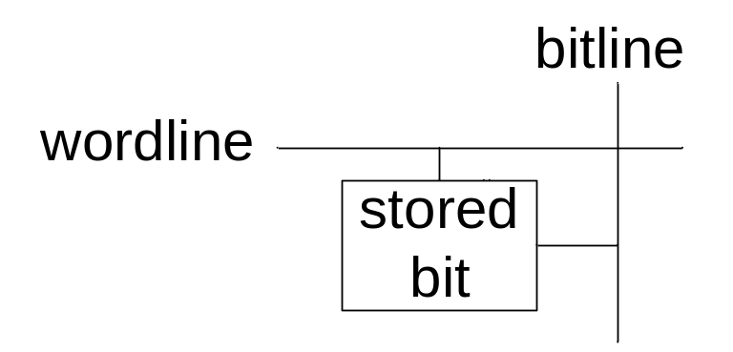
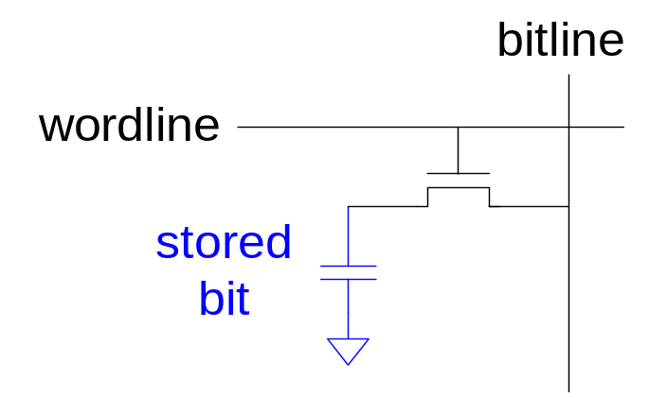
DRAM
Data bits stored on capacitor
Dynamic because the value needs to be refreshed (rewritten) periodically and after read:
  Charge leakage from the capacitor degrades the value
  Reading destroys the stored value

Slide 56
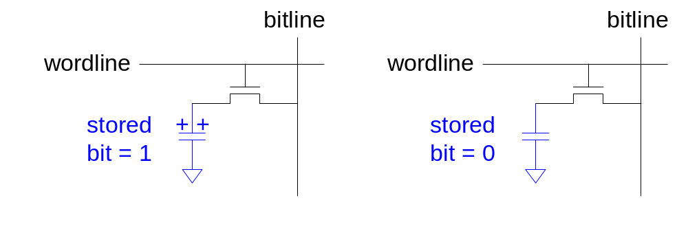
DRAM

Slide 57
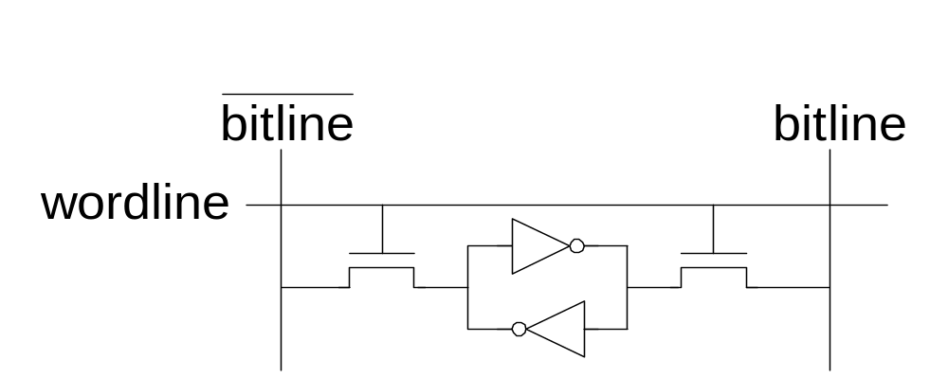
SRAM

Slide 58
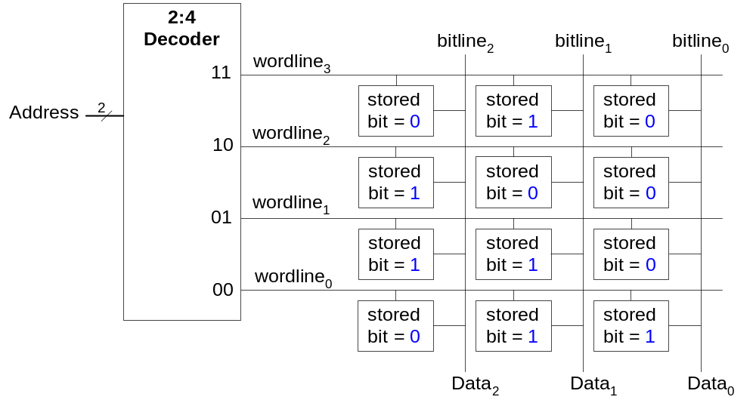
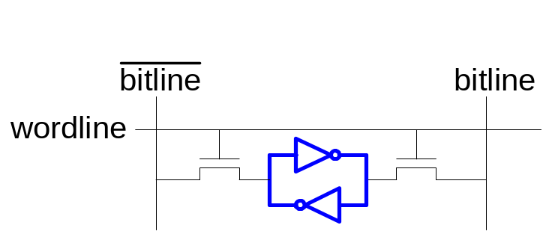
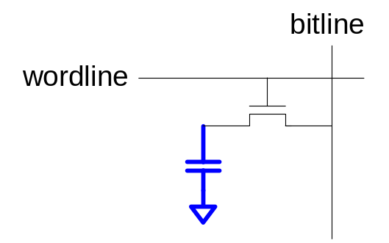
Memory Arrays Review
DRAM bit cell:
SRAM bit cell:

Slide 59

Fujio Masuoka, 1944 -
Developed memories and high speed circuits at Toshiba, 1971-1994
Invented Flash memory as an unauthorized project pursued during nights and weekends in the late 1970’s
The process of erasing the memory reminded him of the flash of a camera
Toshiba slow to commercialize the idea; Intel was first to market in 1988
Flash has grown into a $25 billion per year market

Slide 60
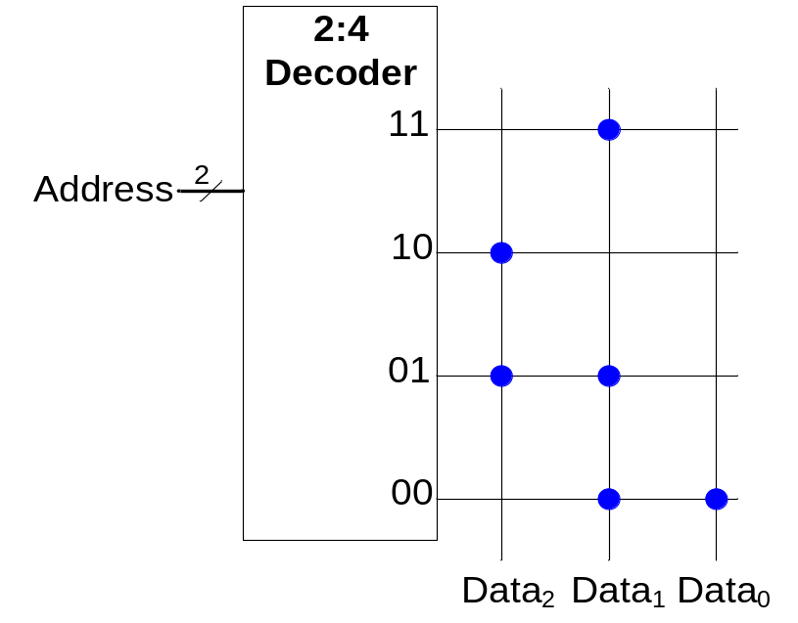
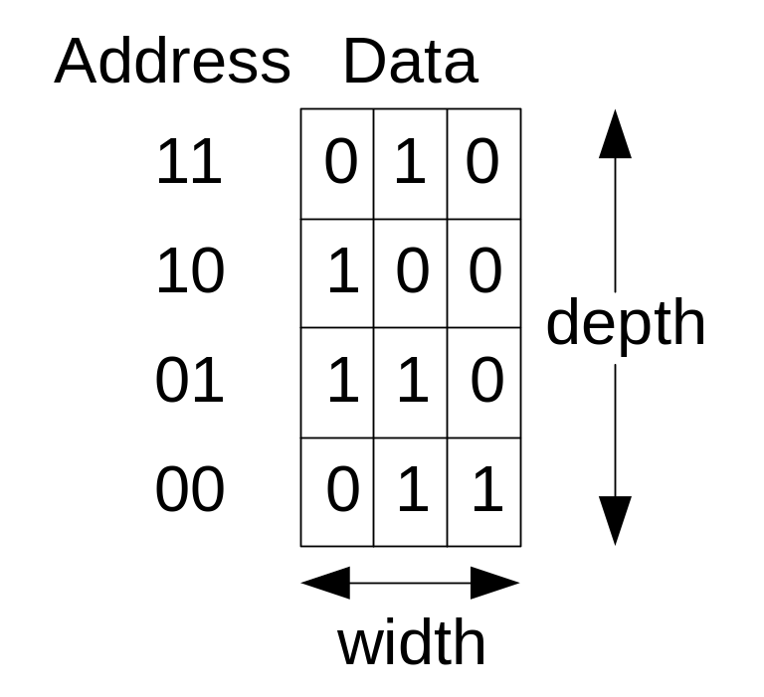
ROM Storage

Slide 61
ROM Logic
Data₂ = A₁ ⊕ A₀
Data₁ = A₁ + A₀
Data₀ = A₁A₀

Slide 62
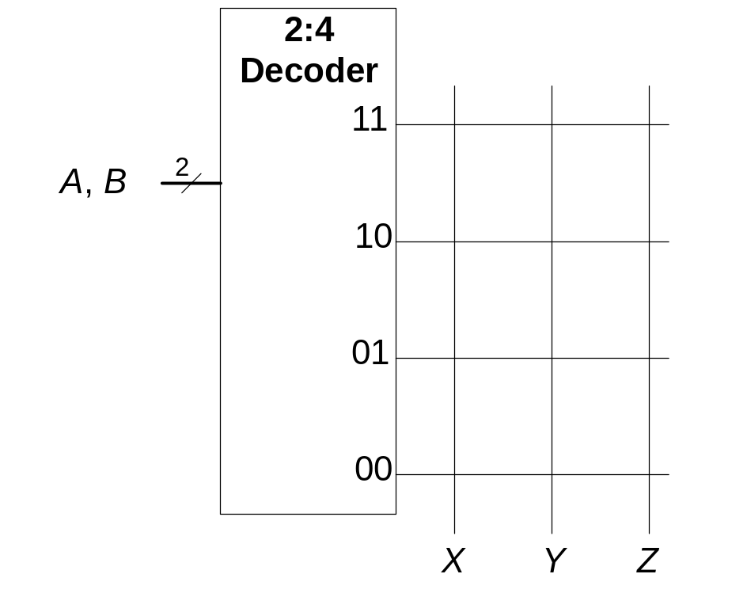
Example: Logic with ROMs
Implement the following logic functions using a 2² × 3-bit ROM:
  X = AB
  Y = A + B
  Z = A B

Slide 63
Logic with Any Memory Array
Data₂ = A₁ ⊕ A₀
Data₁ = A₁ + A₀
Data₀ = A₁A₀

Slide 64
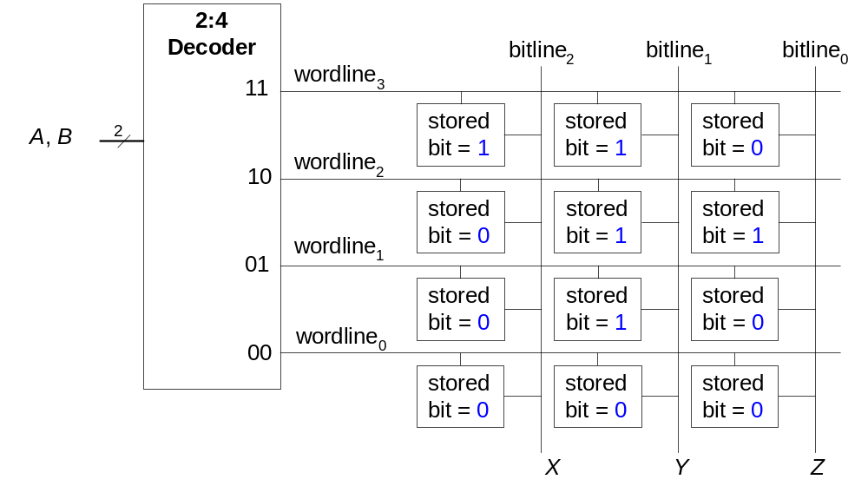
Logic with Memory Arrays
Implement the following logic functions using a 2² × 3-bit memory array:
  X = AB
  Y = A + B
  Z = A B

Slide 65
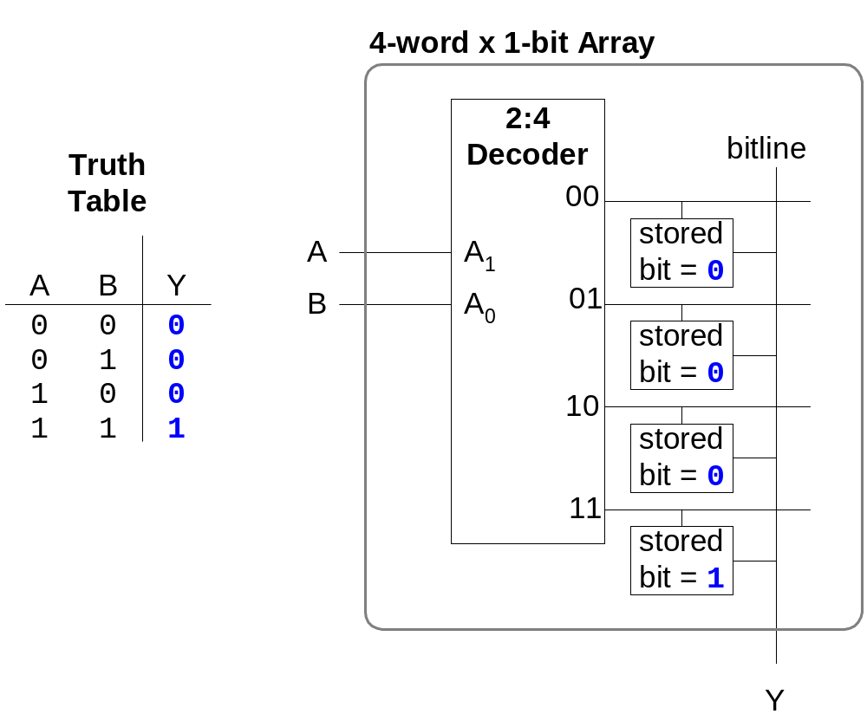
Logic with Memory Arrays
Called lookup tables (LUTs): look up output at each input combination (address)

Slide 66
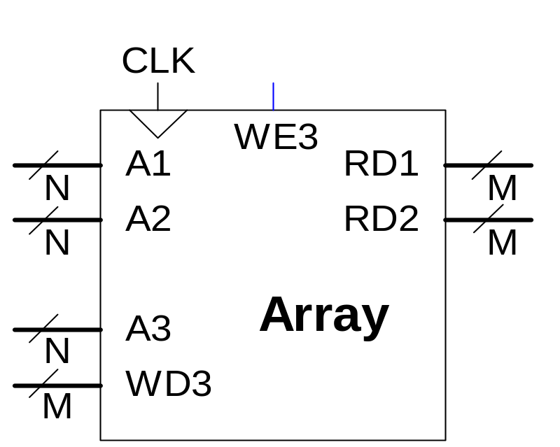
Multi-ported Memories
Port: address/data pair
3-ported memory
  2 read ports (A1/RD1, A2/RD2)
  1 write port (A3/WD3, WE3 enables writing)
Register file: small multi-ported memory

Slide 67
SystemVerilog Memory Arrays
// 256 x 3 memory module with one read/write port
module dmem( input logic clk, we,
input logic [7:0] a,
input logic [2:0] wd,
output logic [2:0] rd);
logic [2:0] RAM[255:0];
assign rd = RAM[a];
always @(posedge clk)
if (we)
RAM[a] <= wd;
endmodule

Slide 68
Logic Arrays
PLAs (Programmable logic arrays)
  AND array followed by OR array
  Combinational logic only
  Fixed internal connections
FPGAs (Field programmable gate arrays)
  Array of Logic Elements (LEs)
  Combinational and sequential logic
  Programmable internal connections

Slide 69
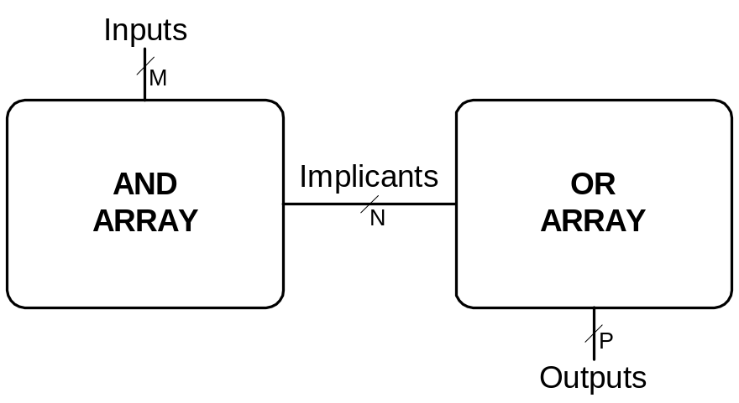
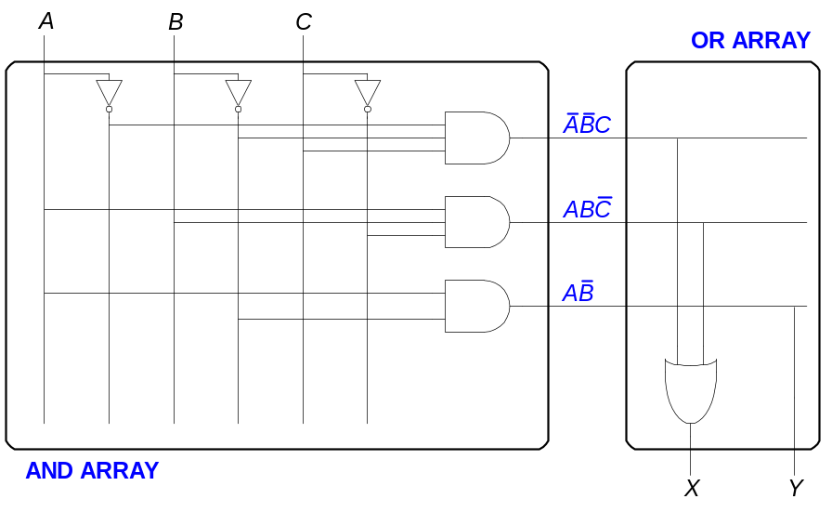
PLAs
X = ABC + ABC
Y = AB

Slide 70
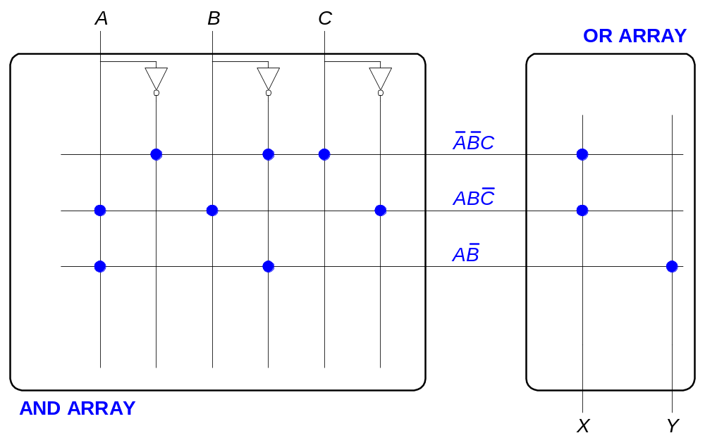
PLAs: Dot Notation

Slide 71
FPGA: Field Programmable Gate Array
Composed of:
  LEs (Logic elements): perform logic
  IOEs (Input/output elements): interface with outside world
  Programmable interconnection: connect LEs and IOEs
  Some FPGAs include other building blocks such as multipliers and RAMs

Slide 72
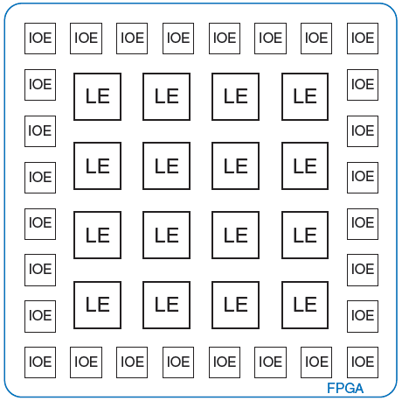
General FPGA Layout

Slide 73
LE: Logic Element
Composed of:
  LUTs (lookup tables): perform combinational logic
  Flip-flops: perform sequential logic
  Multiplexers: connect LUTs and flip-flops

Slide 74
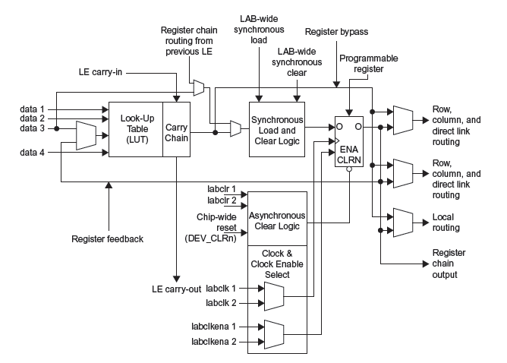
Altera Cyclone IV LE

Slide 75
Altera Cyclone IV LE
The Altera Cyclone IV LE has:
  1 four-input LUT
  1 registered output
  1 combinational output

Slide 76
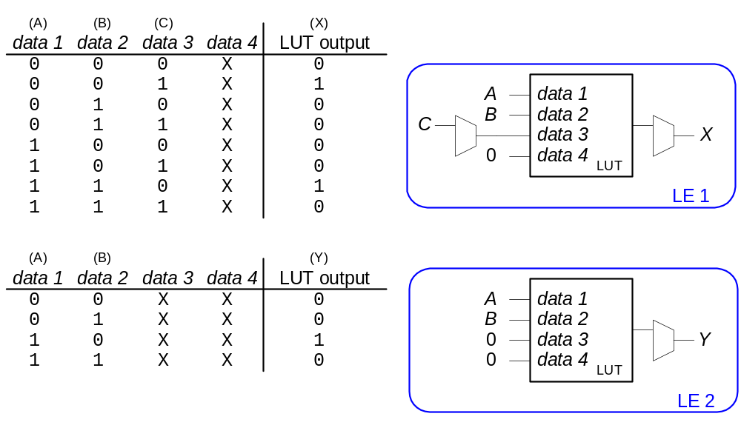
LE Configuration Example
Show how to configure a Cyclone IV LE to perform the following functions:
  X = ABC + ABC
  Y = AB

Slide 77
FPGA Design Flow
Using a CAD tool (such as Altera’s Quartus II)
  Enter the design using schematic entry or an HDL
  Simulate the design
  Synthesize design and map it onto FPGA
  Download the configuration onto the FPGA
  Test the design

