Slide 1
Chapter 4
Digital Design and Computer Architecture, 2nd Edition
David Money Harris and Sarah L. Harris
Edited by J Dean Brock
For CSCI 320

Slide 2
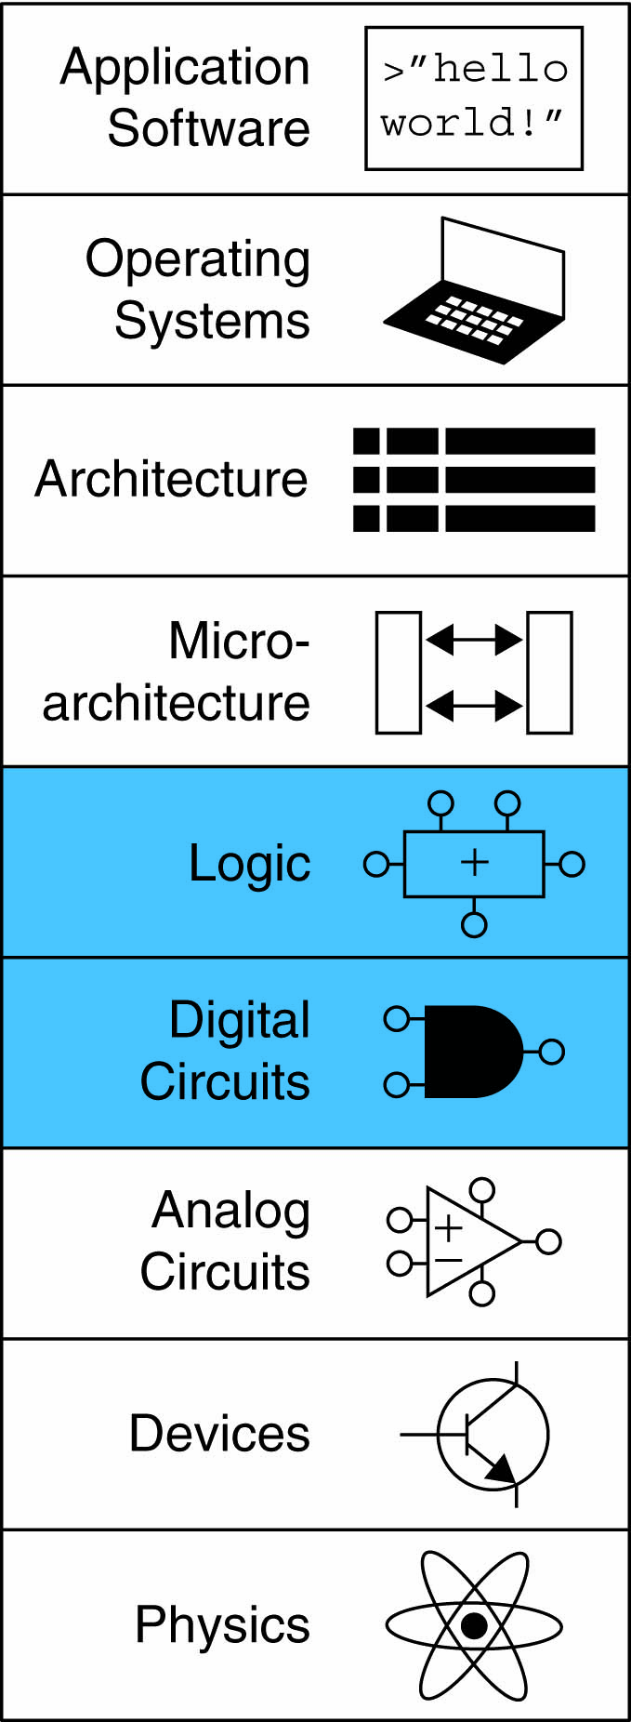
Chapter 4 :: Topics
Introduction
Combinational Logic
Structural Modeling
Sequential Logic
More Combinational Logic
Finite State Machines
Parameterized Modules
Testbenches

Slide 3
Introduction
Hardware description language (HDL):
  specifies logic function only
  Computer-aided design (CAD) tool produces or synthesizes the optimized gates
Most commercial designs built using HDLs
Two leading HDLs:
  SystemVerilog
    developed in 1984 by Gateway Design Automation
    IEEE standard (1364) in 1995
    Extended in 2005 (IEEE STD 1800-2009)
  VHDL 2008
    Developed in 1981 by the Department of Defense
    IEEE standard (1076) in 1987
    Updated in 2008 (IEEE STD 1076-2008)

Slide 4
HDL to Gates
Simulation
  Inputs applied to circuit
  Outputs checked for correctness
  Millions of dollars saved by debugging in simulation instead of hardware
Synthesis
  Transforms HDL code into a netlist describing the hardware (i.e., a list of gates and the wires connecting them)
IMPORTANT:
When using an HDL, think of the hardware the HDL should produce

Slide 5
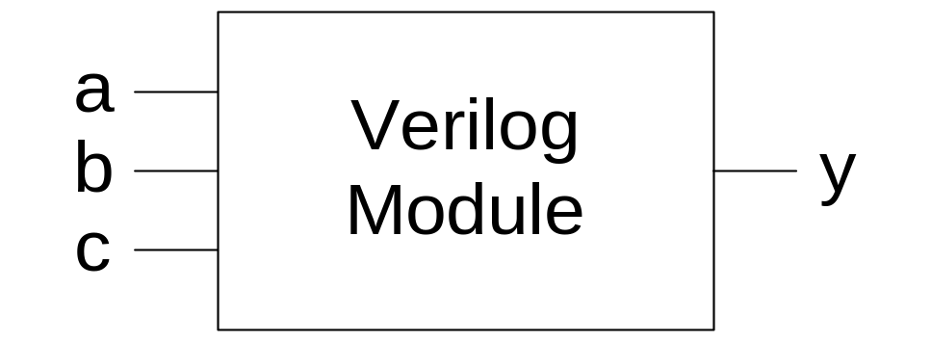
SystemVerilog Modules
Two types of Modules:
  Behavioral: describe what a module does
  Structural: describe how it is built from simpler modules

Slide 6
Behavioral SystemVerilog
SystemVerilog:
module example(input logic a, b, c,
output logic y);
assign y = ~a & ~b & ~c | a & ~b & ~c | a & ~b & c;
endmodule
In older Verilog, you don’t need the “logic”

Slide 7
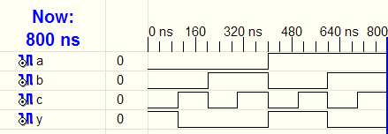
HDL Simulation
SystemVerilog:
module example(input logic a, b, c,
output logic y);
assign y = ~a & ~b & ~c | a & ~b & ~c | a & ~b & c;
endmodule

Slide 8
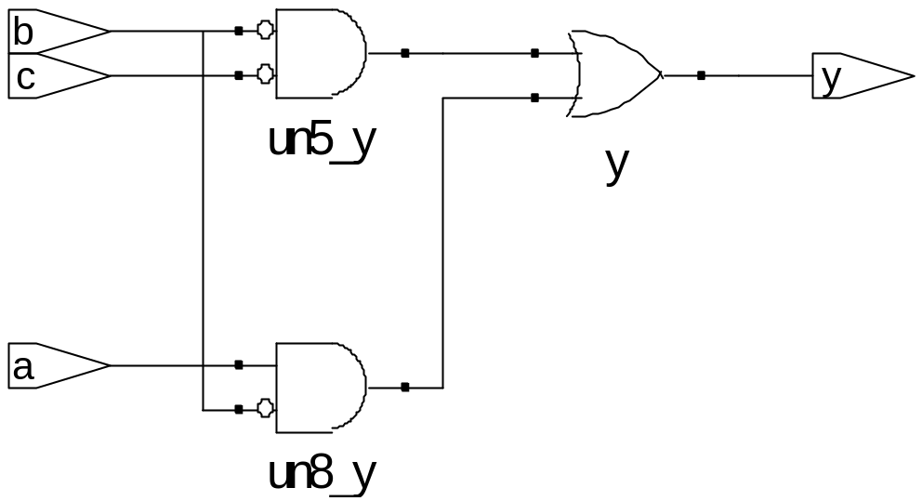
HDL Synthesis
SystemVerilog:
module example(input logic a, b, c,
output logic y);
assign y = ~a & ~b & ~c | a & ~b & ~c | a & ~b & c;
endmodule
Synthesis:
Produced with Synplify
From Synopsys

Slide 9
SystemVerilog Syntax
Case sensitive
  Example: reset and Reset are not the same signal.
No names that start with numbers
  Example: 2mux is an invalid name
Whitespace ignored
Comments:
  // single line comment
  /* multiline
  comment */
Though \2mux is

Slide 10
Structural Modeling - Hierarchy
module and3(input logic a, b, c,
output logic y);
assign y = a & b & c;
endmodule
module inv(input logic a,
output logic y);
assign y = ~a;
endmodule
module nand3(input logic a, b, c
output logic y);
logic n1; // internal signal
and3 andgate(a, b, c, n1); // instance of and3
inv inverter(n1, y); // instance of inverter
endmodule

Slide 11
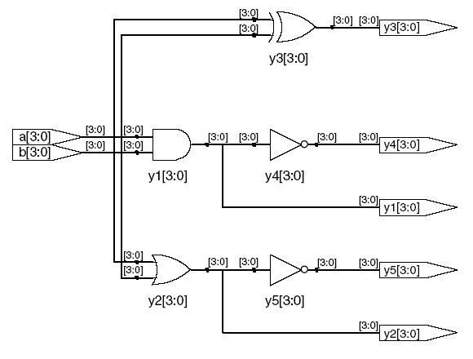
Bitwise Operators
module gates(input logic [3:0] a, b,
output logic [3:0] y1, y2, y3, y4, y5);
/* Five different two-input logic
gates acting on 4 bit busses */
assign y1 = a & b; // AND
assign y2 = a | b; // OR
assign y3 = a ^ b; // XOR
assign y4 = ~(a & b); // NAND
assign y5 = ~(a | b); // NOR
endmodule
// single line comment
/*…*/ multiline comment

Slide 12
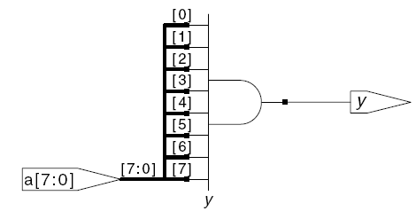
Reduction Operators
module and8(input logic [7:0] a,
output logic y);
assign y = &a;
// &a is much easier to write than
// assign y = a[7] & a[6] & a[5] & a[4] &
// a[3] & a[2] & a[1] & a[0];
endmodule

Slide 13
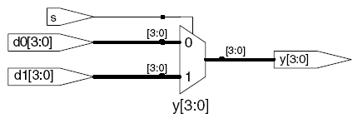
Conditional Assignment
module mux2(input logic [3:0] d0, d1,
input logic s,
output logic [3:0] y);
assign y = s ? d1 : d0;
endmodule
? : is also called a ternary operator because it
operates on 3 inputs: s, d1, and d0.

Slide 14
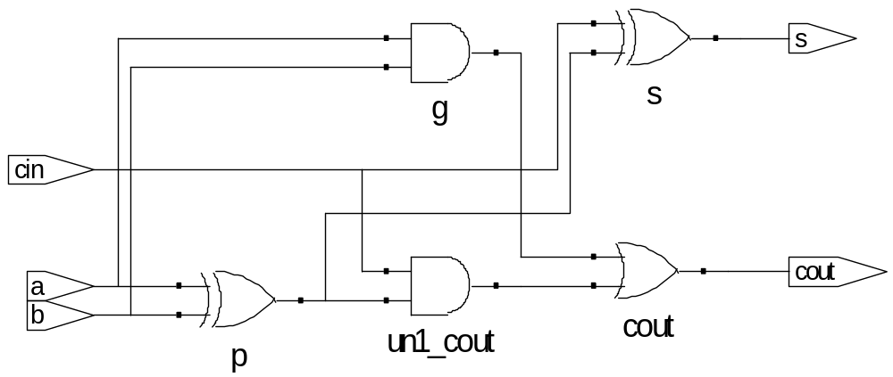
Internal Variables
module fulladder(input logic a, b, cin,
output logic s, cout);
logic p, g; // internal nodes
assign p = a ^ b;
assign g = a & b;
assign s = p ^ cin;
assign cout = g | (p & cin);
endmodule

Slide 15
Precedence
Order of operations
Highest
~ | NOT
*, /, % | mult, div, mod
+, - | add,sub
<<, >> | shift
<<<, >>> | arithmetic shift
<, <=, >, >= | comparison
==, != | equal, not equal
&, ~& | AND, NAND
^, ~^ | XOR, XNOR
|, ~| | OR, NOR
?: | ternary operator
Just like >>> in Java
Lowest

Slide 16
Numbers
C and Java use 043 for octal and 0xAB for hexadecimal. Java now allows 0b101 for binary.
Format: N'Bvalue
N = number of bits, B = base
N'B is optional but recommended (default is decimal)
Number | # Bits | Base | Decimal Equivalent | Stored
3'b101 | 3 | binary | 5 | 101
'b11 | unsized | binary | 3 | 00…0011
8'b11 | 8 | binary | 3 | 00000011
8'b1010_1011 | 8 | binary | 171 | 10101011
3'd6 | 3 | decimal | 6 | 110
6'o42 | 6 | octal | 34 | 100010
8'hAB | 8 | hexadecimal | 171 | 10101011
42 | Unsized | decimal | 42 | 00…0101010

Slide 17
Bit Manipulations: Example 1
assign y = {a[2:1], {3{b[0]}}, a[0], 6'b100_010};
// if y is a 12-bit signal, the above statement produces:
y = a[2] a[1] b[0] b[0] b[0] a[0] 1 0 0 0 1 0
// underscores (_) are used for formatting only to make it easier to read. SystemVerilog ignores them.
Java now has this same use of underscores in numbers

Slide 18
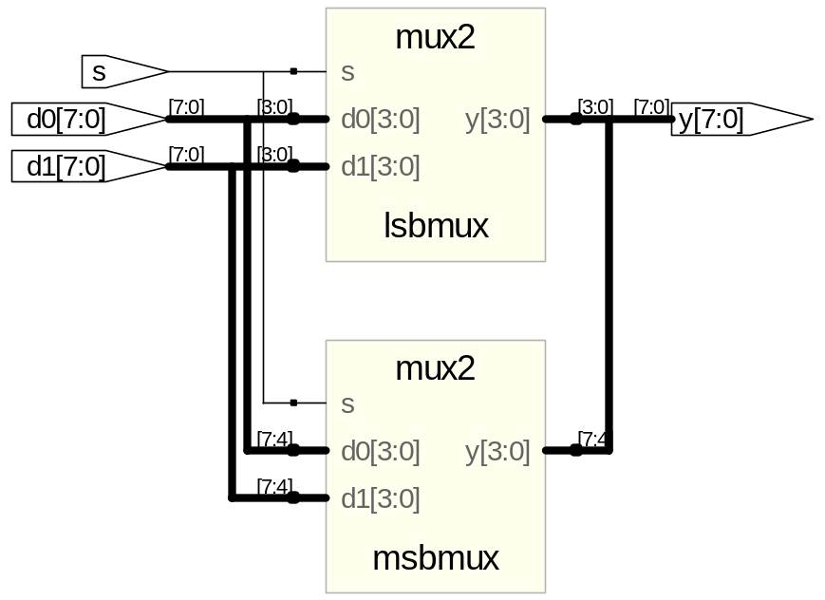
Bit Manipulations: Example 2
SystemVerilog:
module mux2_8(input logic [7:0] d0, d1,
input logic s,
output logic [7:0] y);
mux2 lsbmux(d0[3:0], d1[3:0], s, y[3:0]);
mux2 msbmux(d0[7:4], d1[7:4], s, y[7:4]);
endmodule

Slide 19
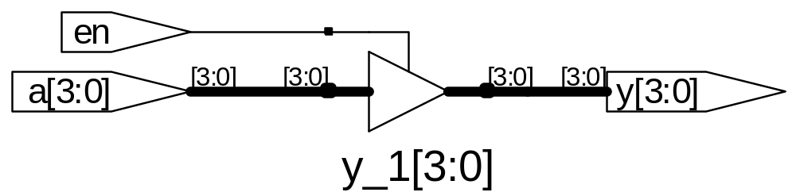
Z: Floating Output
SystemVerilog:
module tristate(input logic [3:0] a,
input logic en,
output logic [3:0] y);
assign y = en ? a : 4'bz;
endmodule
z is high impedance

Slide 20
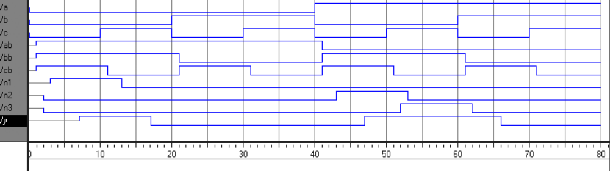
Delays
module example(input logic a, b, c,
output logic y);
logic ab, bb, cb, n1, n2, n3;
assign #1 {ab, bb, cb} = ~{a, b, c};
assign #2 n1 = ab & bb & cb;
assign #2 n2 = a & bb & cb;
assign #2 n3 = a & bb & c;
assign #4 y = n1 | n2 | n3;
endmodule

Slide 21
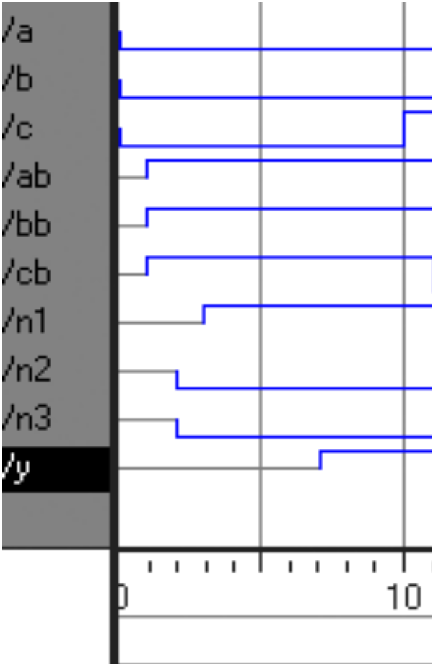
Delays
module example(input logic a, b, c,
output logic y);
logic ab, bb, cb, n1, n2, n3;
assign #1 {ab, bb, cb} =
~{a, b, c};
assign #2 n1 = ab & bb & cb;
assign #2 n2 = a & bb & cb;
assign #2 n3 = a & bb & c;
assign #4 y = n1 | n2 | n3;
endmodule

Slide 22
Sequential Logic
SystemVerilog uses Idioms to describe latches, flip-flops and FSMs
Other coding styles may simulate correctly but produce incorrect hardware

Slide 23
Always Statement
General Structure:
always @(sensitivity list)
statement;
Whenever the event in sensitivity list occurs, statement is executed

Slide 24
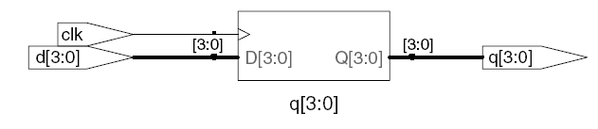
D Flip-Flop
module flop(input logic clk,
input logic [3:0] d,
output logic [3:0] q);
always_ff @(posedge clk)
q <= d; // pronounced “q gets d”
endmodule

Slide 25
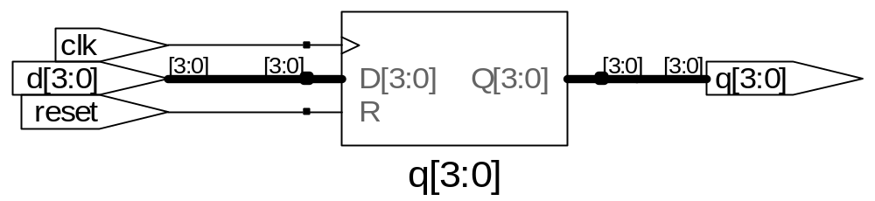
Resettable D Flip-Flop
module flopr(input logic clk,
input logic reset,
input logic [3:0] d,
output logic [3:0] q);
// synchronous reset
always_ff @(posedge clk)
if (reset) q <= 4'b0;
else q <= d;
endmodule

Slide 26
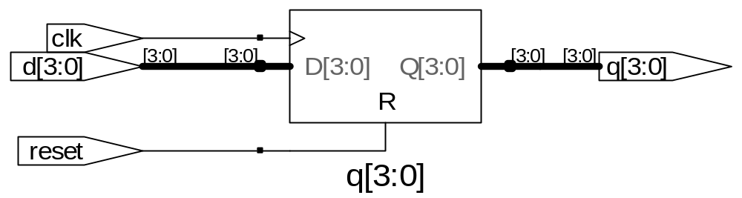
Resettable D Flip-Flop
module flopr(input logic clk,
input logic reset,
input logic [3:0] d,
output logic [3:0] q);
// asynchronous reset
always_ff @(posedge clk, posedge reset)
if (reset) q <= 4'b0;
else q <= d;
endmodule

Slide 27
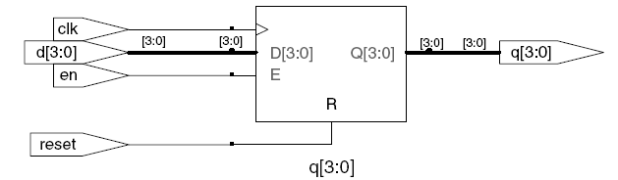
D Flip-Flop with Enable
module flopren(input logic clk,
input logic reset,
input logic en,
input logic [3:0] d,
output logic [3:0] q);
// asynchronous reset and enable
always_ff @(posedge clk, posedge reset)
if (reset) q <= 4'b0;
else if (en) q <= d;
endmodule

Slide 28
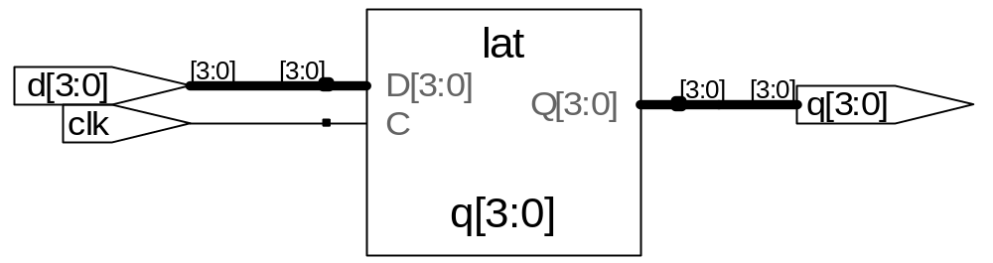
Latch
module latch(input logic clk,
input logic [3:0] d,
output logic [3:0] q);
always_latch
if (clk) q <= d;
endmodule
Warning: We don’t use latches in this text. But you might write code that inadvertently implies a latch. Check synthesized hardware – if it has latches
in it, there’s an error.

Slide 29
Other Behavioral Statements
Statements that must be inside always statements:
  if / else
  case, casez

Slide 30
Combinational Logic using always
// combinational logic using an always statement
module gates(input logic [3:0] a, b,
output logic [3:0] y1, y2, y3, y4, y5);
always_comb // need begin/end because there is
begin // more than one statement in always
y1 = a & b; // AND
y2 = a | b; // OR
y3 = a ^ b; // XOR
y4 = ~(a & b); // NAND
y5 = ~(a | b); // NOR
end
endmodule
This hardware could be described with assign statements using fewer lines of code, so it’s better to use assign statements in this case.

Slide 31
Combinational Logic using case
module sevenseg(input logic [3:0] data,
output logic [6:0] segments);
always_comb
case (data)
// abc_defg
0: segments = 7'b111_1110;
1: segments = 7'b011_0000;
2: segments = 7'b110_1101;
3: segments = 7'b111_1001;
4: segments = 7'b011_0011;
5: segments = 7'b101_1011;
6: segments = 7'b101_1111;
7: segments = 7'b111_0000;
8: segments = 7'b111_1111;
9: segments = 7'b111_0011;
default: segments = 7'b000_0000; // required
endcase
endmodule
None of those annoying break statements like in C

Slide 32
Combinational Logic using case
case statement implies combinational logic only if all possible input combinations described
Remember to use default statement

Slide 33
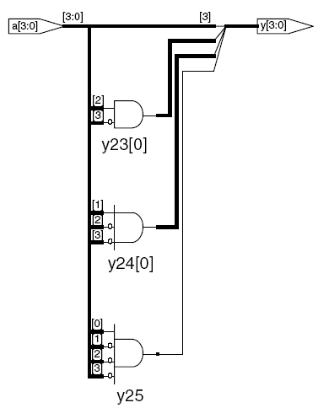
Combinational Logic using casez
module priority_casez(input logic [3:0] a,
output logic [3:0] y);
always_comb
casez(a)
4'b1???: y = 4'b1000; // ? = don’t care
4'b01??: y = 4'b0100;
4'b001?: y = 4'b0010;
4'b0001: y = 4'b0001;
default: y = 4'b0000;
endcase
endmodule

Slide 34
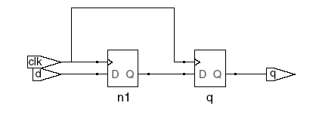

Blocking vs. Nonblocking Assignment
<= is nonblocking assignment
  Occurs simultaneously with others
= is blocking assignment
  Occurs in order it appears in file
// Good synchronizer using
// nonblocking assignments
module syncgood(input logic clk,
input logic d,
output logic q);
logic n1;
always_ff @(posedge clk)
begin
n1 <= d; // nonblocking
q <= n1; // nonblocking
end
endmodule
// Bad synchronizer using
// blocking assignments
module syncbad(input logic clk,
input logic d,
output logic q);
logic n1;
always_ff @(posedge clk)
begin
n1 = d; // blocking
q = n1; // blocking
end
endmodule

Slide 35
Rules for Signal Assignment
Synchronous sequential logic: use always_ff @(posedge clk) and nonblocking assignments (<=)
always_ff @ (posedge clk)
q <= d; // nonblocking
Simple combinational logic: use continuous assignments (assign…)
assign y = a & b;
More complicated combinational logic: use always_comb and blocking assignments (=)
Assign a signal in only one always statement or continuous assignment statement.

Slide 36
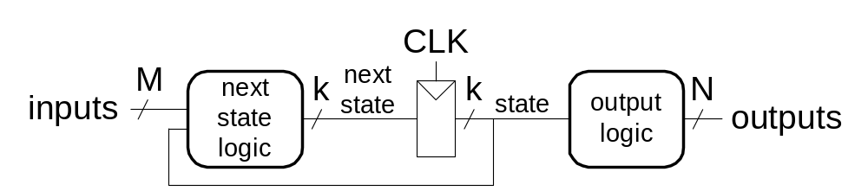
Finite State Machines (FSMs)
Three blocks:
  next state logic
  state register
  output logic

Slide 37
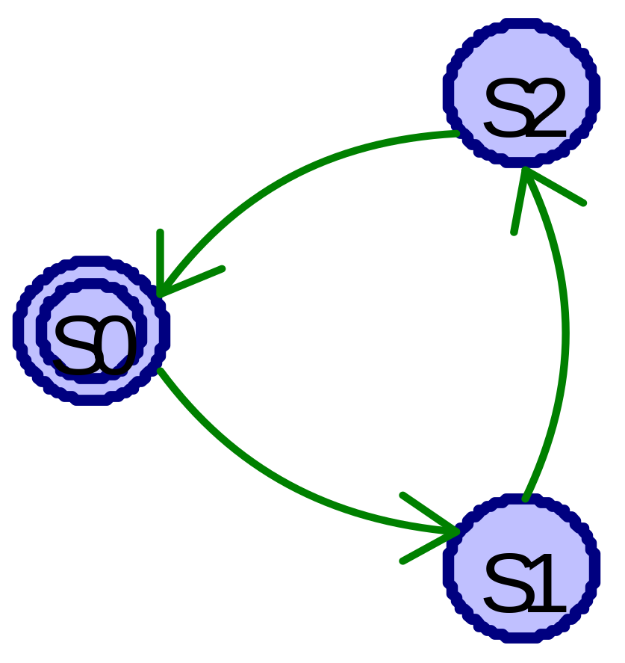
FSM Example: Divide by 3
The double circle indicates the reset state
In 431 and 434, the double circle will probably indicate the accepting state

Slide 38
FSM in SystemVerilog
module divideby3FSM (input logic clk,
input logic reset,
output logic q);
typedef enum logic [1:0] {S0, S1, S2} statetype;
statetype [1:0] state, nextstate;
// state register
always_ff @ (posedge clk, posedge reset)
if (reset) state <= S0;
else state <= nextstate;
// next state logic
always_comb
case (state)
S0: nextstate = S1;
S1: nextstate = S2;
S2: nextstate = S0;
default: nextstate = S0;
endcase
// output logic
assign q = (state == S0);
endmodule
In plain Verilog, you had to specify the state assignments.
In VHDL, you wouldn’t have to specify the number of bits.

Slide 39
Parameterized Modules
2:1 mux:
module mux2
#(parameter width = 8) // name and default value
(input logic [width-1:0] d0, d1,
input logic s,
output logic [width-1:0] y);
assign y = s ? d1 : d0;
endmodule
Instance with 8-bit bus width (uses default):
mux2 mux1(d0, d1, s, out);
Instance with 12-bit bus width:
mux2 #(12) lowmux(d0, d1, s, out);

Slide 40
Testbenches
HDL that tests another module: device under test (dut)
Not synthesizeable
Types:
  Simple
  Self-checking
  Self-checking with testvectors

Slide 41
Testbench Example
Write SystemVerilog code to implement the following function in hardware:
y = bc + ab
Name the module sillyfunction

Slide 42
Testbench Example
Write SystemVerilog code to implement the following function in hardware:
y = bc + ab
module sillyfunction(input logic a, b, c,
output logic y);
assign y = ~b & ~c | a & ~b;
endmodule

Slide 43
Simple Testbench
module testbench1();
logic a, b, c;
logic y;
// instantiate device under test
sillyfunction dut(a, b, c, y);
// apply inputs one at a time
initial begin
a = 0; b = 0; c = 0; #10;
c = 1; #10;
b = 1; c = 0; #10;
c = 1; #10;
a = 1; b = 0; c = 0; #10;
c = 1; #10;
b = 1; c = 0; #10;
c = 1; #10;
end
endmodule

Slide 44
Self-checking Testbench
module testbench2();
logic a, b, c;
logic y;
sillyfunction dut(a, b, c, y); // instantiate dut
initial begin // apply inputs, check results one at a time
a = 0; b = 0; c = 0; #10;
if (y !== 1) $display("000 failed.");
c = 1; #10;
if (y !== 0) $display("001 failed.");
b = 1; c = 0; #10;
if (y !== 0) $display("010 failed.");
c = 1; #10;
if (y !== 0) $display("011 failed.");
a = 1; b = 0; c = 0; #10;
if (y !== 1) $display("100 failed.");
c = 1; #10;
if (y !== 1) $display("101 failed.");
b = 1; c = 0; #10;
if (y !== 0) $display("110 failed.");
c = 1; #10;
if (y !== 0) $display("111 failed.");
end
endmodule

Slide 45
Testbench with Testvectors
Testvector file: inputs and expected outputs
Testbench:
  Generate clock for assigning inputs, reading outputs
  Read testvectors file into array
  Assign inputs, expected outputs
  Compare outputs with expected outputs and report errors

Slide 46
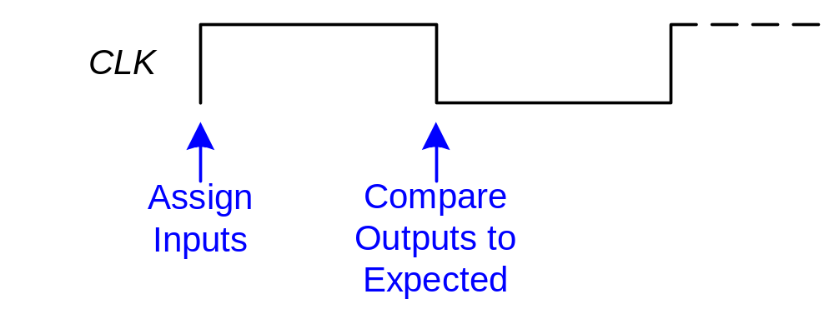
Testbench with Testvectors
Testbench clock:
  assign inputs (on rising edge)
  compare outputs with expected outputs (on falling edge).
Testbench clock also used as clock for synchronous sequential circuits

Slide 47
Testvectors File
File: example.tv
contains vectors of abc_yexpected
000_1
001_0
010_0
011_0
100_1
101_1
110_0
111_0
But weren’t underscores ignored?
You can’t always be consistent.

Slide 48
1. Generate Clock
module testbench3();
logic clk, reset;
logic a, b, c, yexpected;
logic y;
logic [31:0] vectornum, errors; // bookkeeping variables
logic [3:0] testvectors[10000:0]; // array of testvectors
// instantiate device under test
sillyfunction dut(a, b, c, y);
// generate clock
always // no sensitivity list, so it always executes
begin
clk = 1; #5; clk = 0; #5;
end

Slide 49
2. Read Testvectors into Array
// at start of test, load vectors and pulse reset
initial
begin
$readmemb("example.tv", testvectors);
vectornum = 0; errors = 0;
reset = 1; #27; reset = 0;
end
// Note: $readmemh reads testvector files written in
// hexadecimal

Slide 50
3. Assign Inputs & Expected Outputs
// apply test vectors on rising edge of clk
always @(posedge clk)
begin
#1; {a, b, c, yexpected} = testvectors[vectornum];
end

Slide 51
4. Compare with Expected Outputs
// check results on falling edge of clk
always @(negedge clk)
if (~reset) begin // skip during reset
if (y !== yexpected) begin
$display("Error: inputs = %b", {a, b, c});
$display(" outputs = %b (%b expected)",y,yexpected);
errors = errors + 1;
end
// Note: to print in hexadecimal, use %h. For example,
// $display(“Error: inputs = %h”, {a, b, c});

Slide 52
4. Compare with Expected Outputs
// increment array index and read next testvector
vectornum = vectornum + 1;
if (testvectors[vectornum] === 4'bx) begin
$display("%d tests completed with %d errors",
vectornum, errors);
$finish;
end
end
endmodule
// === and !== can compare values that are 1, 0, x, or z.

