Slide 1
Chapter 3
Digital Design and Computer Architecture, 2nd Edition
David Money Harris and Sarah L. Harris
Edited by J Dean Brock
For CSCI 320

Slide 2
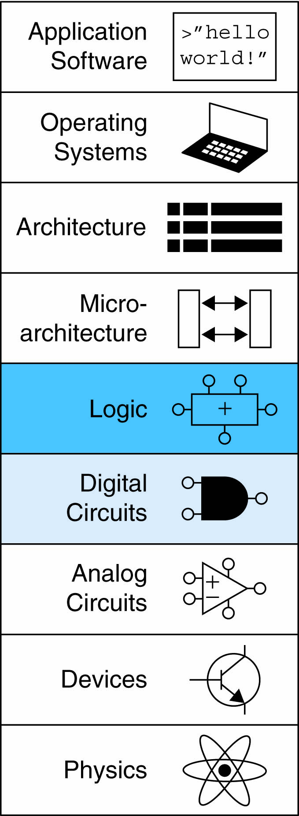
Chapter 3 :: Topics
Introduction
Latches and Flip-Flops
Synchronous Logic Design
Finite State Machines
Timing of Sequential Logic
Parallelism

Slide 3
Introduction
Outputs of sequential logic depend on current and prior input values – it has memory.
Some definitions:
  State: all the information about a circuit necessary to explain its future behavior
  Latches and flip-flops: state elements that store one bit of state
  Synchronous sequential circuits: combinational logic followed by a bank of flip-flops

Slide 4
State Elements
The state of a circuit influences its future behavior
State elements store state
  Bistable circuit
  SR Latch
  D Latch
  D Flip-flop

Slide 5
Bistable Circuit
Fundamental building block of other state elements
Two outputs: Q, Q
No inputs

Slide 6
Bistable Circuit Analysis
Consider the two possible cases:
  Q = 0:
  then Q = 1, Q = 0 (consistent)
  Q = 1:
  then Q = 0, Q = 1 (consistent)
Stores 1 bit of state in the state variable, Q (or Q)
But there are no inputs to control the state

Slide 7
SR (Set/Reset) Latch
SR Latch
Consider the four possible cases:
  S = 1, R = 0
  S = 0, R = 1
  S = 0, R = 0
  S = 1, R = 1

Slide 8
SR Latch Analysis
  S = 1, R = 0:
  then Q = 1 and Q = 0
  S = 0, R = 1:
  then Q = 1 and Q = 0

Slide 9
SR Latch Analysis
  S = 0, R = 0:
  then Q = Q_{prev}
  Memory!
  S = 1, R = 1:
  then Q = 0, Q = 0
  Invalid State
  Q ≠ NOT Q

Slide 10
SR Latch Symbol
SR stands for Set/Reset Latch
  Stores one bit of state (Q)
Control what value is being stored with S, R inputs
  Set: Make the output 1
  (S = 1, R = 0, Q = 1)
  Reset: Make the output 0
  (S = 0, R = 1, Q = 0)
Must do something to avoid
invalid state (when S = R = 1)

Slide 11
D Latch
Two inputs: CLK, D
  CLK: controls when the output changes
  D (the data input): controls what the output changes to
Function
  When CLK = 1,
  D passes through to Q (transparent)
  When CLK = 0,
  Q holds its previous value (opaque)
Avoids invalid case when
Q ≠ NOT Q

Slide 12
D Latch Internal Circuit

Slide 13
D Flip-Flop
Inputs: CLK, D
Function
  Samples D on rising edge of CLK
    When CLK rises from 0 to 1, D passes through to Q
    Otherwise, Q holds its previous value
  Q changes only on rising edge of CLK
Called edge-triggered
Activated on the clock edge

Slide 14
D Flip-Flop Internal Circuit
Two back-to-back latches (L1 and L2) controlled by complementary clocks
When CLK = 0
  L1 is transparent
  L2 is opaque
  D passes through to N1
When CLK = 1
  L2 is transparent
  L1 is opaque
  N1 passes through to Q
Thus, on the edge of the clock (when CLK rises from 0 1)
  D passes through to Q
D must hold its value during this time

Slide 15
D Latch vs. D Flip-Flop

Slide 16
Registers

Slide 17
Enabled Flip-Flops
Inputs: CLK, D, EN
  The enable input (EN) controls when new data (D) is stored
Function
  EN = 1: D passes through to Q on the clock edge
  EN = 0: the flip-flop retains its previous state

Slide 18
Resettable Flip-Flops
Inputs: CLK, D, Reset
Function:
  Reset = 1: Q is forced to 0
  Reset = 0: flip-flop behaves as ordinary D flip-flop

Slide 19
Resettable Flip-Flops
Two types:
  Synchronous: resets at the clock edge only
  Asynchronous: resets immediately when Reset = 1
Asynchronously resettable flip-flop requires changing the internal circuitry of the flip-flop
Synchronously resettable flip-flop?
You’ll see examples of this with Verilog

Slide 20
Settable Flip-Flops
Inputs: CLK, D, Set
Function:
  Set = 1: Q is set to 1
  Set = 0: the flip-flop behaves as ordinary D flip-flop

Slide 21
Synchronous Sequential Logic Design
Breaks cyclic paths by inserting registers
Registers contain state of the system
State changes at clock edge: system synchronized to the clock
Rules of synchronous sequential circuit composition:
  Every circuit element is either a register or a combinational circuit
  At least one circuit element is a register
  All registers receive the same clock signal
  Every cyclic path contains at least one register
Two common synchronous sequential circuits
  Finite State Machines (FSMs)
  Pipelines

Slide 22
Finite State Machine (FSM)
Consists of:
  State register
    Stores current state
    Loads next state at clock edge
  Combinational logic
    Computes the next state
    Computes the outputs

Slide 23
Finite State Machines (FSMs)
Next state determined by current state and inputs
Two types of finite state machines differ in output logic:
  Moore FSM: outputs depend only on current state
  Mealy FSM: outputs depend on current state and inputs

Slide 24
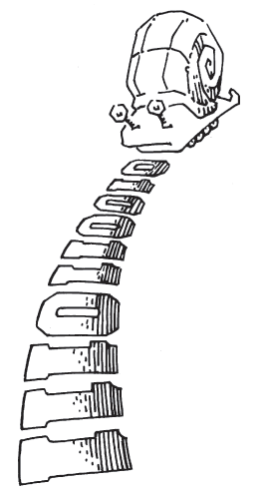
Moore vs. Mealy FSM
Alyssa P. Hacker has a snail that crawls down a paper tape with 1’s and 0’s on it. The snail smiles whenever the last two digits it has crawled over are 01. Design Moore and Mealy FSMs of the snail’s brain.

Slide 25
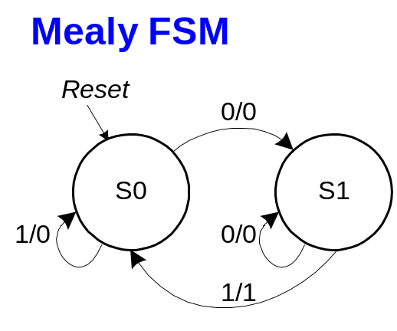
State Transition Diagrams
Mealy FSM: arcs indicate input/output
Ludwig Mies van der Rohe:
More is less
Usually the Moore machine will have more states because it must “remember” the next output.
In the Mealy machine, the output changes as soon as the input does. This can be very confusing.

Slide 26
Moore FSM State Transition Table
Current State |  | Inputs | Next State
S₁ | S₀ | A | S'₁ | S'₀
0 | 0 | 0
0 | 0 | 1
0 | 1 | 0
0 | 1 | 1
1 | 0 | 0
1 | 0 | 1
State | Encoding
S0 | 00
S1 | 01
S2 | 10

Slide 27
Moore FSM State Transition Table
Current State |  | Inputs | Next State
S₁ | S₀ | A | S'₁ | S'₀
0 | 0 | 0 | 0 | 1
0 | 0 | 1 | 0 | 0
0 | 1 | 0 | 0 | 1
0 | 1 | 1 | 1 | 0
1 | 0 | 0 | 0 | 1
1 | 0 | 1 | 0 | 0
State | Encoding
S0 | 00
S1 | 01
S2 | 10
S₁’ = S₀A
S₀’ = A

Slide 28
Moore FSM Output Table
Current State |  | Output
S₁ | S₀ | Y
0 | 0
0 | 1
1 | 0
Y = S₁

Slide 29
Moore FSM Output Table
Current State |  | Output
S₁ | S₀ | Y
0 | 0 | 0
0 | 1 | 0
1 | 0 | 1
Y = S₁

Slide 30
Mealy FSM State Transition & Output Table
Current State | Input | Next State | Output
S₀ | A | S'₀ | Y
0 | 0
0 | 1
1 | 0
1 | 1
State | Encoding
S0 | 00
S1 | 01

Slide 31
Mealy FSM State Transition & Output Table
Current State | Input | Next State | Output
S₀ | A | S'₀ | Y
0 | 0 | 1 | 0
0 | 1 | 0 | 0
1 | 0 | 1 | 0
1 | 1 | 0 | 1
State | Encoding
S0 | 00
S1 | 01

Slide 32
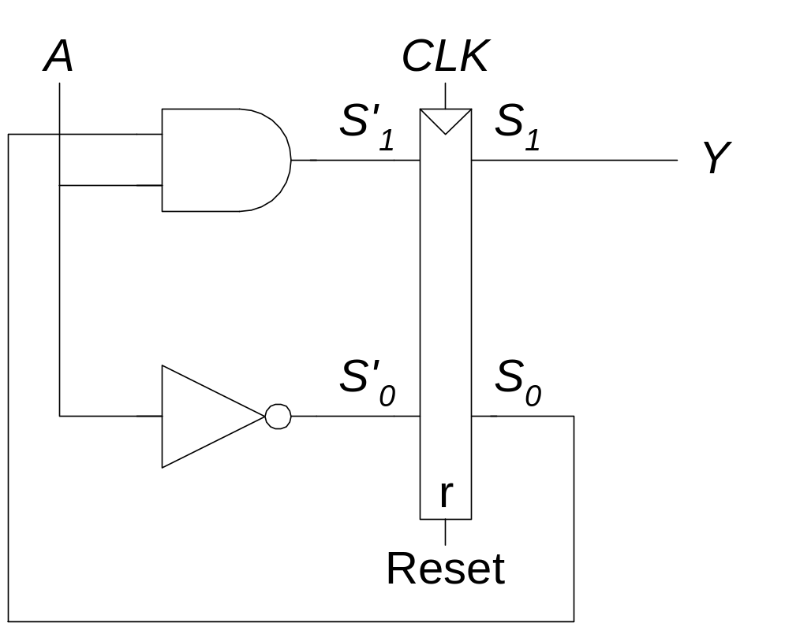
Moore FSM Schematic

Slide 33
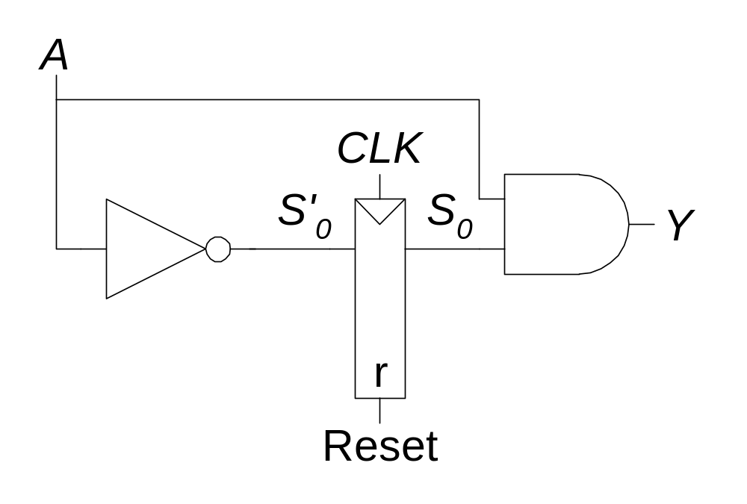
Mealy FSM Schematic

Slide 34
Moore & Mealy Timing Diagram

Slide 35
Factoring State Machines
Break complex FSMs into smaller interacting FSMs
Example: Modify traffic light controller to have Parade Mode.
  Two more inputs: P, R
  When P = 1, enter Parade Mode & Bravado Blvd light stays green
  When R = 1, leave Parade Mode
A bit like code refactoring
But not really NetBean refactoring

Slide 36
Parade FSM
Unfactored FSM
Factored FSM

Slide 37
Unfactored FSM

Slide 38
Factored FSM
And number factoring
8 = 4 x 2

Slide 39
FSM Design Procedure
Identify inputs and outputs
Sketch state transition diagram
Write state transition table
Select state encodings
For Moore machine:
  Rewrite state transition table with state encodings
  Write output table
For a Mealy machine:
  Rewrite combined state transition and output table with state encodings
Write Boolean equations for next state and output logic
Sketch the circuit schematic

Slide 40
Timing
Flip-flop samples D at clock edge
D must be stable when sampled
Similar to a photograph, D must be stable around clock edge
If not, metastability can occur

Slide 41
Input Timing Constraints
Setup time: t_{setup} = time before clock edge data must be stable (i.e. not changing)
Hold time: t_{hold} = time after clock edge data must be stable
Aperture time: t_{a} = time around clock edge data must be stable (t_{a} = t_{setup} + t_{hold})

Slide 42
Output Timing Constraints
Propagation delay: t_{pcq} = time after clock edge that the output Q is guaranteed to be stable (i.e., to stop changing)
Contamination delay: t_{ccq} = time after clock edge that Q might be unstable (i.e., start changing)

Slide 43
Dynamic Discipline
Synchronous sequential circuit inputs must be stable during aperture (setup and hold) time around clock edge
Specifically, inputs must be stable
  at least t_{setup} before the clock edge
  at least until t_{hold} after the clock edge

Slide 44
Dynamic Discipline
The delay between registers has a minimum and maximum delay, dependent on the delays of the circuit elements

Slide 45
Setup Time Constraint
Depends on the maximum delay from register R1 through combinational logic to R2
The input to register R2 must be stable at least t_{setup} before clock edge
T_{c} ≥ t_{pcq} + t_{pd} + t_{setup}
t_{pd} ≤ T_{c} – (t_{pcq} + t_{setup})
Two propagation delays:
New value out of the flip-flop
New value out of the combinational circuit

Slide 46
Hold Time Constraint
Depends on the minimum delay from register R1 through the combinational logic to R2
The input to register R2 must be stable for at least t_{hold} after the clock edge
t_{hold} < t_{ccq} + t_{cd}
t_{cd} > t_{hold} - t_{ccq}
Two contamination delays:
Old value still out the flip-flop
Old value still out of the combinational circuit

Slide 47
Timing Analysis
Timing Characteristics
t_{ccq} = 30 ps
t_{pcq} = 50 ps
t_{setup} = 60 ps
t_{hold} = 70 ps
t_{pd} = 35 ps
t_{cd} = 25 ps
t_{pd} = 3 x 35 ps = 105 ps
t_{cd} = 25 ps
Setup time constraint:
T_{c} ≥ (50 + 105 + 60) ps = 215 ps
f_{c} = 1/T_{c} = 4.65 GHz
Y’ stable after change
Contamination can flow through flip-flop and combinational circuit before flip-flop hold is over
Y’ contaminated after change
Hold time constraint:
t_{ccq} + t_{cd} > t_{hold} ?
(30 + 25) ps > 70 ps ? No!
Flip-flops propagate
AND/ORs propagate
Flip-flop setup

Slide 48
Timing Analysis
Add buffers to the short paths:
Timing Characteristics
t_{ccq} = 30 ps
t_{pcq} = 50 ps
t_{setup} = 60 ps
t_{hold} = 70 ps
t_{pd} = 35 ps
t_{cd} = 25 ps
t_{pd} = 3 x 35 ps = 105 ps
t_{cd} = 2 x 25 ps = 50 ps
Setup time constraint:
T_{c} ≥ (50 + 105 + 60) ps = 215 ps
f_{c} = 1/T_{c} = 4.65 GHz
Add buffers to slow down contamination
Hold time constraint:
t_{ccq} + t_{cd} > t_{hold} ?
(30 + 50) ps > 70 ps ? Yes!
No change in clock time

Slide 49
Clock Skew
The clock doesn’t arrive at all registers at same time
Skew: difference between two clock edges
Perform worst case analysis to guarantee dynamic discipline is not violated for any register – many registers in a system!
This is a significant problem in large chips.
A great deal of engineering and chip real goes into the solution of this problem.

Slide 50

Violating the Dynamic Discipline
Asynchronous (for example, user) inputs might violate the dynamic discipline

Slide 51
Metastability
Bistable devices: two stable states, and a metastable state between them
Flip-flop: two stable states (1 and 0) and one metastable state
If flip-flop lands in metastable state, could stay there for an undetermined amount of time
How long can a flipped coin roll or stand on its edge?

Slide 52
Flip-Flop Internals
Flip-flop has feedback: if Q is somewhere between 1 and 0, cross-coupled gates drive output to either rail (1 or 0)
Metastable signal: if it hasn’t resolved to 1 or 0
If flip-flop input changes at random time, probability that output Q is metastable after waiting some time, t:
P(t_{res} > t) = (T₀/T_{c} ) e^{-t/τ}
t_{res} : time to resolve to 1 or 0
T₀, τ : properties of the circuit

Slide 53
Metastability
Intuitively:
  T₀/T_{c}: probability input changes at a bad time (during aperture)
P(t_{res} > t) = (T₀/T_{c} ) e^{-t/τ}
  τ: time constant for how fast flip-flop moves away from metastability
P(t_{res} > t) = (T₀/T_{c} ) e^{-t/τ}
In short, if flip-flop samples metastable input, if you wait long enough (t), the output will have resolved to 1 or 0 with high probability.

Slide 54
Synchronizers
Asynchronous inputs are inevitable (user interfaces, systems with different clocks interacting, etc.)
Synchronizer goal: make the probability of failure (the output Q still being metastable) low
Synchronizer cannot make the probability of failure 0

Slide 55
Synchronizer Internals
Synchronizer: built with two back-to-back flip-flops
Suppose D is transitioning when sampled by F1
Internal signal D2 has (T_{c} - t_{setup}) time to resolve to 1 or 0

Slide 56
Synchronizer Probability of Failure
For each sample, probability of failure is:
P(failure) = (T₀/T_{c} ) e^{-(T}_{c} ^{- t}_{setup}^{)/τ}
T₀ and τ and “properties of the circuit, that is, someone else’s problem.

Slide 57
Synchronizer Mean Time Between Failures
If asynchronous input changes once per second, probability of failure per second is P(failure).
If input changes N times per second, probability of failure per second is:
P(failure)/second = (NT₀/T_{c}) e^{-(T}_{c} ^{- t}_{setup}^{)/τ}
Synchronizer fails, on average, 1/[P(failure)/second]
Called mean time between failures, MTBF:
MTBF = 1/[P(failure)/second] = (T_{c}/NT₀) e^{(T}_{c} ^{- t}_{setup}^{)/τ}
Let’s trust them on this one…

Slide 58
Example Synchronizer
Suppose: T_{c} = 1/500 MHz = 2 ns τ = 200 ps
T₀ = 150 ps t_{setup} = 100 ps
N = 1 events per second
What is the probability of failure? MTBF?
P(failure) = (150 ps/2 ns) e^{-(1.9 ns)/200 ps}
= 5.6 × 10⁻⁶
P(failure)/second = 10 × (5.6 × 10⁻⁶ )
= 5.6 × 10⁻⁵ / second
MTBF = 1/[P(failure)/second] ≈ 5 hours

Slide 59
Parallelism
Two types of parallelism:
  Spatial parallelism
    duplicate hardware performs multiple tasks at once
  Temporal parallelism
    task is broken into multiple stages
    also called pipelining
    for example, an assembly line

Slide 60
Parallelism Definitions
Token: Group of inputs processed to produce group of outputs
Latency: Time for one token to pass from start to end
Throughput: Number of tokens produced per unit time
Parallelism increases throughput

Slide 61
Parallelism Example
Ben Bitdiddle bakes cookies to celebrate traffic light controller installation
5 minutes to roll cookies
15 minutes to bake
What is the latency and throughput without parallelism?

Slide 62
Parallelism Example
Ben Bitdiddle bakes cookies to celebrate traffic light controller installation
5 minutes to roll cookies
15 minutes to bake
What is the latency and throughput without parallelism?
Latency = 5 + 15 = 20 minutes = 1/3 hour
Throughput = 1 tray/ 1/3 hour = 3 trays/hour

Slide 63
Parallelism Example
What is the latency and throughput if Ben uses parallelism?
  Spatial parallelism: Ben asks Allysa P. Hacker to help, using her own oven
  Temporal parallelism:
    two stages: rolling and baking
    He uses two trays
    While first batch is baking, he rolls the second batch, etc.

Slide 64
Spatial Parallelism
Latency = 5 + 15 = 20 minutes = 1/3 hour
Throughput = 2 trays/ 1/3 hour = 6 trays/hour

Slide 65
Temporal Parallelism
Latency = 5 + 15 = 20 minutes = 1/3 hour
Throughput = 1 trays/ 1/4 hour = 4 trays/hour
Using both techniques, the throughput would be 8 trays/hour

