Slide 1
Chapter 2
Digital Design and Computer Architecture, 2nd Edition
David Money Harris and Sarah L. Harris
Edited by J Dean Brock
For CSCI 320

Slide 2
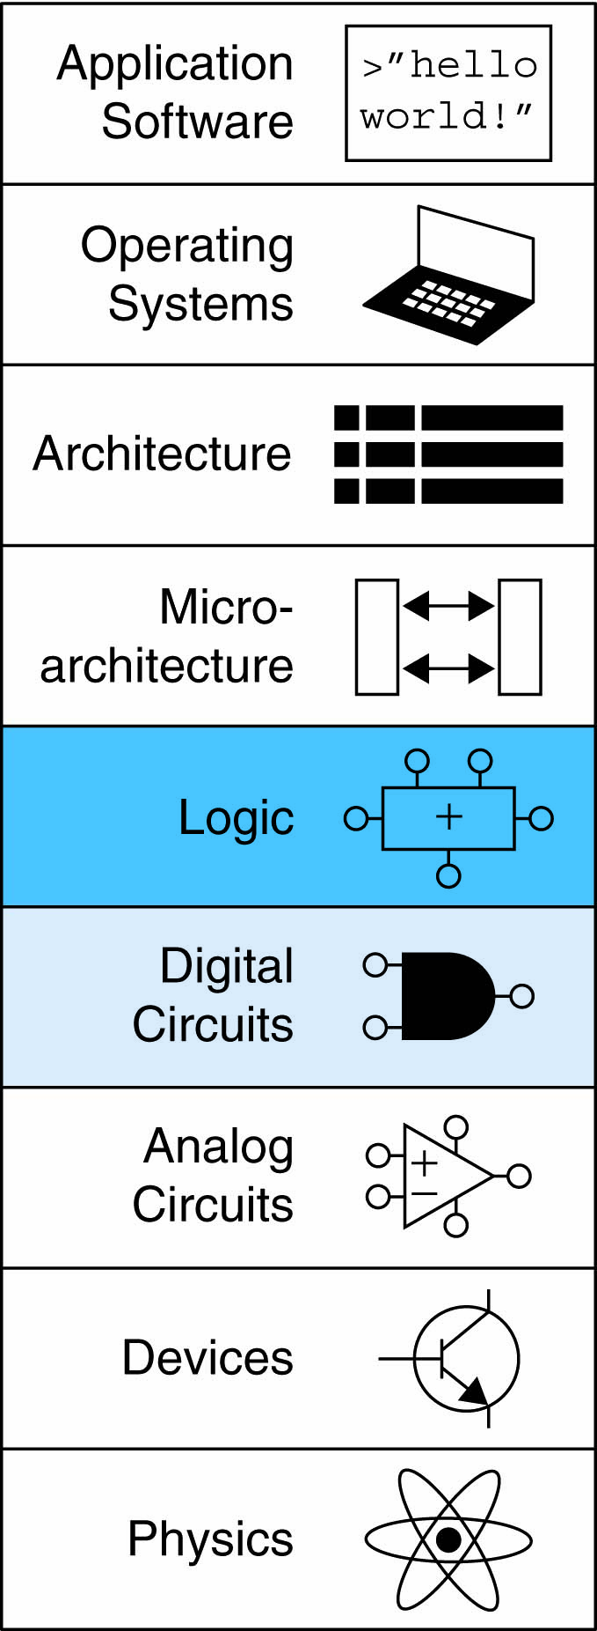
Chapter 2 :: Topics
Introduction
Boolean Equations
Boolean Algebra
From Logic to Gates
Multilevel Combinational Logic
X’s and Z’s, Oh My
Karnaugh Maps
Combinational Building Blocks
Timing

Slide 3
Introduction
A logic circuit is composed of:
Inputs
Outputs
Functional specification
Timing specification

Slide 4
Circuits
Nodes
  Inputs: A, B, C
  Outputs: Y, Z
  Internal: n1
Circuit elements
  E1, E2, E3
  Each a circuit

Slide 5
Types of Logic Circuits
Combinational Logic
  Memoryless
  Outputs determined by current values of inputs
Sequential Logic
  Has memory
  Outputs determined by previous and current values of inputs

Slide 6
Rules of Combinational Composition
Every element is combinational
Every node is either an input or connects to exactly one output
The circuit contains no cyclic paths
Example:

Slide 7
Boolean Equations
Functional specification of outputs in terms of inputs
Example: S = F(A, B, C_{in})
C_{out} = F(A, B, C_{in})

Slide 8
Some Definitions
Complement: variable with a bar over it
A, B, C
Literal: variable or its complement
A, A, B, B, C, C
Implicant: product of literals
ABC, AC, BC
Minterm: product that includes all input variables
ABC, ABC, ABC
Maxterm: sum that includes all input variables
(A+B+C), (A+B+C), (A+B+C)

Slide 9
Sum-of-Products Form
Sum-of-Products (SOP) Form
All equations can be written in SOP form
Each row has a minterm
A minterm is a product (AND) of literals
Each minterm is TRUE for that row (and only that row)
Form function by ORing minterms where the output is TRUE
Thus, a sum (OR) of products (AND terms)
Often called
canonical
sum-of-products
Y = F(A, B) = AB + AB = Σ(1, 3)

Slide 10
Product-of-Sums (POS) Form
All Boolean equations can be written in POS form
Each row has a maxterm
A maxterm is a sum (OR) of literals
Each maxterm is FALSE for that row (and only that row)
Form function by ANDing the maxterms for which the output is FALSE
Thus, a product (AND) of sums (OR terms)
Y = F(A, B) = (A + B)(A + B) = Π(0, 2)

Slide 11
Boolean Equations Example
You are going to the cafeteria for lunch
  You won’t eat lunch (E)
  If it’s not open (O) or
  If they only serve corndogs (C)
Write a truth table for determining if you will eat lunch (E).
This is the sort of thing done in symbolic logic course

Slide 12
SOP & POS Form
SOP – sum-of-products
POS – product-of-sums
Y = OC
= Σ(2)
Y = (O + C)(O + C)(O + C)
= Π(0, 1, 3)

Slide 13
Boolean Algebra
Axioms and theorems to simplify Boolean equations
Like regular algebra, but simpler: variables have only two values (1 or 0)
Duality in axioms and theorems:
  ANDs and ORs, 0’s and 1’s interchanged
This is a really big deal

Slide 14
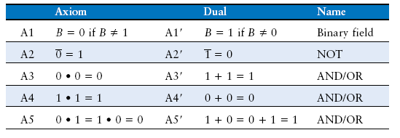
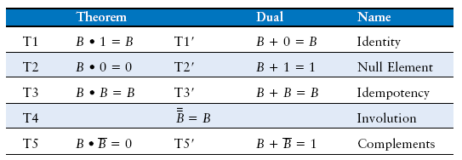
Boolean Axioms

Slide 15
T1: Identity Theorem
B 1 = B
B + 0 = B

Slide 16
T2: Null Element Theorem
B 0 = 0
B + 1 = 1
annihilation

Slide 17
T3: Idempotency Theorem
B B = B
B + B = B

Slide 18
T4: Identity Theorem
B = B
they meant
Involution

Slide 19
T5: Complement Theorem
B B = 0
B + B = 1
In ordinary mathematics,
  Minus is an inverse for addition
  Reciprocal is an inverse for multiplication
In Boolean algebra the complement is the inverse for both AND and OR

Slide 20
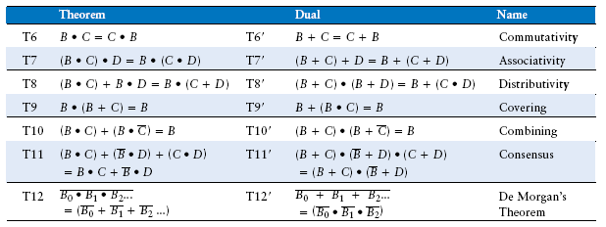
Boolean Theorems of Several Vars
In set theory, make the following replacements
  + with union
  * with intersection
  complementation with set complementation
That gives you many Boolean algebras

Slide 21
Simplifying Boolean Equations
Example 2:
Y = A(AB + ABC)
= A(AB(1 + C)) T8
= A(AB(1)) T2’
= A(AB) T1
= (AA)B T7
= AB T3

Slide 22
Bubble Pushing Rules
Begin at output, then work toward inputs
Push bubbles on final output back
Draw gates in a form so bubbles cancel

Slide 23
From Logic to Gates
Two-level logic: ANDs followed by ORs
Example: Y = ABC + ABC + ABC

Slide 24
Circuit Schematics Rules
Inputs on the left (or top)
Outputs on right (or bottom)
Gates flow from left to right
Straight wires are best

Slide 25
Circuit Schematic Rules (cont.)
Wires always connect at a T junction
A dot where wires cross indicates a connection between the wires
Wires crossing without a dot make no connection

Slide 26
Contention: X
Contention: circuit tries to drive output to 1 and 0
  Actual value somewhere in between
  Could be 0, 1, or in forbidden zone
  Might change with voltage, temperature, time, noise
  Often causes excessive power dissipation
Warnings:
  Contention usually indicates a bug.
  X is used for “don’t care” and contention - look at the context to tell them apart

Slide 27
Floating: Z
Floating, high impedance, open, high Z
Floating output might be 0, 1, or somewhere in between
  A voltmeter won’t indicate whether a node is floating
Tristate Buffer

Slide 28
Tristate Busses
Floating nodes are used in tristate busses
  Many different drivers
  Exactly one is active at
  once

Slide 29
Karnaugh Maps (K-Maps)
Boolean expressions can be minimized by combining terms
K-maps minimize equations graphically
PA + PA = P

Slide 30
K-Map
Circle 1’s in adjacent squares
In Boolean expression, include only literals whose true and complement form are not in the circle
Y = AB

Slide 31
3-Input K-Map

Slide 32
K-Map Definitions
Complement: variable with a bar over it
A, B, C
Literal: variable or its complement
A, A, B, B, C, C
Implicant: product of literals
ABC, AC, BC
Prime implicant: implicant corresponding to the largest circle in a K-map

Slide 33
K-Map Rules
Every 1 must be circled at least once
Each circle must span a power of 2 (i.e. 1, 2, 4) squares in each direction
Each circle must be as large as possible
A circle may wrap around the edges
A “don't care” (X) is circled only if it helps minimize the equation
A similar process is called Quine-McCluskey minimization
Circuit minimization is an NP complete program
Win $1,000,000 for a polynomial algorithm.

Slide 34
4-Input K-Map

Slide 35
K-Maps with Don’t Cares

Slide 36
Logic using Multiplexers
Using the mux as a lookup table
Lookup tables are used in FPGA chips programmed using Verilog; however, they use PROMs.

Slide 37
Logic using Multiplexers
Reducing the size of the mux
This is still taught in EE digital logic courses.

Slide 38
Logic Using Decoders
OR minterms

Slide 39
Timing
Delay between input change and output changing
How to build fast circuits?

Slide 40
Propagation & Contamination Delay
Propagation delay: t_{pd} = max delay from input to output
Contamination delay: t_{cd} = min delay from input to output
The output is “contaminated” because it may not be the ultimate output.
It could be a “glitch”.

Slide 41
Propagation & Contamination Delay
Delay is caused by
  Capacitance and resistance in a circuit
  Speed of light limitation
Reasons why t_{pd} and t_{cd} may be different:
  Different rising and falling delays
  Multiple inputs and outputs, some of which are faster than others
  Circuits slow down when hot and speed up when cold

Slide 42
Critical (Long) & Short Paths
Critical (Long) Path: t_{pd} = 2t_{pd_AND} + t_{pd_OR}
Short Path: t_{cd} = t_{cd_AND}

Slide 43
Glitches
When a single input change causes multiple output changes
Well, I guess that’s one definition.

Slide 44
Glitch Example
What happens when A = 0, C = 1, B falls?

Slide 45
Glitch Example (cont.)

Slide 46
Fixing the Glitch

Slide 47
Why Understand Glitches?
Glitches don’t cause problems because of synchronous design conventions (see Chapter 3)
It’s important to recognize a glitch: in simulations or on oscilloscope
Can’t get rid of all glitches – simultaneous transitions on multiple inputs can also cause glitches

