Slide 1
Chapter 1
Digital Design and Computer Architecture, 2nd Edition
David Money Harris and Sarah L. Harris
Edited by J Dean Brock
For CSCI 320

Slide 2
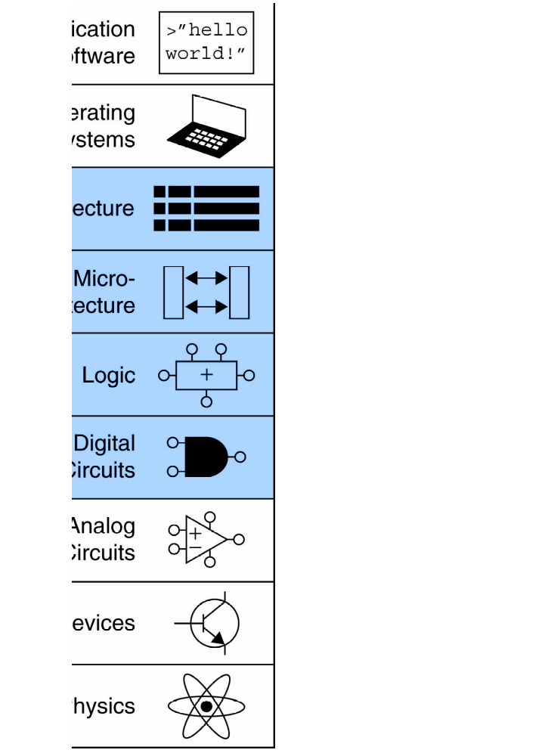
Abstraction
Hiding details when they aren’t important
CSCI 255 covered logic and digital circuits
CSCI 320 looks at micro-architecture and architecture

Slide 3
The Three -Y’s
Hierarchy
  A system divided into modules and submodules
Modularity
  Having well-defined functions and interfaces
Regularity
  Encouraging uniformity, so modules can be easily reused
  Often called orthogonality

Slide 4
The Digital Abstraction
Most physical variables are continuous
  Voltage on a wire
  Frequency of an oscillation
  Position of a mass
Digital abstraction considers discrete subset of values

Slide 5
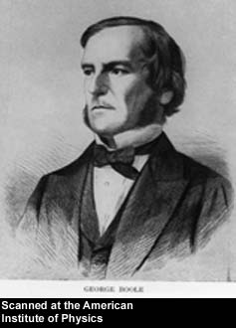
George Boole, 1815-1864
Born to working class parents
Taught himself mathematics and joined the faculty of Queen’s College in Ireland.
Wrote An Investigation of the Laws of Thought (1854)
Introduced binary variables
Introduced the three fundamental logic operations: AND, OR, and NOT.

Slide 6
Number Systems
Decimal numbers
Binary numbers

Slide 7
Powers of Two
2⁰ = 1
2¹ = 2
2² = 4
2³ = 8
2⁴ = 16
2⁵ = 32
2⁶ = 64
2⁷ = 128
Handy to memorize up to 2⁹
2⁸ = 256
2⁹ = 512
2¹⁰ = 1024
2¹¹ = 2048
2¹² = 4096
2¹³ = 8192
2¹⁴ = 16384
2¹⁵ = 32768

Slide 8
Number Conversion
Decimal to binary conversion:
  Convert 10011₂ to decimal
  16×1 + 8×0 + 4×0 + 2×1 + 1×1 = 19₁₀
Decimal to binary conversion:
  Convert 47₁₀ to binary
  32×1 + 16×0 + 8×1 + 4×1 + 2×1 + 1×1 = 101111₂

Slide 9
Binary Values and Range
N-digit decimal number
  How many values? 10^{N}
  Range? [0, 10^{N} - 1]
  Example: 3-digit decimal number:
    10³ = 1000 possible values
    Range: [0, 999]
N-bit binary number
  How many values? 2^{N}
  Range: [0, 2^{N} - 1]
  Example: 3-digit binary number:
    2³ = 8 possible values
    Range: [0, 7] = [000₂ to 111₂]

Slide 10
Hexadecimal to Binary Conversion
Hexadecimal to binary conversion:
  Convert 4AF₁₆ (also written 0x4AF) to binary
  0100 1010 1111₂
Hexadecimal to decimal conversion:
  Convert 4AF₁₆ to decimal
  16²×4 + 16¹×10 + 16⁰×15 = 1199₁₀

Slide 11
Bits, Bytes, Nibbles…
Bits
Bytes & Nibbles
Bytes

Slide 12
Large Powers of Two
2¹⁰ = 1 kilo ≈ 1000 (1024)
2²⁰ = 1 mega ≈ 1 million (1,048,576)
2³⁰ = 1 giga ≈ 1 billion (1,073,741,824)

Slide 13
Binary Addition Examples
Add the following 4-bit binary numbers
Add the following 4-bit binary numbers
Overflow!
For unsigned

Slide 14
Overflow
Digital systems operate on a fixed number of bits
Overflow: when result is too big to fit in the available number of bits
See previous example of 11 + 6

Slide 15
Two’s Complement Numbers
Msb has value of -2^{N-1}
Most positive 4-bit number: 0111
Most negative 4-bit number: 1000
The most significant bit still indicates the sign (1 = negative, 0 = positive)
  Range of an N-bit two’s comp number:
  [-(2^{N-1}), 2^{N-1}-1]

Slide 16
“Taking the Two’s Complement”
Flip the sign of a two’s complement number
Method:
    Invert the bits
    Add 1
Example: Flip the sign of 3₁₀ = 0011₂
    1100
    + 1
    1101 = -3₁₀

Slide 17
Two’s Complement Addition
Add 6 + (-6) using two’s complement numbers
Add -2 + 3 using two’s complement numbers

Slide 18
Sign-Extension
Sign bit copied to msb’s
Number value is same
Example 1:
  4-bit representation of 3 = 0011
  8-bit sign-extended value: 00000011
Example 2:
  4-bit representation of -5 = 1011
  8-bit sign-extended value: 11111011
(int) (short) -5

Slide 19
Zero-Extension
Zeros copied to msb’s
Value changes for negative numbers
Example 1:
  4-bit value = 0011₂ = 3₁₀
  8-bit zero-extended value: 00000011 = 3₁₀
Example 2:
  4-bit value = 1011 = -5₁₀
  8-bit zero-extended value: 00001011 = 11₁₀
(int) (unsigned short) -5

Slide 20
Logic Gates
Perform logic functions:
  inversion (NOT), AND, OR, NAND, NOR, etc.
Single-input:
  NOT gate, buffer
Two-input:
  AND, OR, XOR, NAND, NOR, XNOR
Multiple-input

Slide 21
Single-Input Logic Gates

Slide 22
Two-Input Logic Gates

Slide 23
More Two-Input Logic Gates

Slide 24
Logic Levels

Slide 25
DC Transfer Characteristics

Slide 26
MOS Transistors
Metal oxide silicon (MOS) transistors:
  Polysilicon (used to be metal) gate
  Oxide (silicon dioxide) insulator
  Doped silicon

Slide 27
Transistors: nMOS
Gate = 0
OFF (no connection between source and drain)
Gate = 1
ON (channel between source and drain)

Slide 28
Transistors: pMOS
pMOS transistor is opposite
  ON when Gate = 0
  OFF when Gate = 1

Slide 29
Transistor Function

Slide 30
Transistor Function
nMOS: pass good 0’s, so connect source to GND
pMOS: pass good 1’s, so connect source to V_{DD}

Slide 31
CMOS Gates: NOT Gate
A | P1 | N1 | Y
0 | ON | OFF | 1
1 | OFF | ON | 0

Slide 32
CMOS Gates: NAND Gate
A | B | P1 | P2 | N1 | N2 | Y
0 | 0 | ON | ON | OFF | OFF | 1
0 | 1 | ON | OFF | OFF | ON | 1
1 | 0 | OFF | ON | ON | OFF | 1
1 | 1 | OFF | OFF | ON | ON | 0

Slide 33
AND2 Gate

Slide 34
Transmission Gates
nMOS pass 1’s poorly
pMOS pass 0’s poorly
Transmission gate is a better switch
  passes both 0 and 1 well
When EN = 1, the switch is ON:
  EN = 0 and A is connected to B
When EN = 0, the switch is OFF:
  A is not connected to B

Slide 35
Pseudo-nMOS Gates
Replace pull-up network with weak pMOS transistor that is always on
pMOS transistor: pulls output HIGH only when nMOS network not pulling it LOW
Similar to how the NOR and SR were made in CSCI 255, but there a real resistor was used instead of a weak pMOS

Slide 36
Pseudo-nMOS Example
Pseudo-nMOS NOR4

