Slide 1
ECE 109 / CSCI 255
What’s next

Slide 2
Some gradable events
CSCI 255 final lab meeting
  Monday, May 6 for all CSCI 255 students
  With four simple what-does-this-do questions
    With the appropriate “cheat sheet”
Assignment 6
  Due Monday, May 6
No Homework 7
  It will only distract from the LC-3

Slide 3
Exam 4 Logistics
Tuesday, May 5, 1:00 to ~3:00
  NCSU ECE 109 exam slot
  UNCA no class day
  In Robinson 217
Weighs equally with other 3 exams
Planned for 75 minutes
If there is a problem with this time,
  You should have emailed yesterday

Slide 4
Exam 4 topics
Some old favorites
  One from each of the previous exams
Short answers about computer architecture
  Why does a cache make a computer faster?
Programming the LC-3
Programming the LC-3
Programming the LC-3
Programming the LC-3
Programming the LC-3

Slide 5
After this course I
Digital logic (first third of course)
  Topics include
    Circuit optimization
    Data paths
    System building
    Verilog
  NCSU ECE 212 and UNCA CSCI 311
    Generally in Spring

Slide 6
After this course II
Assembly language programming
  Rest of Patt and Patel
    Function implementation
    Arrays
    Structures
    Realization of C
  NCSU ECE 209
    Fall

Slide 7
After this course III
Computer architecture
  How to build real computers
    That are fast
    And can support operating systems
  UNCA CSCI 320 and NCSU ECE 463
    And a little of NCSU ECE 212
    ECE 463 has ECE 406 as prerequisite
  The textbook
    Hennessey and Patterson, Computer Architecture

Slide 8
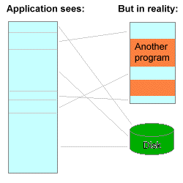
Virtual memory
Wikipedia
Program memory is not necessary RAM
  Allows programs to run on lots of computers
  Programs can also use the same address space
Picture from Wikimedia Commons

Slide 9
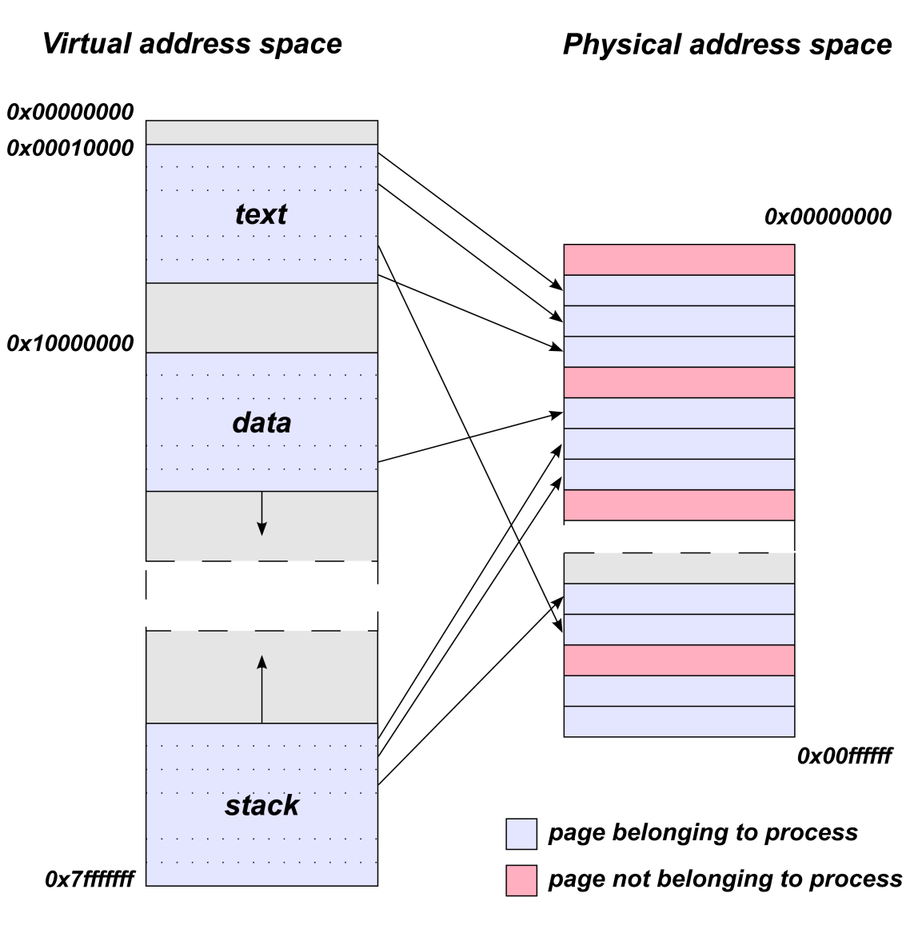
Address translation
Wikipedia
Translates virtual to real
Pentium paging
  In gory detail
Power PC paging
  Too gory
From Wikipedia Commons

Slide 10
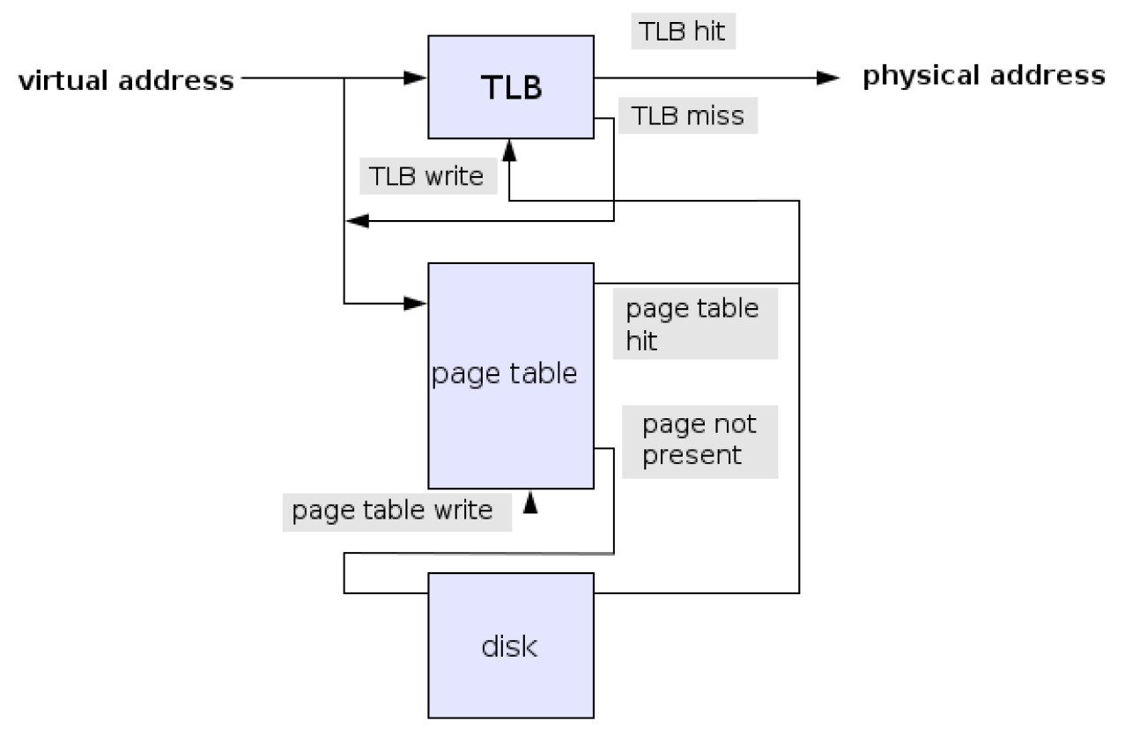
TLB
Translation Lookaside Buffer
Didn’t the Pentium just get 3 times slower
From Wikipedia Commons

Slide 11
Caching
Wikipedia
Keeping frequently accessed items nearby
Examples
  Keys are kept on the kitchen table
  People on your phone contacts list
  Favorite music is on the top of the stack
  Comfortable shirt is in the closet
    Suit is in the basement
  Recently used web pages are kept on your disk

Slide 12
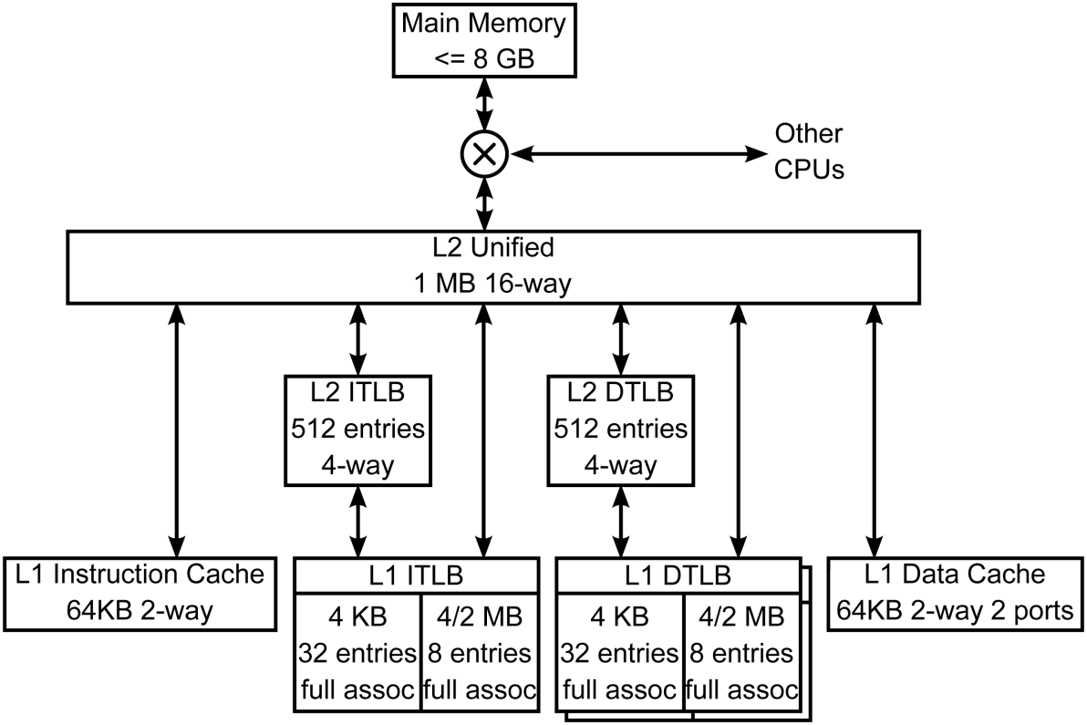
CPU cache
Wikipedia
Greatly improves system performance
AMD Athlon 64 cache
64 byte cache lines
From Wikipedia Commons

Slide 13
Pipelining
Wikipedia
Execute many instructions at once
  Efficient use of CPU resources
  Complicates the jobs of compiler designers
Instructions goes through stages
  Some Pentiums had over 30 stages
The less you do per stage
  The faster you can make the clock

Slide 14
Other common speedups
Hyperthreading
  Two virtual “processors” on a chip
    Share some pipeline segments
Multiple issues
  Start more than one instruction at a time
Data parallelism
  Intel MMX
    Matrix Multiplication or Multi-Media
  Very useful in graphics applications
    Aka, gaming applications

Slide 15
Branch prediction
Wikipedia
Branches can “stall” the pipeline
  Speculative executive is necessary
Forms of branch prediction
  Static prediction
    Predict backward branches taken
    Predict forward branches fail
  Dynamic prediction
    Pentium branch tables

Slide 16
How do they make it fast
Use some math
  And common sense
Gather lots of significant algorithms
  And simulate and simulate and simulate
Listen to the compiler designers
  And make them listen to you
    Especially about the cache
  Same thing with the operating system designers
In the long run two things matter
  SPEC
  Marketing

