Slide 1


Slide 2
Vector Graphics
Vector graphics are computer graphics that use geometrical primitives such as points, lines, curves, and shapes or polygon(s), which are all based on mathematical equations, to represent images.
source: Wikipedia

Slide 3
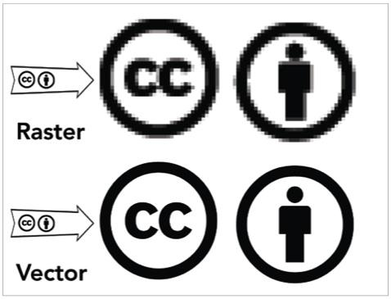
Vector vs. Bitmap
Vector graphics are complementary to bitmap graphics

Slide 4
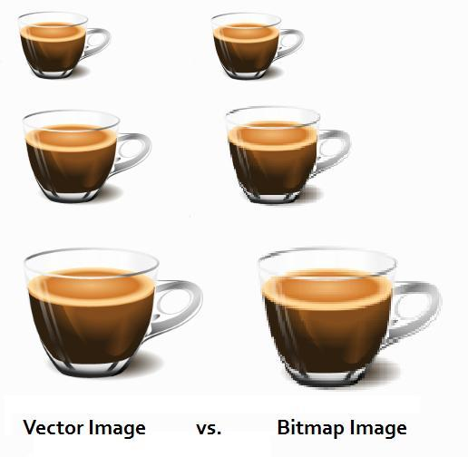
Vector vs. Bitmap

Slide 5
Uses of Vector Graphics
Logos
Letterheads
Icons
Basically, anything you may want to use in multiple contexts

Slide 6
Vector Graphics
(0, 0)
50
100
150
50
100
150
vector graphics are specified on a grid

Slide 7
Vector Graphics
(0, 0)
50
100
150
Line XY of length 40 starting at (60, 20)
50
100
150
vector graphics are specified on a grid

Slide 8
Vector Graphics
(0, 0)
50
100
150
Line XY of length 40 starting at (60, 20)
Circle of radius 20 with a center at (50, 90)
50
100
150
vector graphics are specified on a grid

Slide 9
Vector Graphics
(0, 0)
50
100
150
Line XY of length 40 starting at (60, 20)
Circle A of radius 20 with a center at (50, 90)
Line YZ of length 40 starting at (100, 20)
50
100
150
vector graphics are specified on a grid

Slide 10
Vector Graphics
(0, 0)
50
100
150
Line XY of length 40 starting at (60, 20)
Circle A of radius 20 with a center at (90, 50)
Line YZ of length 40 starting at (100, 20)
Line XZ of length ?
50
100
150
vector graphics are specified on a grid

Slide 11
Exercises
1. Let X be a point on a vector grid, say (50, 100). If XY is a horizontal line of length 80, what is point Y?
2. Let X be a point on a vector grid, say (2, 3). If XY is a vertical line of length 5, what is point Y?
3. Let XY be a line starting at point (50,100) and ending at point (200,100). How long is XY?
4. Let X be a point on a vector grid, say (40, 40). If Y is a at point (70,70), and XY is the diagonal line connecting them, what is the length of the line?

