Slide 1

Controlling the World with Raspberry Pi
J Dean Brock, Rebecca Bruce, and Marietta E. Cameron
IEEE Southeast Conference 2014

Slide 2
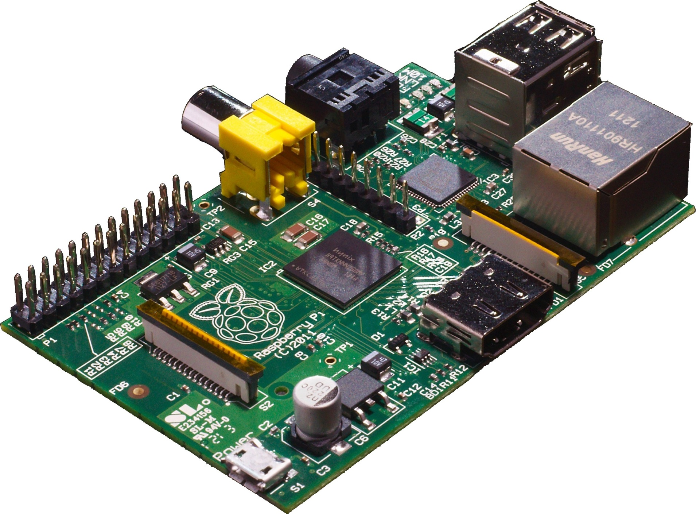
Rapberry Pi Model B
Picture from Wikimedia

Slide 3
Raspberry Pi history
A computer to inspire children
  to put the fun back into learning computing
  provide computers to the poor
  guided by Raspberry Pi foundation
Early support from academia and industry
  University of Cambridge Computer Laboratory
  Broadcom
Raspberry Pi model B launched in early 2012
  Model A is $10 cheaper

Slide 4
A Headless Connection
Fine for embedded systems applications, web server, home router, network and sensors (monitoring), etc.
Requires personal computer setup
  Install a terminal emulator or ssh client for Windows
    MobaXterm
    PuTTY
    or something else

Slide 5
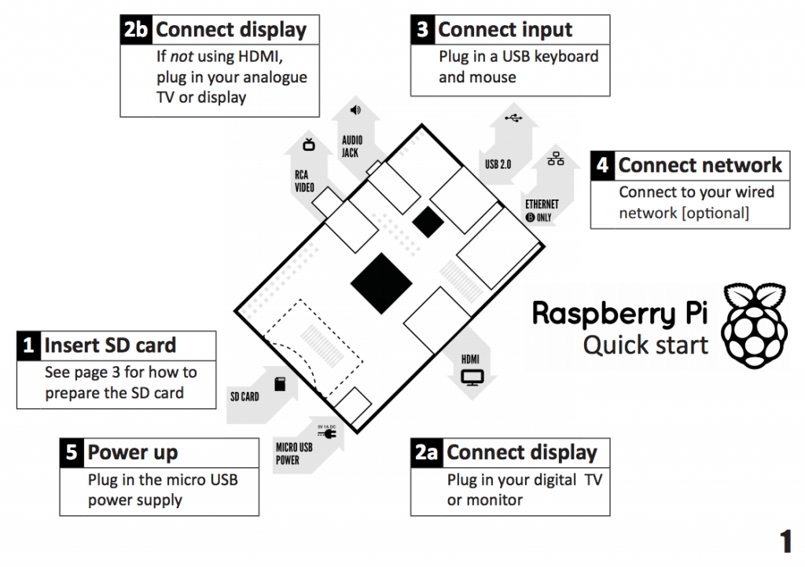
Raspberry Pi Quick start
From Raspberry Pi Quick start guide

Slide 6
Raspberry Pi hardware
Broadcom BCM2835 SoC (system on chip)
  700 MHz ARM1176JZF-S CPU
    ARM11 microarchitecture with ARMv6A ISA
  Video Core IV GPU (1080p, 24GFLOPS)
  Peripherals: UART, USB, I²C, GPIO
LAN9512 USB hub and Ethernet controller
512 Mbytes RAM
Connectors: USB, Ethernet, HDMI, camera
SD-card

Slide 7
Very detailed references
Schematics for Rasberry Pi board
BCM2835 ARM peripherals data sheet
LAN9512 data sheet
ARMv6 architecture reference manual
  Available with ARM login id
    Or search using google
  Almost 400 pages

Slide 8
Connecting
With a monitor
  Nothing to it
Headless
  Secure Shell (ssh)
    IP assigned by DHCP
      Use your router administrative page
      Run tail on /var/log/messages
  Serial-Connection
    Use a serial cable connection and connect like you did in 1988

Slide 9
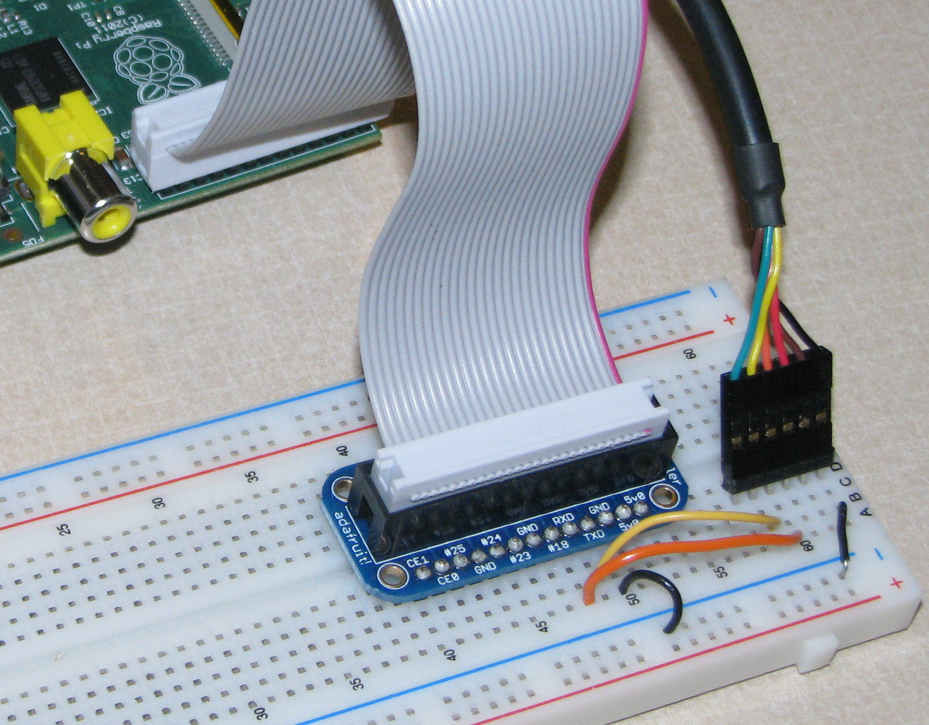
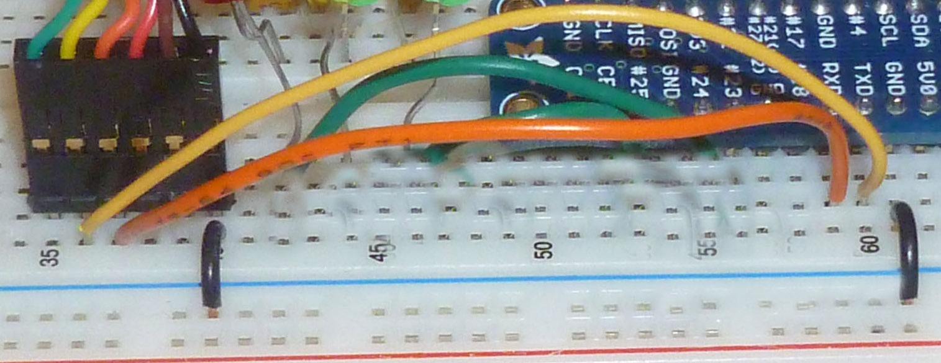
Physical Serial Connection
The colored wire-must connect to pin 1 on the Pi
DETAIL:
Connect ground to ground and
RX to TX in both directions:
Connect FTDI yellow to Pi TX
Connect FTDI orange to Pi RX
Connect Gnd to Gnd via the
power rail

Slide 10
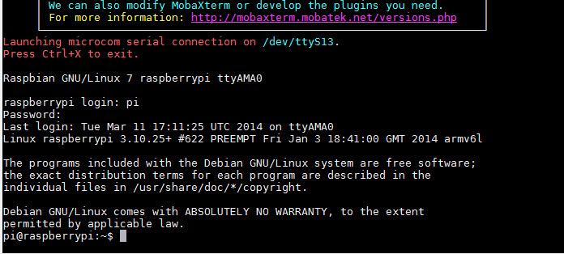
Login to the Pi
Account name: pi
Password: creative
Hit the enter key a couple of
times to initiate the prompt

Slide 11
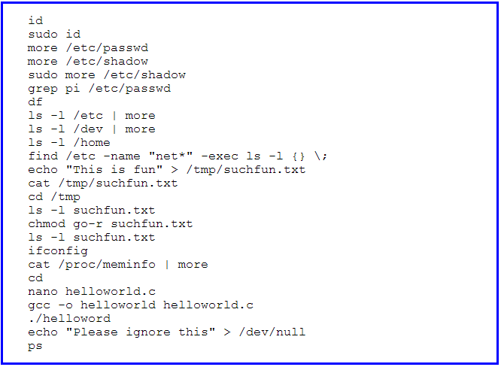
Linux
Try it out:

Slide 12
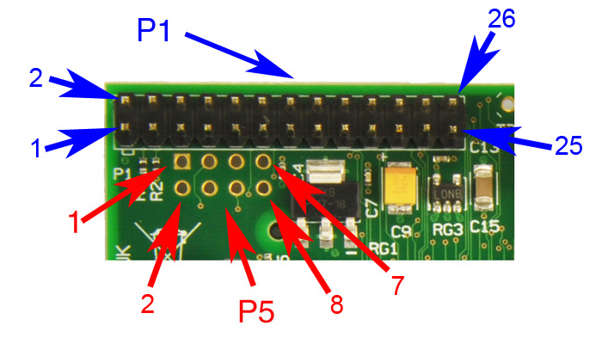
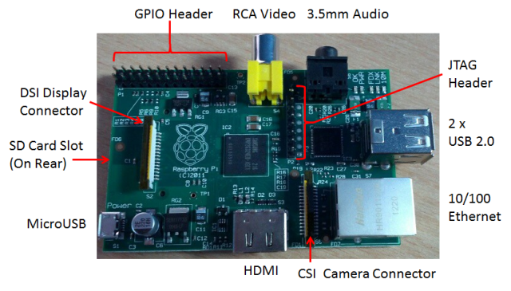
Raspberry Pi GPIO
A subset of the BCM2835 GPIO pins

Slide 13
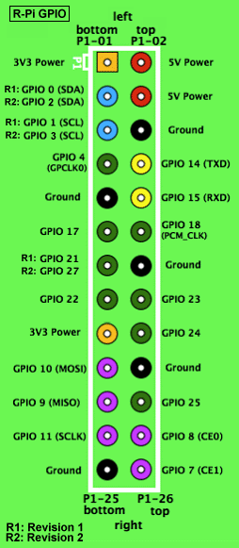
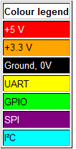
RPi General Purpose IO (GPIO) Pins
17 GPIO pins on the P1 header
  most have alternated functions
  two pins for UART; two for I2C; six for SPI
All 17 pins can be GPIO (i.e., INPUT or OUTPUT)
    all support interrupts
  internal pull-ups & pull-downs for each pin
  I2C pins have onboard pull-ups
    using them for GPIO may not work
Pins are 3.3V not 5V like on the Arduino
They are connected directly to the Broadcom chip
Sending 5V to a pin may kill the Pi
Maximum permitted current draw from a 3.3V pin is 50mA

Slide 14
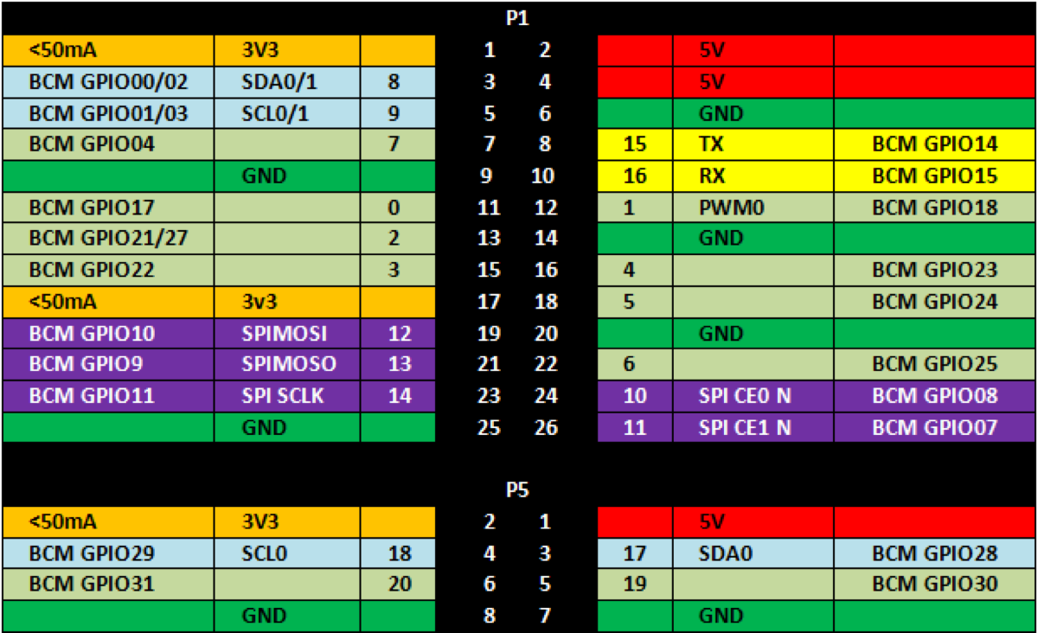
The Bigger Picture
Diagram includes BCM GPIO references (GPIO.BCM), common
functions, WiringPi pin references, and Pin numbers (GPIO.BOARD)

Slide 15
Using the GPIO Pins
There are two methods to read or write these pins
  File-type access in userspace
    accessed through the device (/dev) interface
  Write/read memory addresses allocated to the GPIO peripheral of the SoC
    Memory locations can be found in the datasheet for the BCM2835
You can use the WiringPi library to help with both

Slide 16
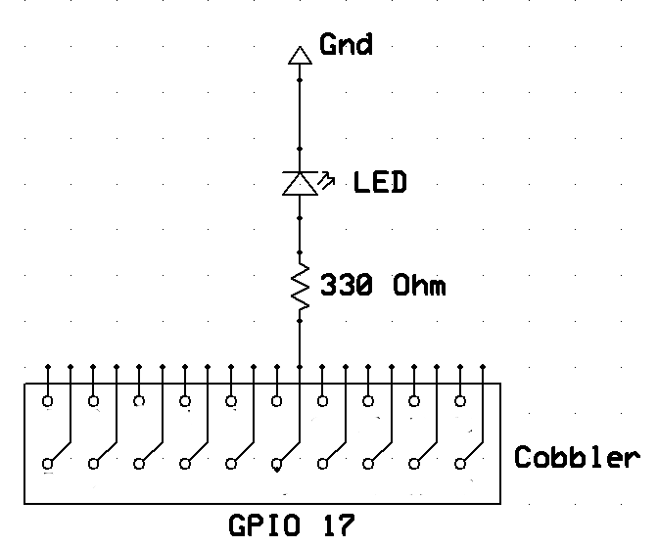
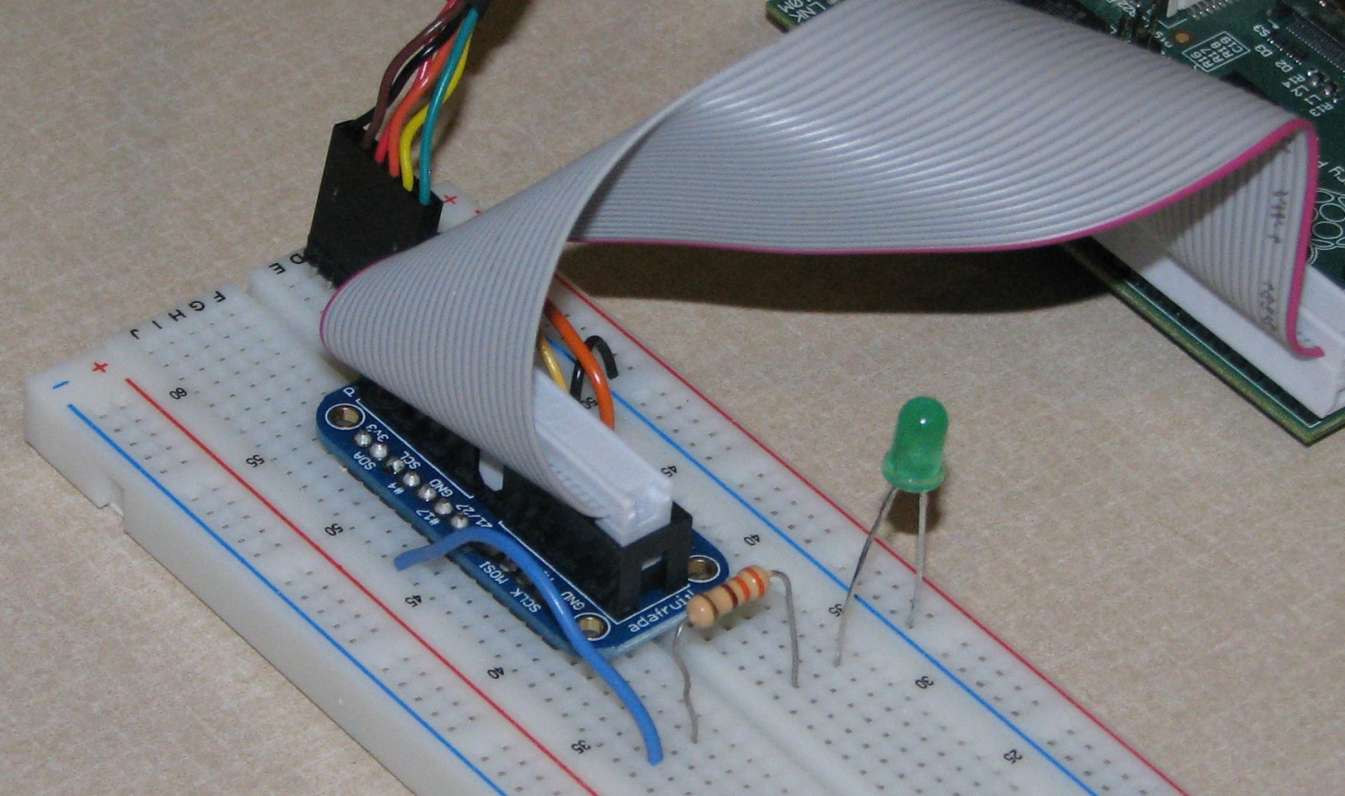
Blinking LED: Physical Connection
Connect an LED to GPIO 17 (P1-11)
The LED will initially be off because the GPIO pins are initialized as inputs at power-on (except for TXD).

Slide 17
Blinking LED: Software Solution 1
Using a file-type access
  Run shell script blink.sh
    cd examples
    sudo./blink.sh
#!/bin/sh
echo 17 > /sys/class/gpio/export
echo out > /sys/class/gpio/gpio17/direction
while true
do
echo 1 > /sys/class/gpio/gpio17/value
sleep 1
echo 0 > /sys/class/gpio/gpio17/value
sleep 1
done
“Close” the /sys/class/gpio/gpio17 directory:
  echo 17 > /sys/class/gpio/unexport

Slide 18
More Details
Create a shell script using nano:
  Change the permissions on blink.sh: chmod 755 blink.sh
  Run blink.sh: sudo ./blink.sh (in directory where blink.sh is stored)
After running the script your LED should be blinking endlessly. Give the command: Ctrl-c Ctrl-c to abort the script
All of the commands in the script can be issued one at a time on the command line; beginning by giving the commands: sudo -i to run a root shell---notice the change in the prompt
Look at the files and their contents in directory /sys/class/gpio/ and its subdirectories --- see next slide

Slide 19
Understanding /sys/class/gpio/
In Linux, everything is a file: /dev/ttyUSB0, /sys/class/net/eth0/address, /dev/mmcblk0p2,…
sysfs is a kernel module providing a virtual file system for device access at /sys/class
  provides a way for users (or code in user-space) to interact with devices at the system (kernel) level
A demo
Advantages / Disadvantage
  Allows conventional access to pins from userspace
  Always involves mode switch to kernel, action in kernel, mode switch back to user, and could have a context switch
  Slower than digitalWrite()/digitalRead() of Arduino
    with less predictable response times

Slide 20
A C program to do the same thing
GPIO with sysfs on Raspberry Pi (Part 2)
Code on Github
  Beware: the code assumes a Rev1 pinout

Slide 21
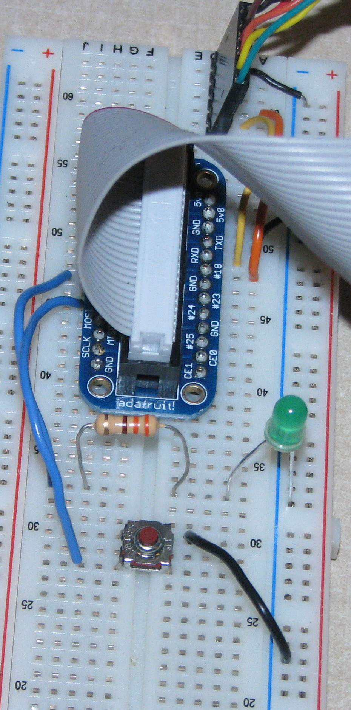
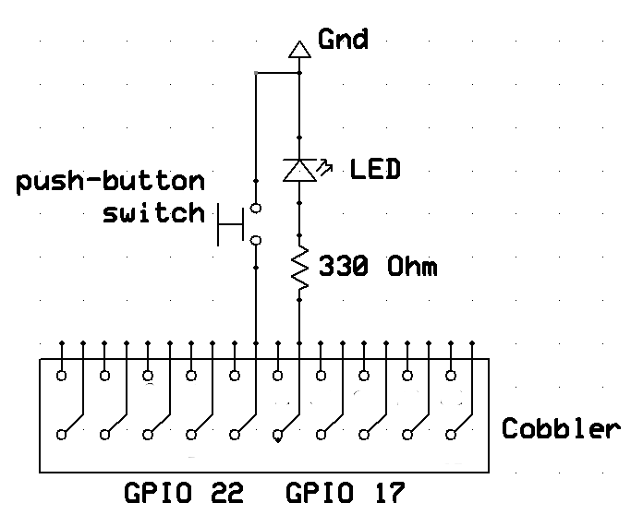
Input Example
Physical Connection:
Add a push-button switch to
GPIO 22

Slide 22
Input Example Software
Look in examples directory for button.c
Compile and run the button program
  gcc -Wall -o button button.c -lwiringPi ⬅ compile
  sudo ./button ⬅ run
The push-button controls the LED
Runs forever
  kill with ctrl-c ctrl-c

Slide 23
button.c
#include <stdio.h>
#include <wiringPi.h>
// LED Pin - wiringPi pin 0 is BCM_GPIO 17
#define LED 0
// LED Pin - wiringPi pin 3 is BCM_GPIO 22
#define BUTTON 3
int main (void) {
printf ("Raspberry Pi Push-Button Controlled LED\n");
wiringPiSetup ();
pinMode (LED, OUTPUT);
pinMode (BUTTON, INPUT);
pullUpDnControl (BUTTON, PUD_UP); // ⬅ using a pull-up resistor
for(;;) {
if ( digitalRead (BUTTON) == HIGH ) {
digitalWrite (LED, LOW);
} else {
digitalWrite (LED, HIGH);
}
delay (1);
}
}

Slide 24
I²C – Inter-Integrated Circuit
Invented by Phillips in 1982
  I²C specification
A tradeoff between speed and area
  Less spaces devoted to wires
  Fewer wires can decrease throughput
A good idea for sensors
  But not for disk drives
Adopted by Intel for personal computers
  Under the name SMBus
  00:1f.3 SMBus: Intel Corporation 82801JD/DO (ICH10 Family) SMBus Controller (rev 02)

Slide 25
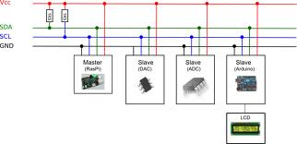
I²C
Understanding I²C
  The physical I²C bus
  Masters and Slaves
  The physical protocol
  I²C device addressing
  The software protocol
  I²C support in Linux kernel
    And Windows and Arduino
    And Microcontrollers and …
A good Tutorial at Robot Electronics
Image credit: http://quick2wire.com/articles/i2c-and-spi/

Slide 26
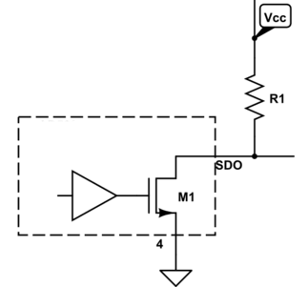
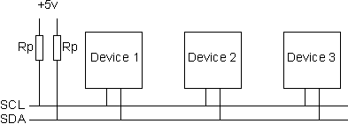
  The physical I²C bus
Image credit: http://electronics.stackexchange.com/questions/70312/n-ch-fet-with-open-drain-output
Image credit: http://www.robot-electronics.co.uk/acatalog/I2C_Tutorial.html
Two wires: SCL and SDA
  SCL is the clock line: used to synchronize all data transfers
  SDA is the data line
Both SCL and SDA lines are "open drain" drivers
  Can only be driven low
  For the line to go high provide a pull-up resistors to Vcc
    The value of Vcc is an example of something SMBus restricts

Slide 27
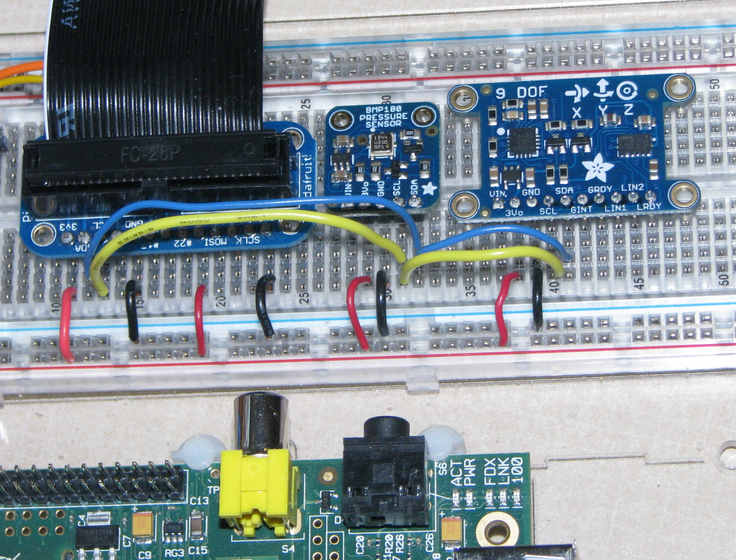
It might look like this

Slide 28
Getting the Pi ready
Stop the “blacklisting” of I2C
  In /etc/modprobe.d/raspi-blacklist.conf
    Comment out the blacklist of i2c-bcm2708
Add the appropriate modules
  By adding the following lines to /etc/modules
    i2c-bcm2708
    i2c-dev
Install a couple of packages
  i2c-tools
  libi2c-dev
Add user pi to group i2c
Reboot

Slide 29
Linux i2c device interface
Device files are /dev/i2c-*
  Major number is 89
  Minor number is bus number
Linux device documentation for “userspace”
  The usual read and write are supported
  but ioctl is the preferred interface
  especially with smbus protocol macros

Slide 30
The i2c utilities
Before programming, try the i2c utilities
  i2cdetect
  i2cdump
  i2cget
  i2cset
On Rev1 versions of the Raspberry Pi, the i2c devices on a bus 0

Slide 31
Using the I²C utilities finding the bus
ls -l /dev/i2c-*
lsmod | grep i2c
id
i2cdetect –l
i2cdetect -y 1
Use 0 with Rev1

Slide 32
Using the I²C utilities finding the temperature
i2cget -y 1 0x77 0xD0 b
  Make sure you have a BMP180
i2cdump -r 0xAA-0xBF -y 1 0x77
  Examine mysterious EEPROM registers
i2cdump -y -r 0xF4-0xF7 1 0x77
  Examine measurement register
i2cset -y 1 0x77 0xF4 0x2E
  Tell device to read temperature
i2cdump -y -r 0xF4-0xF7 1 0x77

Slide 33
Programming examples
Read the temperature on BMP180
  C program using device interface
  C program with block read operation
  Python program using SMBus module
    Which is really a Pythonized-C interface
Read acceleration using a LSM303
  In Python using SMBus
And use i2c utilities from the shell
  Which really isn’t programming

Slide 34
Trying out the device interface
Take a look at the bmp180 program
  Which should be in the examples directory
Note the usual structures
  Lots of register definitions
  Routines to interpret the data
  Actions
    Open the device
    Read and write to the device

Slide 35
But what about the hard part?
Where does this come from
  x1 = (ut-ac6)*ac5/32768 ;
  x2 = mc * 2048 / (x1 + md) ;
  b5 = x1 + x2 ;
  t = (b5 + 8) / 16 ;
the BMP180 datasheet
  See page 15 for the details
    and don’t expect to understand why

Slide 36
Secrets of the I2C sensor
Read the datasheet
Find an application note
Find example programs
Search for device drivers for the manufacturer
  It should contain a lot of DEFINE
Try I²Cdevlib

Slide 37
Time to test it out
Compile the programs
Test it out
  It should get warmer when touched
  And colder when using an ice cube
The program has no filtering
  So sometimes odd results are returned

Slide 38
Running the simpler program
Compile it
  gcc -o bmp180json -DDEBUG bmp180json.c
    Or simply use make
Run it
  ./bmp180json
Changing it?
  Display the pressure

Slide 39
Why Python?
A good “first” programming language
  Especially if you don’t like the following
    public static void main(String[] args)
    int main(int argc, char *argv[])
Lots of good packages
Fun interfaces for kids
  See Python for Kids
Generally easy to get something running
  Mispelled varyabals can hide for months

Slide 40
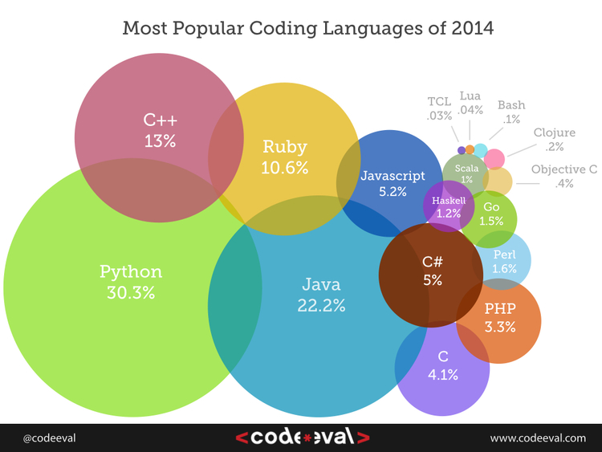
Python?

Slide 41
Why the JSON?
Pretty to easy to read
Has a formal schema for validation
Works well with web applications
  JavaScript
  HTML5
Will please the New Media students in CSCI 185
Supported in all common programming languages
http://pinkie-pie.cs.unca.edu is running on a Raspberry Pi Model B Rev1 -- 256 MBtyes of RAM
  Once it could tell you how hot it is over the web

Slide 42
Reading the temperature
No need to compile
Run it
  python bmp180json.py
Changing it?
  Display the pressure

Slide 43
What about those interrupts?
Some I²C sensors do have interrupt lines
To “handle” an interrupt
  Connect the interrupt line to a GPIO pin
  Write to /sys/class/gpio/N/edge
    none, rising, falling, both
  Use poll on /sys/class/gpio/N/value
    Waits for I/O activity with optional time-out
A hard system call to use
  But there are many examples because of its frequent use in networking applications

