Slide 1
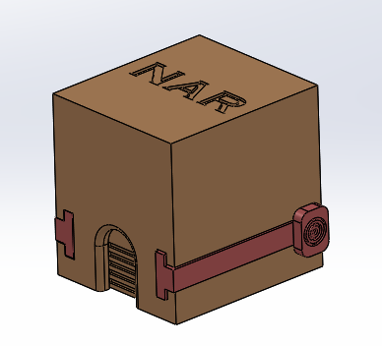
Steps to creating 2D drawings of assemblies
Solidworks Procedures

Slide 2
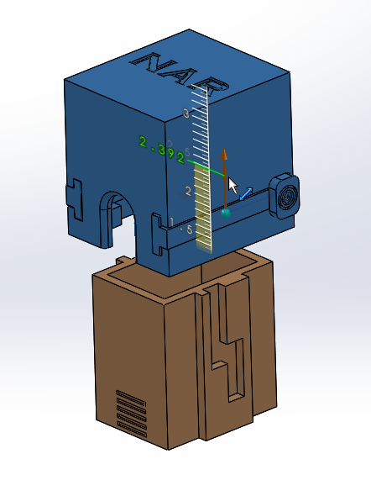
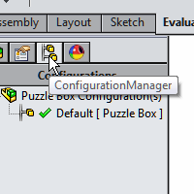
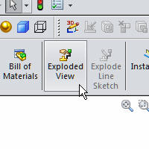
Explode the Assembly

Slide 3
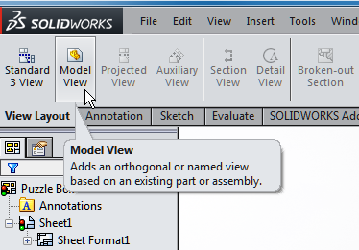
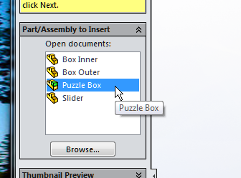
Incorporate into a 2D sheet
Double Click on your Assy or browse as needed.
Notes:
References:
Pg 337 Engineering Drawing and Design 3rd Edition by David Madsen et. al.
Pg 109 Fundamentals of Modern Drafting by Paul Wallach
Pg 425 Technical Drawing 9th Edition by Frederick Giesecke et. al.
Pg 701 Technical Graphics Communication 3rd Edition by Gary Bertoline & Eric Wiebe

Slide 4
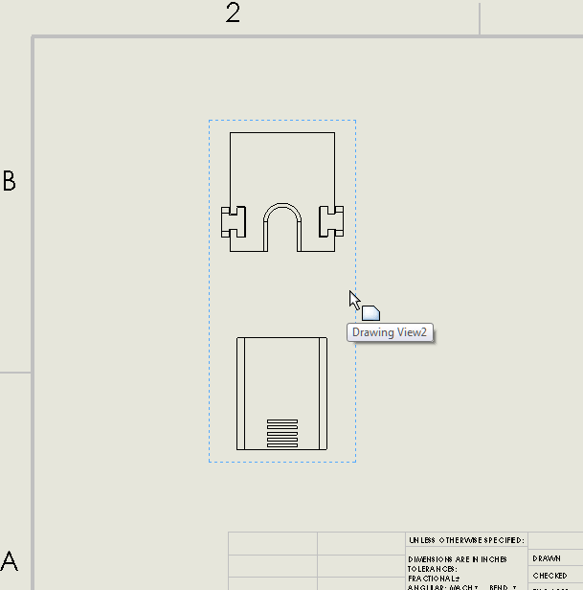
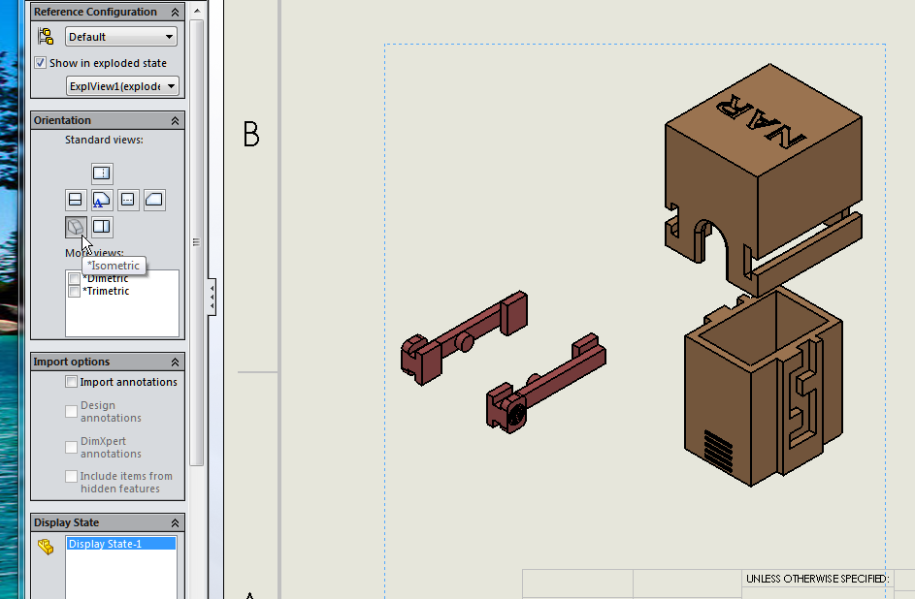
Incorporate into a 2D sheet
Place into drawing by
moving and clicking
Modify view and appearance
As desired
Notes:
References:
Pg 337 Engineering Drawing and Design 3rd Edition by David Madsen et. al.
Pg 109 Fundamentals of Modern Drafting by Paul Wallach
Pg 425 Technical Drawing 9th Edition by Frederick Giesecke et. al.
Pg 701 Technical Graphics Communication 3rd Edition by Gary Bertoline & Eric Wiebe

Slide 5
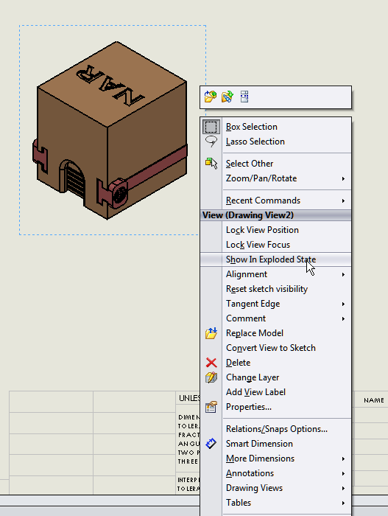
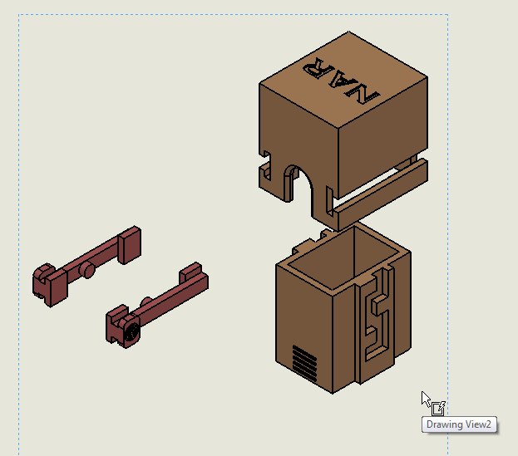
If your assembly comes in un-exploded...
Right click on view and Select “Show in Exploded State”
It will then appear exploded.
You can reverse the process...
Notes:
References:
Pg 337 Engineering Drawing and Design 3rd Edition by David Madsen et. al.
Pg 109 Fundamentals of Modern Drafting by Paul Wallach
Pg 425 Technical Drawing 9th Edition by Frederick Giesecke et. al.
Pg 701 Technical Graphics Communication 3rd Edition by Gary Bertoline & Eric Wiebe

Slide 6
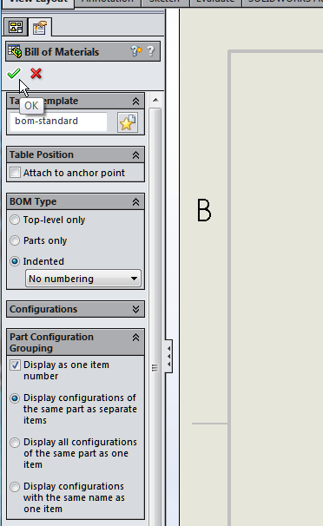
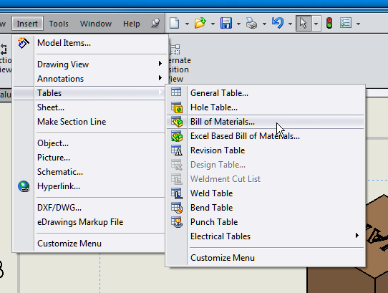
Add a BOM (Bill of Materials)
Click on a view and then select Insert-Tables-Bill of Materials
You can modify how the BOM
will appear, then click OK
Notes:
References:
Pg 337 Engineering Drawing and Design 3rd Edition by David Madsen et. al.
Pg 109 Fundamentals of Modern Drafting by Paul Wallach
Pg 425 Technical Drawing 9th Edition by Frederick Giesecke et. al.
Pg 701 Technical Graphics Communication 3rd Edition by Gary Bertoline & Eric Wiebe

Slide 7
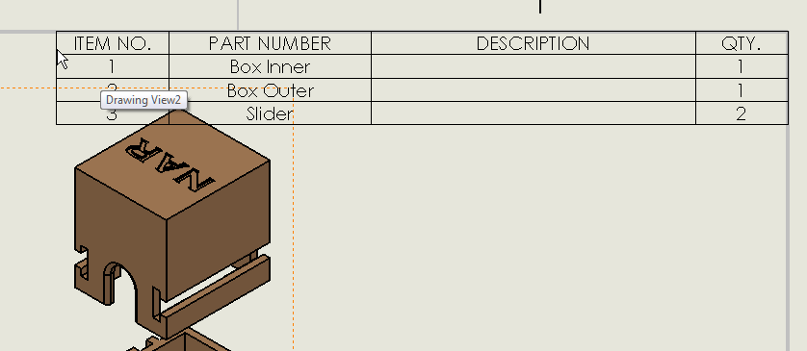
Add a BOM (Bill of Materials)
You will then see the BOM which you can place on the sheet. The upper right corner is a typical location. Notice that this example has three unique parts, quantity 1 of two, and quantity two of a third.
Notes:
References:
Pg 337 Engineering Drawing and Design 3rd Edition by David Madsen et. al.
Pg 109 Fundamentals of Modern Drafting by Paul Wallach
Pg 425 Technical Drawing 9th Edition by Frederick Giesecke et. al.
Pg 701 Technical Graphics Communication 3rd Edition by Gary Bertoline & Eric Wiebe

Slide 8
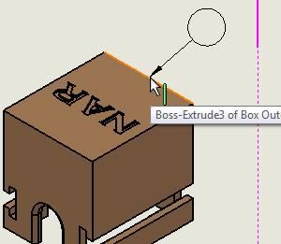
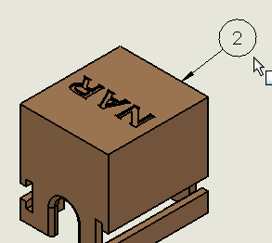
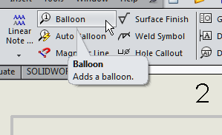
Add Balloons
In the Annotation tab click on Balloon
Now as you move your cursor to an edge of a part, the balloon appears.
Left click and place the balloon. Notice the number is coordinated with the BOM.
Notes:
References:
Pg 337 Engineering Drawing and Design 3rd Edition by David Madsen et. al.
Pg 109 Fundamentals of Modern Drafting by Paul Wallach
Pg 425 Technical Drawing 9th Edition by Frederick Giesecke et. al.
Pg 701 Technical Graphics Communication 3rd Edition by Gary Bertoline & Eric Wiebe

Slide 9
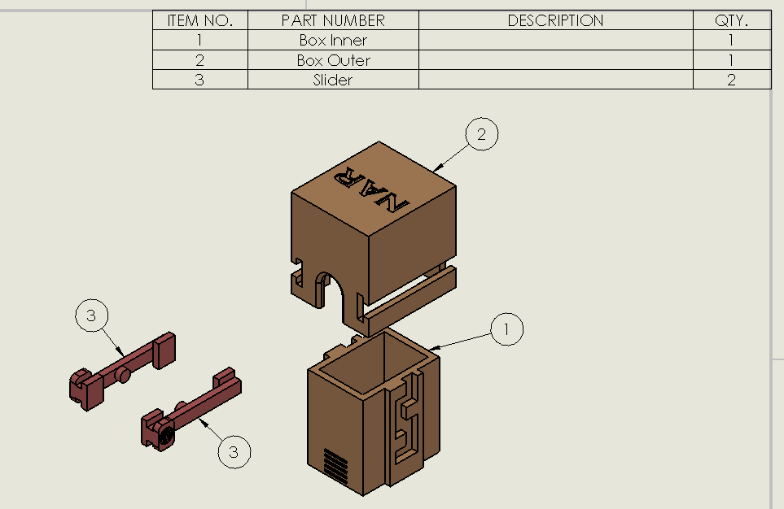
Add Balloons
Repeat the process for all parts
Notes:
References:
Pg 337 Engineering Drawing and Design 3rd Edition by David Madsen et. al.
Pg 109 Fundamentals of Modern Drafting by Paul Wallach
Pg 425 Technical Drawing 9th Edition by Frederick Giesecke et. al.
Pg 701 Technical Graphics Communication 3rd Edition by Gary Bertoline & Eric Wiebe

Slide 10
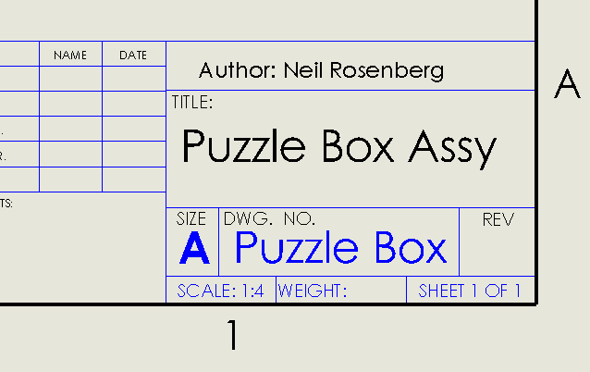
Update this sheet’s title block
Use Edit Sheet Format to modify title block

Slide 11
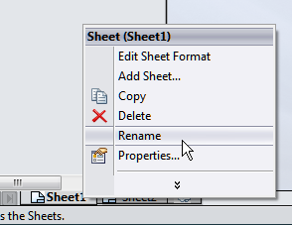
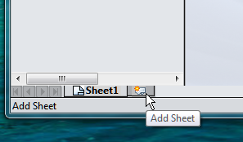
Create additional sheets for all parts and other assemblies
Add sheets as needed...
Rename sheets...

Slide 12
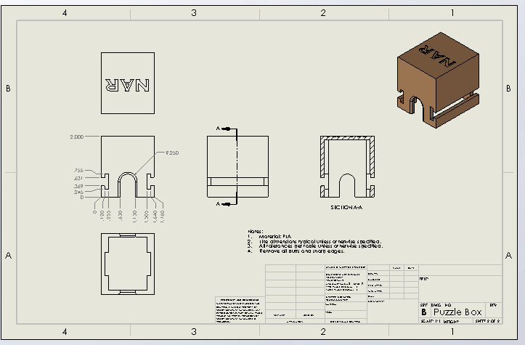
Begin to document each component part
Note: It’s ok to have mixed sheet sizes as shown here.

Slide 13
Make sure you have a “Notes” block as appropriate.
The “Notes” block is how you can share information that may not be obvious, or that isn’t easily shown in other ways.

