Slide 1

Controlling the World with Raspberry Pi
J. Dean Brock, Rebecca Bruce, and Marietta E. Cameron
IEEE Southeast Conference 2014

Slide 2
Personal computer setup
Install an ssh client for Windows
  MobaXterm
  PuTTY
  or something else

Slide 3
Raspberry Pi history
A computer to inspire children
  to put the fun back into learning computing
  guided by Raspberry Pi foundation
Early support from academia and industry
  University of Cambridge Computer Laboratory
  Broadcom
Raspberry Pi model B launched in early 2012
  Model A is $10 cheaper

Slide 4
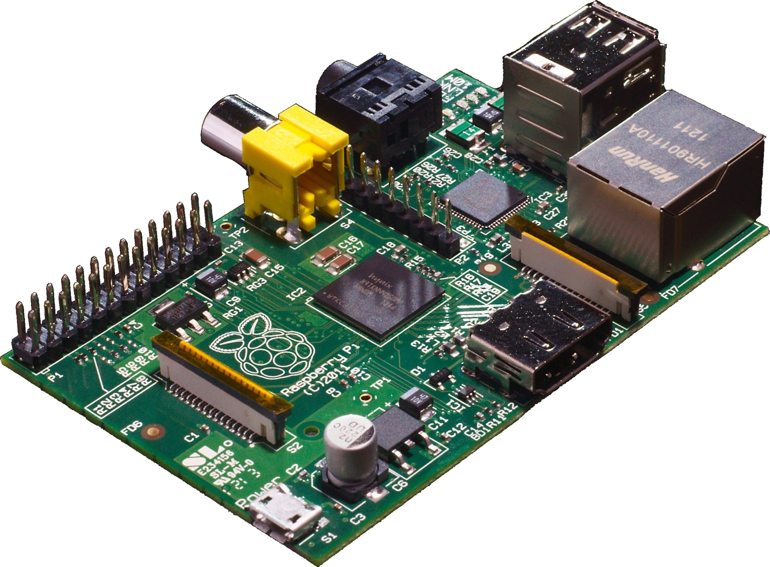
Rapberry Pi Model B
Picture from Wikimedia

Slide 5
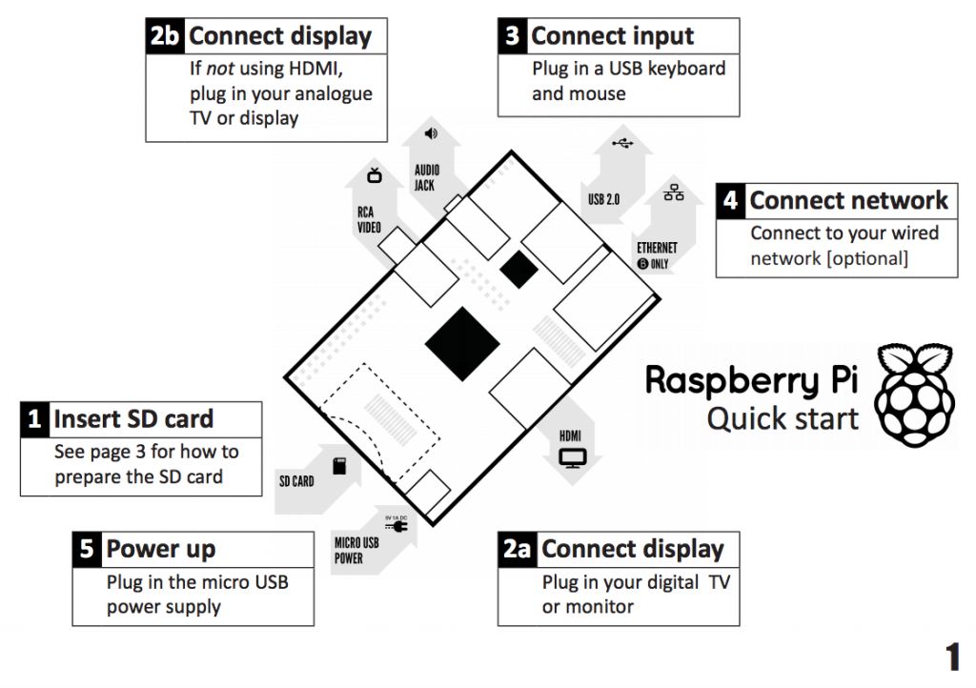
Raspberry Pi Quick start
From Raspberry Pi Quick start guide

Slide 6
Raspberry Pi hardware
Broadcom BCM2835 SoC (system on chip)
  700 MHz ARM1176JZF-S CPU
    ARM11 microarchitecture with ARMv6A ISA
  Video Core IV GPU (1080p, 24GFLOPS)
  Peripherals: UART, USB, I²C, GPIO
LAN9512 USB hub and Ethernet controller
512 Mbytes RAM
Connectors: USB, Ethernet, HDMI, camera
SD-card

Slide 7
Very detailed references
Schematics for Rasberry Pi board
BCM2835 ARM peripherals data sheet
LAN9512 data sheet
ARMv6 architecture reference manual
  Available with ARM login id
    Or search using google
  Almost 400 pages

Slide 8
Distros
Consult the lists
  Raspberry Pi foundation list
  Embedded Linux list
Or purchase a preformatted card
We are using Raspbian
  A variation of the wheezy release of debian
Students may have strong opinions
  It won’t hurt to let them have their way

Slide 9
Formatting the SD card
You really need to follow the directions
  Of course, you also have to choose wisely
dd is old fashioned command-line program
  but it works on Linux and Mac OS
  We use a shell script that calls dd
Win32DiskManager is fine for Windows
Allocate plenty of time

Slide 10
First boot with a monitor
raspi-config starts automatically
Login as use “pi”
  With password “raspberry”
Your next steps
  Expand the root file system
  Change the password
  Get the right internationalisation
  Reboot

Slide 11
First boot with headless Pi
Figure out another connection route
  Determine the Pi’s IP address
      Won’t work with wireless
    and use ssh to connect
  Use a serial cable connection
    and connect like you did in 1988
Then run raspi-config
  It may be useful to set a hostname

Slide 12
Second boot
Update your distribution
  apt-get update
  apt-get upgrade
You will want to install additional software
  sudo apt-get install emacs python-pyside
Create your own account
Be prepared to wait
  SD Cards are “classed” by write speed
  Sometimes it takes a while to save a file

Slide 13
If using in a class
Consider making your own image
Set up a system and then copy the SD card
Inexperienced students may take weeks to achieve the first boot
Expect to hear:
  But my father uses Arduinos

Slide 14
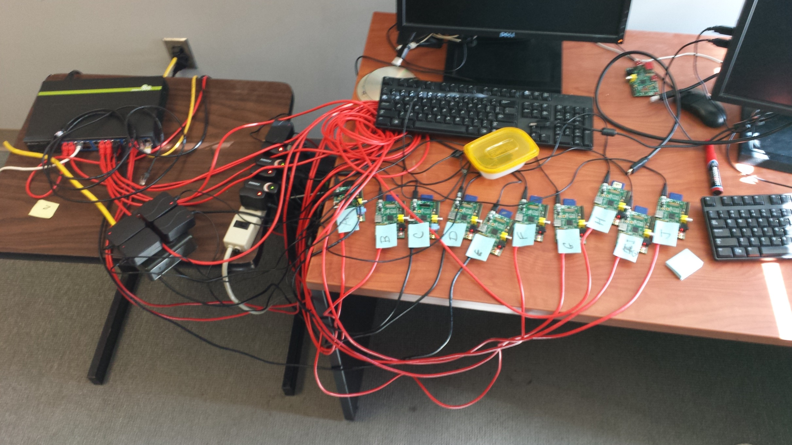
Pi room last week

Slide 15
A Serial Connection to the Pi
The Physical Connection:
  Plug in the power supply
  Grab (1) breadboard, (1) 3.3V FTDI cable, (1) 6-pin header, (1) Pi cobbler and ribbon cable, and (3) wires to create the physical connection shown on the next slide.
  To implement a 3-wire TTL RS-232 connection to your Pi, you’ll connect ground to ground and RX to TX in both directions.

Slide 16
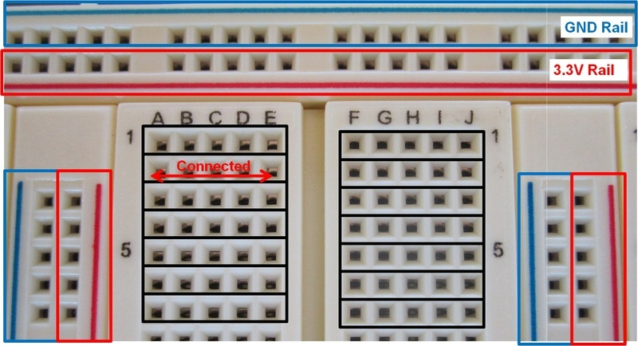
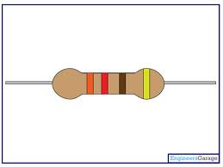

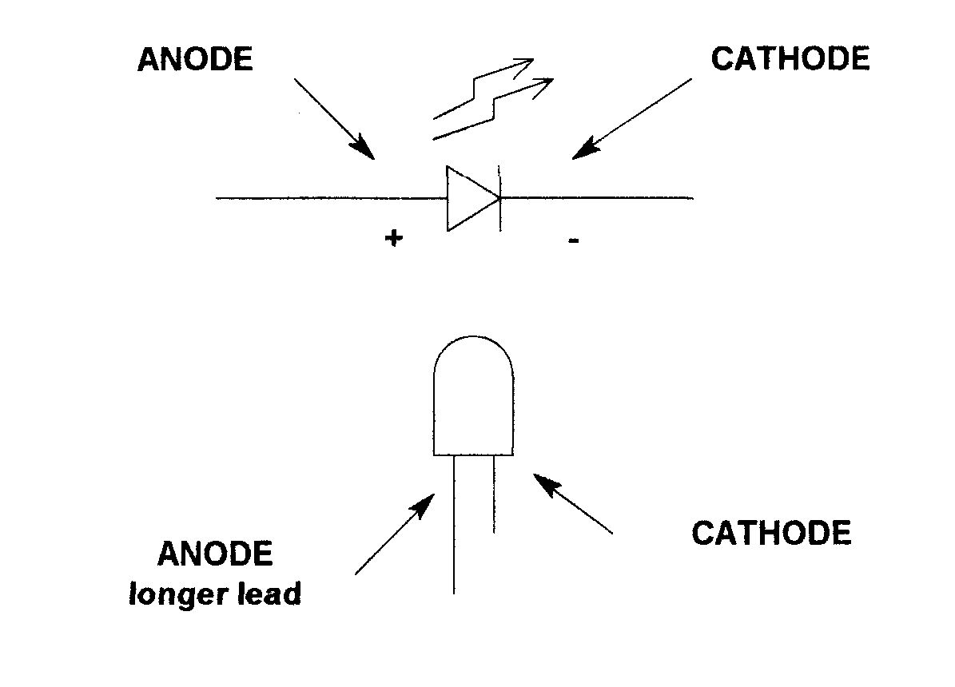
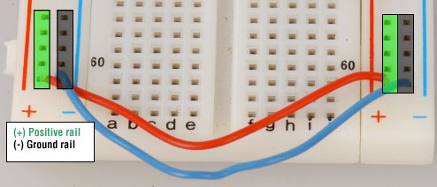
Component Tidbits

Slide 17
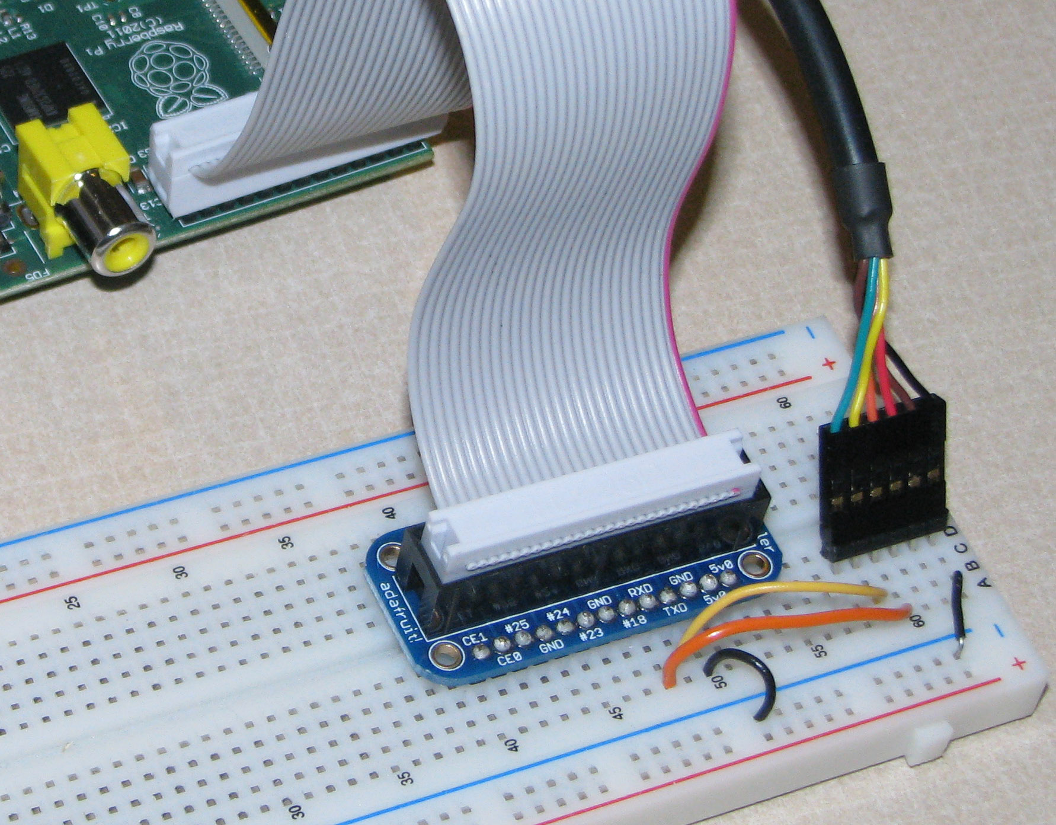
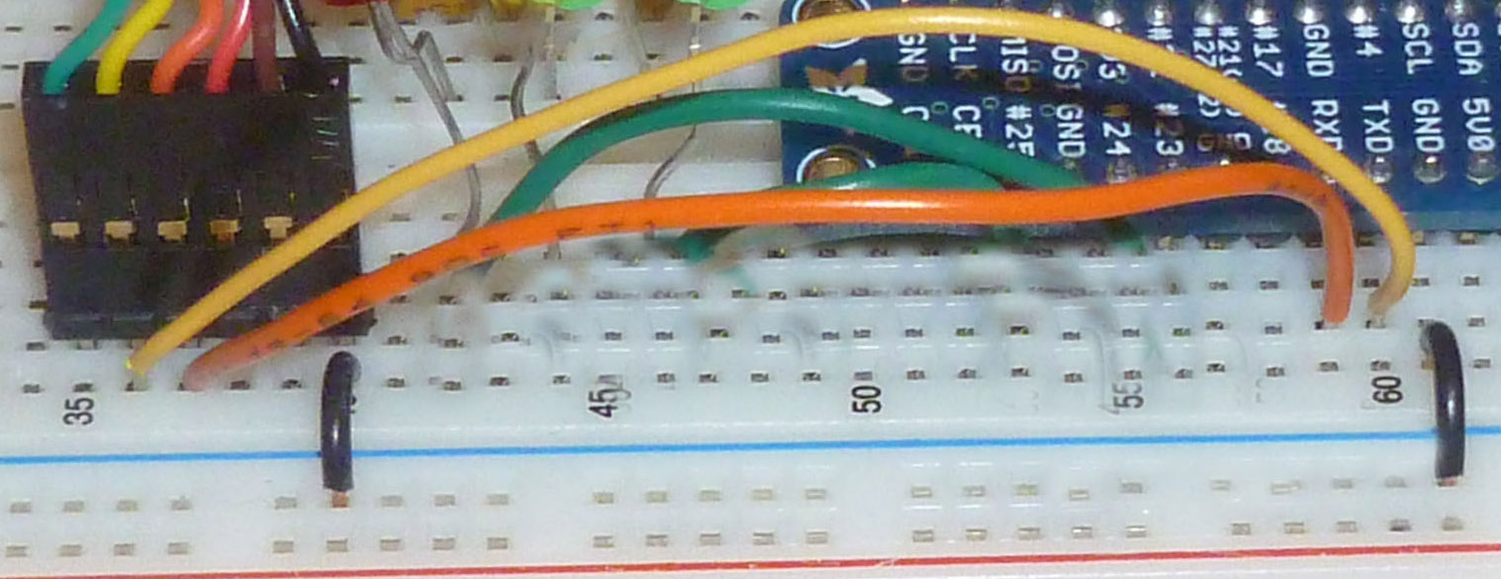
Physical Serial Connection
The colored wire-must connect to pin 1 on the Pi
DETAIL:
Connect ground to ground and
RX to TX in both directions:
Connect FTDI yellow to Pi TX
Connect FTDI orange to Pi RX
Connect Gnd to Gnd via the
power rail

Slide 18
The Software Serial Connection
On Windows, use MobaXterm or PuTTY to connect to the Pi with these RS-232 settings:
  Baud: 115200
  Data: 8-bit
  Parity: none
  Stop bits: 1
  Flow control: none
On Linux use screen to connect to the serial device.
Make sure your Pi has power!

Slide 19
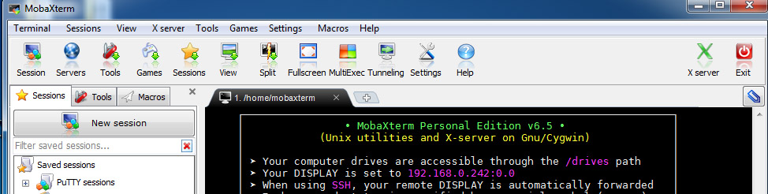
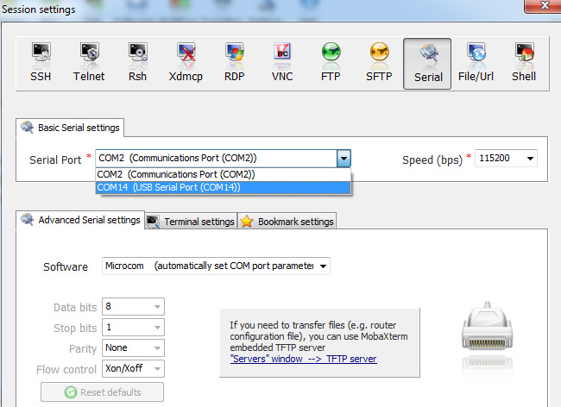
MobaXterm
Select: Sessions->Serial
Choose COM port
Set Baud rate

Slide 20
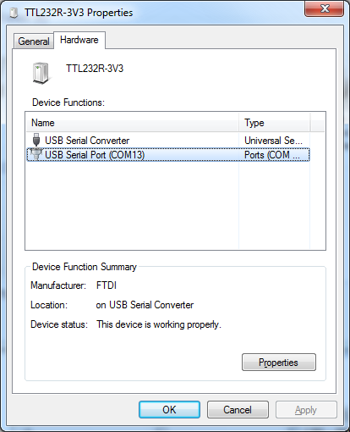
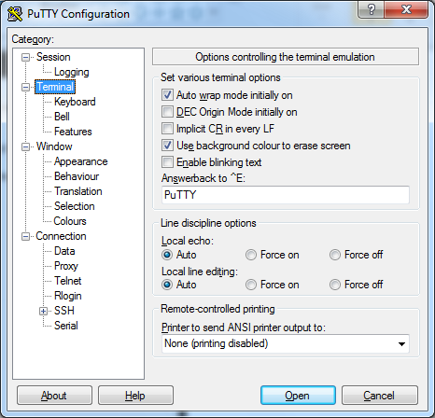
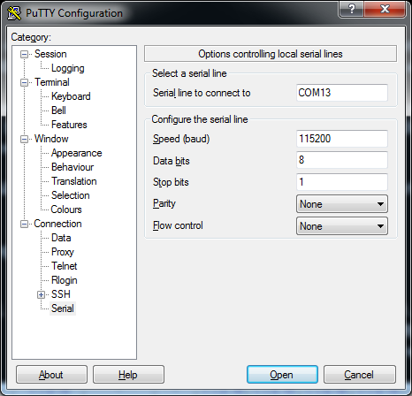
PuTTY
Use PuTTY with the following settings.

Slide 21
A Linux Serial Connection
First, determine the name of the serial device that is connected to the Pi. It is probably something like/dev/ttyUSBN.
Connect to it with the following command:
screen /dev/ttyUSBN 115200
Hit Enter a couple of times and hopefully the Pi will give you a login prompt.
Use the two-character sequence CTRL+A k to exit from screen.

Slide 22
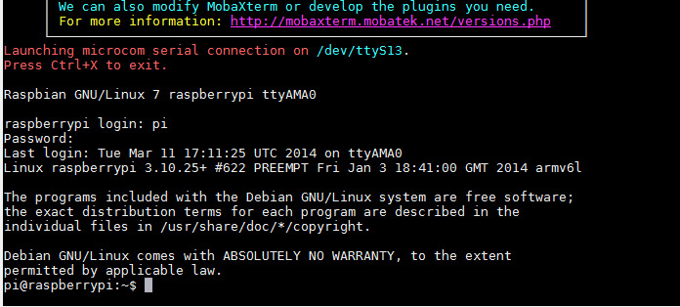
Login to the Pi
Account name: pi
Password: creative
Hit the enter key a couple of
times to initiate the prompt

Slide 23
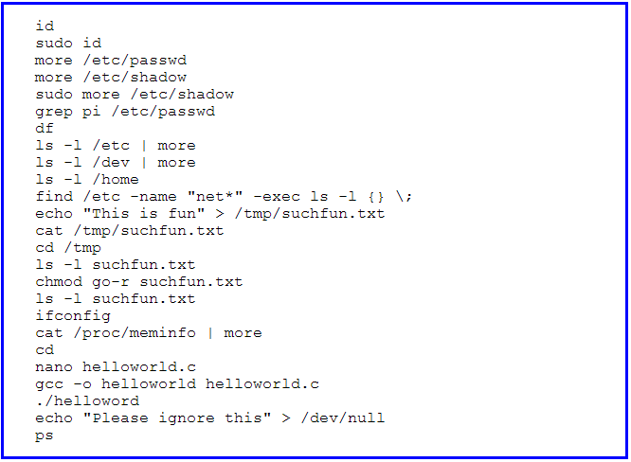
Linux
Try it out:

Slide 24
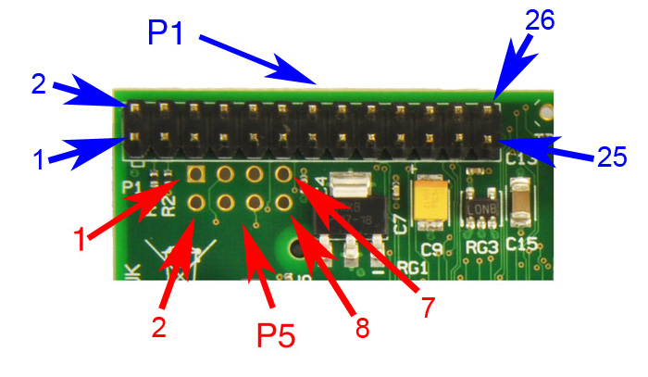
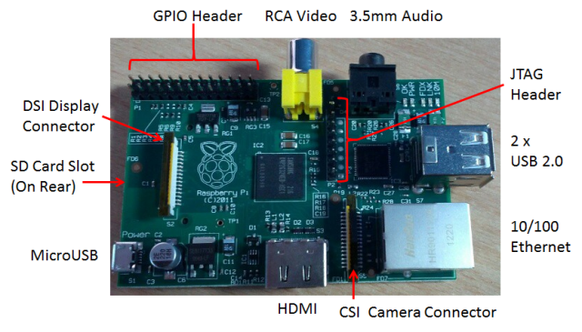
Raspberry Pi GPIO
A subset of the BCM2835 GPIO pins

Slide 25
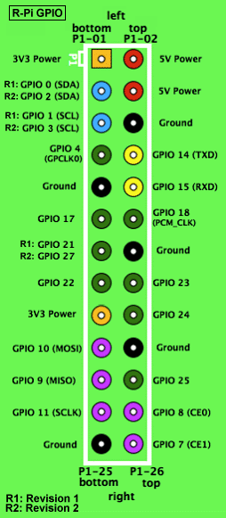
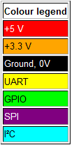
RPi General Purpose IO (GPIO) Pins
17 GPIO pins on the P1 header
  most have alternated functions
  two pins for UART; two for I2C; six for SPI
All 17 pins can be GPIO (i.e., INPUT or OUTPUT)
    all support interrupts
  internal pull-ups & pull-downs for each pin
  I2C pins have onboard pull-ups
    using them for GPIO may not work
Pins are 3.3V not 5V like on the Arduino
They are connected directly to the Broadcom chip
Sending 5V to a pin may kill the Pi
Maximum permitted current draw from a 3.3V pin is 50mA

Slide 26
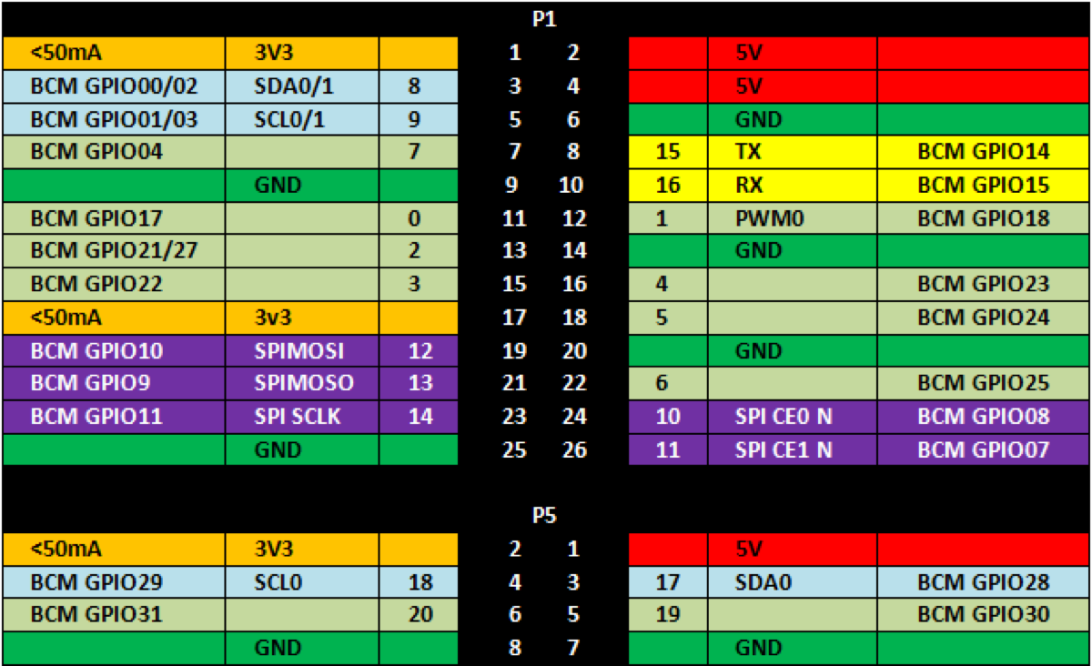
The Bigger Picture
Diagram includes BCM GPIO references (GPIO.BCM), common
functions, WiringPi pin references, and Pin numbers (GPIO.BOARD)

Slide 27
Using the GPIO Pins
There are two methods to read or write these pins
  File-type access in userspace
    accessed through the /dev interface
  Write/read memory addresses allocated to the GPIO peripheral of the SoC
    Memory locations can be found in the datasheet for the BCM2835
You can use the WiringPi library to help with both

Slide 28
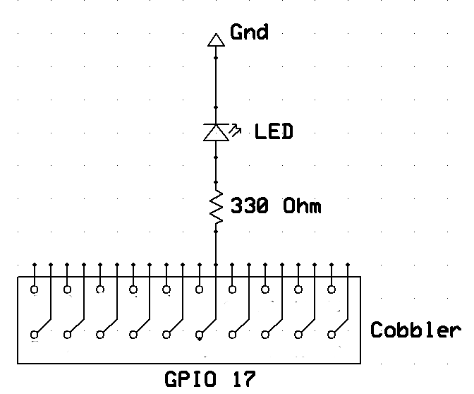
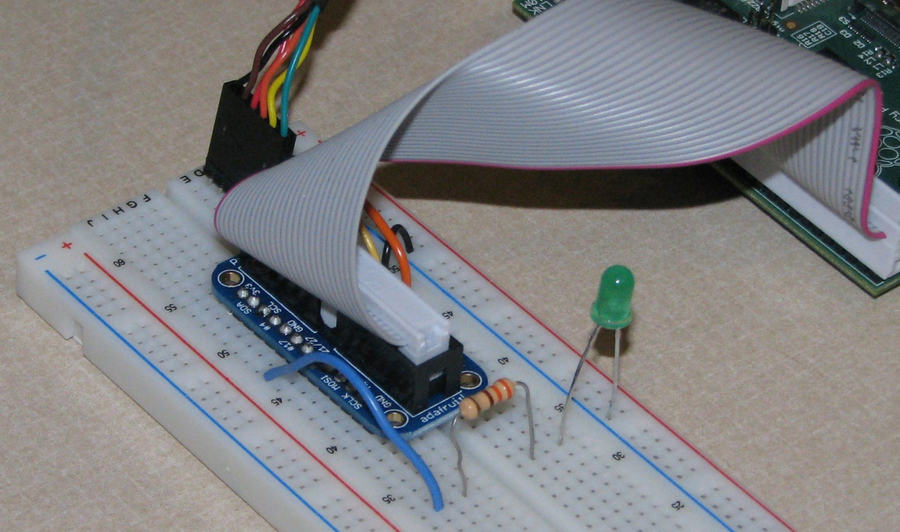
Blinking LED: Physical Connection
Connect an LED to GPIO 17 (P1-11)
The LED will initially be off because the GPIO pins are initialized as inputs at power-on (except for TXD).

Slide 29
Blinking LED: Software Solution 1
Using a file-type access
  Run shell script blink.sh
    cd examples
    sudo./blink.sh
#!/bin/sh
echo 17 > /sys/class/gpio/export
echo out > /sys/class/gpio/gpio17/direction
while true
do
echo 1 > /sys/class/gpio/gpio17/value
sleep 1
echo 0 > /sys/class/gpio/gpio17/value
sleep 1
done
“Close” the /sys/class/gpio/gpio17 directory:
  echo 17 > /sys/class/gpio/unexport

Slide 30
More Details
Create a shell script using nano:
  Change the permissions on blink.sh: chmod 755 blink.sh
  Run blink.sh: sudo ./blink.sh (in directory where blink.sh is stored)
After running the script your LED should be blinking endlessly. Give the command: Ctrl-c Ctrl-c to abort the script
All of the commands in the script can be issued one at a time on the command line; beginning by giving the commands: sudo -i to run a root shell---notice the change in the prompt
Look at the files and their contents in directory /sys/class/gpio/ and its subdirectories --- see next slide

Slide 31
Understanding /sys/class/gpio/
In Linux, everything is a file: /dev/ttyUSB0, /sys/class/net/eth0/address, /dev/mmcblk0p2,…
sysfs is a kernel module providing a virtual file system for device access at /sys/class
  provides a way for users (or code in user-space) to interact with devices at the system (kernel) level
A demo
Advantages / Disadvantage
  Allows conventional access to pins from userspace
  Always involves mode switch to kernel, action in kernel, mode switch back to user, and could have a context switch
  Slower than digitalWrite()/digitalRead() of Arduino
    with less predictable response times

Slide 32
A C program to do the same thing
GPIO with sysfs on Raspberry Pi (Part 2)
Code on Github
  Beware: the code assumes a Rev1 pinout

Slide 33
Introducing the WiringPi library
A GPIO access library written in C for the BCM2835
  Writes/reads the addresses of the memory allocated to the GPIO
Used to make common IO operations easier
  Similar to the Wiring library in the Arduino
Features:
  command-line utility gpio
  supports analog reading and writing
  More
Install the Wiring Pi library following these instructions
  Already installed on your Pi

Slide 34
Wiring Pin Numbers
WiringPi Pin numbers
Image credit: https://projects.drogon.net/raspberry-pi/wiringpi/pins/

Slide 35
Software Solution 2: WiringPi
blink.c is an example provided with the wiringPi library
  cd to examples or wiringPi/examples
#include <stdio.h>
#include <wiringPi.h>
// LED Pin - wiringPi pin 0 is BCM_GPIO 17.
#define LED 0
int main (void) {
printf ("Raspberry Pi blink\n") ;
wiringPiSetup () ; // ⬅ note the setup method chosen
pinMode (LED, OUTPUT) ;
for (;;) {
digitalWrite (LED, HIGH) ; // On
delay (500) ; // mS
digitalWrite (LED, LOW) ; // Off
delay (500) ;
}
return 0 ;
}

Slide 36
Running blink.c
Compile and run the blink program
  gcc -Wall -o blink blink.c -lwiringPi ⬅ compile
  sudo ./blink ⬅ run
Runs forever
  kill ctrl-c ctrl-c
Note: One of the four wiring setup functions must be called at the start of your program or your program will not work correctly

Slide 37
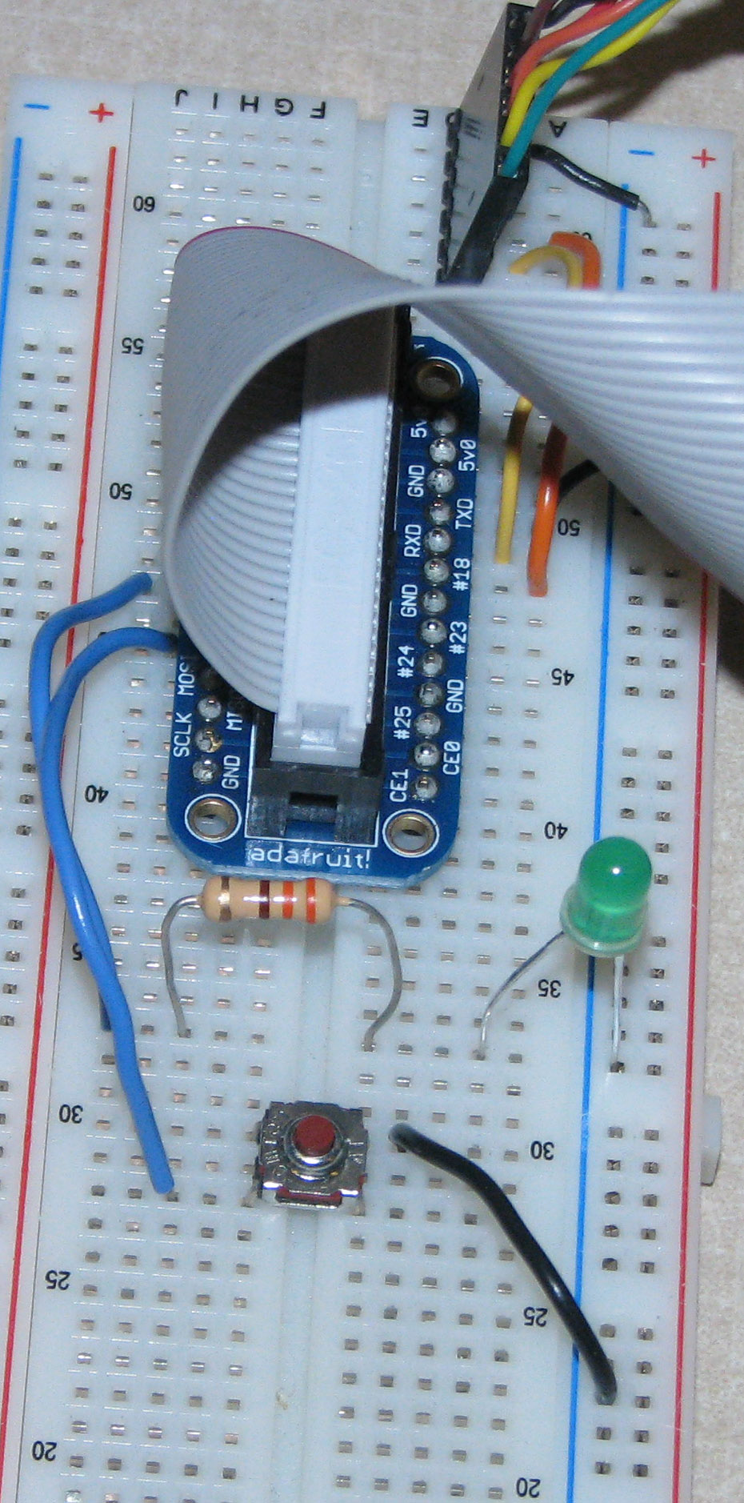
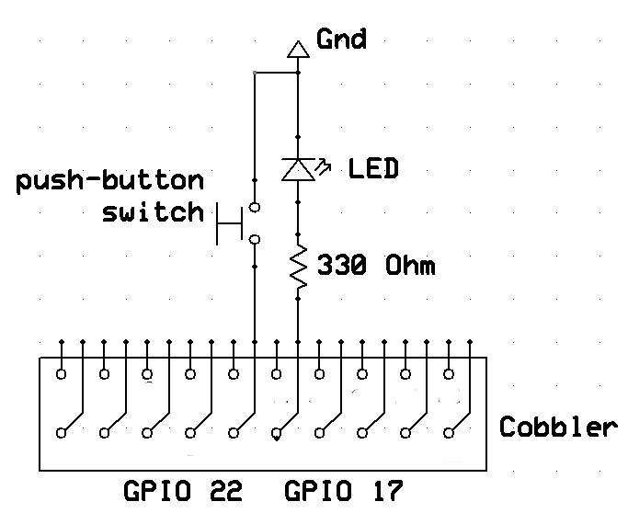
Input Example
Physical Connection:
Add a push-button switch to
GPIO 22

Slide 38
Input Example Software
Look in examples directory for button.c
Compile and run the button program
  gcc -Wall -o button button.c -lwiringPi ⬅ compile
  sudo ./button ⬅ run
The push-button controls the LED
Runs forever
  kill with ctrl-c ctrl-c

Slide 39
button.c
#include <stdio.h>
#include <wiringPi.h>
// LED Pin - wiringPi pin 0 is BCM_GPIO 17
#define LED 0
// LED Pin - wiringPi pin 3 is BCM_GPIO 22
#define BUTTON 3
int main (void) {
printf ("Raspberry Pi Push-Button Controlled LED\n");
wiringPiSetup ();
pinMode (LED, OUTPUT);
pinMode (BUTTON, INPUT);
pullUpDnControl (BUTTON, PUD_UP); // ⬅ using a pull-up resistor
for(;;) {
if ( digitalRead (BUTTON) == HIGH ) {
digitalWrite (LED, LOW);
} else {
digitalWrite (LED, HIGH);
}
delay (1);
}
}

Slide 40
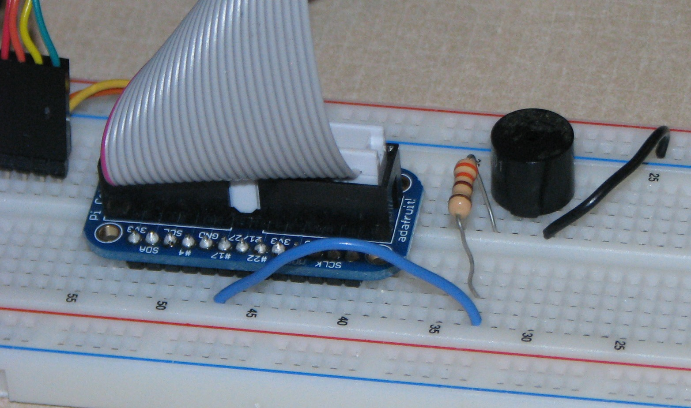
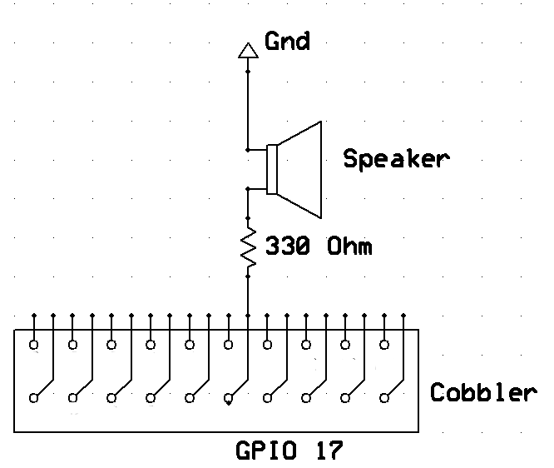
Just for Fun try Music
Physical Connection:
Remove the push-button &
Replace the LED with a speaker

Slide 41
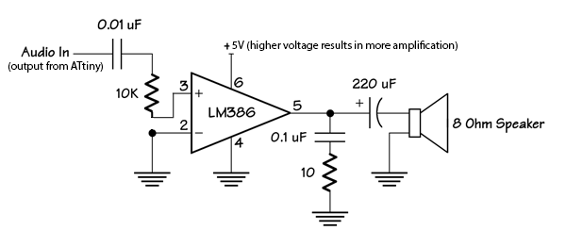
Just for Fun try Music
Software
Look in examples directory for music.c & pitches.h
Compile and run the program
  gcc -Wall -o music music.c -lwiringPi
  sudo ./music
Could add an amplifier
but not today

Slide 42
I²C – Inter-Integrated Circuit
Invented by Phillips in 1982
  I²C specification
A tradeoff between speed and area
  Less spaces devoted to wires
  Fewer wires can decrease throughput
A good idea for sensors
  But not for disk drives
Adopted by Intel for personal computers
  Under the name SMBus
  00:1f.3 SMBus: Intel Corporation 82801JD/DO (ICH10 Family) SMBus Controller (rev 02)

Slide 43
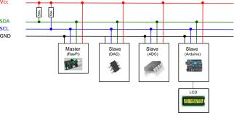
I²C
Understanding I²C
  The physical I²C bus
  Masters and Slaves
  The physical protocol
  I²C device addressing
  The software protocol
  I²C support in Linux kernel
    And Windows and Arduino
    And Microcontrollers and …
A good Tutorial at Robot Electronics
Image credit: http://quick2wire.com/articles/i2c-and-spi/

Slide 44
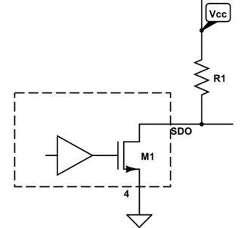
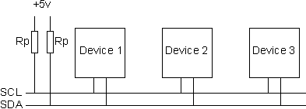
  The physical I²C bus
Image credit: http://electronics.stackexchange.com/questions/70312/n-ch-fet-with-open-drain-output
Image credit: http://www.robot-electronics.co.uk/acatalog/I2C_Tutorial.html
Two wires: SCL and SDA
  SCL is the clock line: used to synchronize all data transfers
  SDA is the data line
Both SCL and SDA lines are "open drain" drivers
  Can only be driven low
  For the line to go high provide a pull-up resistors to Vcc
    The value of Vcc is an example of something SMBus restricts

Slide 45
Add the physical I²C devices
Adafruit breakout boards
  BMP180
  9-DOF: L3GD20 and LSM303
There’s just four connections on each
  GND
  3Vo (to 3V3 of T-Cobbler)
  SDA
  SCL

Slide 46
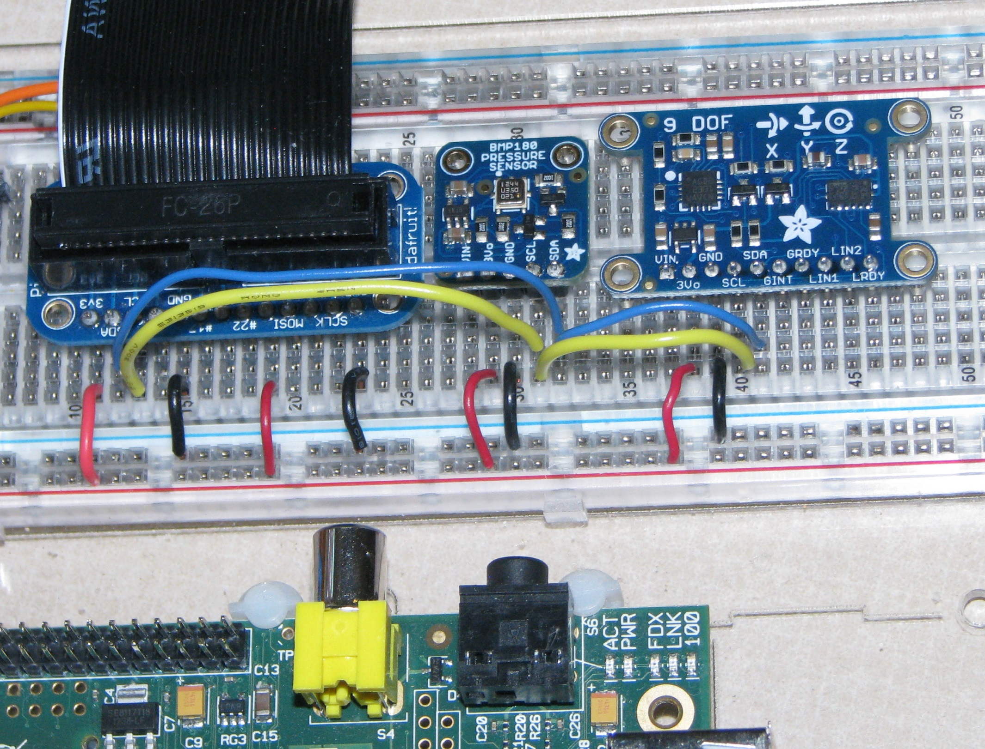
It might look like this

Slide 47
Masters and Slaves
The devices are either masters or slaves
Master device drives the clock
Master device initiates the transfers
Master device controls the transfer
Typically only one master.
  But multi-master mode is possible

Slide 48
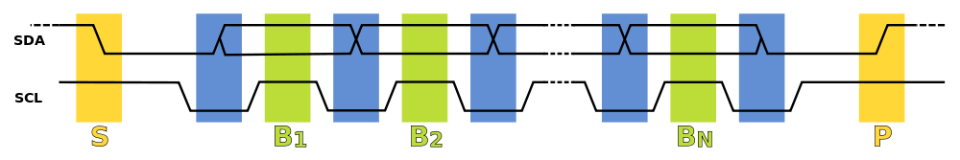
The I²C Physical Protocol
Wikimedia commons image
Data is transferred in sequences of 8 bits, followed by an acknowledge bit
Bits are sent with the MSB (Most Significant Bit) first.
The SCL line is pulsed high, then low for each bit
The standard clock (SCL) speed for I²C is up to 100KHz
Start and stop sequences mark the beginning and end of a transaction
Transfer is initiated with SDA is pulled low while SCL (clock line) is high
During data transfer, SDA must not change while SCL is high

Slide 49

I²C Device Addressing
Image credit: http://www.robot-electronics.co.uk/acatalog/I2C_Tutorial.html
I²C addresses are 7 bits or sometimes 10 bits
  Up to 128 devices on the usual I²C bus
Devices has fixed addresses
  But SMBus supports “address resolution”
Addresses are still sent in 8 bits
  Last bit is zero if writing
  Last bit is one if reading

Slide 50
I²C Write Protocol
Send start sequence
Send address of slave address with last bit 0
Send one byte register number or “command”
  It’s a bit more complicated with an EEPROM
Send the data byte
If appropriate send more data
  Register number will be incremented
Send stop sequence
  No length field!

Slide 51
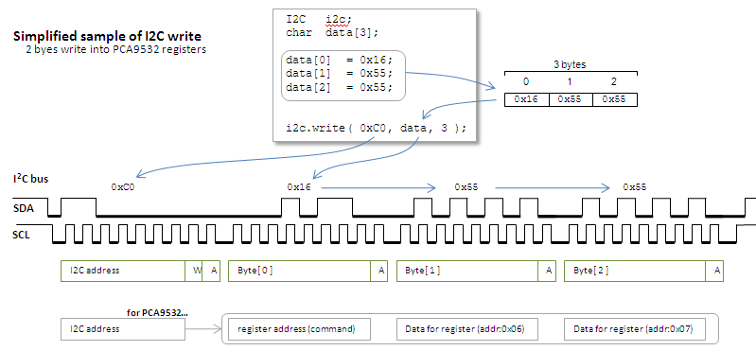
A great picture from http://mbed.org/users/okano/notebook/i2c-access-examples/

Slide 52
I²C Read Protocol
Send start sequence
Send address of slave address with last bit 0
Send one byte register number or “command”
Send start sequence
Send address of slave address with last bit 1
Read data
  Use multiple ACK followed by STOP for multi-byte read
A read is really a write followed by a read

Slide 53
Another great picture from http://mbed.org/users/okano/notebook/i2c-access-examples/

Slide 54
Getting the Pi ready
Stop the “blacklisting” of I2C
  In /etc/modprobe.d/raspi-blacklist.conf
    Comment out the blacklist of i2c-bcm2708
Add the appropriate modules
  By adding the following lines to /etc/modules
    i2c-bcm2708
    i2c-dev
Install a couple of packages
  i2c-tools
  libi2c-dev
Add user pi to group i2c
Reboot

Slide 55
Linux i2c device interface
Device files are /dev/i2c-*
  Major number is 89
  Minor number is bus number
Linux device documentation for “userspace”
  The usual read and write are supported
  but ioctl is the preferred interface
  especially with smbus protocol macros

Slide 56
The i2c utilities
Before programming, try the i2c utilities
  i2cdetect
  i2cdump
  i2cget
  i2cset
On Rev1 versions of the Raspberry Pi, the i2c devices on a bus 0

Slide 57
Using the I²C utilities finding the bus
ls -l /dev/i2c-*
lsmod | grep i2c
id
i2cdetect –l
i2cdetect -y 1
Use 0 with Rev1

Slide 58
Using the I²C utilities finding the temperature
i2cget -y 1 0x77 0xD0 b
  Make sure you have a BMP180
i2cdump -r 0xAA-0xBF -y 1 0x77
  Examine mysterious EEPROM registers
i2cdump -y -r 0xF4-0xF7 1 0x77
  Examine measurement register
i2cset -y 1 0x77 0xF4 0x2E
  Tell device to read temperature
i2cdump -y -r 0xF4-0xF7 1 0x77

Slide 59
Trying out the kernel interface
Take a look at the bmp180 program
  Which should be in the examples directory
Note the usual structures
  Lots of register definitions
  Routines to interpret the data
  Actions
    Open the device
    Read and write to the device

Slide 60
But what about the hard part?
Where does this come from
  x1 = (ut-ac6)*ac5/32768 ;
  x2 = mc * 2048 / (x1 + md) ;
  b5 = x1 + x2 ;
  t = (b5 + 8) / 16 ;
the BMP180 datasheet
  See page 15 for the details
    And don’t expect to understand why

Slide 61
What can be done?
Read the datasheet
Find an application note
Find example programs
Search for device drivers for the manufacturer
  It should contain a lot of DEFINE
Try I²Cdevlib

Slide 62
Block read and write
Reading in blocks
  May be more efficient
  May give more consistent information
    Read X, Y and Z as an atomic unit
Check out another BMP180 program

Slide 63
Time to test it out
Compile the programs
Test it out
  It should get warmer when touched
  And colder when using an ice cube
The program has no filtering
  So sometimes odd results are returned

Slide 64
Why Python?
A good “first” programming language
  Especially if you don’t like the following
    public static void main(String[] args)
    int main(int argc, char *argv[])
Lots of good packages
Fun interfaces for kids
  See Python for Kids
Generally easy to get something running
  Mspeled variables can hide for months

Slide 65
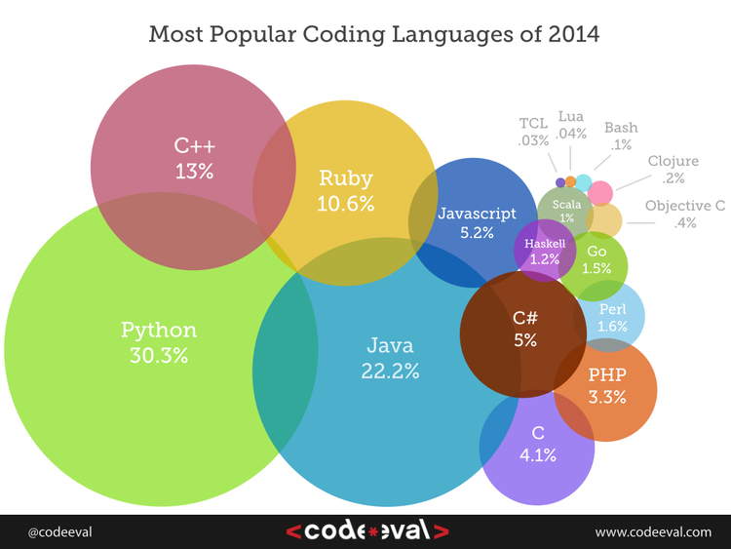
Python?

Slide 66
A couple of Python programs
One for the BMP180
  Note the lack of block reads
One for an accellerometer

Slide 67
Why the JSON?
Pretty to easy to read
Has a formal schema for validation
Works well with web applications
  JavaScript
  HTML5
Will please the New Media students in CSCI 185
Supported in all common programming languages
http://pinkie-pie.cs.unca.edu is running on a Raspberry Pi Model B Rev1 -- 256 MBtyes of RAM
It could tell you how hot it is

