Slide 2
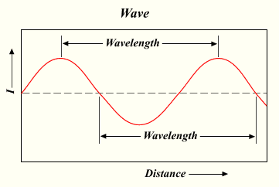
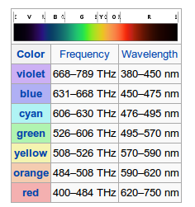
Light
Light has wave-like properties
Colors correspond to different wavelengths of light

Slide 3
The eye
Eyes are very complex, but respond to light waves
Rods cannot distinguish color, but allow you to see at night
Cones respond to different wavelengths of light

Slide 4
Different cones respond to...
Red Light
Green Light
Blue Light

Slide 5
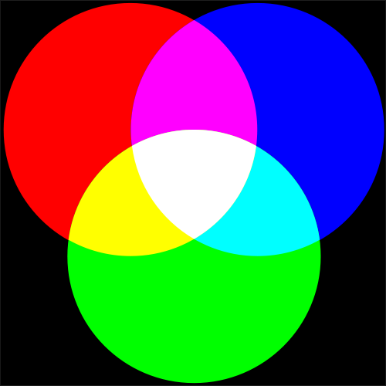
RGB
The RGB color model is an additive color model
Adding different amounts of Red, Green or Blue light allows you to produce any visible colors

Slide 6
Color-Depth
RGB colors are stored as a bit-strings
Each bit-string has 3 bytes for red, green and blue
So, usually, the color-depth on a computer is 24 bits.
There are 256 possible bitstrings associated with a byte, so R,G, and B each have 256 different possible values
0
0
1
1
0
0
1
0
0
0
0
0
0
0
1
0
0
1
0
0
1
1
0
1

Slide 7
Exercises
Each color in RGB is represented as 3 numbers (0,0,0) where the first value is the amount of red, the second is the amount of green and the third is the amount of blue. Find the code values for each of the following colors.
1) Red
2) Green
3) Blue
4) Yellow
5) Cyan
6) Magenta
7) Black
8) White
Use GIMP or Inkscape to verify that your code is correct.

Slide 8
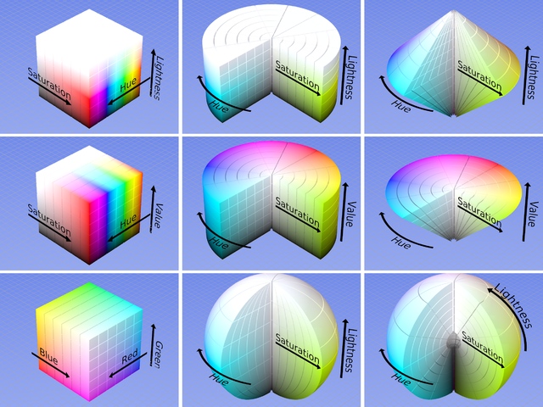
HSL (HSV, HSB)
Hue, Saturation and Lightness (or Value, or Brightness) is equivalent to RGB encoding but is slightly more intutive
H: Hue
S: Saturation
L: Lightness

Slide 9
Exercises
Each color in HSL is represented as 3 numbers (0,0,0) where the first value is the hue (or color), the second is the saturation (or the amount of the color) and the third is the lightness (or the amount of white light in the color). Find the HSL code values for each of the following colors.
1) Red
2) Green
3) Blue
4) Yellow
5) Cyan
6) Magenta
7) Black
8) White
Use GIMP or Inkscape to verify that your code is correct.

Slide 10
CMYK
CMYK is the color model you learn in elementary school based on ink.
C: Cyan
M: Magenta
Y: Yellow
K: Black (Key)

Slide 11
CMYK
CMYK is a subtractive color model, meaning that you are blocking light by covering it with ink
Cyan = G + B = W - R
Magenta = R + B = W - G
Yellow = R + G = W - B
K: Black (Key)

Slide 12
CMYK
Each primary color in CMYK is measured in percentages instead of numerical values.
Total coverage is the total of all the percentages. Here's one way to get green:
C: 90%
M: 10%
Y: 90%
K: 10%
Total Coverage: 200

Slide 13
CMYK
Total Coverage should never go over 255, since the page would be too saturated with ink to dry.

Slide 14
Exercises
Each color in CMYK is represented 4 numbers (0,0,0,0) where the first value is the amount of cyan ink, the second is the amount of magenta ink, the third is the amount of yellow ink and the fourth is the amount of black ink. Find the CMYK code values for each of the following colors.
1) Red
2) Green
3) Blue
4) Yellow
5) Cyan
6) Magenta
7) Black
8) White
Use GIMP or Inkscape to verify that your code is correct.

Slide 15
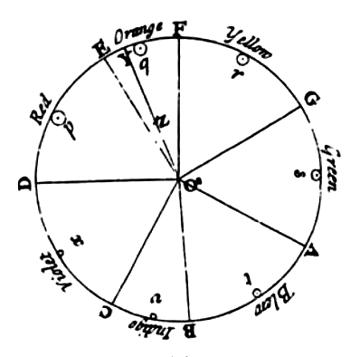
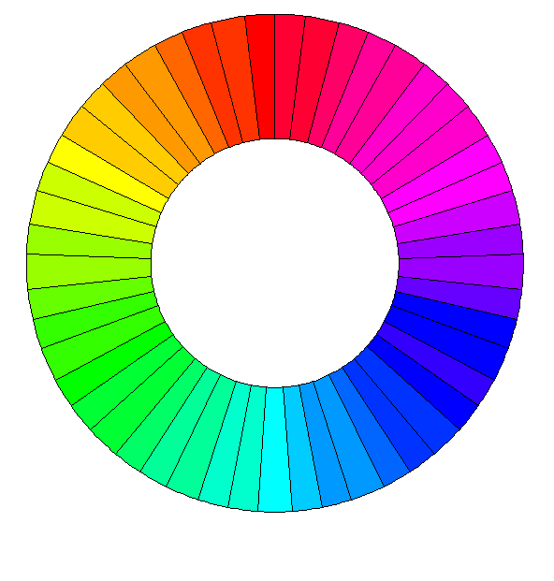
Using Color
The Color Wheel provides a good rule of thumb for picking color schemes to enhance your designs
It's not perfect however, since reactions to color are often influenced by culture and personal taste

