Slide 1

Sensing the World with Raspberry Pi
J Dean Brock and Rebecca Bruce
CCSC:SE 2014

Slide 2
They’re back
CCSC:SE 2013
  Changing the World with Raspberry Pi
    GPIO with the Raspberry Pi
    Illustrating numeric algorithms using Python
This year
  Use of sensors to collect “environmental” information
  Display of sensor data on the “web”

Slide 3
Raspberry Pi in our courses
Relevant course for today
  CSCI/EGM Mechatronics Design (Fall 2013)
  CSCI Operating Systems (Spring 2014)
  CSCI/EGM Robotics Project (Fall 2014)
Other course applications
  CSCI Database Management Systems (Spring 2014)
    Students set up database and web servers
  CSCI Computer Organization (Fall 2014)
  CSCI Computer Networking (Spring 2015)

Slide 4
Workshop Materials
All workshop materials will be available on our own (256 Mbyte) RPi webserver:
  pinkie-pie.cs.unca.edu
Mirrored on the UNCA CS webserver:
  www.cs.unca.edu/pinkie-pie

Slide 5
Time to (try to) connect with VNC Server
Step 1: On your PC, install the tightvnc viewer
  From the Internet (preferred):
  http://www.tightvnc.com/download.php
  (download the Java viewer as a JAR file)
  It’s also on the SD card, in case there is no internet
Step 2: power up the RPi; the VNC server starts at boot; Power-up procedure:
  Insert SD card
  Connect cobbler ribbon cable
  Connect power adapter
Step 3: Get Pi’s IP as described on the slide

Slide 6
What we are trying today
Pi’s are configured to connect to our web server
  Makes a query containing
    “local” (possibly NATed) IP address
    Ethernet address
      Helps us to configure DHCP
A CGI script stores this information a file
  Remote IP is also stored
File can be accessed from a browser
This won’t be needed if we have monitors!

Slide 7
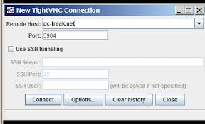
Complete VNC connection
Step 4: On PC, start viewer with IP for your RPi and port number 5901
RPi’s IP number
5901

Slide 8
Other Connection Options
Direct connection to a monitor, key board, mouse
  (We would be looking at this slide if that is an option)
Secure shell (SSH) connection
  On Windows, you need MobaXterm or PuTTY to make an SSH connection; it also on the SD card
Serial connection using FTDI cable
  On Windows, you need MobaXterm or PuTTY for this connection; it also on the SD card

Slide 9
A quick introduction
Because you might have seen this at Furman last year

Slide 10
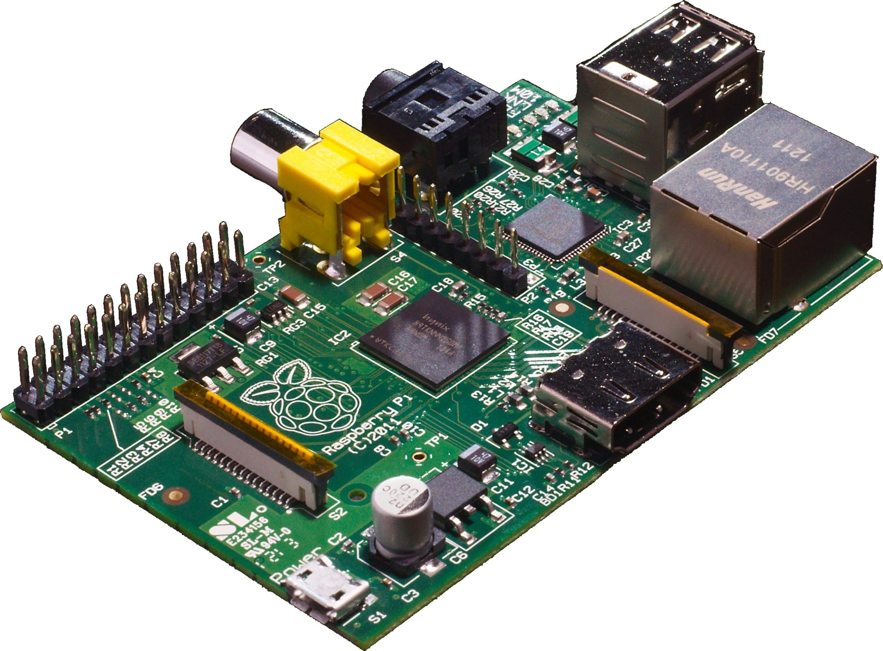
Rapberry Pi Model B
Picture from Wikimedia

Slide 11
Raspberry Pi history
A computer to inspire children
  to put the fun back into learning computing
  provide computers to the poor
  guided by Raspberry Pi foundation
Early support from academia and industry
  University of Cambridge Computer Laboratory
  Broadcom
Raspberry Pi model B launched in early 2012
  Now there is the Raspberry Pi B+

Slide 12
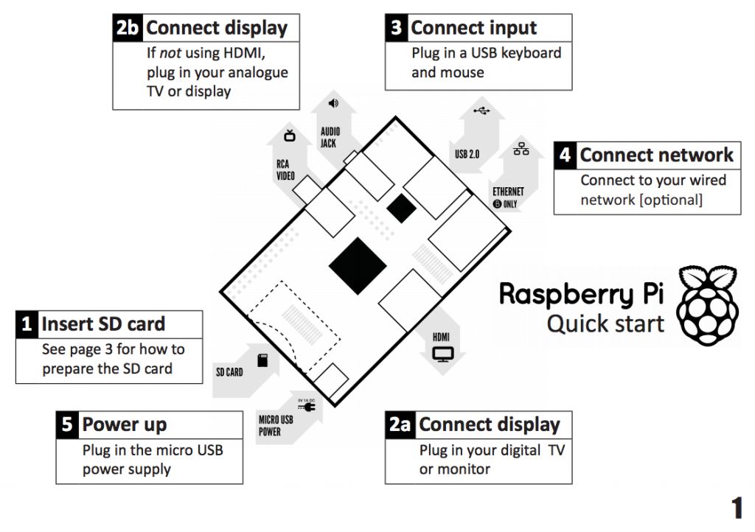
Raspberry Pi Quick start
From Raspberry Pi Quick start guide

Slide 13
Raspberry Pi hardware
Broadcom BCM2835 SoC (system on chip)
  700 MHz ARM1176JZF-S CPU
    ARM11 microarchitecture with ARMv6A ISA
  Video Core IV GPU (1080p, 24GFLOPS)
  Peripherals: UART, USB, I²C, GPIO
LAN9512 USB hub and Ethernet controller
512 Mbytes RAM
Connectors: USB, Ethernet, HDMI, camera
SD-card

Slide 14
Very detailed references
Schematics for Rasberry Pi board
BCM2835 ARM peripherals data sheet
LAN9512 data sheet
ARMv6 architecture reference manual
  Available with ARM login id
    Or search using google
  Almost 400 pages

Slide 15
How we name our Pi’s
We give the Pi’s name and label them
We put this information in our servers
  DNS – Domain Name System
    Name-to-IP and IP-to-Name
  DHCP – Dynamic Host Configuration Protocol
    Ethernet-to-IP

Slide 16
Figuring out your IP address
When at home, connect to your router
  And try to find the Pi
Elsewhere
  Connect with a monitor
    Look at the display
      IP number will be at the end
  Connect with serial connection from your PC
    Run
      ip addr

Slide 17
What we are trying today
Pi’s are configured to connect to our web server
  Makes a query containing
    “local” (possibly NATed) IP address
    Ethernet address
      Helps us to configure DHCP
A CGI script stores this information a file
  Remote IP is also stored
File can be accessed from a browser
Obviously this needs a lot of work
  Let’s hope we have monitors!

Slide 18
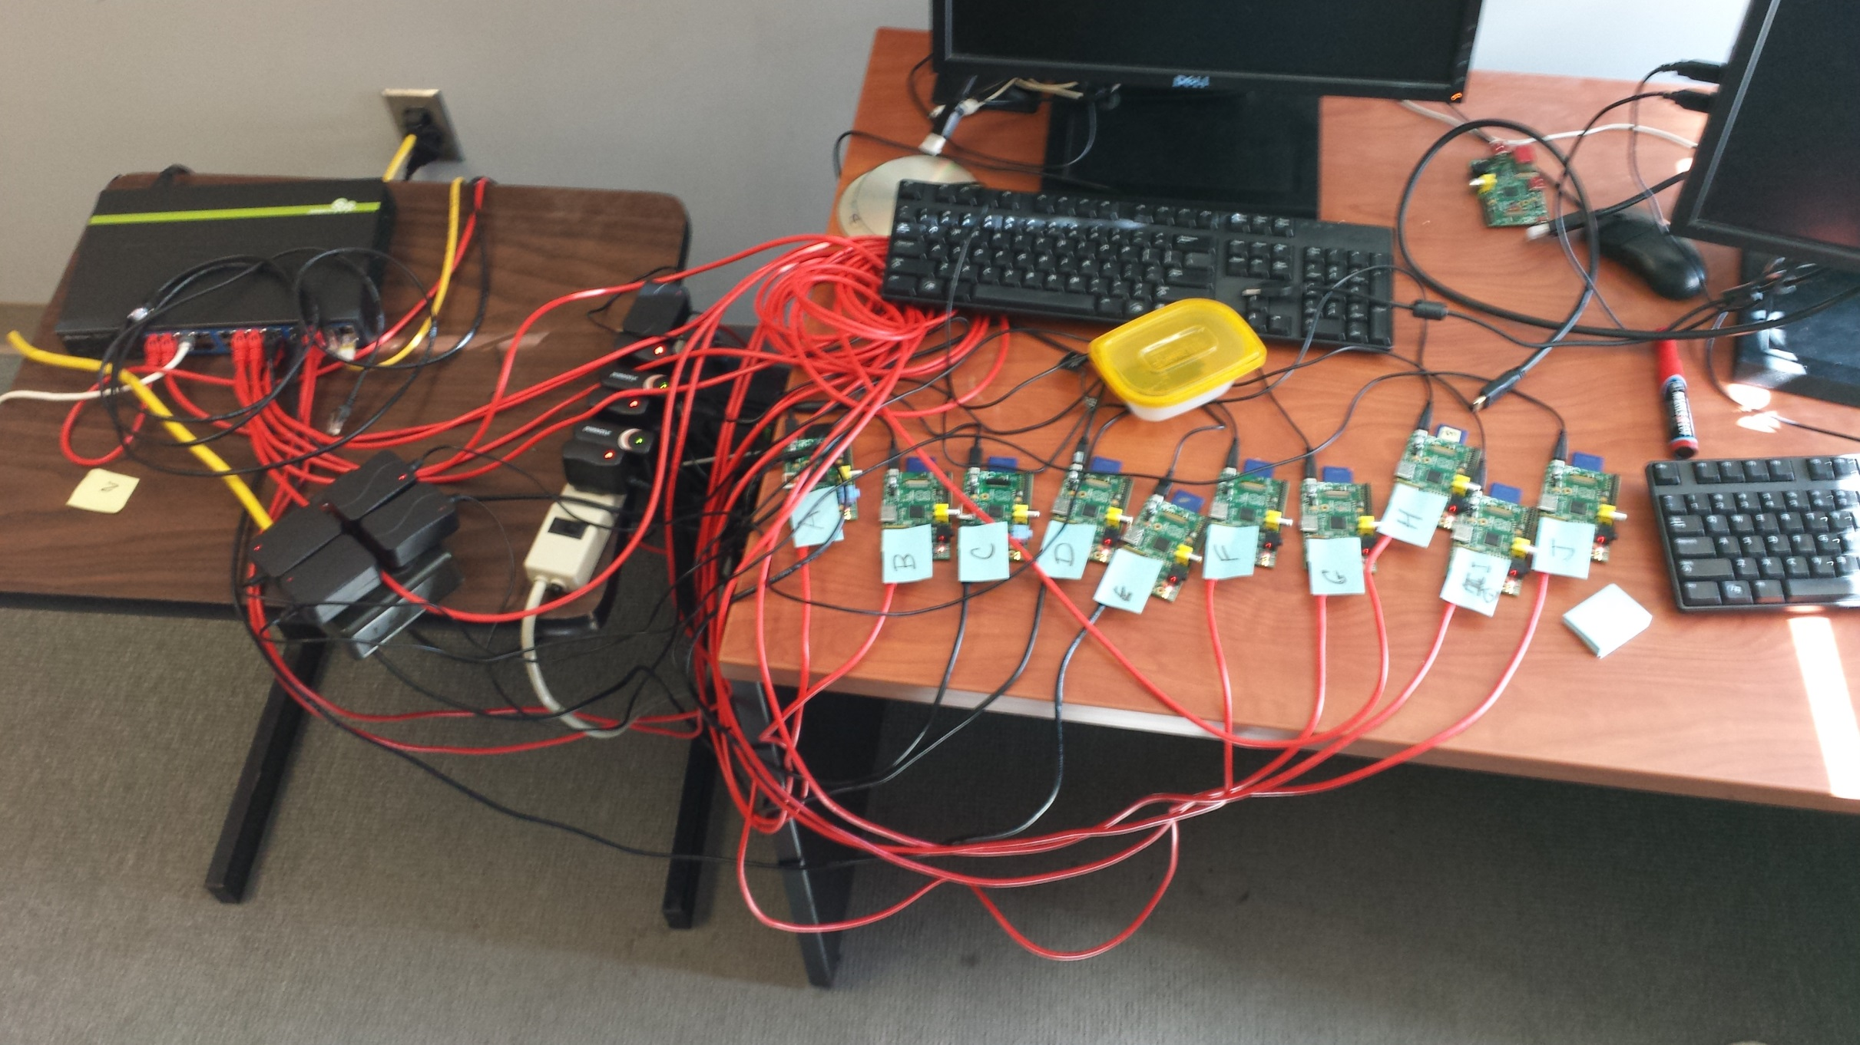
Pi room last week

Slide 19
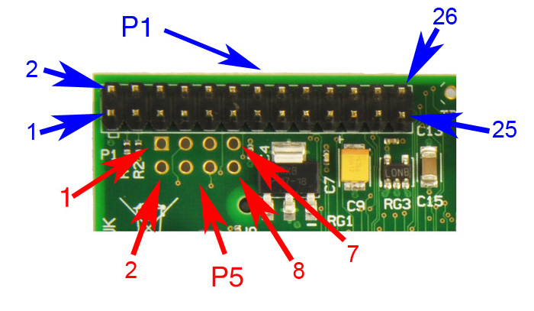
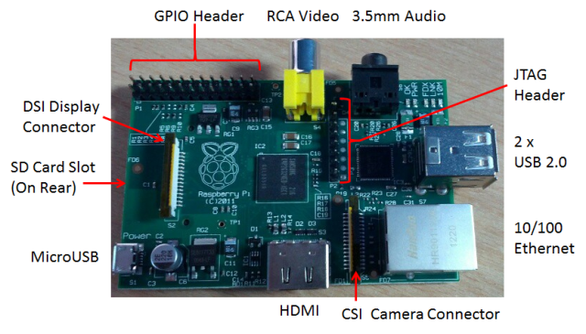
Raspberry Pi GPIO
A subset of the BCM2835 GPIO pins

Slide 20

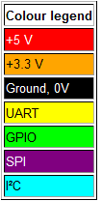
RPi General Purpose IO (GPIO) Pins
17 GPIO pins on the P1 header
  most have alternated functions
  two pins for UART; two for I2C; six for SPI
All 17 pins can be GPIO (i.e., INPUT or OUTPUT)
    all support interrupts
  internal pull-ups & pull-downs for each pin
  I2C pins have onboard pull-ups
    using them for GPIO may not work
Pins are 3.3V not 5V like on the Arduino
They are connected directly to the Broadcom chip
Sending 5V to a pin may kill the Pi
Maximum permitted current draw from a 3.3V pin is 50mA

Slide 21
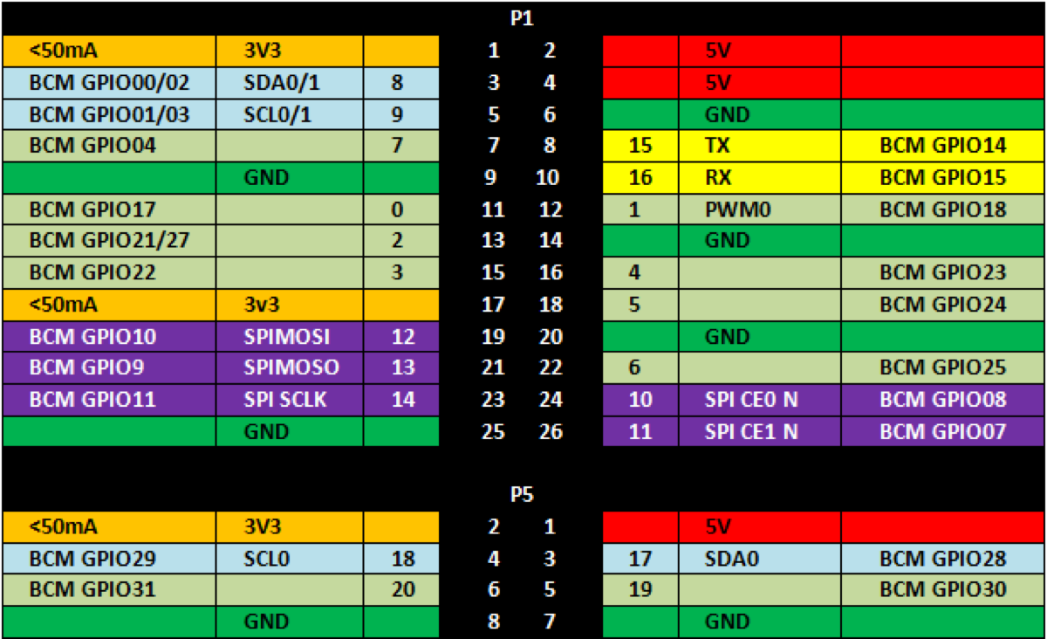
The Bigger Picture
Diagram includes BCM GPIO references (GPIO.BCM), common
functions, WiringPi pin references, and Pin numbers (GPIO.BOARD)

Slide 22
Using the GPIO Pins
There are two methods to read or write these pins
  File-type access in userspace
    accessed through the device (/dev) interface
  Write/read memory addresses allocated to the GPIO peripheral of the SoC
    Memory locations can be found in the datasheet for the BCM2835

Slide 23
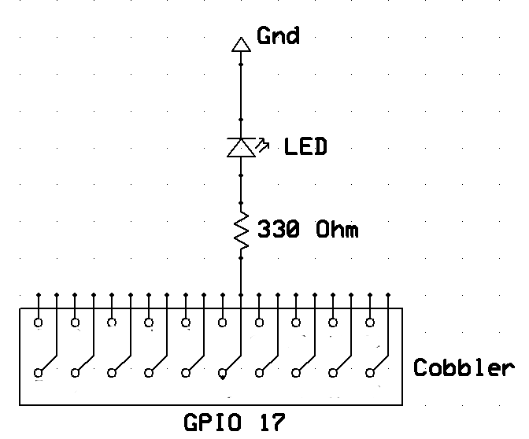
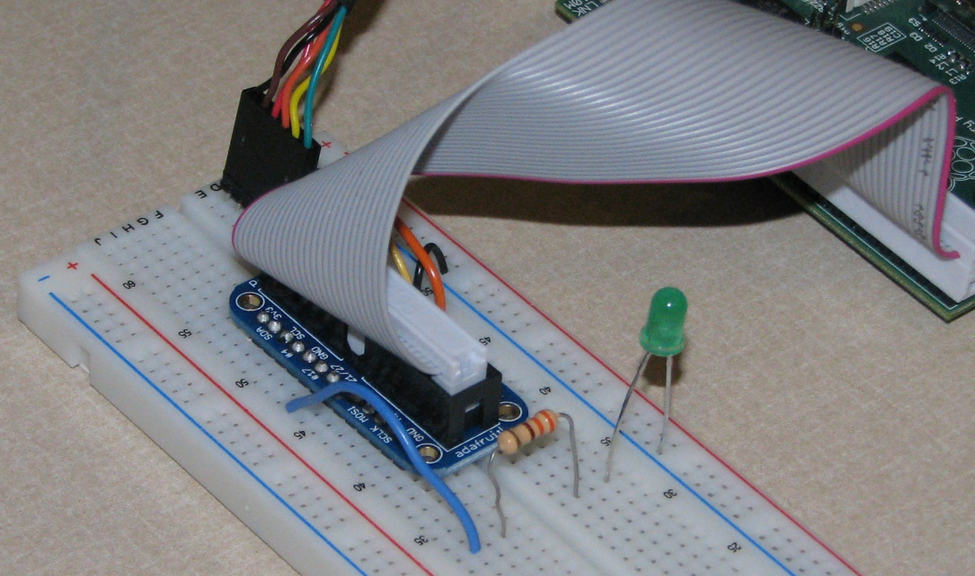
Flash LEDs: Physical Connection
Connect an LED to GPIO 17 (P1-11)
The LED will initially be off because the GPIO pins are initialized as inputs at power-on (except for TXD).

Slide 24
Flash LEDs: Software Solution 1
Using a file-type access
  Run shell script ledBash.sh
    cd ccscse2014/examples
    sudo ./ledBash.sh
#!/bin/sh
echo 17 > /sys/class/gpio/export
echo out > /sys/class/gpio/gpio17/direction
echo 1 > /sys/class/gpio/gpio17/value
sleep 1
echo 0 > /sys/class/gpio/gpio17/value
echo 17 > /sys/class/gpio/unexport

Slide 25
Flash LEDs: Other Software Solutions
Solution 2: Write/read memory addresses allocated to the GPIO peripheral of the SoC using pointers
  Memory locations can be found in the datasheet for the BCM2835
  RPi.GPIO
    Comes with Raspbian
  RPIO
    Supports PWM & servos
  WiringPi-python
  Quick2Wire
The best way to access the GPIOs?
A Python program using RPi.GPIO to flash the LEDs:
  Run Python script ledPython.py
    cd ccscse2014/examples
    sudo ./ledPython.py

Slide 26
I²C – Inter-Integrated Circuit
Invented by Phillips in 1982
  I²C specification
A tradeoff between speed and area
  Less spaces devoted to wires
  Fewer wires can decrease throughput
A good idea for sensors
  But not for disk drives
Adopted by Intel for personal computers
  Under the name SMBus
  00:1f.3 SMBus: Intel Corporation 82801JD/DO (ICH10 Family) SMBus Controller (rev 02)

Slide 27
What about SPI?
Needs one line per device
  O(n) vs O(1) wires
Sensors aren’t packaged in DIPs
  You must use breakout boards
Adafruit
  Tutorials
  Libraries
  Many useful choices
    Search for “adafruit i2c images”
  Limor Fried likes them

Slide 28
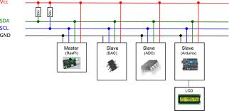
I²C
Understanding I²C
  The physical I²C bus
  Masters and Slaves
  The physical protocol
  I²C device addressing
  The software protocol
  I²C support in Linux kernel
    And Windows and Arduino
    And Microcontrollers and …
A good Tutorial at Robot Electronics
Image credit: http://quick2wire.com/articles/i2c-and-spi/

Slide 29
Adding physical I²C devices
Adafruit breakout boards
  BMP180
  9-DOF: L3GD20 and LSM303
There’s just four connections on each
  GND
  3Vo (to 3V3 of T-Cobbler)
  SDA
  SCL

Slide 30
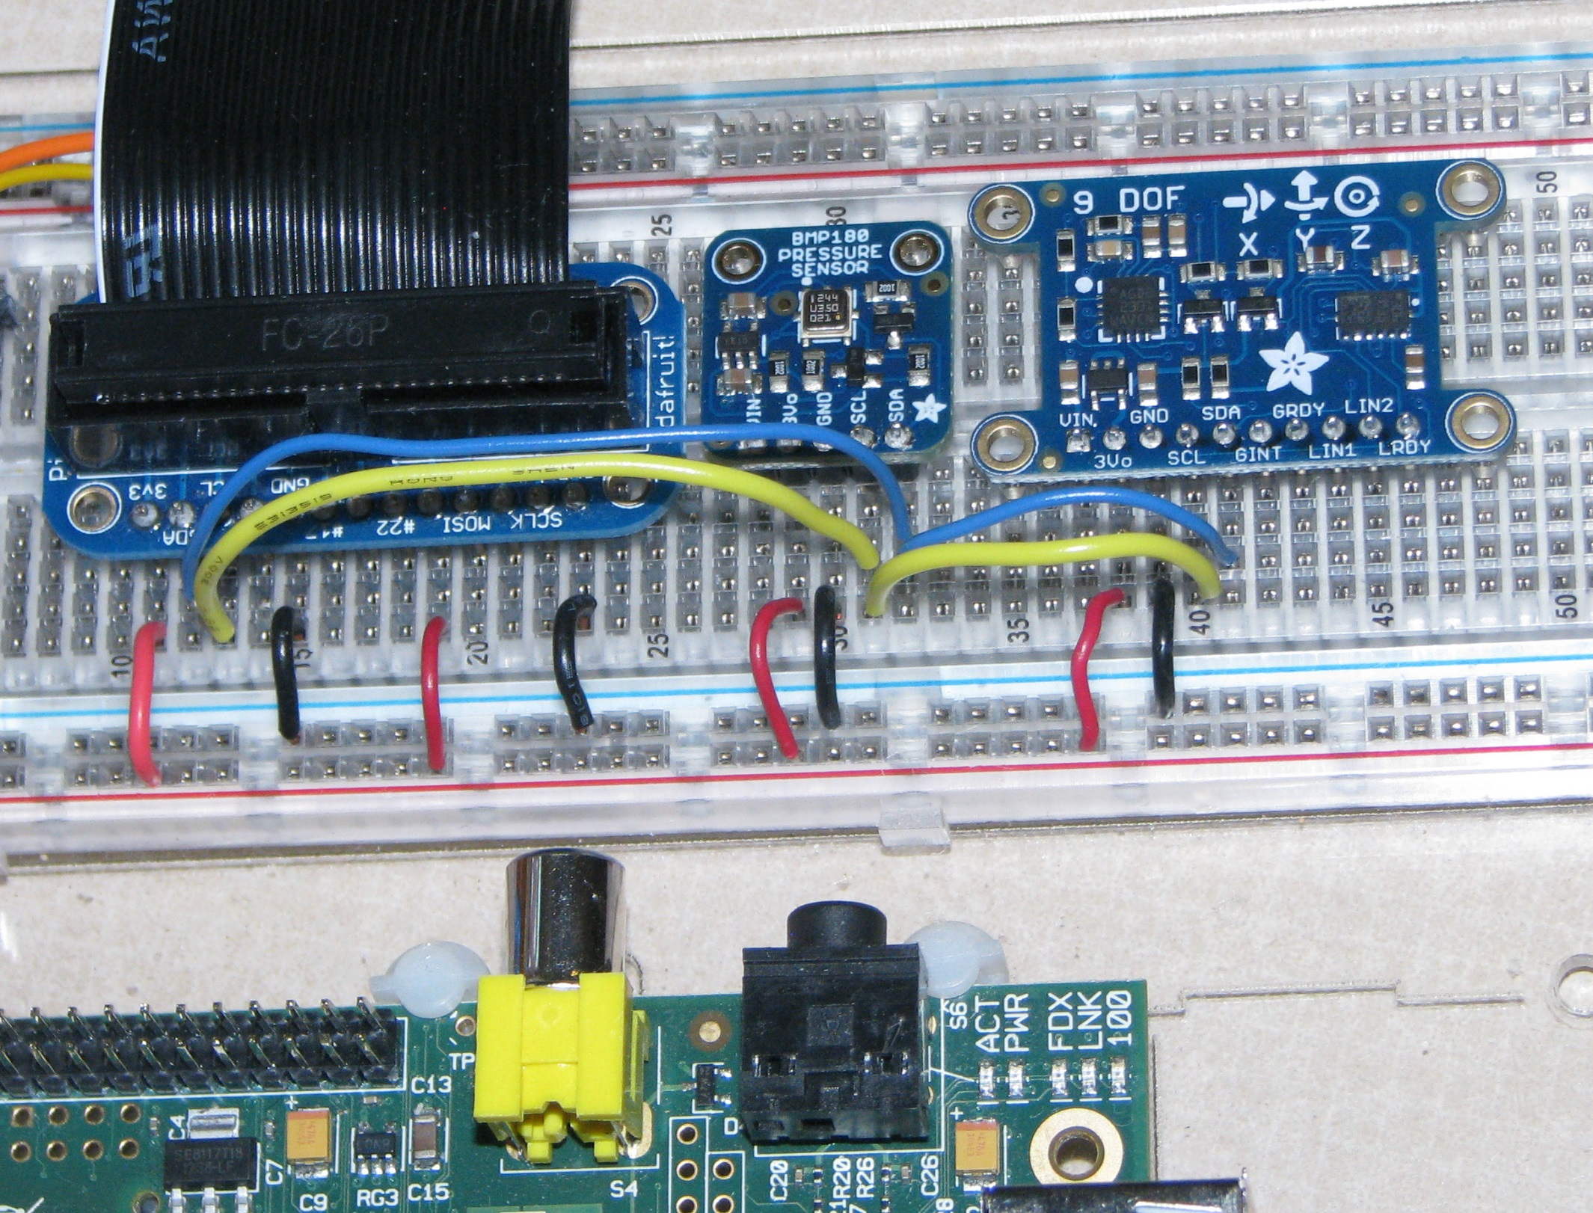
It might look like this

Slide 31
Masters and Slaves
The devices are either masters or slaves
Master device drives the clock
Master device initiates the transfers
Master device controls the transfer
Typically only one master.
  But multi-master mode is possible

Slide 32
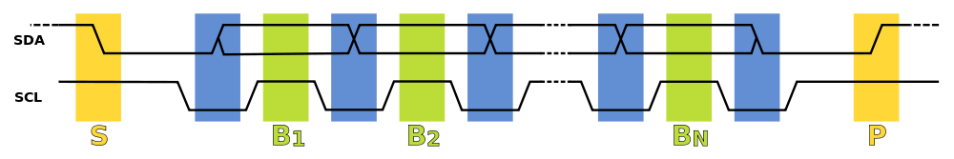
The I²C Physical Protocol
Wikimedia commons image
Data is transferred in sequences of 8 bits, followed by an acknowledge bit
Bits are sent with the MSB (Most Significant Bit) first.
The SCL line is pulsed high, then low for each bit
The standard clock (SCL) speed for I²C is up to 100KHz
Start and stop sequences mark the beginning and end of a transaction
Transfer is initiated with SDA is pulled low while SCL (clock line) is high
During data transfer, SDA must not change while SCL is high

Slide 33

I²C Device Addressing
Image credit: http://www.robot-electronics.co.uk/acatalog/I2C_Tutorial.html
I²C addresses are 7 bits or sometimes 10 bits
  Up to 128 devices on the usual I²C bus
Devices has fixed addresses
  But SMBus supports “address resolution”
Addresses are still sent in 8 bits
  Last bit is zero if writing
  Last bit is one if reading

Slide 34
I²C Write Protocol
Send start sequence
Send address of slave address with last bit 0
Send one byte register number or “command”
  It’s a bit more complicated with an EEPROM
Send the data byte
If appropriate send more data
  Register number will be incremented
Send stop sequence
  No length field!

Slide 35
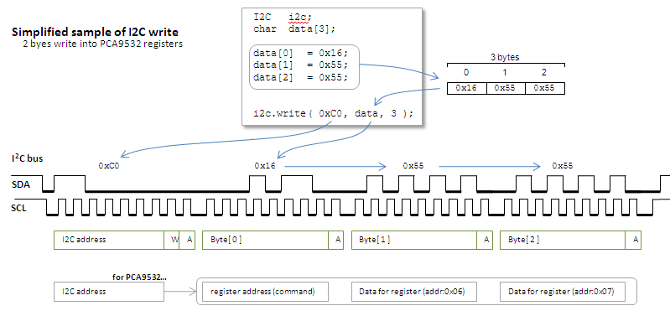
A great picture from http://mbed.org/users/okano/notebook/i2c-access-examples/

Slide 36
I²C Read Protocol
Send start sequence
Send address of slave address with last bit 0
Send one byte register number or “command”
Send start sequence
Send address of slave address with last bit 1
Read data
  Use multiple ACK followed by STOP for multi-byte read
A read is really a write followed by a read

Slide 37
Another great picture from http://mbed.org/users/okano/notebook/i2c-access-examples/

Slide 38
Getting the Pi ready
Stop the “blacklisting” of I2C
  In /etc/modprobe.d/raspi-blacklist.conf
    Comment out the blacklist of i2c-bcm2708
Add the appropriate modules
  By adding the following lines to /etc/modules
    i2c-bcm2708
    i2c-dev
Install a couple of packages
  i2c-tools
  libi2c-dev
Add user pi to group i2c
Reboot

Slide 39
Linux i2c device interface
Device files are /dev/i2c-*
  Major number is 89
  Minor number is bus number
Linux device documentation for “userspace”
  The usual read and write are supported
  but ioctl is the preferred interface
  especially with smbus protocol macros

Slide 40
The i2c utilities
Before programming, try the i2c utilities
  i2cdetect
  i2cdump
  i2cget
  i2cset
On Rev1 versions of the Raspberry Pi, the i2c devices on a bus 0

Slide 41
Using the I²C utilities finding the bus
ls -l /dev/i2c-*
lsmod | grep i2c
id
i2cdetect –l
i2cdetect -y 1
Use 0 with Rev1

Slide 42
Using the I²C utilities finding the temperature
i2cget -y 1 0x77 0xD0 b
  Make sure you have a BMP180
i2cdump -r 0xAA-0xBF -y 1 0x77
  Examine mysterious EEPROM registers
i2cdump -y -r 0xF4-0xF7 1 0x77
  Examine measurement register
i2cset -y 1 0x77 0xF4 0x2E
  Tell device to read temperature
i2cdump -y -r 0xF4-0xF7 1 0x77

Slide 43
Programming examples
Read the temperature on BMP180
  C program using device interface
  Python program using SMBus module
    Which is really a Pythonized-C interface
  Python program using AdaFruit library
And use i2c utilities from the shell
  Which really isn’t programming

Slide 44
Trying out the device interface
Take a look at the bmp180 program
  Which should be in the examples directory
Note the usual structures
  Lots of register definitions
  Routines to interpret the data
  Actions
    Open the device
    Read and write to the device

Slide 45
But what about the hard part?
Where does this come from
  x1 = (ut-ac6)*ac5/32768 ;
  x2 = mc * 2048 / (x1 + md) ;
  b5 = x1 + x2 ;
  t = (b5 + 8) / 16 ;
the BMP180 datasheet
  See page 15 for the details
    and don’t expect to understand why

Slide 46
Secrets of the I2C sensor
Read the datasheet
Find an application note
Find example programs
Search for device drivers for the manufacturer
  It should contain a lot of DEFINE
Try I²Cdevlib

Slide 47
Time to test it out
Compile the programs
Test it out
  It should get warmer when touched
  And colder when using an ice cube
The program has no filtering
  So sometimes odd results are returned

Slide 48
Why the JSON?
Pretty to easy to read
Has a formal schema for validation
Works well with web applications
  JavaScript
  HTML5
Will please the New Media students in CSCI 185
Supported in all common programming languages
http://pinkie-pie.cs.unca.edu is running on a Raspberry Pi Model B Rev1 -- 256 MBtyes of RAM
  Once it could tell you how hot it is over the web

Slide 49
What about those interrupts?
Some I²C sensors do have interrupt lines
To “handle” an interrupt
  Connect the interrupt line to a GPIO pin
  Write to /sys/class/gpio/N/edge
    none, rising, falling, both
  Use poll on /sys/class/gpio/N/value
    Waits for I/O activity with optional time-out
A hard system call to use
  But there are many examples because of its frequent use in networking applications

Slide 50
WebIOPi: Install
Install WebIOPi on your Raspberry Pi
  Download the tar archive file from Sourceforge:
    Already done for you---change directories to ccscse2014 & look for WebIOPi-0.7.0.tar.gz
  Uncompress:
    tar xvfz WebIOPi-0.7.0.tar.gz
  Change directory to new WebIOPi folder:
    cd WebIOPi-0.7.0
  Run setup shell script:
    sudo ./setup.sh

Slide 51
WebIOPi: Default Page
Try it:
  On the Pi, start the web server:
  sudo service webiopi start
  On the Pi, open the WebIOPi default page in Midori:
    use the URL: localhost:8000
  On your PC, open the WebIOPi default page in a browser:
    On your Pi, use the ifconfig command to determine your pi's IP
      For example, it might be: 192.168.0.146
    On you PC, open Chrome and open the URL: IP:8000
      For example the URL might be: 192.168.0.146:8000

Slide 52
WebIOPi: What's happening
All of the source code is installed on your Pi in the WebIOPi-0.7.0 directory but it's easier to view on the Source tab of the WebIOPi site
WebIOPi is a REST API containing many things: a HTTP server (written in python), a library of javascript library, python library...
The default WebIOPi display is created using:
  the index.html file in the htdocs directory
  The GPIO configuration as defined by the files in the python directory
Both the GPIO configuration and the browser display can be customized

Slide 53
WebIOPi: Configuration
A configuration file is used to setup the WebIOPi server
  The syntax is the same as windows INI files
    Several sections containing key=value pairs
  The webiopi service use /etc/webiopi/config as a configuration file
    That can be changed
Extend the webiopi server using a Python script
  Edit the [SCRIPTS] section of the config file to designate location of the python script
Customize the browser display using Javascript
  Edit the [HTTP] section of the config file to designate location of the index.html file

Slide 54
WebIOPi: Customizing I
    Example 1: the script and index file in ccscse2014/WebIOIPi-0.7.0/examples/LED
Make the following changes to /etc/webiopi/config:
  sudo emacs (or nano) /etc/webiopi/config
  In the [HTTP] section, change doc-root to be:
  doc-root=/home/pi/ccsce2014/WebIOPi-0.7.0/examples/LED
  In the [SCRIPTS] section, change myscript to be:
  myscript =/home/pi/ccsce2014/WebIOPi-0.7.0/examples/LED/script.py
  In the [DEVICES] section, uncomment pwm0 = PCA9685
Restart the server:
  sudo service webiopi restart

Slide 55
WebIOPi: Customizing II
    Example 2: the script and index file in ccscse2014/WebIOIPi-0.7.0/examples/BMP
Make the following changes to /etc/webiopi/config:
  sudo emacs (or nano) /etc/webiopi/config
  In the [HTTP] section, change doc-root to be:
  doc-root=/home/pi/ccsce2014/WebIOPi-0.7.0/examples/BMP
  In the [SCRIPTS] section, change myscript to be:
  myscript =/home/pi/ccsce2014/WebIOPi-0.7.0/examples/BMP/script.py
  In the [DEVICES] section, uncomment the BMP device
Restart the server:
  sudo service webiopi restart

